Slide 1
Secondary data analysis
Robert Meckin, Presidential Fellow, School of Social Sciences, University of Manchester
@rjmeckin; robert.meckin@manchester.ac.uk

Slide 2
Secondary data analysis
What is secondary data analysis?
What is our evidence?
Why choose secondary data analysis?
Potential in the pandemic and some resources
Notes:
MASS OBSERVATION ARCHIVE

Slide 3
What is secondary data analysis (SDA)
Contested definitions (Smith 2008)
Analysing existing data collected for another purpose
Might involve analysis of someone else’s data
Might be revisiting own old data set with a new purpose
Panel and cohort studies, agency data, research project data etc.
Focused on design and analysis, rather than elicitation
Notes:
MASS OBSERVATION ARCHIVE

Slide 4
Evidence
Covid-19 publications using agency and longitudinal study data
Blogs and discussions regarding qualitative secondary data analysis
Workshop
Notes:
MASS OBSERVATION ARCHIVE

Slide 5
SDA in and on the pandemic
Using Understanding Society data to investigate pandemic and restrictions and showing:
Disproportionate effects on those with lower incomes (Crossley et al. 2021; Witteveen 2020)
Gender differences in effects work and care (Hupkau & Petrongolo 2020)
Learning inequalities due to primary school closures in the Netherlands (Engzell et al. 2020)
Changes in human-animal relations: increases in dog adoption in Israel (Morgan et al. 2020)
Fertility changes in 1918 ‘flu pandemic (Wagner et al. 2020)
Notes:
MASS OBSERVATION ARCHIVE

Slide 6
Qualitative SDA
Photo by Dennis Kummer on Unsplash
Notes:
“As the lockdown makes traditional approaches to qualitative research challenging, now is an appropriate time for us to reconsider the tendency for primary data generation to be the ‘go to’ form of fieldwork and new research.” (Tarrant and Hughes 2020)
“The substitution of virtual means of data collection for face-to-face means, such as interviewing using internet telephony, is not the only possible…researchers at or able to return to the design stage might consider the creative possibilities of drawing together existing archived qualitative data for new research” (Jamieson 2020)

Slide 7
Why appropriate?
Already-collected data – less impact of restrictions
Speed & cost – timely research
But, “rich, in-depth insights can be achieved by re-using ostensibly ‘small’ datasets and samples.” (Tarrant & Hughes 2020)

Slide 8
Data access & (re)sources
https://www.ukdataservice.ac.uk

Slide 9
UK Data Service
Notes:
British Social attitudes survey
Citizenship survey
Crime survey for England and wales
Eurobarometer
European election study
European social survey
1970 british cohort study
English longitudinal study of ageing
Understanding society

Slide 10
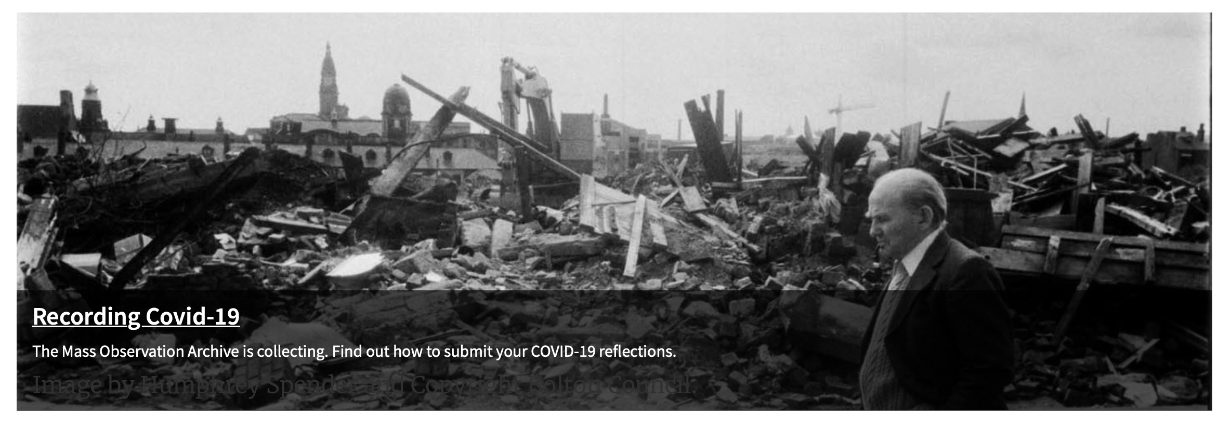
Mass Observation Project
http://www.massobs.org.uk
Notes:
Regular writers – 450
Lots of submissions – writing, poetry, pictures
Directives - specific calls for submissions. Can work with MO
Covid – lots of submissions, writing day 12th May 2020

Slide 11
Reanimatingdata.co.uk
Images by Michi Mathias
Notes:
Women, aids & risk project – late 1980s
Interviews with women in London and Manchester
Revisiting and working with the dataset in new ways
a newly available digital archive of qualitative interviews, conducted with young women in London and Manchester in the late 1980s and to suggest that this might be a valuable resource for research students looking to carry out original feminist research. (Gahnstrom 2020)

Slide 12
SDA Summary
Option at design stage
Careful consideration of questions, data and repurposing
Possible funding (Secondary data initiative from UKRI)
Need to find and know about datasets

Slide 13
References
Crossley, T., Fisher, P. & Low, H. (2020) The heterogeneous and regressive consequences of COVID-19: Evidence from high quality panel data. Journal of Public Economics, Volume 193, Jan 2021.
Engzell, P., Frey, A. & Verhagen, M. (2020) Learning Inequality During the Covid-19 Pandemic, SocArXiv ve4z7, Center for Open Science.
Hupkau, C. and Petrongolo, B. (2020), Work, Care and Gender during the COVID‐19 Crisis*. Fiscal Studies, 41: 623-651. https://doi.org/10.1111/1475-5890.12245
Morgan, L., Protopopova, A., Birkler, R.I.D. et al. (2020) Human–dog relationships during the COVID-19 pandemic: booming dog adoption during social isolation. Humanit Soc Sci Commun 7, 155. https://doi.org/10.1057/s41599-020-00649-x
Tarrant, A & Hughes K. (2020) The re-use of qualitative data is an under-appreciated field for innovation and the creation of new knowledge in the social sciences. LSE Blog. https://blogs.lse.ac.uk/impactofsocialsciences/2020/06/08/the-re-use-of-qualitative-data-is-an-under-appreciated-field-for-innovation-and-the-creation-of-new-knowledge-in-the-social-sciences/
Wagner, S., Tropf, F. C., Cavalli, N., & Mills, M. C. (2020, November 24). Pandemics, Public Health Interventions and Fertility: Evidence from the 1918 Influenza. https://doi.org/10.31235/osf.io/f3hv8
Witteveen, D. (2020) Sociodemographic inequality in exposure to COVID-19-induced economic hardship in the United Kingdom, Research in Social Stratification and Mobility, Volume 69, Oct 2020.

Slide 14
Q and A

