Slide 1
Anonymisation: what is it and how do I do it
Mark Elliot
Manchester University

Slide 2
Outline
Describe UKAN – who we are
Discuss what anonymisation is
  Including it relationship with other concepts such as privacy and risk.
Introduce “The Anonymisation Decision Making Framework”

Slide 3
The UK Anonymisation Network

Slide 4
Originating Aims
1. To establish a mutual understanding of differences in perspective on anonymisation across sectors, disciplines and components.
2. To synthesise key concepts into a common framework.
3. To agree best practice principles.

Slide 5
4 Tier Structure
Hub: Operations
Partners: Management Group
Core Network: Strategy
Extended Network: The Community of Members

Slide 6
What is Anonymisation?

Slide 7
Privacy, confidentiality and anonymisation
Anonymisation
Confidentiality
Privacy
Notes:
Make distinction between these three elements.
Disclosure control is one of the aspects of protecting confidentiality.
Confidentiality is also protected via secure setting. Confidentiality concerns data.
Privacy is to do with people.
SDC is one of the ways in which we can protect confidentiality
Easy to confuse confidentiality (data) with privacy (people) – they are not the same, although are clearly related.

Slide 8
Confidentiality and Risk
Confidentiality
Risk
Likelihood
Impact
Don’t confuse “could”
with “will”.
Notes:
Transport Infrastructure
My accident / collateral damage
Data infrastructure.

Slide 9
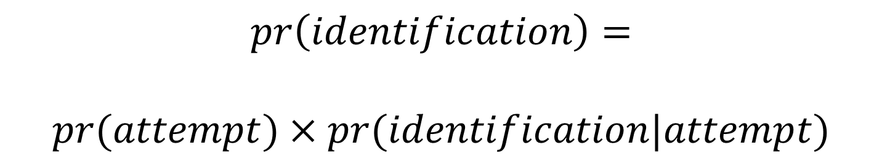
Marsh et al (1991)
$$pr\left(identification\right)=$$
$$pr(attempt)×pr(identification|attempt)$$

Slide 10
Confidentiality and risk
Confidentiality Risk
Likelihood
Impact
Don’t confuse “could”
with “will”.
Treating Privacy breaches as apocalyptic has lead to some very muddled thinking….
Notes:
Transport Infrastructure
My accident / collateral damage
Data infrastructure.

Slide 11
Confidentiality and risk
Consequences
Precursors
Precursors
Event
Consequences
Precursors
Consequences
Notes:
Transport Infrastructure
My accident / collateral damage
Data infrastructure.

Slide 12
What is Anonymisation?
Anonymisation is process by which personal data are rendered non personal.

Slide 13
What is Anonymisation?
Anonymisation is process by which personal data are rendered non personal.
Be careful when using success terms:
“anonymised”

Slide 14
What is Anonymisation?
Anonymisation is process by which personal data are rendered non personal.
Be careful when using success terms
“anonymised”
or worse “truly anonymised”

Slide 15
What is Anonymisation?
Anonymisation is process by which personal data are rendered non personal.
Be careful when using success terms:
“anonymised”
or worse “truly anonymised”
And “really truly anonymised” is right out

Slide 16
Anonymisation and de-identification
Deal with different parts of the normal definition of personal data
Deidentification tackles:
  “Directly from those data”
Anonymisation tackles:
  “Indirectly from those data and other information which is in the in the possession of, or is likely to come into the possession of, the data controller…”

Slide 17
Anonymisation types
Absolute Anonymisation
  Zero possibility of re-identification under any circumstances
Formal Anonymisation
  De-identification (including pseudonymisation)
Statistical Anonymisation
  Statistical Disclosure Control
Functional Anonymisation

Slide 18
Principles Underpinning FA
1. Comprehensiveness principle: You cannot decide whether data are safe to share or not by examining the data alone. But you do need to examine the data.
2. Utility principle: Anonymisation is a process to produce safe data but it only makes sense if what you are producing is safe useful data.
Notes:
Introduction concept of data environment -definition of personal data, with data being personal in some data environments and not others, and
Our claim is that, far from being able to determine whether data is anonymous by looking at the data alone, any anonymisation technique worth its salt must take account of not only the data but also its environment.
Or adjust the data taking into account its environment.
About the data environment - other data; people; infrastructure
The third element of the data environment consists of the governance processes over the environment that determine how the users’ relationships with the data are managed. These will typically cover a range of behavioural restrictions including formal governance (e.g. data access controls, licensing arrangements, policies which prescribe and proscribe user behaviour, and potentially sanctions for breaching agreements) through de facto norms and practices to socio-cognitive properties of users (e.g. risk aversion, prior tendency towards disclosure, etc.).
The final element is the infrastructure, including physical elements such as security systems, and the software processes that implement functional restrictions on how users can interact with the derived dataset.
We discuss these

Slide 19
Principles Underpinning FA
3. Realistic Risk principle: Zero risk is infeasible if you are to produce useful data.
4. Proportionality principle :The measures you put in place to manage disclsoure risk should be proportional to the likelihood and the likely impact of that risk.
Notes:
The aim of functional anonymisation, as described in the ADF, is for the data controller to reduce the risk of a data breach to an acceptably low level
Introduce the concept of functional anonymisation - various interpretations of the concept of anonymisation and also of the related notion of the risk of reidentification. we will argue that anonymisation itself is a complex process requiring attention to far more than the data. functional anonymisation, which is intended to anonymise data in the context in which it sits, the data environment.
The DPA does not require anonymisation to remove risk entirely, but rather demands that those sharing or disseminating data mitigate the risk of re-identification until it is negligible (UK: Information Commissioner’s Office 2012a).
In contrast, by focusing on whether reidentification is “reasonably likely,” the GDPR may provide greater flexibility than the Directive. For example, where the controller deletes the identification key and the remaining indirect identifiers pose little risk of identifying an individual, the controller may be able to argue that there is no reasonable risk of reidentification

Slide 20
Drilling down on the comprehensiveness principle
Anonymisation is not about the data.
Anonymisation is about data situations.
Data situations arise from data interacting with data environments.

Slide 21
Some tenets
Data environments are:
  the set of formal and informal structures, processes, mechanisms and agents that either:
  act on data;
  provide interpretable context for those data or
  define, control and/or interact with those data.
  Elliot and Mackey (2014)

Slide 22
Data Environments consist of
Other Data
Agents (people)
(Security) infrastructure
Governance processes

Slide 23
Disclosure
from both ICOs guidance and the Article 29 working parties opinion
  we are not just concerned with identification
  But with disclosure
Consists of two processes which can occur:
  Identification
  Attribution
  Without the later there is no disclosure.

Slide 24
The Disclosure Risk Problem:
Type I: Identification
Identification file
Name
Address
Sex
DOB
..
Sex
Age
..
Income
..
..
Target file
ID
variables
Key
variables
Target
variables

Slide 25
The Disclosure Risk Problem II: Attribution

Slide 26


Slide 27
The Disclosure Risk Problem III: Subtraction

Slide 28
The Disclosure Risk Problem III:
After Subtraction

Slide 29
The Anonymisation Decision Making Framework

Slide 30
What is the ADMF?
A system for developing anonymisation policy.
A practical tool for understanding your data situation.
Not a checklist.

Slide 31
What is your responsibility?
Understand how a confidentiality breach might occur.
Understand the possible consequences of the breach (including the privacy impact).
Reduce the risk of a breach occurring to a negligible level.

Slide 32
10 step process
Describe your data situation
Understand your legal responsibilities
Know your data
Understand the use case
Meet your ethical obligations
Identify the processes you will need to go through to assess disclosure risk
Identify the disclosure control processes that are relevant to your data situation
Identify your stakeholders an plan how you will communicate with them
Plan what happens next once you have shared or released the data
Plan what you will do if things go wrong

Slide 33
Describe your Data Situation
Static or Dynamic
What is/are the environment(s)?
How does your data relate to that/those environment?

Slide 34
Describe your Data Situation:
A Simple Example

Slide 35
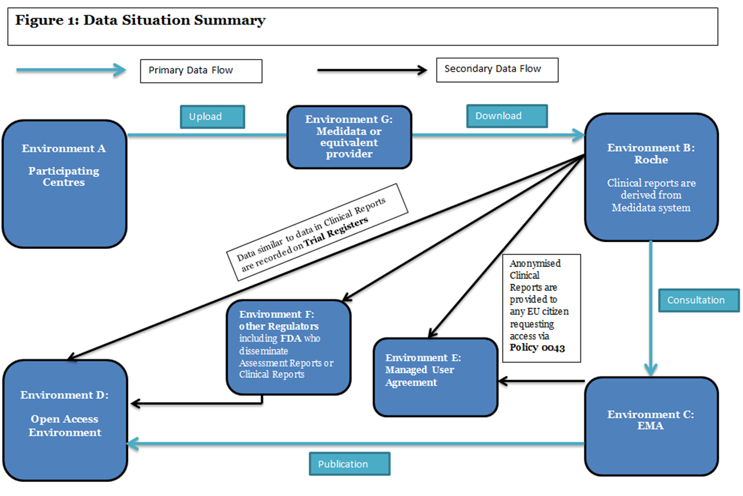

Slide 36
Understand your legal responsibilities
What legislation is relevant?
  How does different legislation interact?
What happened to the data before it reached you?

Slide 37
Know your data
Origins
  Where have the data come from?
  How were they collected?
  Who is/are the data controller(s)?

Slide 38
Know your data
Basic Data Spec
  Is the data about people?
  Is the base data personal data?
  Quantitative/qualitative/mixed?
  Form: Individual data/aggregates/mixed?

Slide 39
Know your data
Detailed Data Spec
  What variables? Standard keys? Sensitivity?
  What population? Vulnerable?
  Data quality
  Special features
    Time linked?
    Hierarchical household data?
    Multiple sources?

Slide 40
Understand the use case
What will the data be used for?
What information/data is actually needed for that use?
Is all the data needed or will a sample suffice?
Who will hold the shared data?
Who will access it and how?

Slide 41
Meet your ethical obligations
Data subject relative ontology
  What are the data for the data subjects?
  What is the relationship between the data subjects and the data?
  Are the data sensitive?
Use Intentionality
  Where are the loci of consent?
  Is the use indented/expected by (reasonable) data subjects?
Data subject awareness
  (How) are the data subjects aware of the data and the intended use?

Slide 42
Identify the processes you will need to assess disclosure risk
Scenario Analysis.
Statistical disclosure risk assessment.
Penetration tests.
Comparative data situation analysis.

Slide 43
Scenario Analysis
INPUTS
  Motivation: What are the intruders trying to achieve?
  Means: What resources (including other data) and skills do they have?
  Opportunity: How do they access the data?
  Target Variables: For a disclosure to be meaningful something has to be learned; this is related to the notion of sensitivity.
  Goals achievable by other means? Is there a better way for the intruders to get what they want than attacking your dataset?
  Effect of Data Divergence: All data contain errors/mismatches against reality. How will that affect the attack?

Slide 44
Scenario Analysis
INTERMEDIATE OUTPUTS (to be used in the risk analysis)
  Attack Type: What is the technical aspect of statistical/computational method used to attack the data?
  Key Variables: What information from other data resources is going to be brought to bear in the attack?

Slide 45
Scenario Analysis
FINAL OUTPUTS (the results of the risk analysis)
  Likelihood of Attempt: Given the inputs, how likely is such an attack?
  Likelihood of Success: If there is such an attack, how likely is it to succeed?
  Consequences of Attempt: What happens next if they are successful (or not)?
  Effect of Variations in the Data Situation:36 By changing the data situation can you affect the above?

Slide 46
Identify the processes you will need to assess disclosure risk
Scenario Analysis.
Statistical disclosure risk assessment.
Penetration tests.
Comparative data situation analysis.

Slide 47
Identify the processes you will need to assess disclosure risk
Scenario Analysis.
Statistical disclosure risk assessment.
Penetration tests.
Comparative data situation analysis.

Slide 48
Identify the processes you will need to assess disclosure risk
Scenario Analysis.
Statistical disclosure risk assessment.
Penetration tests.
Comparative data situation analysis.

Slide 49
Identify the disclosure control processes that are relevant
Consider using the thermostat approach.
  Test the environment

Slide 50
Identify the disclosure control processes that are relevant
Restrictions of access
  Who, how, where, to do what.
Data controls
  Inputs
    Sampling
    Aggregation/suppression
    Perturbation
  Outputs

Slide 51
Identify your stakeholders and plan how you will communicate with them
Who needs to know about the share
  Data subjects?
  The wider public?
    Engagement process?
  Users?
What do they need to know?
  Are you going to publish details of your anonymisation process?

Slide 52
Plan what happens next once you have shared and or release data
Continue to monitor use
Continue to consider risk
Will you need to vet outputs of any downstream analytics?
  NB: depending on the data situation outputs may be personal for you.

Slide 53
Plan what you will do if things go wrong
Breach policy
  Avoid the lure of catastrophisation
  Disclosure event mapping
    What happens next?
    Be active and planned.

Slide 54
Exercise
RK Pharma are required by the European Medicines Agency to hand over clinical study reports (from RCTs) and related information which the EMA then publish via their portal. RK have come to you for advice about how to anonymise the data.
Consider this scenario and attempt to map it onto the framework template that you have.

Slide 55
Exercise 2
An NSI is under pressure to release numerous microdata currently available under a restricted end user licenses as open data.
Consider this scenario and attempt to map it onto the framework template that I have provided.

Slide 57
Concluding remarks
The anonymisation decision making framework is a tool which allows you to think constructively about your data situation.
It moves us closer to a harmonised idea of anonymisation
An open source book is available from our website:
  http://ukanon.net/ukan-resources/ukan-decision-making-framework/

Slide 58
Concluding remarks
Review of the ADF is taking place this year.
  Legal Community
  User community
  International expert group
We are also developing a two day training course.
Watch this space!

Slide 59
Thank you!

