Slide 1
The ‘Five Safes’ framework for data access management
Felix Ritchie
University of the West of England, Bristol
presented by
Tanvi Desai
Data Strategy and Policy
4th July 2018

Slide 2
What is the most important factor in data access?
Overlapping problems:
‘Five Safes’: framework for structuring decision-making
anonymisation
IT
users
allowed use
publication model

Slide 3
‘Five safes’ approach
The Five Safes
safe projects
safe people
safe settings
safe data
safe outputs
= safe use
Five components:
Is this an appropriate use of the data?
How trustworthy are the researchers?
Does the environment prevent misuse?
Is the data detail appropriate?
Is there any confidentiality risk from publication?
Consider jointly and severally

Slide 4
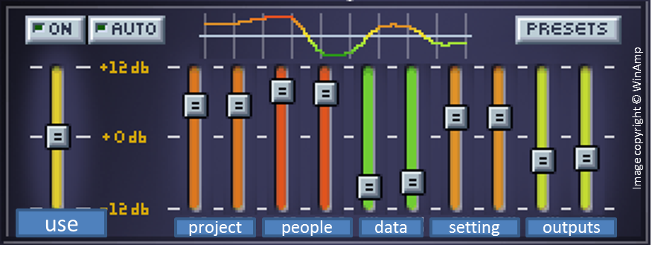
Scales, not targets
Balance is the key:
Similarities to multiple-criteria decision analysis

Slide 5
Just ‘another’ management fashion?
Don’t we already have standards?
Yes!
Five Safes is a framework to support effective decision making around choice and implementation of existing standards

Slide 6
Just ‘another’ management fashion?
The Five Safes
safe projects
safe people
safe settings
safe data
safe outputs
Existing standards/best practice
Ethical committees
Best practice training
InfoSec, ISO27001
Extensive literature
Minimal literature
Making effective decisions using those standards

Slide 7
‘Five safes’ and modern law
Consistent with developments in legislation
Simple ‘it’s your fault’ models becoming indefensible
Older legislation: data-centred
Anonymised vs identifiable
Little about confidentiality management
Modern legislation (GDPR, DEA): user-centred
Confidentiality through combinations of tech, procedure – and detail reduction
DEA explicitly based around five safes
Accreditation of processes much more important

Slide 8
Types of use
Description and evaluation
Statistical authorities, data archives, HMRC, Cancer Research UK, Health Foundation, NIST, Scottish Health Informatics Project, American Academy of Sciences, RCUK, OECD, Eurostat…
Design
ADRN, Australian Bureau of Social Services, Greek Statistical Authority, Nepalese Injury Research Centre…
Training
DEA-accredited Safe Researcher Training, university governance, big data ethics…

Slide 9
Summary
Around for 15 years
Well established, esp in UK, Australia, NZ
Part of a suite of evidence-based data access work
Framework for making decisions, not the decisions
attitudes
assessment of benefits
ethics, culture etc
next set of presentations:
Settings/ skills
Use example

Slide 10
Felix.Ritchie@uwe.ac.uk
Hello@tanvidesai.co.uk
Thank you

