Slide 1
What Are Social Machines?
Kieron O’Hara & David De Roure
05 July 2018
Notes:
Please use the dd month yyyy format for the date for example 11 January 2008. The main title can be one or two lines long.

Slide 2



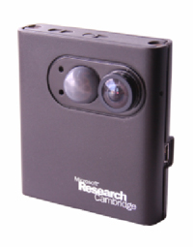



From Society With Machines …

Slide 3
From Society With Machines …

Slide 4
… to Social Machines

Slide 5
Social Machines?
Network technology
Scale
Distribution
Self-organisation
Communication
  People + tech
Data

Slide 6
Social Machines
Real life is and must be full of all kinds of social constraint – the very processes from which society arises. Computers can help if we use them to create abstract social machines on the Web: processes in which the people do the creative work and the machine does the administration... The stage is set for an evolutionary growth of new social engines. The ability to create new forms of social process would be given to the world at large, and development would be rapid.
Berners-Lee, Weaving the Web, 1999 (pp. 172–175)

Slide 7
Four quadrants
Scientific Computing
Big Data
AI/ML/IoT
Distributed
Computation
Conventional
Computation
Social
Machines
Social
Networks
Cybersecurity
More machines
Citizen
Science
Science 2.0
Web 2.0
More people
@dder

Slide 8
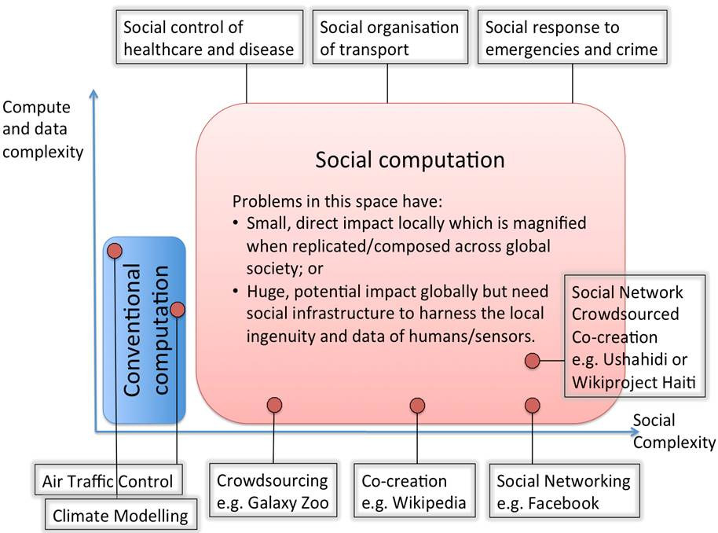
Heading Towards Top Right

Slide 9
Defining SMs?
Casting the net too widely or too narrowly?
Rapid changes in technology & practice
Communication mediated by technology
Depends on researchers’ priorities
  Methods?
  Look for high level of social activity
Wide definition with closer methodological focus

Slide 10
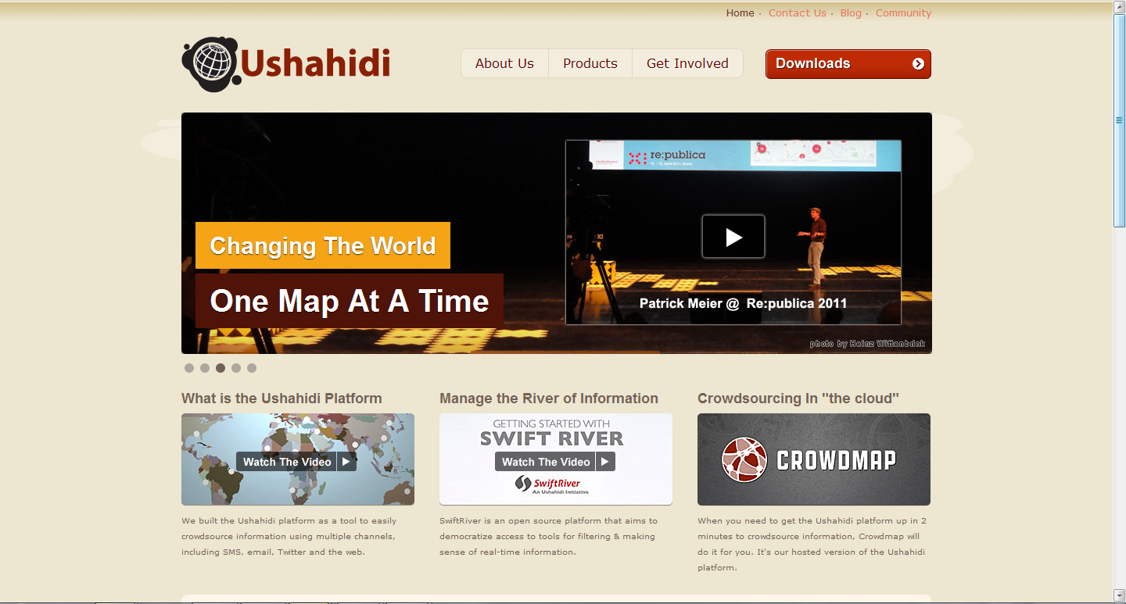
Example: Ushahidi

Slide 11

Example: Cajun Navy

Slide 12
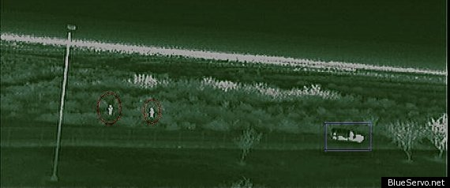
Example: BlueServo

Slide 13
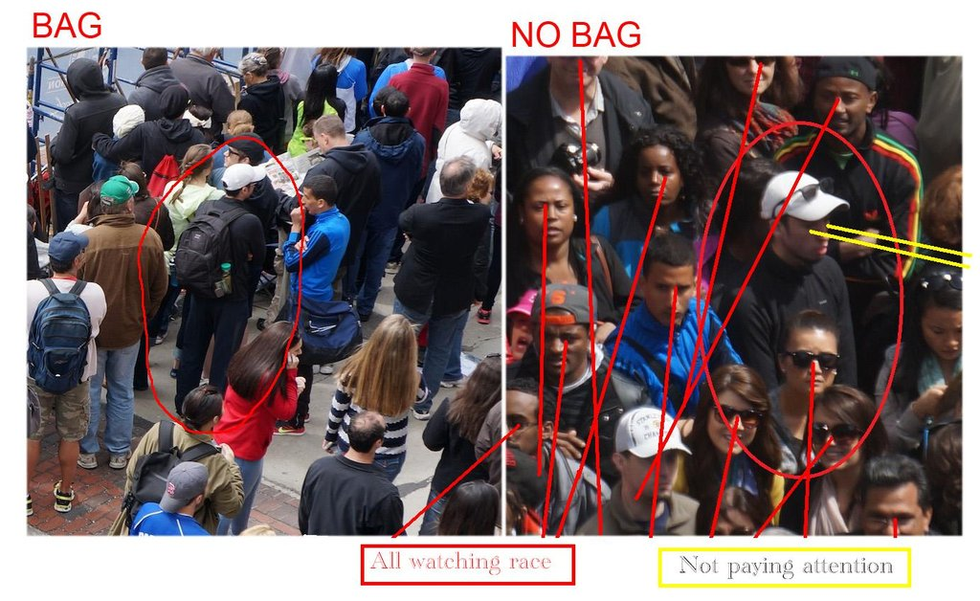
Example: 4chan Think Tank

Slide 14
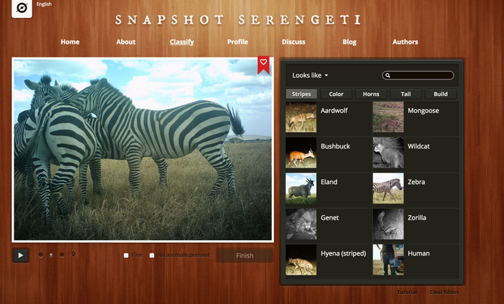
Example: Zooniverse

Slide 15
Structure Matters
Data
Volunteers
Talk
Scientists
Zooniverse platform
Data science

Slide 16

Platforms v Social Machines
Social machines live on and across platforms
Sources of data
Each platform only a partial source

Slide 17
Making Sense

Slide 18
The Machine Metaphor
Machine uses energy to do work
Mechanical advantage => amplification of input force
Material realisation
Assembly of moving parts
A coherent entity
Design (maybe emergent)
A telos (if not a goal)
Machine perspective is emergent from the components’
Computer => processes information in sequence
Computer => holds information in memory

Slide 19






3
Observer of multiple social machines
1
Observer of one social machine
@dder
SM
4
SM
Human participants in multiple Social Machines
5
Human participants in Social Machine
7
Social Machine Observing Social Machines
SM
6
Observer of Social Machine infrastructure
De Roure, D., Hooper, C., Page, K., Tarte, S., and Willcox, P. 2015. Observing Social Machines Part 2: How to Observe? ACM Web Science
Observers using third party observatory
2

Slide 20
Not a Method
A perspective on a phenomenon
  Cf. digital divides
Methods to investigate
  Crowds
  Network interactions
  Data/information processing
A descriptive layer of granularity between the individual and the Web

Slide 21
Methods
Network analysis
Prosopography
Surveys
A/B testing
ML on data
  Data from platforms
  Information cascades across platforms
Discourse analysis on talk/discussion
Phenomenology/digital ethnography
Case studies v platforms v aggregates
Affordances of architecture

Slide 22
Theorising Social Machines
Inclusion/exclusion
Gender/ethnicity/education/disability/age/North-South
Classification theory/sociotechnical infrastructures
  Technologies, authorities, classifications
Social construction/shaping of technology
Geographies and (new kinds of) space
Recognitional perspective (Honneth)
Social capital
Information value/exchange/sociability (Simmel)
Value/appropriation of labour

Slide 23
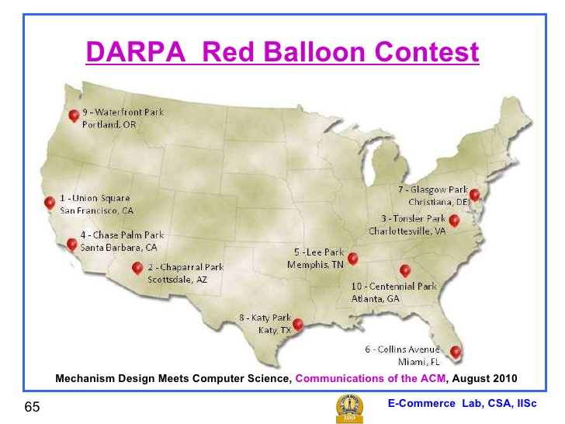
Intelligence: DARPA Balloon Challenge

Slide 24
Intelligence: DARPA Balloon Challenge
We're giving $2000 per balloon to the first person to send us the correct coordinates, but that's not all -- we're also giving $1000 to the person who invited them. Then we're giving $500 whoever invited the inviter, and $250 to whoever invited them, and so on ... (see how it works). It might play out like this. Alice joins the team, and we give her an invite link like http://balloon.media.mit.edu/alice. Alice then e-mails her link to Bob, who uses it to join the team as well. We make a http://balloon.media.mit.edu/bob link for Bob, who posts it to Facebook. His friend Carol sees it, signs up, then twitters about http://balloon.media.mit.edu/carol. Dave uses Carol's link to join ... then spots one of the DARPA balloons! Dave is the first person to report the balloon's location to us, and the MIT Red Balloon Challenge Team is the first to find all 10. Once that happens, we send Dave $2000 for finding the balloon. Carol gets $1000 for inviting Dave, Bob gets $500 for inviting Carol, and Alice gets $250 for inviting Bob. The remaining $250 is donated to charity.
MIT challenge team

Slide 25
How does it work?
Winning solution from Sandy Pentland, MIT
Query Incentive Network Model (Kleinberg & Raghavan 2005)
  5,000 participants (from 4)
  Mediated via social media: Facebook & Twitter
  10 balloons found across US in under 10 hours
Twin incentives
  To find (and report) the balloon
  To introduce new (potential rivals) into the network

Slide 26
AI + Social Machines in Finance
Sentient
  Paucity of financial data
Numerai
  Encrypts financial data and sets mathematical problems
Cerebellum Capital
  Quant ML but humans do the trading
Quantopian
  Competitions for algorithms, funding the winners

Slide 27
Final Thoughts
Social machines a lens on human-machine networks at scale
Expected rapid and unanticipated assembly
  Creative and subversive powers of humans
  … and machines
Intelligence
  Augmenting both human and machine
Data
  Will create (and consume) much data
  Who gets it?
Ethics
  Of design/management
  Of research
  Privacy
  Anti-social machines

Slide 28
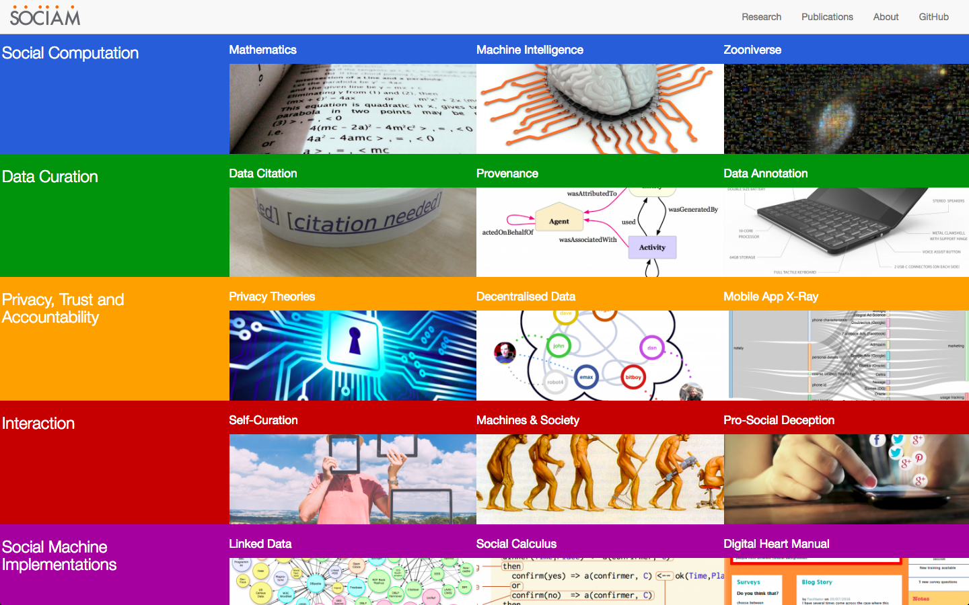
www.sociam.org

Slide 29
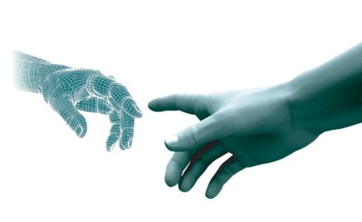
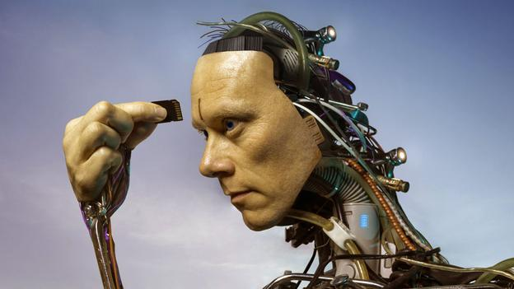
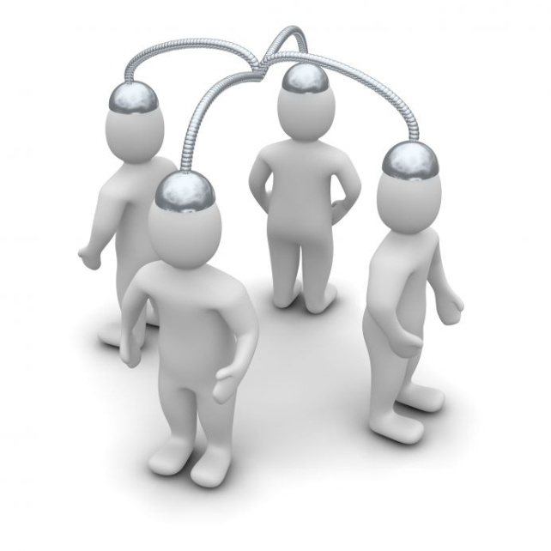
Smart Society
New forms of collectivity
Convergence of the physical and the digital
Convergence of people and machines
Mark Hartswood
People, devices and algorithms, connected by platforms, realising individual goals while addressing collective challenges
Notes:
The Smart Society project carries with it an optimistic narrative of platform based-collaboration, involving ‘augmented people’ participating in ‘augmented collectives’ – that is to say - where people, devices, algorithms, connected by platforms, work together to realise of individual goals, whilst at the same time as addressing collective challenges, such as problems of scarcity and sustainability.

Slide 30
Disclaimer
Texts, marks, logos, names, graphics, images, photographs, illustrations, artwork, audio clips, video clips, and software copyrighted by their respective owners are used on these slides for non-commercial, educational and personal purposes only. Use of any copyrighted material is not authorized without the written consent of the copyright holder. Every effort has been made to respect the copyrights of other parties. If you believe that your copyright has been misused, please direct your correspondence to: kmo@ecs.soton.ac.uk stating your position and I shall endeavour to correct any misuse as early as possible.

