Slide 1

NCRM IVES COLLOQUIUM
UEL, 9 NOVEMBER 2016
JILL BRADBURY
UNIVERSITY OF THE WITWATERSRAND
JOHANNESBURG, SOUTH AFRICA
JILL.BRADBURY@WITS.AC.ZA
NARRATIVE PROJECTS IN ACTION
BRADBURY (PART 1)

Slide 2


Echoes of the Past in Imaginings of the Future:
the problems and possibilities of working with young people in contemporary South Africa
Bradbury and Clark
L/Using the past to make the future

Slide 3
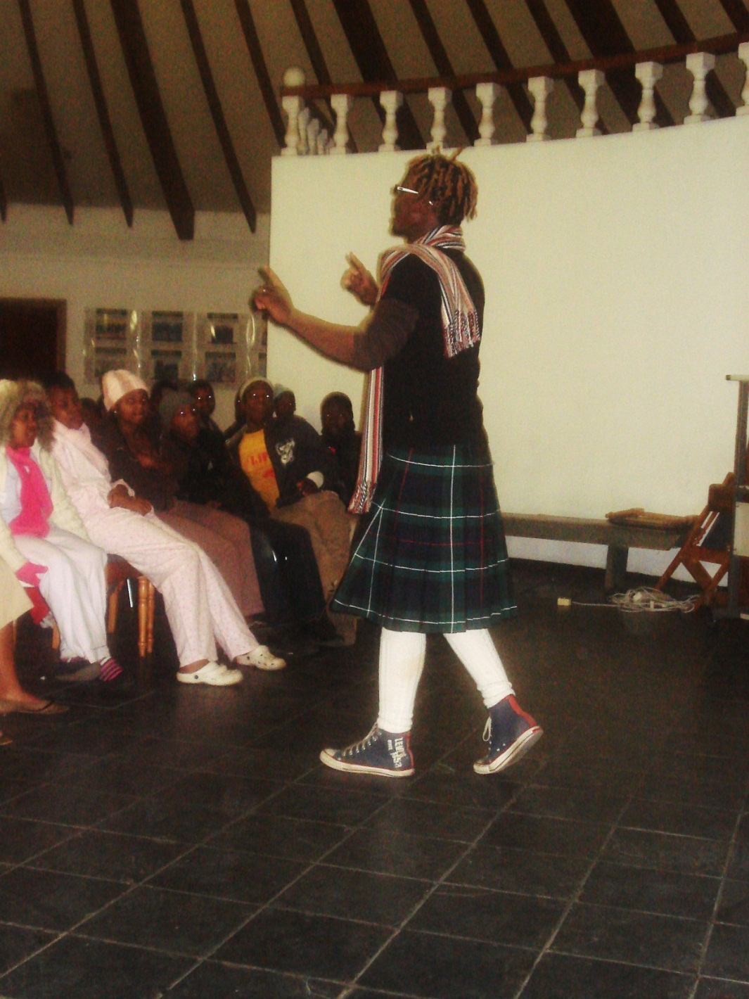
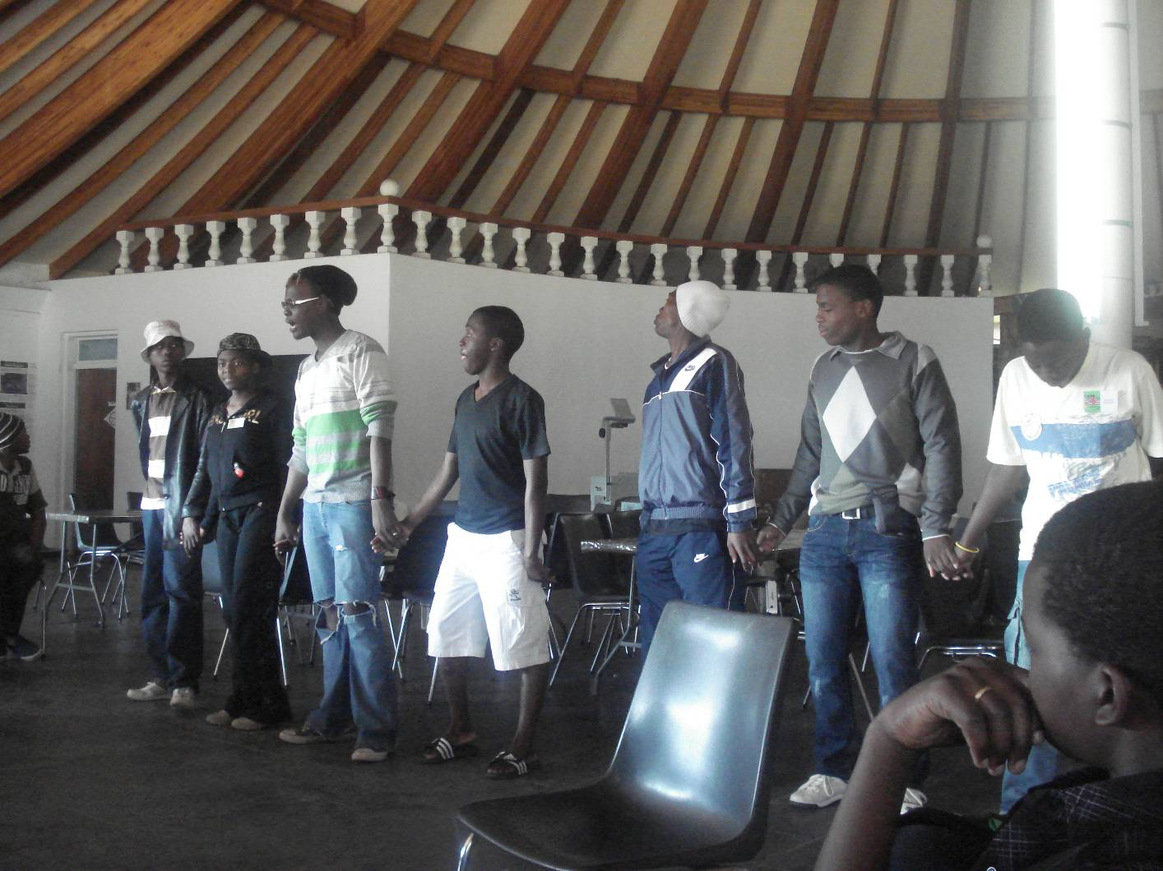

Slide 4
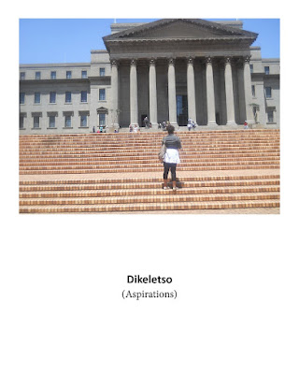
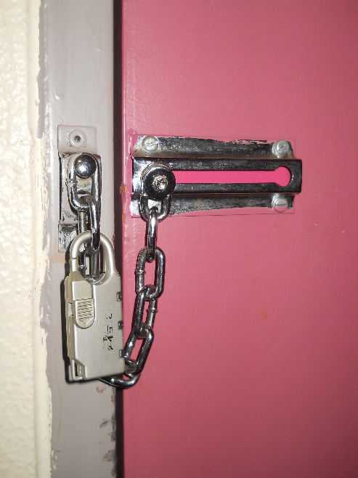
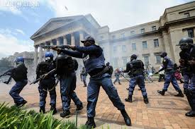
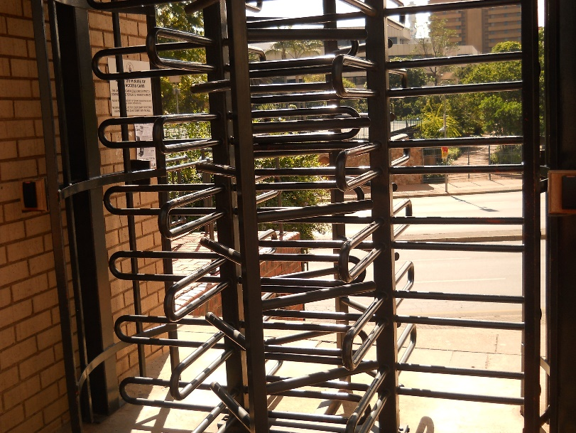
Thinking Women’s worlds: Bradbury & Kiguwa (2012)

Slide 5
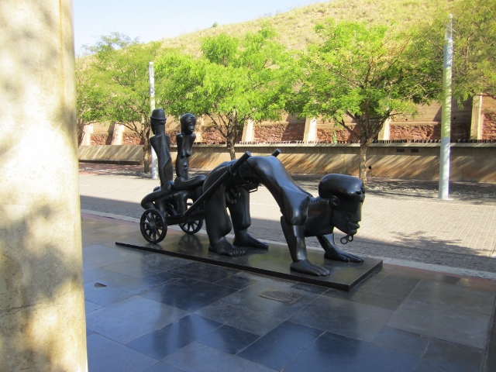
Narrative Possibilities of the Past for the Future: Nostalgia and Hope
Bradbury

Slide 6
CREATIVE TWISTS IN THE TALE
(BRADBURY: PART 2)
Visual Data collection: Coherence & Legibility
Visual Data Analysis: Temporality & Relationality

Slide 7
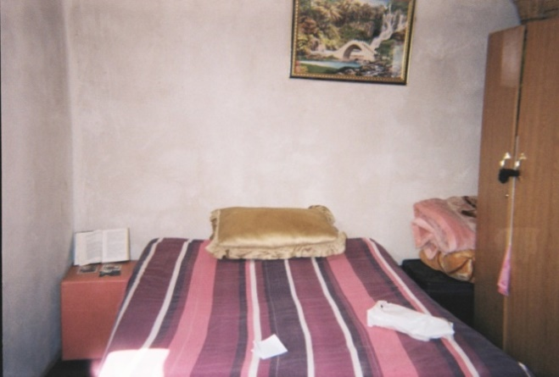
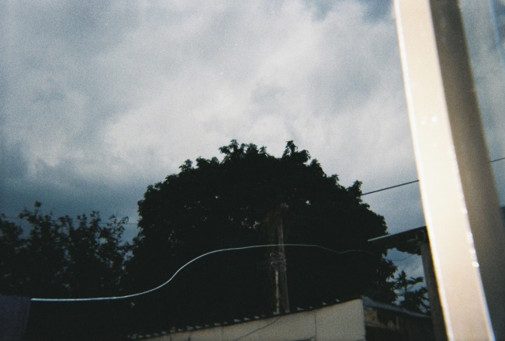
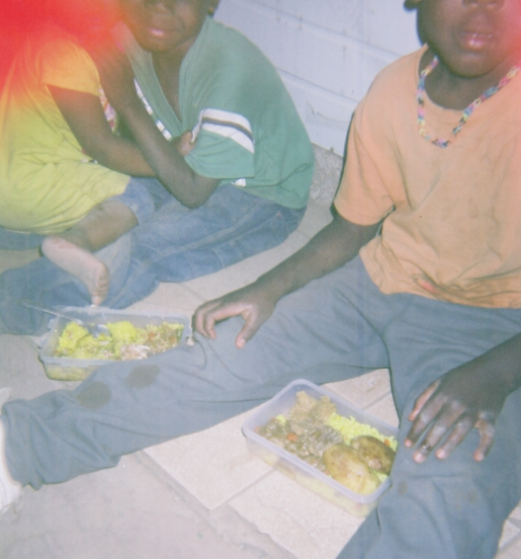
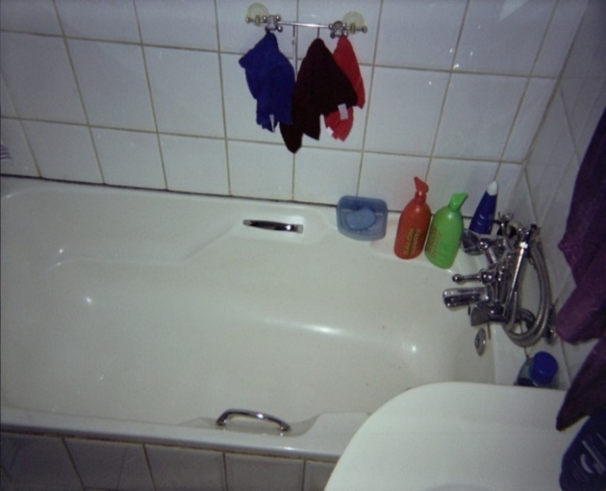
EXAMPLES OF VISUALISING DATA
BIG National Narratives and the Non-storiesof repetitive strain
Moleba: Beginning again
Haynes-Ronaldo: UNDERBELLY STORIES TO THE FOREFRONT - PHOTOVOICE

Slide 8
EXAMPLES OF VISUAL ANALYSIS
TEMPORALITY
LICCARDO: TIME OF TALK
AND TIME OF LIFE

Slide 9
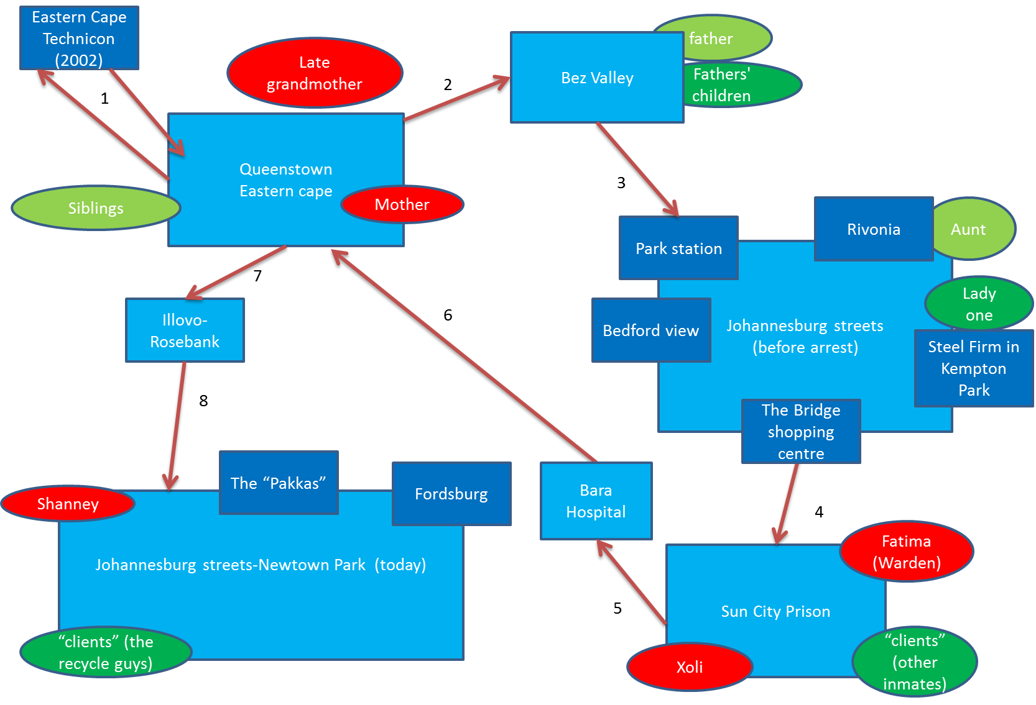
MAKAMA: HOME AND HOMELESSNESS: TRAJECTORIES OF TIME, PLACE AND MOTION
RELATIONALITY
PEOPLE AND PLACES WITHIN

Slide 10
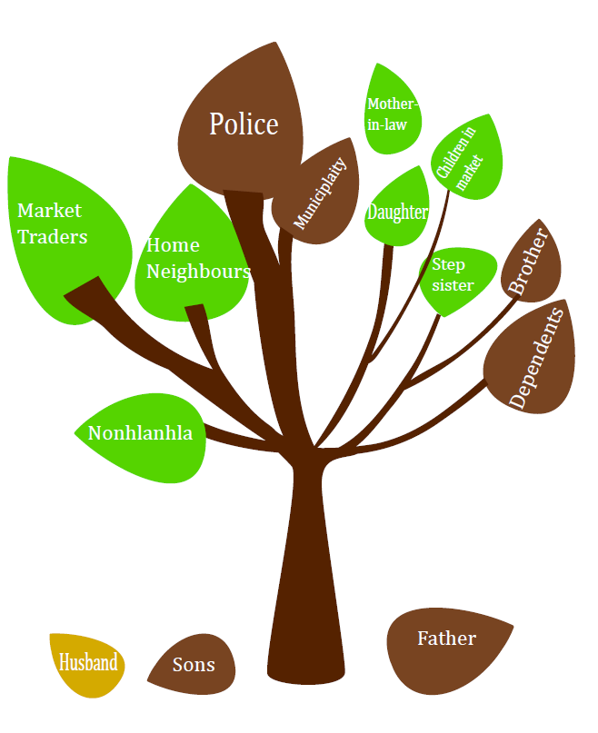
COATS: RELATIONAL TREES

Slide 11
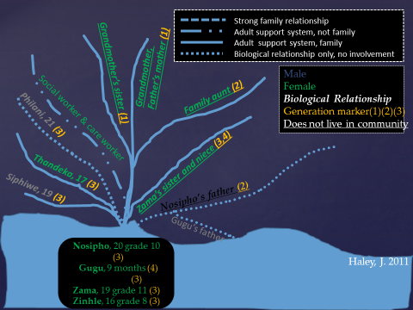
HALEY: FAMILY RIVERS

