Slide 1
How could mobile devices improve survey measurement and social research? Exploring the opportunities and challenges through innovative examples of mobile data collection
Carli Lessof
NCRM Southampton & TNS BMRB Associate

Slide 2
Outline
Transformative opportunities
Three inter-linked challenges
Checking our assumptions - quality & suitability
What do we need to make progress
Acknowledgements
Based on a paper written with Patrick Sturgis
Examples particularly from TNS BMRB
Notes:
Primarily mobile phone (but could extend to devices)
Primarily quant (but could extend to qual)

Slide 3
Transformative opportunities

Slide 4
In the moment surveys measuring behaviour
Notes:
Shopping
Activity – children and exercise
Key issue – short surveys in the moment

Slide 5
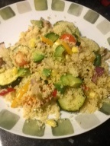
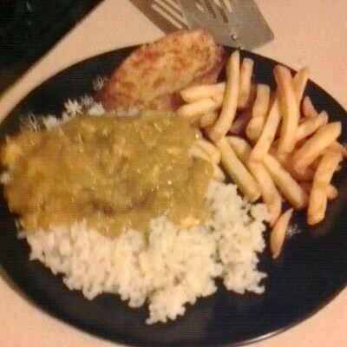
Photographs of meals to validate real behaviours
Notes:
Change4life
Features of mobile phones – in this instance photographs

Slide 6
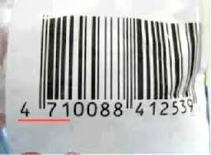
Barcode scans of food purchase and nutrition

Slide 7
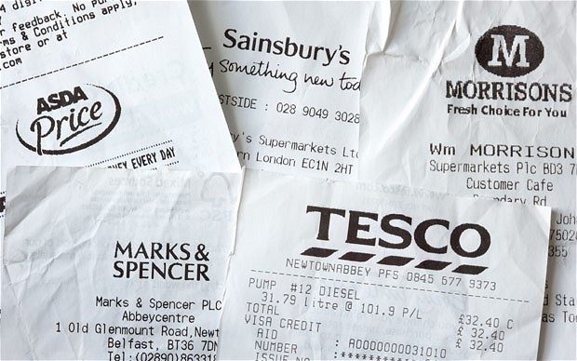
Till receipt capture to measure expenditure
Notes:
Again uses features but key question is whether this can be done with large scale representative sample

Slide 8
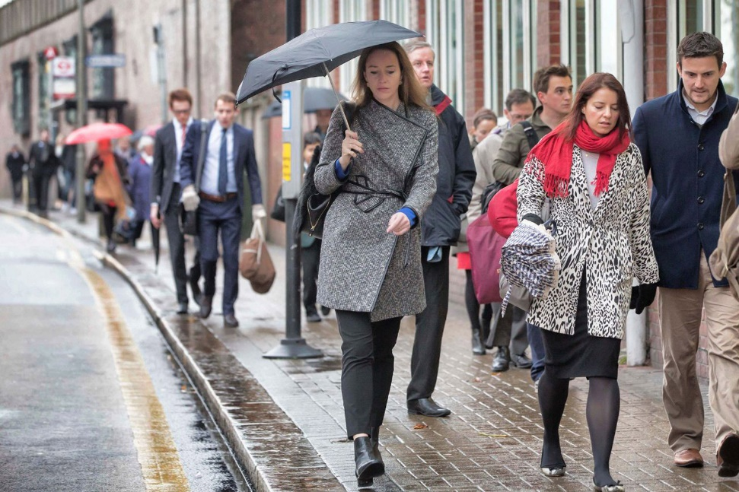
Environmental impact on momentary wellbeing
Notes:
Experience sampling
George Mackerron

Slide 9
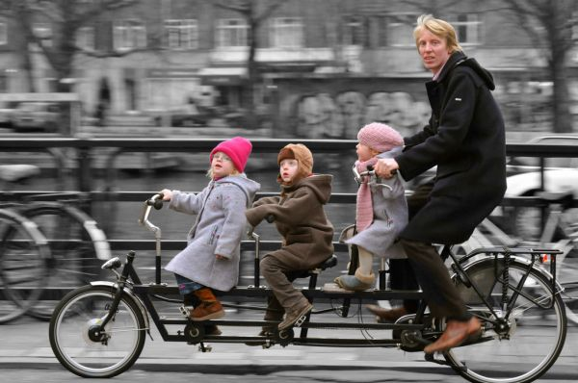
Geo-location in travel surveys in the Netherlands

Slide 10
Other transformative opportunities
Sensors e.g. accelerometry
Biometrics and mHealth
Pollution measurement
Passive data to track mobile behaviours

Slide 11
Strengths
Always on and connected
Multi-media and sensor capabilities
Options to invite data collection
Respondent activity (mobile diary)
Triggered by transaction or interaction
Triggered by random or specific moments in time
Triggered by geo-location or beacons
Create new opportunities for research

Slide 12
Three inter-linked challenges

Slide 13
Challenge 1: Ethics
Consent can be requested during the process
… but strong scrutiny is required
Agreement is given easily
Non-participants may be included without consent
Additional data types increase the risk of disclosure
Respondents’ devices may be vulnerable
Greater protection of data is possible…
…but may reduce opportunities for replication

Slide 14
Challenge 2: Burden
Recall may be cognitively difficult but additional data collection activities are also demanding
downloading an App
remembering to carry your mobile or a sensor
remembering to trigger a micro-survey or scan a receipt
responding to a prompt within a short time period
the time taken to provide the information
New kinds of data collection may be engaging
providing direct feedback or personal insights
reflecting multi-channel lifestyles

Slide 15
Challenge 3: Non-response
Response rates are not fully understood
Commercial panels rely on scale and adjustment
Impact will vary depending on activity
Exploring bias in who is excluded and responds
MCS data less complete from disadvantaged groups
Understanding Society IP trial will provide more info

Slide 16
Checking our assumptions about suitability
Not suitable for long and complex surveys
Smartphone and data plans are not universal
Access to representative samples is challenging

Slide 17
Checking our assumptions about quality
Mobile creates new research opportunities but we cannot assume, for example
In the moment measurement
Concept validity
Mobile may provide complex data where missingness is harder to identify and estimate

Slide 18
What do we need to make progress?
Still learning how to design for mobile
More methodological research
Opportunities for experimentation
Test and learn rather than sit and wait
Collaboration across sectors and disciplines
Early and open sharing
Understanding the innovation cycle

Slide 19
Questions?
cl19g15@soton.ac.uk

