Slide 1
WHAT IS MASS OBSERVATION? Dr Rose Lindsey ESRC RESEARCH METHODS FESTIVAL 2016 R.Lindsey@soton.ac.uk
Notes:
As Mike Savage notes in Identities and Social Change in Britain since 1940, 'Mass-Observation is the most studied, and arguably the most important, social research institution of the mid-twentieth century' (Savage 2010: 57).
But Mass Observation has its champions and decriers.

Slide 2
2016: MASS OBSERVATION ARCHIVE
The Mass Observation Archive is a specialist collection of material about everyday life in Britain.
Contains:
Material generated by the original Mass Observation social research organisation (1937 to early 1950s) – today’s presentation signposting on this.
Newer material collected continuously since 1981 - referred to as the Mass Observation Project. (MOP) –focus of this presentation
Notes:
Consists of 2 collections
I will talk a little about the 1937-1950s material, but my specialism lies with the 1981 Mass Observation Project (MOP) collection, so my presentation today will concentrate on the MOP.

Slide 3
MASS OBSERVATION 1937-50s ‘Anthropology at Home’ (New Statesman, 30/01/1937)
Notes:
Founded 1937 to create an 'anthropology at home… a science of ourselves‘ (New Statesman, 30 January 1937).
Mass-Observation wanted to plot "weather-maps of public feeling", to make ordinary citizens' lives and thoughts better known to the people who governed them. ( Joe Moran New Statesman, 29 January 2007 )
National panels of volunteer writers – writing replies to regular questionnaires and tasks, including diaries (Nella’s Diary – Victoria Wood)
Teams of paid and unpaid observers
Interviews with people in the street
Eavesdropped & recorded conversations in everyday places
Observed people carrying out everyday activities – study of Bolton
Photographs, film making
Anthropological reports
Wartime social survey - used by the government during WW2 to investigate public morale
Became a market research tool in late 1940s –
All material available at The Mass Observation Archive, in Sussex or through Adam Matthew Online – some university libraries have access to this

Slide 4
MASS OBSERVATION 1937-50s ‘Anthropology at Home’ (New Statesman, 30/01/1937)
Founded 1937 to create an 'anthropology at home… a science of ourselves‘ (New Statesman, 30/01/1937)
Mass-Observation wanted to plot "weather-maps of public feeling", to make ordinary citizens' lives
and thoughts better known to the people who governed them”.
( Joe Moran New Statesman, 29 January 2007 )
National panels of volunteer writers
writing replies to regular questionnaires and tasks, including diaries (Nella’s Diary – Victoria Wood)
Teams of paid and unpaid observers
Interviews with people in the street
Eavesdropped & recorded conversations in everyday places
Observed people carrying out everyday activities – study of Bolton
Photographs, film making
Anthropological reports
Wartime social survey - used by the government during WW2 to investigate public morale
Late 1940s – becomes a market research tool – stops in early 1950s.
A large proportion of the material generated ended up at the University of Sussex

Slide 5
ACCESSING HISTORICAL MATERIAL ONLINE: http://www.massobservation.amdigital.co.uk/
Notes:
1930s to 1950s Mass Observation Archive material available by visiting the archive, at The Keep in Brighton
Or through the Adam Matthew digital collection, which 41 UK university libraries subscribe to. These include: Aberystwyth, Bath Spa, Bristol, Cambridge, Durham, Edinburgh, Exeter, Kent, Lancaster, Leeds, Leicester, Manchester, Northumbria, Oxford,Portsmouth, Sheffield, Southampton, Swansea, UWE, UCL. Also universities outside the UK – Australia, Canada USA

Slide 6
Physical archives are held at The Keep, Brighton (most of contemporary 1981+ archive not digitised)

Slide 7
WHAT IS THE MASS OBSERVATION PROJECT? 1981 +
Original historical archive was stored at the University of Sussex.
New Mass Observation Project began at the start of the 1980s at the University of Sussex .
The contemporary archive consists of the writing of a national panel of 3768 (correct in May 2016) volunteer writers who have joined and left at different time points between 1981 and present day.
Writers are given anonymised identities using numbers prefixed by a letter - e.g. A883
They are asked to write this number and a brief demographic description on all their writing.
This will change over time – quality of description can vary - tensions between demographic data and writing – this makes MOP interesting!
“B1898, female, 76, married but husband resident in nursing home, Hailsham East Sussex, claims assessor”
They are asked not to name others.
Consent has been given for secondary use.

Slide 8
WHAT DO THEY WRITE?
Primary source of writing are responses to DIRECTIVES.
2 or 3 sets of themed questions/directives on different topics, sent out by the archive to writers 3 times a year.
Directives ask for writers’:
Views on issues such as: the NHS, legislation, general elections, wars, class, race, new advances in science or technology, and topical events
Descriptions of their lives, such as their experience of the labour market, voluntarism, unemployment, bereavement, family, having a pet.
Descriptions of themselves, for example, their class, wellbeing, or sense of belonging to community.

Slide 9
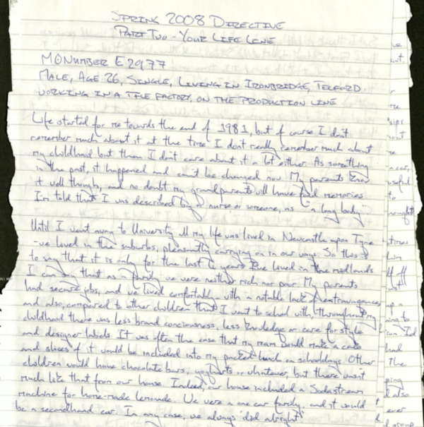
DIRECTIVES: thought up by archive staff or commissioned by researchers

Slide 10
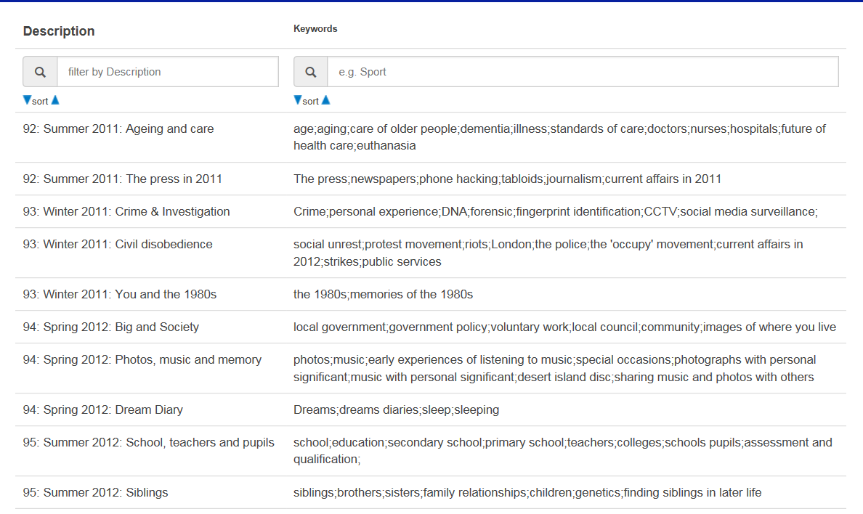
EXAMPLES OF DIRECTIVES
Notes:
Directives are thought up by the MOA staff, and may reflect issues that are politica topical
They can also be commissioned by researchers – for example, the Third Sector Research Centre commissioned a directive that asked writers views on The Big Society in 2012

Slide 11
DIRECTIVES ARE RESEARCH INSTRUMENTS:
2008 Directive - Part 2: Your life line
“Mass Observation is all about people’s lives looking backwards and forwards. Could you draw us your “lifeline” marked up with the key events in your life. If you have never done one before, you start in the year of your birth and come up to the present. Then you mark off as many key events as you think are really important to you….”
Notes:
The 2008 directive asked 2 sets of questions – the first was entitled ‘You & the NHS in 2008’ and asked about writers’ experiences of NHS treatment since 1997, and their views on the future of health and social care and the NHS.
The second part asked writers to write a lifeline

Slide 12
NOT ALL WRITERS RESPOND TO DIRECTIVES NOT ALL WRITERS STICK TO THE SUGGESTED FORMAT NOT ALL WRITERS RESPOND TO THE QUESTIONS ASKED….
M2854/M/56/Wisbech/retired/layabout
“I don’t want to do this – it’s far too depressing. I’ve had such a miserable and wasted time. I want to write about my tree instead.”
F-2218/ 79yr old/white/Anglo-Caledonian/single man/retired NHS Supplies Officer/resident in village of NE England.
“I’m sure you do not want a recital of memorable events (even if I could
remember them): memories fade and become part of a homogenous mass.
If your life is a series of “occasions”, how do you cope with in-betweens?”
Notes:
Different structures were produced
Some people drew lifelines
Some wrote chronological lists
A painting
Essays

Slide 13
RESPONSES TO DIRECTIVES
Writers don’t have to answer a directive, can choose to ignore any or all questions asked, and can ignore directions on format.
Majority do answer most of the questions, and often stick to the order in which these are asked
NOT THE SAME AS READING INTERVIEW TRANSCRIPTS!
This can be extremely frustrating, but sometimes generates unexpected insights - ‘golden nuggets’
It is important to be aware of the research instrument which represents the context in which responses are produced.
Do you need to consider questions asked in associated directives sent out at the same time?
Notes:
When analysing the LifeLine directive, we considered whether the NHS directive/research instrument had influenced the responses to the LifeLine directive… were writers more likely to focus on health and significant events..
No they didn’t - a variety of different ways of presenting and/or narrating lives, and life events were used.

Slide 14
How responses are produced
Responses can capture experiences, thoughts, views - often all in one response – the everyday meets the political
Writing can be both contemporary & retrospective
Big difference in types of responses between early 1980s and late 1980s – directives more relaxed? Cultural change?
Form: handwritten, typed, word processed, one paragraph or 20 pages
Not always written at one sitting

Slide 15
WHO ARE THE MASS OBSERVATION WRITERS?
Self selected volunteer writers
1981 letters to national and local press (tabloid & broadsheet) appealing for writers. Since then no major campaigns to recruit writers.
Currently archive receives 200 applications to become writers each year
Numbers of writers:
1988 -1000 writers 1993 - 700 writers 2016 450 writers
Simple analyses undertaken by the Mass Observation Archive (MOA) suggested over-representation by women over 50 from the South-East. Selection criteria changed in 2004 to younger men, from the North East.
Social sciences argument that writers are not representative of the broader UK population - is the Mass Observation Project a trustworthy source of qualitative data?

Slide 16
Who are the Mass Observation Project writers?
ESRC funded project to find out more about MOP writers 1981+ - enable confident use of MOP
https://definingmassobservation.wordpress.com/
Creation of database using archival metadata - writers’ demographic characteristics & writing behaviours
http://database.massobs.org.uk/
Enables simple comparisons with broader UK population
Official launch event at The Keep, 18 July 2016. Sign up closes 12 noon Fri 8th July!!
http://www.eventbrite.co.uk/e/who-are-the-mass-observation-writers-1981-2016-tickets-25268705378

Slide 17
MOP WRITERS’ CHARACTERISTICS
3768 WRITERS | Data collected at ONE TIME POINT - 1990s, or when joined if post 1990 No info collected on ethnicity!
Gender | 32% men 68% women
Age | Panel consists of writers aged 16 to 94. 75% writers born between 1920 and 1969 Average age at joining MOP – 50
Residence | 89% England 5% Scotland 5% Wales 1% Northern Ireland
Marital status | 50% married/civil partnerships 10% cohabiting 25% single (some singles may be in same-sex partnerships)
Who they live with | Of 30% of 3768 writers who provided information on living arrangements – 40% living with partner 21% with partner and child 20% live alone
Labour market | Of the half of the 3768 writers who provided employment status: 50% employed – half in public sector, half in private sector 27% retired
ONS Standard Occupational Classification (SOC) SOC 2010 and 1990 used as measures | Higher professionals – managers and senior officials are under-represented Greater representation of professionals Under-representation of skilled and non-skilled professions

Slide 18
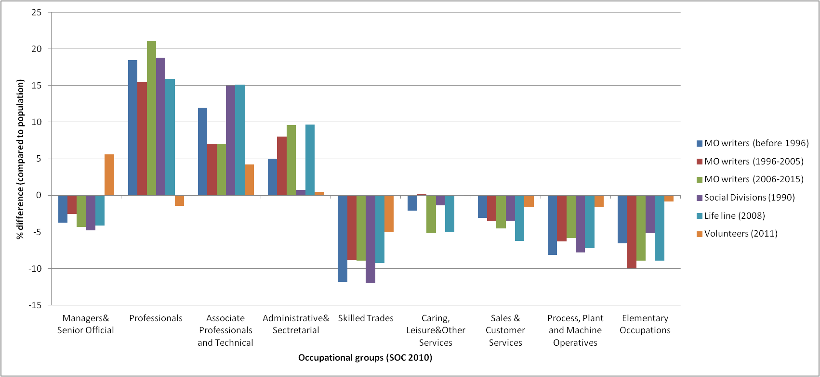
MOP RESPONDENTS COMPARED TO GENERAL POPULATION AND VOLUNTEERS D.Kamerade@bham.ac.uk
Notes:
This table shows occupational data for different time points
Only 40% of the respondents provided occupational data.
The table provides a comparison with UK population at the given time points:
During all periods higher occupations, except for managers and senior officials, were heavily overrepresented among the MO respondents.
Individuals in lower occupational groups were significantly underrepresented among MO respondents

Slide 19
USES OF MOP: SOURCE OF SECONDARY DATA
Interdisciplinary: widely used across social sciences and humanities. Also used by arts disciplines. Some use by sciences.
Thematic: mostly used to look at particular themes at one time point. Or cross-sectionally at different time-points
Selective sampling: Database offers opportunities to sample writers by gender, occupational classification, age or year of birth.
Longitudinal: Database offers opportunity to sample writers and follow them through time
Mixed-method Can be used with other qualitative/quantitative data
Computer Assisted Qualitative analysis: Archive gradually increasing its digital collection. Transcription is an option.

Slide 20
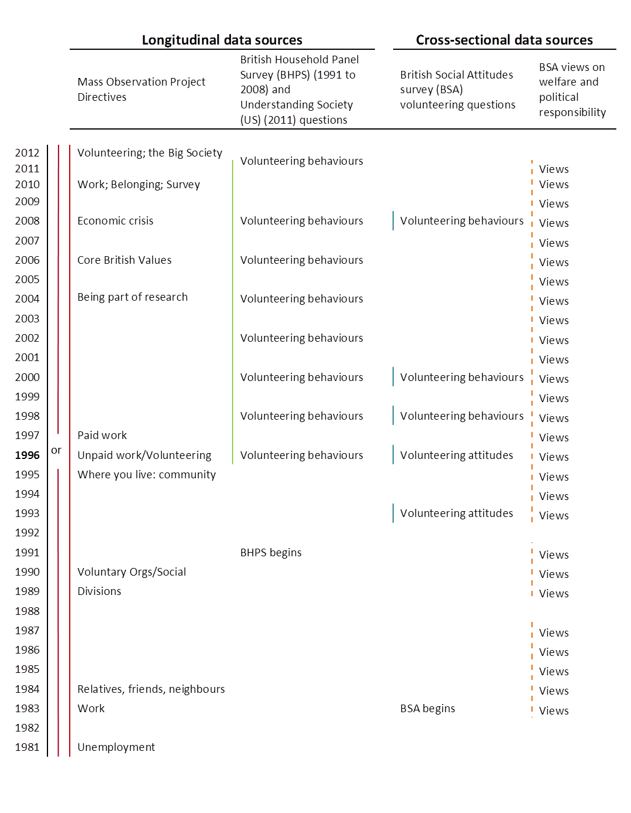
Using MOP with survey data: following 40 writers through time

Slide 21
CONTACT DETAILS
DAIGA KAMERÃDE – D.Kamerade@bham.ac.uk – Cleaning metadata quantitative analysis, comparison of writers with UK population and with volunteering population
ROSE LINDSEY – R.Lindsey@soton.ac.uk – Principal investigator, and LifeLine analysis
JOHN MOHAN – J.Mohan@bham.ac.uk – volunteering and the MOP
JESSICA SCANTLEBURY – J.C.Scantelbury@sussex.ac.uk – Mass Observation Archive liaison person re MOA sources and use of database
CHRISTINA SILVER – C.Silver@surrey.ac.uk – computer assisted qualitative analysis
GEORGE STEVENSON – G.S.M.Stevenson@durham.ac.uk – class and MOP
Website: https://definingmassobservation.wordpress.com/

Slide 22
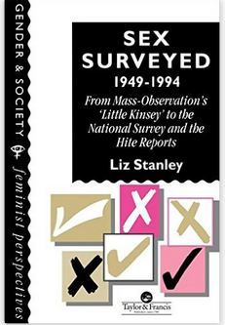
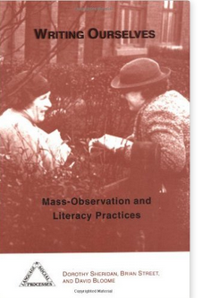
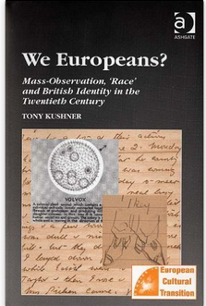

Slide 23
Articles on Mass Observation
Casey E., Courage F., Hubble N, ‘Mass Observation as Method’ in Sociological Research Online, 19 (3), 22
Lindsey R., Bulloch S. ‘A Sociologist's Field Notes to the Mass Observation Archive: A Consideration of the Challenges of 're-Using' Mass Observation Data in a Longitudinal Mixed-Methods Study’ in Sociological Research Online, 19 (3), 8
Pollen A., Research Methodology in Mass Observation Past and Present: ‘Scientifically, about as valuable as a chimpanzee’s tea party at the zoo’? in History Workshop Journal 2013
Savage M., 2006, ‘Changing Social Class Identities in Post-War Britain: Perspectives from Mass-Observation, in Sociological Research Online 12(3)6

