Slide 1
'Statistics Anxiety' A Fairy Tale For Our Times?
Kevin Ralston and John MacInnes
Project team: Graham Crow and Vernon Gayle
NCRM RFM festival, 6th July 2016
kev.ralston@ed.ac.uk

Slide 2
Study: General Aims
QM pedagogy:
http://www.ncrm.ac.uk/research/WP6/wp6.php
Substantial primary data collection component
Teaching
Review of evidence
What is out there empirically?
Practitioner experience of difficulty in teaching students involving maths
Views of school level teachers of problems of preparing students for university
Learning
Influence of Statistical Anxiety
Comparisons of different subject areas
Researching a number of universities
Differences, by gender, age, previous education, type of institution etc
Ralston, K.,MacInnes, J. Crow, G. Gayle, V. (Forthcoming) We need to talk about statistical anxiety, NCRM Working Paper
Ralston, K.,MacInnes, J. Crow, G. Gayle, V. (2015), Quantitative Methods Pedagogy in Social Science, Methods News, ESRC National Centre for Research Methods Newsletter, Summer 2015
Ralston, K. (2015), Quantitative Methods Pedagogy in Sociology: What have we got to go on? The Detective’s Handbook (blog), (accessed 25/11/15).

Slide 3
QM/sociology/social-science literature
3 categories in the relevant literature:
High level - Background
Agenda setting/ horizon scanning
General recommendations for QM pedagogy
Different approaches to QM
This is how I/we do it
E.g. ‘I’ve spent 20 years teaching and this is how I do it…’
Empirical Studies, some evidence
A course or a year in an institution
Maybe assessing an intervention
Often not to too rigorous
Typically small n
Often based on written feedback

Slide 4
Statistical Anxiety (SA)
This has been a main focus of our work
Probably the most researched aspect of QM pedagogy
Reviewed the SA literature – comprehensively
Psychology
Education
Undertaken some secondary analysis
More later?
Undertaken some primary data collection
More later

Slide 5
Definition(s), SA:
Onwuegbuzie et al. (1997)
‘an anxiety that comes to the fore when a student encounters statistics in any form and at any level’
Chew and Dillon (2014)
‘a negative state of emotional arousal experienced by individuals as a result of encountering statistics in any form and at any level; this emotional state is preceded by negative attitudes toward statistics and is related to but distinct from mathematics anxiety.’
Macher et al. (2015)
‘Statistics anxiety describes the apprehension that occurs when an individual is exposed to statistics content or problems and instructional situations, or evaluative contexts that deal with statistics. As statistics-anxious individuals always experience anxiety when doing statistics, statistics anxiety describes an enduring, habitual type of anxiety’

Slide 6
Measures of SA have been developed
Anxiety
Statistics Anxiety Rating Scale - STARS (Cruise et al., 1985)
Statistics Anxiety Inventory - STAI (Zeidner, 1991)
10 item, Statistics Anxiety Scale - SAS (Pretorius and Norman, 1992)
An unnamed instrument measuring statistics anxiety and attitudes developed by (Zanakis and Valenzi, 1997)
Statistics Anxiety Measure (Earp, 2007)
24 item, Statistics Anxiety Scale by (Vigil-Colet et al., 2008)
Attitudes
Attitudes Towards Statistics scale - ATS (Wise, S. L, 1985)
Multifactorial Scale of Attitudes Toward Statistics - MSATS (Auzmendi, 1991)
Survey of Attitudes Toward Statistics - SATS-36 (Schau et al., 1995)
Attitudes Towards Research - ATR (Papanastasiou, 2005)
Maths
Maths anxiety Ratings Scale (Richardson and Suinn, 1972)

Slide 7
Statistics Anxiety Ratings Scale (STARS) ‘Statistics teachers are so abstract they seem inhuman’
51 Items!
6 dimensions
Test and class anxiety
Interpretation anxiety (anxiety when interpreting statistical results)
Ask for help anxiety
Worth of Statistics
Teacher anxiety:
Self-concept
How much anxiety would you experience, from no anxiety to strong anxiety (on a scale of 1 to 5 with 1 being no anxiety and 5 being strong anxiety)
Chew and Dillon (2014) recommend the Q 1-23:
Hanna (2008) provides a confirmatory analysis of STARS in a UK context, they reword several questions.

Slide 8
STARS: Self-concept
25 I have not done maths for a long time. I know I will have problems getting through statistics
31 I cannot even understand secondary school maths; how can I possibly do statistics?
34 Since I have never enjoyed maths I do not see how I can enjoy statistics
38 I do not have enough brains to get through statistics
39 I could enjoy statistics if it were not so mathematical
48 Statistics is not really bad. It is just too mathematical
51 I am too slow in my thinking to get through statistics

Slide 9
Empirical evidence…
Students being statistically anxious is widely cited in the literature.
(e.g. Bridges et al., 1998; Paxton, 2006; Schacht and Stewart, 1990)
There are 2 systematic reviews
Chew and Dillon, 2014, psychology, cites ≈100 papers
Onwuegbuzie and Wilson, 2003, education cites ≈ 84 papers
It is contested
DeCesare (2007) it’s a self fulfilling prophesy (n=194)
42% report no angst
25% reported being very anxious
32% reported being anxious
57% of men reported being relaxed or indifferent to the thought of taking the course. (n=49)
Williams et al. (2009) a slight minority report being anxious

Slide 10
SA literature
In the SA literature it is often accepted that its a measurable thing and that its bad
Construct validity
Predictive validity
Largely missing from the definitions of statistical anxiety is the idea that could be positive
Related to motivation
Could help focus performance?
What evidence is there that SA is negative?
42 papers recommending simulations only x2 assessing simulations (Smith 2003)
Its a bit like this in the social science QM pedagogy literature

Slide 11
What evidence is there of predictive validity?
Chew and Dillon (2014) and Onwuegbuzie and Wilson (2003)
specifically cite several papers which find a negative relationship between anxiety and performance
5 report just a simple regression or correlation between a measure of anxiety and exam/test score
4 papers undertake multivariate analysis

Slide 12
Multivariate models
Modelling evidence:
Lalonde and Gardner (1993), SEM approach, finding no association
Onwuegbuzie (2003), similar SEM analysis, finds a significant association
Zanekis and Valenzi (1997), control only GPA and experience of working with computers, finds an association
Onwuegbuzie and Seaman (1995), control various co-variates n=26, only reports correlation
Does this convincingly demonstrate an association?

Slide 13
Even More Recently
Macher et al. 2015
Identifies 11 papers measuring SA and performance
5 present non significant correlations
6 report significant –ve correlation
Largest association r=-0.49 in research
Generally a weak relationship is found

Slide 15
Zero effect?
Macher et al. (2011) They suggest their work points to a suppression effect between statistics anxiety and performance
statistics anxiety had a small but significant negative influence on performance, via state anxiety experienced immediately before and during the examination.
But statistics anxiety also had a small but significant positive influence on performance (probably through more efficient learning behaviors and/or more time spent on learning)

Slide 16
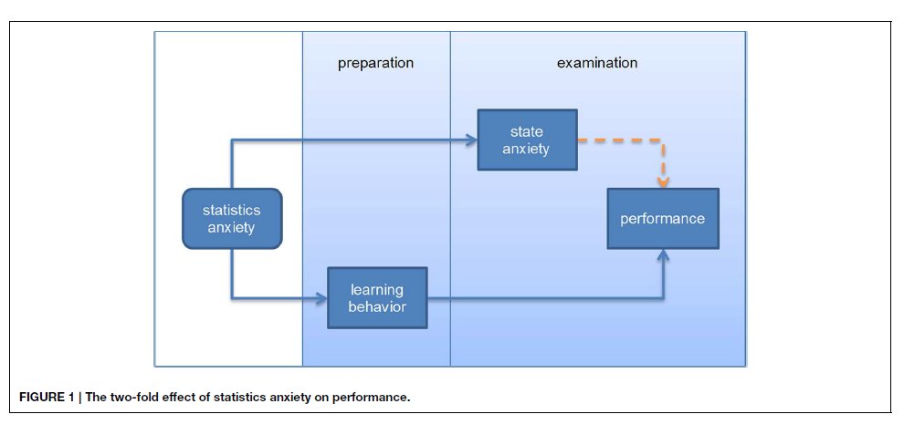
Model of SA:
Macher, D., Papousek, I., Ruggeri, K., Paechter, M., 2015. Statistics anxiety and performance: blessings in disguise. Frontiers in psychology 6.

Slide 17
Anxiety as facilitating
This idea exists in the sports, language and test anxiety literatures
Alpert and Haber (1960), paper on test anxiety
SA concentrates almost exclusively on intensity, not direction
It is implicit that SA is negative/bad
Keeley et al. (2008) Curvilinear relationships between statistics anxiety and performance among undergraduate students: Evidence for optimal anxiety, Statistics Education Research Journal
Only applies STARS measure, not multivariate

Slide 18
Secondary Analysis

Slide 19
Secondary Analysis
Data are limited for such a niche subject
Williams et al. 2009
SN: 6173 UK data archive, Student Perceptions and Experiences of Quantitative Methods, 2006
Asks this question:
The idea of learning statistics makes me feel anxious, agree, disagree, not sure.

Slide 20
Simple preliminary analysis
Reported women have higher levels of SA than men (Papanastasiou and Zembylas 2008, Onwuegbuzie 1998, Zeidner 1991)
Are women more likely to report experiencing anxiety than men?
Dichotomous outcome: the idea of learning statistics makes me feel anxious,
1=agree
0=not sure/disagree (do not agree)

Slide 21
Table 1, Descriptive statistics: bivariate crosstabs of the independent and dependent variables
 | % Do not agree (n) | % Agree (n)
Learning statistics makes me feel anxious? | 46 (339) | 54 (393) | chi | Phi Φ
Sex
Male | 52 (65) | 48 (60) | 0.16 | Φ 0.05
Female | 45 (274) | 55 (333)
Age
<=24 | 48 (312) | 52 (338) | 0.01 | Φ 0.10
>=25 | 33 (27) | 67 (55)
On the whole I am good at maths (dispositional)
Agree | 66 (213) | 34 (108) | 0.00 | Φ 0.3.8
Disagree | 26 (78) | 74 (226)
Not Sure | 45 (48) | 55 (59)
Last qualification obtained included maths (situational)
Yes | 66 (72) | 34 (37) | 0.00 | Φ 0.17
No | 43 (267) | 57 (356)
n= 732 Source: Williams et al. 2009, SN: 6173

Slide 22
Table 1, Descriptive statistics: bivariate crosstabs of the independent and dependent variables
 | % Do not agree (n) | % Agree (n)
Learning statistics makes me feel anxious? | 46 (339) | 54 (393) | chi | Phi Φ
Sex
Male | 52 (65) | 48 (60) | 0.16 | Φ 0.05
Female | 45 (274) | 55 (333)
Age
<=24 | 48 (312) | 52 (338) | 0.01 | Φ 0.10
>=25 | 33 (27) | 67 (55)
On the whole I am good at maths (dispositional)
Agree | 66 (213) | 34 (108) | 0.00 | Φ 0.3.8
Disagree | 26 (78) | 74 (226)
Not Sure | 45 (48) | 55 (59)
Last qualification obtained included maths (situational)
Yes | 66 (72) | 34 (37) | 0.00 | Φ 0.17
No | 43 (267) | 57 (356)
n= 732 Source: Williams et al. 2009, SN: 6173

Slide 25
Research conclusions
It seems a lower odds of ‘young’ men reporting anxiety drives the age effect seen in model 1
young women experience higher odds of reporting anxiety than young men
older women have lower odds of experiencing anxiety than older men
Older men also have higher odds of experiencing anxiety than younger men
no significant age differences evident between older women and younger women
a need to consider the relationship between anxiety and its antecedents in a multivariate context where sensitivity analyses are undertaken

Slide 26
Going forward- establish the phenomenon
We have been piloting instruments
More coming up
We would like* to survey students in the UK
We have heard anecdotally that Universities are now very reluctant to allow access to students
We have good access to Q-Step institutions
Augment this by taking a random sample of UK universities, stratified by ranking
We will measure performance, together with anxiety and antecedents
Can also look longitudinally, using a sub sample, or alternative sample

Slide 27
Is statistics anxiety a fairy tale?
Well, no
It’s a measurable phenomenon
Convincingly shown as distinct from other types of anxiety
However
Current evidence suggests it is not the pedagogical issue we may think it is.
At best it is suggested to have a weak bi-variate association with performance
Overall it seems to be having no great influence on outcomes

