Slide 1
COMPLEXITY and method: complexity, cases and policy-making
Prof. Dr. Lasse Gerrits

Slide 2
Topics
The conundrum
Example: (un)satisfied with PPP
Equifinality and multifinality

Slide 3
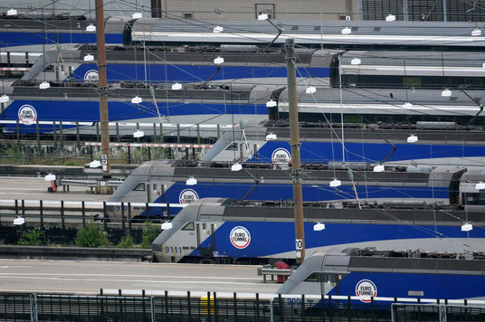
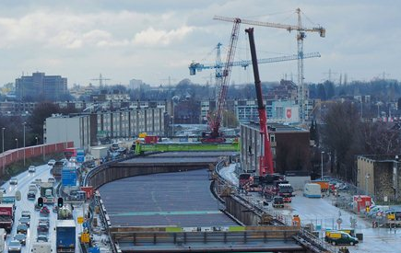
Policy evaluation: what outcomes?

Slide 4
The conundrum
Comparing cases: patterns but no detail
Single cases: detail, no idea how it relates
Cases are open, contingent systems
Evaluation matters, policies are adjusted

Slide 5
Set-up of the study

Slide 6
Results
Low satisfaction: 22 cases
High satisfaction: 20 cases

Slide 7
Pathways
Low satisfaction (22)
High satisfaction (20)

Slide 8
Pathways
Internal private response (13)
Internal public response (2)
Low satisfaction (22)
Disruptive events (42)
Internal response (9)
High satisfaction (20)
Social events (25)
External response (16)
Physical events (2)
Internal-coop response (2)

Slide 9
Pathway A
Internal private response (13)
Internal public response (2)
Low satisfaction (22)
Disruptive events (42)
Internal response (9)
High satisfaction (20)
Social events (25)
External response (16)
Physical events (2)
Internal-coop response (2)

Slide 10
Pathway B
Internal private response (13)
Internal public response (2)
Low satisfaction (22)
Disruptive events (42)
Internal response (9)
High satisfaction (20)
Social events (25)
External response (16)
Physical events (2)
Internal-coop response (2)

Slide 11
Pathway C
Internal private response (13)
Internal public response (2)
Low satisfaction (22)
Disruptive events (42)
Internal response (9)
High satisfaction (20)
Social events (25)
External response (16)
Physical events (2)
Internal-coop response (2)

Slide 12
Pathway D
Internal private response (13)
Internal public response (2)
Low satisfaction (22)
Disruptive events (42)
Internal response (9)
High satisfaction (20)
Social events (25)
External response (16)
Physical events (2)
Internal-coop response (2)

Slide 13
Pathway E
Internal private response (13)
Internal public response (2)
Low satisfaction (22)
Disruptive events (42)
Internal response (9)
High satisfaction (20)
Social events (25)
External response (16)
Physical events (2)
Internal-coop response (2)

Slide 14
Conclusions regarding PPP
Several pathways to achieving (un)satisfactory results
Devil is in the detail
No one single solution
It is easy to mess up things ☺

Slide 15
Equifinality and multifinality
Multiple conditions, similar outcomes
Similar conditions, multiple outcomes
The misleading attraction of symmetry
Necessity of context-sensitive research

Slide 16
Appearances of complexity
Uncertainty
Networks
Time

Slide 17
Sources
This empirical study:
Verweij, S., Teisman, G. & Gerrits, L (2016). Implementing public-private partnerships: how management response produces (un)satisfactory outcomes. In: Public Works Management & Policy (forthcoming)
Complexity, policy and research:
Gerrits, L. (2012). Punching Clouds: an introduction to the complexity of public decision-making. Litchfield Park, AZ: Emergent Publications
Complexity and qualitative research:
Gerrits, L. & Verweij, S. (2013). Critical realism as a meta-framework for understanding the relationship between complexity and qualitative comparative analysis. Journal of Critical Realism 12(2) 166-182
Evaluation of public-private partnerships:
Verweij, S. (2015). Once the shovel hit the ground. Rotterdam: Erasmus University Rotterdam

