Slide 1
CLOSER Discovery Alison Park, UCL Institute of Education

Slide 2
What is CLOSER Discovery?
Search tool for longitudinal studies
Search questions and variables
Find the data and questions you need
Go directly to the dataset or study to access the data
Notes:
What is CD?
Online search tool that allows users to explore detailed content of eight longitudinal studies.
So far, 43,000 variables and 18,000 questions from 37 sweeps spanning 60 years
Why do we need this? Key obstacle to more use of longitudinal data is fact that often very hard to find out what has been covered on different studies or early rounds. Might be a marked up q/re, but not always clear how its contents relate to the existing datasets. No way of finding out if similar or the same questions have been asked on different studies, making cross-study comparisons hard.

Slide 3
How did we get here?
Majority of the work
Content enhancement
DDI Lifecycle standard metadata format
Content sits within metadata repository, accessed via Discovery website
Notes:
Taking data from q/res and getting into a standard format – eg old pdfs and paper q/res, mapping questions to variables on the dataset, rigorous checking and QA.

Slide 4
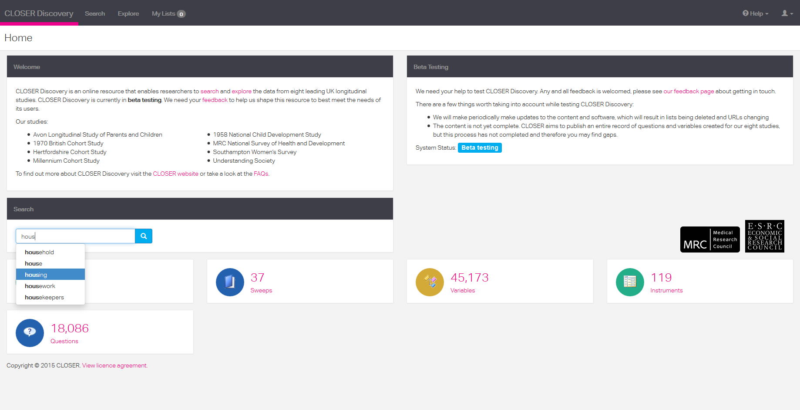

Slide 5
Using Discovery
Search for free text (‘search’) or explore via drop down menu
Save to lists
Notes:
Easiest way to start is by searching for key text. Here started typing the word ‘housing’ – various autofill options come up which you can use or ignore.
Save to lists

Slide 6
Using Discovery
Produce list of eligible items with study details
Identify questions and variables
Refine search by range of attributes
Save search results
Notes:
Part of a search result page
Save functionality – can save to multiple lists which you can save and download.

Slide 7
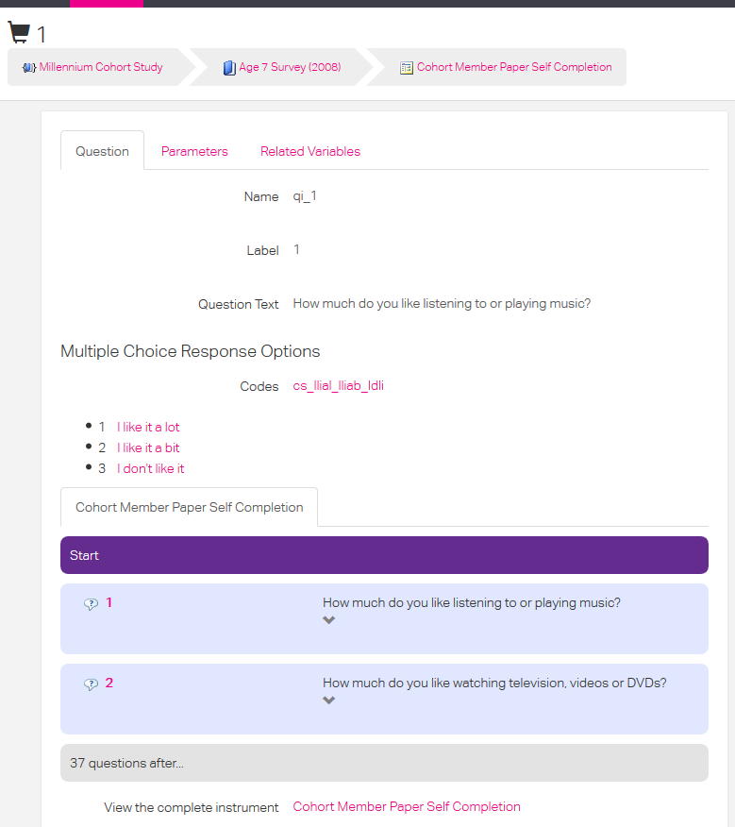
Using Discovery
See precise question and answer wording
Identify relevant questionnaire
View in context of wider questionnaire
Identify related variables

Slide 8
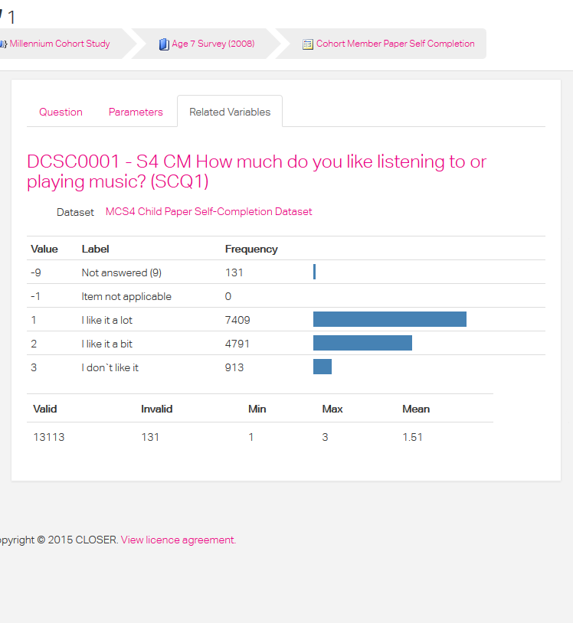
Using Discovery
Frequency count
Notes:
Helpful in initial research planning stage, especially when access to dataset limited – find out if enough cases to answer your research question.

Slide 9
Next steps
Currently in beta testing
Feel free to test – www.discovery.closer.ac.uk
Feedback welcome – closerdiscovery@ucl.ac.uk
Full launch later this year
Full training including webinars

Slide 10
Thank you
www.closer.ac.uk
alison.park@ucl.ac.uk

Slide 11
Why CLOSER? Unique value of longitudinal data …
Detail and accuracy
Rich array of information over multiple waves/sources
Unique analytic potential
Patterns of change, dynamics of behaviour, time related characteristics
Insights into causality
Long tradition
Across social and biomedical sciences
Reliability and accuracy

Slide 12
… but range of factors inhibiting more use
Low awareness
Analytic potential of data
Practical challenges
Data management, analysis complexity
Not joined up
Limited collaboration between social and biomedical sciences
Discoverability
Practical problems finding out what data exists, data access
Generalisability from cohorts
Policy relevance of findings
Notes:
Give some examples

