Slide 1
The pedagogy of methodological learning
Michela Insenga, PhD
Cordelia Sutton, PhD
7th ESRC research methods festival
Bath, 05/07/16

Slide 2
Aims of presentation
Examine some of the questions arising from the pedagogy of methodological learning through a methods diary circle
What is the diary circle?
Who are the participants?
Addressing five questions we have asked ourselves about the pedagogy of learning research methods

Slide 3
What is the diary circle?
Part of a new ESRC (NCRM) project exploring how advanced or innovative social research methods are taught and learnt.
Participants who are learning and using research methods record, document and reflect on research methods learning experiences over 30 month period
We blog on anything that we feel is connected to learning and using research methods- this is very varied! .
We have met once face to face at the launch of the Diary Circle in October.
Diary entries are sometimes individual reflections, sometimes questions for the other diary members to consider, and frequently prompt reflection from others. Contributions vary in length and frequency

Slide 4
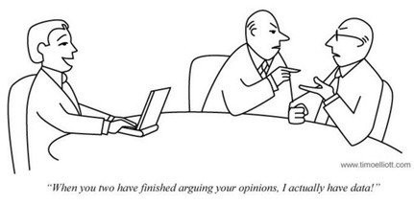
Participants: who are we?
Eight doctoral and early career researchers from a variety of universities around the UK
Some international and some UK students and researchers
Ranging from beginning doctoral studies, to nearing completion and beyond
Volunteered to participate in the Diary Circle following a call for participants

Slide 5
Question 1: how do we learn research methods?
Teaching
Reflection
“The university had a pool of research students, mainly students who had above aptitude in statistics and other research methods that were charged with offering a few hours (paid) to help any student including staff of the university with methodology issues....They said that consultant students (what a fancy name) were able to relate and communicate at the same wavelength with those students that sought help. Moreover, they added that it was easy to "pour themselves out" to a fellow student and discuss what some termed "silly stuff" compared to a senior staff.” Hamis
Learning (through being 'taught', through reading textbooks, research methods books and journals)
Notes:
Some of the ways we are learning through teaching:
-Leading education and training events
-Working with own students:
and how to apply those methods
-Learning though experience such as auditing a module
Learning through Reflection:
-Reflecting on the use of research methods both inside and outside of academia (early career researchers)
-Reflecting on data analysis, data, tools used (early career researcher)
-Reflecting on feedback from reviewers (early career researcher)
-Reflecting on the limitations of (own) existing knowledge of research methods- uncertainty
-Reflecting on the experience of carrying out research compared with the being taught/learning from tutors and books,
Learning- Hamis writes about learning from other students. We also learn from reading and speaking and interacting with many others

Slide 6
Question 1: how do we learn research methods?
“We discussed my academic needs and any gaps in my knowledge or training that I should address” Chloe
The ‘PhD process’
Writing/presenting
Talking and Listening
Practical Experience
“[In my experience] the research methods MSc consists of a lot of ‘learning about’ research methods, but the ‘learning how’ to use research methods clearly doesn’t come from a textbook.” James
Notes:
-PhD induction
-Awareness (and associated fear) of gaps in knowledge and practice of research methods
-Courses offered at some universities for learning research methods.
-Access to courses differ, and knowledge about what is offered differ.
-Supervisory
-Workshops
-Lectures/plenaries, tutorials/seminars
-Spending time trying to find the most appropriate method of analysis
-Needing to plan what we need to learn
-Making choices about the right research method for your project
-Finding specialists in the chosen methodology
-Joining relevant networks (online, conferences and other events)
-Writing academic papers on learner analytics (early career researcher)
-Expectation of learning from journal reviewers (early career researcher)
-Explaining (writing) about methods (early career researcher) including comparison with other frameworks/methods
-Writing notes
-Writing methods chapters
-Presenting work at Work in Progress seminars- helps to clarify thought processes, and a good opportunity for feedback from your peers
-Preparing research bid proposals

Slide 7
Question 2: what do we learn/are we learning about research methods?
There are many assumptions that exist in the learning (and teaching) of research methods.
Data analysis tools and research methods are changing in the post digital world and we need new methods and analysis tools for this.
Institutions and university departments tend to focus on a set of methods, often quantitative.
(Good) qualitative methods training are often side-lined at undergraduate and Masters level, and PhD students enter this period of study with little knowledge and practical experience of qualitative methods.

Slide 8
Question 2: what do we learn/are we learning about research methods?
Participating in the Diary Circle has enabled contributors to learn (through experience) a new method, engaging in evaluation and reflection.
We develop (epistemological) identities in our learning of research methods...sometimes these can come into conflict
Real life experience of learning/practising a method is invaluable and is not always as expected from previous reading or teaching:
Postgraduate level learners of research methods are often teachers of undergraduate level research methods learners (eg Hamis, James and Michela from the Diary Circle)

Slide 9
Question 3: who is teaching me?
“My starting point, as I have been suggested, is a book called The foundation of social research – Michael Crotty – I am on page 3 and quite enjoying it. So I am at the beginning of my journey, getting my head around understanding new research methods and methodologies, and the difference between these two. I will keep you posted to see what’s going on. ☺ “ Michela
Research supervisors
Peer learning
Students, participants
Internet, social media
Seminars, training on research methods
Relevant literature, textbooks, journal articles on research methods

Slide 10
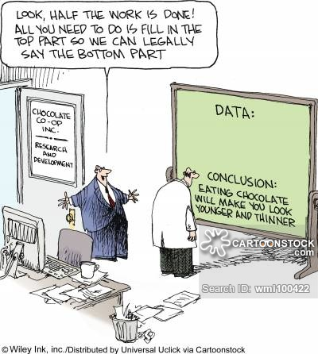
Question 4: timing- from being ‘taught’ to putting it into practice.
As for the question of what I do with this knowledge; I certainly didn’t apply it immediately. [In my experience] the research methods MSc consists of a lot of ‘learning about’ research methods, but the ‘learning how’ to use research methods clearly doesn’t come from a textbook. […] The same thing happened when I did my dissertation: I had read a lot of textbooks and written a lot about interviews; but it was only as I was sitting on a train, making my way to my first interviewees’ house, mentally preparing myself, that interviewing actually became a thing which I did.

Slide 11
Most people felt at different stages of their research that research methods was just a theoretical notion for them.
Some felt they had inadequate knowledge;
Others felt they had the adequate knowledge, but the lack of practice make the concept of research methods quite abstract.
Only when they started putting their knowledge into practice, i.e. starting their interview/data collection process etc. research methods became “an actual thing” to them.

Slide 12
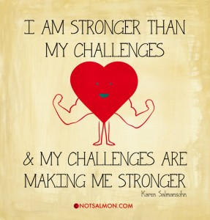
What support would have been/would be helpful in methodological learning?
More hand-on experience throughout their theoretical learning journey
Peer support/network structure
Availability and choice of training courses
Supervisors’ support

Slide 13
Interim conclusions
From the analysis of the diary circle posts conducted through the use of NVIVO, we learnt about eight individual journeys to learning research methods, a journey that has a turning point when it goes from being taught to putting theoretical knowledge into practice, and that varies from individual to individual.

Slide 14
Thank you ☺
Michela Insenga
insengam@edgehill.ac.uk
Cordelia Sutton
cordelia.sutton@open.ac.uk

