Slide 1
Pelotas Birth Cohort Study

Slide 2
South America

Slide 3
Perinatal study
All children born in the maternity hospitals
Family living in the urban area of the city
Hospital deliveries accounted for more than 99% of births
Losses < 1%

Slide 4
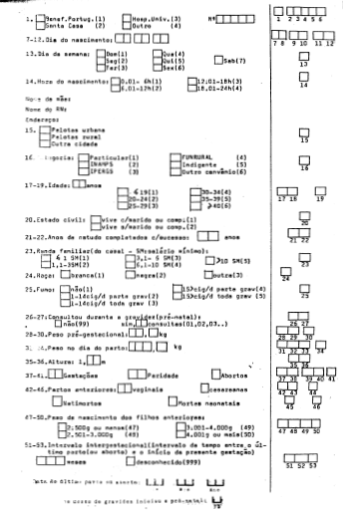
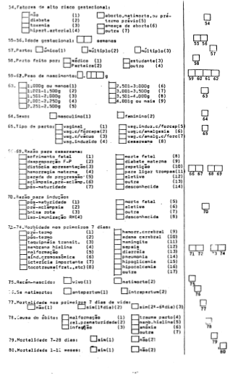
Questionnaire

Slide 5
1983 Follow-up study
All children born from Januay to April 1982 (1/3 of the cohort)
Visit to adressess obtained in hospital
Losses = 21%
Age = 11.3 months

Slide 6
1984 Follow-up study
All cohort children
Census of all households in the city (70,000)
Losses = 13%
Age = 19.4 months

Slide 7
1986 Follow-up study
All cohort children
Census of all households in the city (70,000)
Age = 43.1 months
Losses = 16%

Slide 8
1997 Follow-up visit
Visit to all households in a systematic sample of 27% of the city’s census tracts (70)
Losses = 28.2%
Age = 14.7 years

Slide 9
2000 Follow-up visit
All male cohort adolescents
Army recruitment examination
Losses = 21%
Age = 18.2 years

Slide 10
2001 Follow-up visit
Losses = 31%
Age= 18.9 years
Visit to all households in a systematic sample of 27% of the city’s census tracts (70)

Slide 11
2004-5 Follow-up visit
Census of all households in the city (98,000) plus visit to previous addresses
Losses: 22.6%
Age = 23 years

Slide 12
20012-13 Follow-up visit
Subjects were searched using multiplie strategies
Invited to visit the research clinic
Losses: 31.9%
Age = 30 years

Slide 13
Questionnaire – 2012/13
Eletronic questionnaire
587 questions
Physical examination
Blood sample

Slide 14
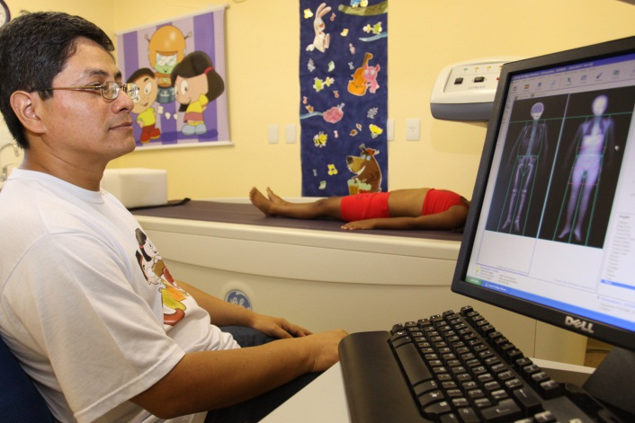

Slide 15
What has been measured? Early phases
Socioeconomic and demographic variables
Maternal characteristics
Pregnancy
Delivery
Mortality
Environmental characteristics
Health service utilization and morbidity
Nutrition
Child care
Maternal health
Psychosocial development

Slide 16
What has been measured? Late phases
Family situation
Schooling
Dietary habits
Smoking
Physical activity
Illicit drug use
Use of health services
Offspring
Weight
Standing and sitting height
Subscapular and triceps skinfold
Body composition (bioimpedance)
Waist circumference
Blood pressure
Blood lipids
C reactive protein

Slide 17
Measurements – (2012)
Body composition – 4 compartments model
Intima media thickness
Visceral fat
Bone mineral density - DXA
Peak flow velocity
IQ
Depression

Slide 18
Challenges and strategies

Slide 19
1983 visit
Visit to addresses obtained in hospital
Losses: 21 %
Address did not exist
Family was not known in the address
Moved
We had gathered information on the mother’s name and family address

Slide 20
What we did
We tried to find any information on the family address
Neighbours
Electric Power Company
Department store

Slide 21
1984
New follow-up strategies
Census in the urban area
70,000 households were visited
In search of children born in 1982
Linkage of datasets
Perinatal study
Census

Slide 22
Fuzzy logic - Manual
Hospital
Date of birth
Maternal name

Slide 23
Losses to follow-up

Slide 24
5914 livebirths
490 losses in
1984 and 1986
233 deaths
266 -
1986
449 -
1984
4476 evaluated in
1984 e 1986

Slide 25
Losses – The return
2004
Census - identified only 52% of the cohort members

Slide 26
Other strategies
Visit to the last address
SINASC – National Birth Registration Service
Army recruitment Office
University and Middle Schools
Electoral register

Slide 27
Challenge
Lack of Funding
Precluded regular visits
Followed a sampling fraction of the cohort
930 subjects were followed in 1984, 1986, 1997 e 2001.

Slide 28
Visits – 4 cohorts
 | 82 | 83 | 84 | 85 | 86 | 87 | 88 | 89 | 90 | 91 | 92 | 93 | 94 | 95 | 96 | 97 | 98 | 99 | 00 | 01 | 02 | 03 | 04 | 05 | 06 | 07 | 08 | 09 | 10 | 11 | 12 | 13 | 14 | 15 | 16 | 17
1982 |  | ● |  |  |  |  |  |  |  |  |  |  |  | ● |  | ● |  |  |  | ●
1993 |  |  |  |  |  |  |  |  |  |  |  |  | ● |  |  |  | ●
2004
2015
● 1,3, 6 and 12 months
3 and 12 months
● Sample

