Slide 1
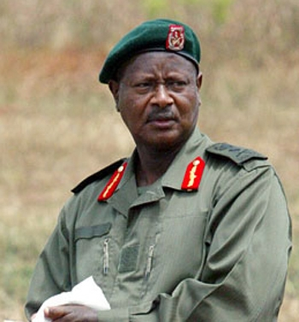
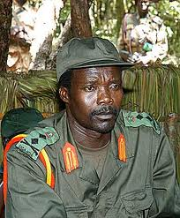
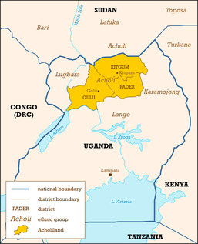
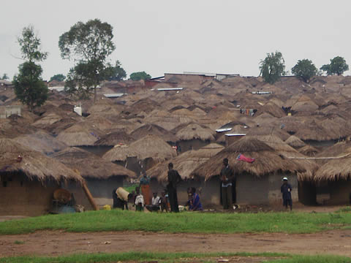
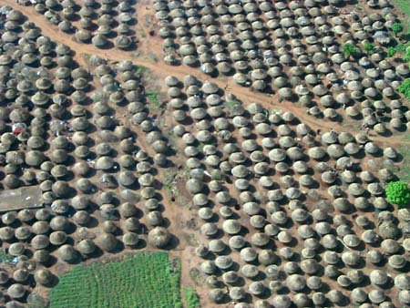
DATA COLLECTION IN ZONES OF VIOLENCE AND ARMED CONFLICT: Gulu, northern Uganda
Colette Harris, SOAS
ESRC Methods Festival 5- 7 July University of Bath Panel Session Wednesday 6 July 9.15-10.45

Slide 2
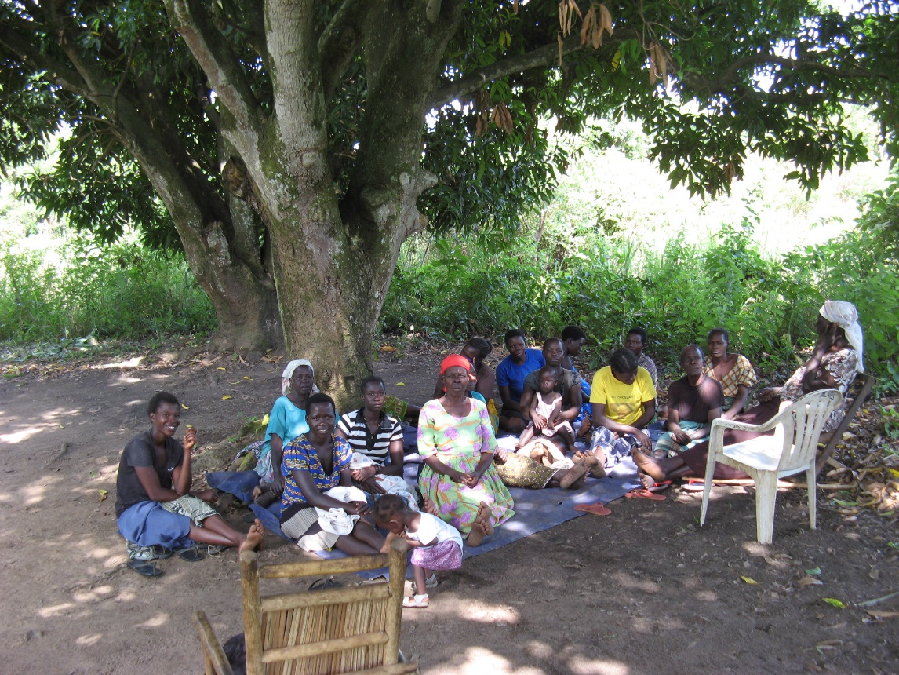
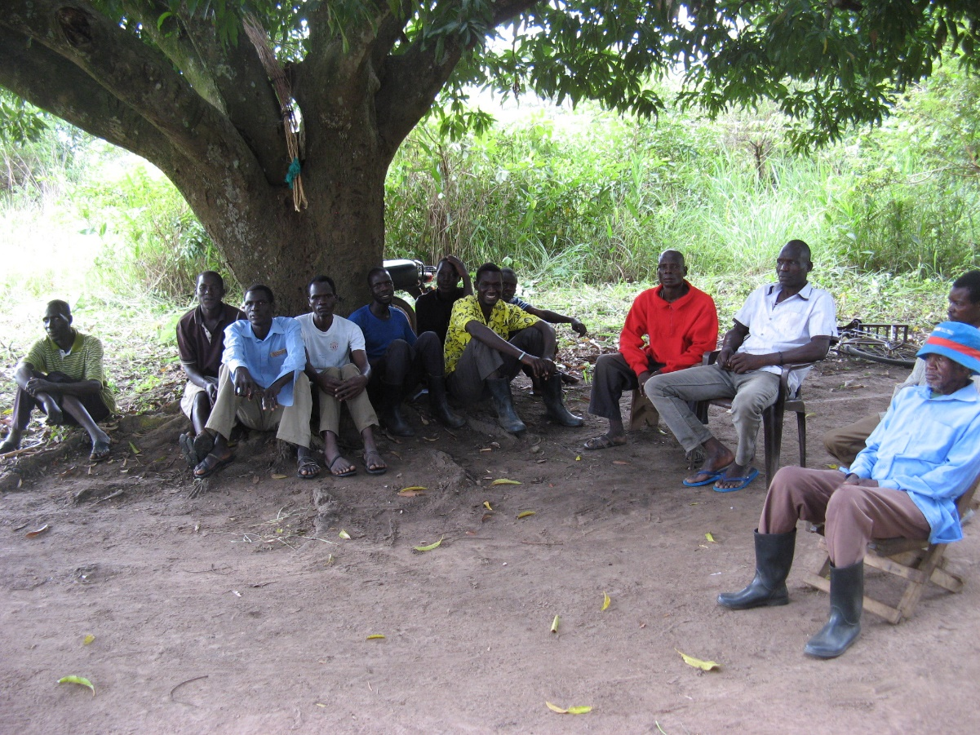
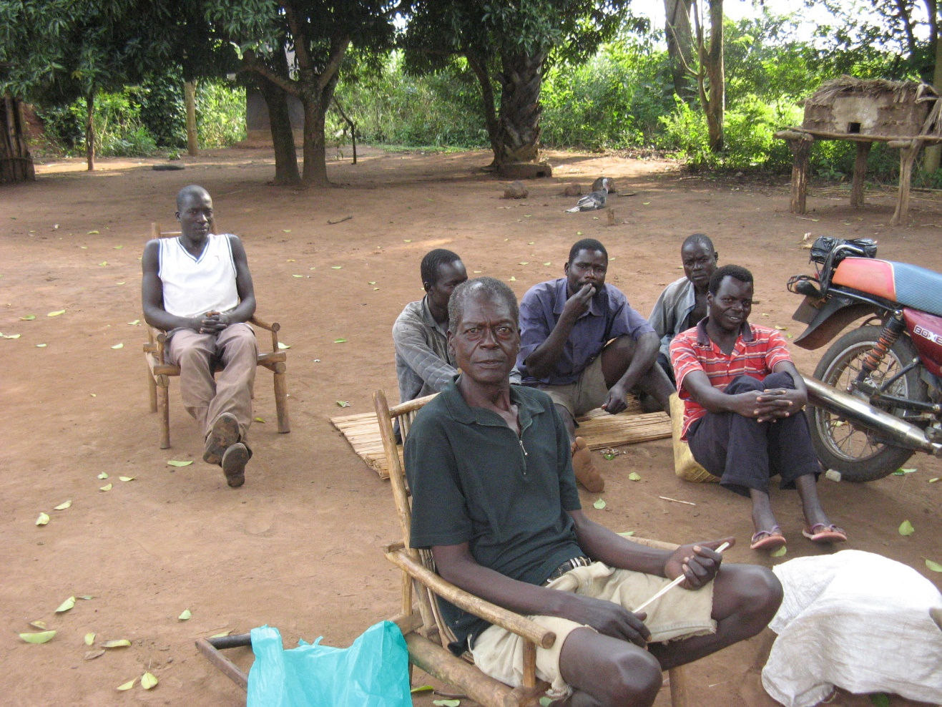

Slide 3
Harris, Colette (2014) The use of participatory gender analysis for violence reduction in (post-)conflict settings: a study of a community education project in northern Uganda, in Vasilikie Demos and Marcia Segal (eds.) Advances in Gender Research, vol. 18B, Bingley: Emerald Group Publishing, 143-168.

