Slide 1
The hierarchies of age-period-cohort research
Political context and the development of generational turnout patterns
Dr Kaat Smets (Royal Holloway, University of London)
Dr Anja Neundorf (University of Nottingham)
Department of Politics and International Relations
Prepared for presentation at the ESRC Research Methods Festival
7 July 2016

Slide 2
Introduction
Two central questions in APC research:
How to disentangle age, period and cohort (APC) effects?
A=P-C
What is it about age, birth date, or period of observation that influences our outcome of interest?
Hierarchical Age-Period-Cohort Models (HACP)
Notes:
Two central questions in APC analysis:
The question of how to disentangle age, period and cohort (APC) effects is the central theme of cohort analysis that has challenged researchers for decades (Mason et al., 1973; Riley, 1973; Glenn, 1976, 2005).
Age, birth date and period of observation are normally used as surrogates for unspecified and unmeasured variables of ultimate theoretical concern. From the beginning, critics of cohort analysis (e.g., Markus, 1983) pointed out that the true challenge of APC research was not reparameterization, but identifying substantive variables that operationalized the various effects.

Slide 3
Hierarchical Age-Period-Cohort Models
Hierarchical Age-Period-Cohort (HAPC) Models:
Use repeated cross-sectional data.
Treat individuals as nested in cohorts and in periods.
Treat age as a fixed effect, and cohorts and periods as random effects.
The random effects for periods and cohorts are used to estimate variance in the dependent variable across these two dimensions isolated from any effects of age.
The variance is then explained away through the inclusion of explanatory variables.
Notes:
The use of hierarchical modelling in combination with repeated cross-sectional surveys as such avoids the APC identification problem as linear fixed effects are estimated for one out of three components only (Harding, 2009, 1450). Implementing this method, we thus leave the debate of identification behind us and focus on the issue of actually testing whether substantively interesting factors can account for any observed cohort heterogeneity.

Slide 4
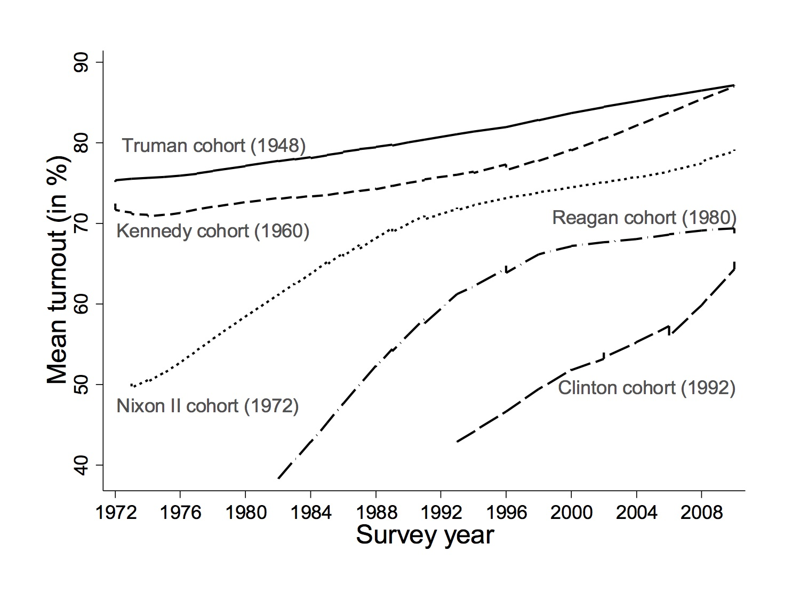
Application: Generational turnout patterns
Notes:
What explains generational turnout differences?

Slide 5
Project background
Political context and generational turnout levels
Political socialization: importance of impressionable/ formative years for the development of political attitudes and behaviour.
Political learning: citizens learn the habit of voting or abstention in the early stages of their adult life, past behaviour predicts future behaviour.
The cause of repeated behaviour: reactions to the character of elections by incoming cohorts.

Slide 6
Research focus
Political context and generational turnout levels
Hypothesis: Citizens coming of age in a highly-politicized context have a higher propensity to establish a habit of turnout.
Length of exposure: How long do cohorts need to be exposed to the political context before a generational learning effect sets in?

Slide 7
HAPC Models
Hierarchical Age-Period-Cohort (HACP) models
Yang et al. (2006, 2008) propose to think of repeated cross-sectional data as having a hierarchical structure.
Individuals are nested in cohorts and survey years → cross-classification.
Random intercept effects are used to estimate variance in the dependent variable.
Factors of theoretical interest can be modelled to explain this variance.
Notes:
Yang et al. propose to think of repeated cross- sectional data as having a hierarchical structure whereby individuals sharing the same context are nested in cohorts and periods. While age is thought of as a fixed attribute, period and cohort effects are considered higher-level variables that are allowed to vary randomly. The random effects for periods and cohorts are used to estimate variance in the dependent variable across these two dimensions isolated from any effects of age. The use of hierarchical modelling in combination with repeated cross-sectional surveys as such avoids the APC identification problem as linear fixed effects are estimated for one out of three components only (Harding, 2009, 1450).
Statistical developments now allow shifting focus to the more substantial question of identi- fying factors that can explain intercohort heterogeneity rather than attempting to juggle the intricacies of the identification problem.
Implementing this method, we thus leave the debate of identification behind us and focus on the issue of actually testing whether substantively interesting factors can account for any observed cohort heterogeneity.

Slide 8
What and how: a recap
Question: What explains generational differences in voter turnout?
Hypothesis: Citizens coming of age in a highly-politicized context have a higher propensity to establish a habit of turnout.
Method: Hierarchical Age-Period-Cohort analysis
Fixed attributes: Age
Random components: Periods and Cohorts -> to estimate the variance in the dependent variable across these two dimensions isolated from the effects of age
Notes:
Yang et al. propose to think of repeated cross- sectional data as having a hierarchical structure whereby individuals sharing the same context are nested in cohorts and periods. While age is thought of as a fixed attribute, period and cohort effects are considered higher-level variables that are allowed to vary randomly. The random effects for periods and cohorts are used to estimate variance in the dependent variable across these two dimensions isolated from any effects of age. The use of hierarchical modelling in combination with repeated cross-sectional surveys as such avoids the APC identification problem as linear fixed effects are estimated for one out of three components only (Harding, 2009, 1450).
Implementing this method, we thus leave the debate of identification behind us and focus on the issue of actually testing whether substantively interesting factors can account for any observed cohort heterogeneity.

Slide 9
Data
Data: US General Social Survey 1972-2010 (t=28)
Dependent variable: Self-reported turnout in the previous presidential election.

Slide 10
Independent variables
Explanatory factors
Cohort level (measured at first election):
aggregate turnout levels % VEP (+)
Average margin of the victory across all states (–)
Polarization (–)
Presidential approval rates (+/–)

Slide 11
Independent variables
Explanatory factors
Cohort level (measured at first election): aggregate turnout levels % VEP (+), average margin of the victory across all states (–), polarization (–), presidential approval rates (+/–)
Individual level (measured at survey year): age (+), age2 (–), female (+/–), white (+), marital status (+), attendance of religious services (+), employment status (+), strength of party identification (+)

Slide 12
Illustration of cohort measure
Indiv. | Year of survey | Age | Birth year | Legal voting age | First election | Presidential cohort
A | 1980 | 40 | 1940 | 21 | 1964 | Johnson
B | 1990 | 50 | 1940 | 21 | 1964 | Johnson
C | 1980 | 30 | 1950 | 21 | 1972 | Nixon II
D | 1990 | 36 | 1954 | 18 | 1972 | Nixon II
E | 2000 | 30 | 1970 | 18 | 1992 | Clinton I

Slide 13
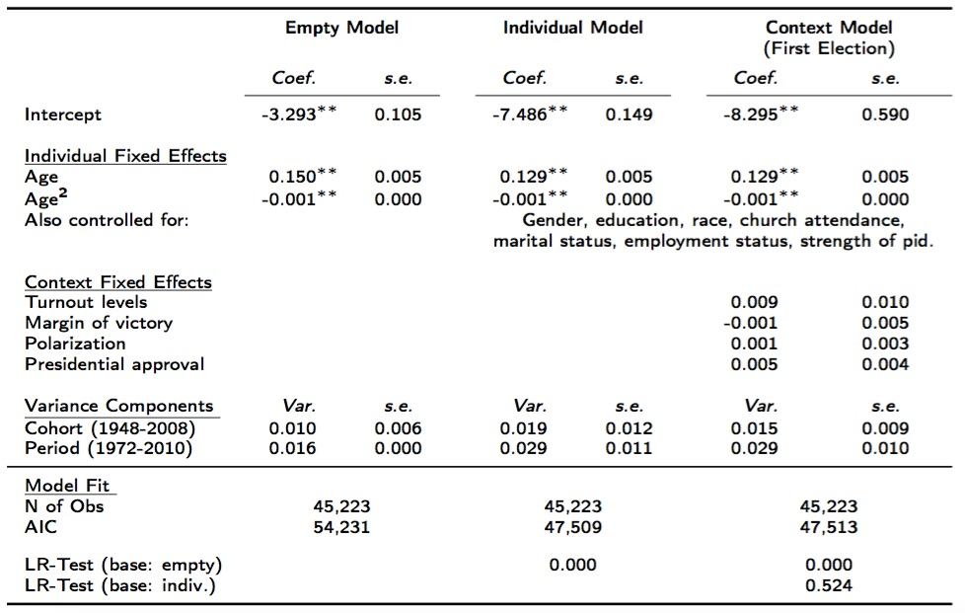
Results: HACP models and turnout

Slide 14
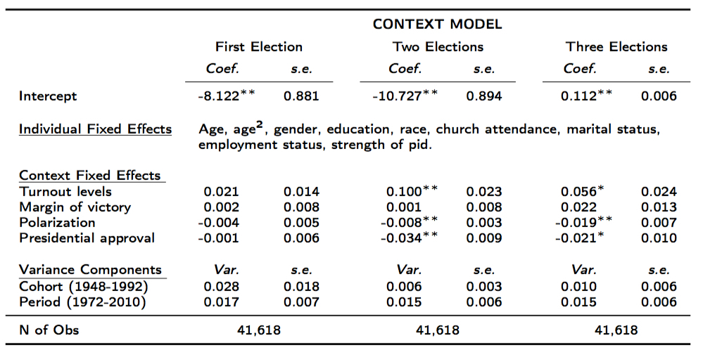
Results: Averaging context effects

Slide 15
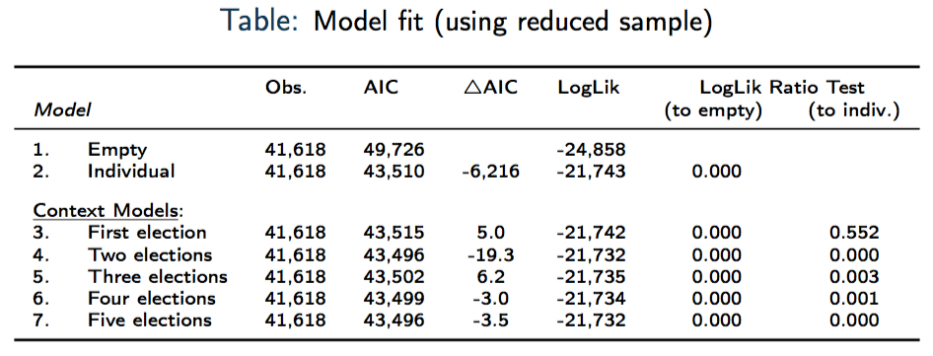
Results: Multiple elections and model fit

Slide 16
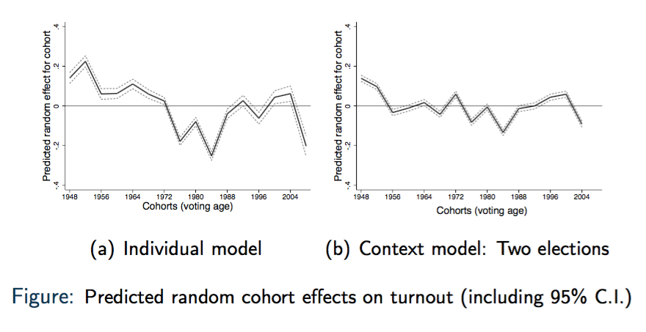
Results: Predicted random cohort effects

Slide 17
Conclusion
Substantial results:
Political context matters for generational turnout patterns
One election not sufficient to establish learning pattern
Averaging context over two elections gives best results
Large impact individual characteristics on generational turnout patterns
Methodological:
How HAPC models can be used for APC research

