Slide 1
The Hierarchical APC model: why does it find the results that it finds?
Research Methods Festival, Bath, July 2016
Dr Andrew Bell
Lecturer in Quantitative Social Sciences
@andrewjdbell
Andrew.j.d.bell@sheffield.ac.uk

Slide 2
Aim
Critique the HAPC model – demonstrate why the model finds the results that it does
Give advice for practitioners
Show how the debate has moved on since the talk I gave at RMF in Oxford 2 years ago!

Slide 3
What are APC effects? (Suzuki, 2012,452)
A: I can’t seem to shake off this tired feeling. Guess I’m just getting old. [Age effect]
B: Do you think it’s stress? Business is down this year, and you’ve let your fatigue build up. [Period effect]
A: Maybe. What about you?
B: Actually, I’m exhausted too! My body feels really heavy.
A: You’re kidding. You’re still young. I could work all day long when I was your age.
B: Oh, really?
A: Yeah, young people these days are quick to whine. We were not like that. [Cohort effect]

Slide 4
The APC identification problem
Age = Period – Cohort
“the term [confounded] is not used in the traditional design sense of experimentally confounded but in the stronger sense of logically or mathematically confounded” (Goldstein, 1979, 19)

Slide 5
Consider these DGPs
$$Health=(1∗Age)+(1∗Period)+(1∗Cohort)$$
$$Health=(2∗Age)+(2∗Cohort)$$
$$Health=\left(0∗Age\right)+(2∗Period)$$
All will produce exactly the same outcome variable
Given that dataset, there is no logical way of telling which DGP created it
Exact collinearity from putting all three into a regression model – model will not run.
Grouping of one of APC breaks this collinearity, but produces arbitrary results (that depend on the chosen grouping)

Slide 6
The Hierarchical APC model
Yang and Land 2006, 2013
Period
Cohort
Individual (Age)
Health = Intercept
+ Age linear trend + Age quadratic trend
+ Cohort residual
+ Period residual
+ individual residual

Slide 8
This is where we got to by RMF2014 (video is online)
http://www.ncrm.ac.uk/resources/video/RMF2014/filmed.php?id=76907cb
The debate has continued since then and follows a pattern of:
Critics of the HAPC model showing the model doesn’t work
Proponents coming up with a reason why that example is not relevant to real-life processes
Repeat

Slide 9
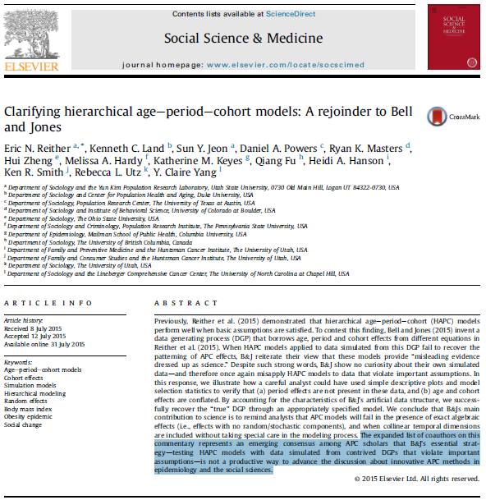

Slide 11
What is missing from this debate?
Simulations are in our view convincing in showing that the HAPC model doesn’t work
They have shown the HAPC model tends towards showing period trends and not cohort trends
But no-one has given an explanation as to why the HAPC model finds the results that it finds
That is what we will do here – using both simulations and real data

Slide 12
What I arguing here
It is the data structure that causes the results that we find, not any substantive processes
Repeated cross-sectional data (and panel data) is collected by years
As a result, cohorts will always span a wider range than periods

Slide 13
What we argue
Year
Age

Slide 14
What we argue
Year
Age

Slide 15
What we argue
Cohort
Age

Slide 16
What we argue
Cohort
Age

Slide 17
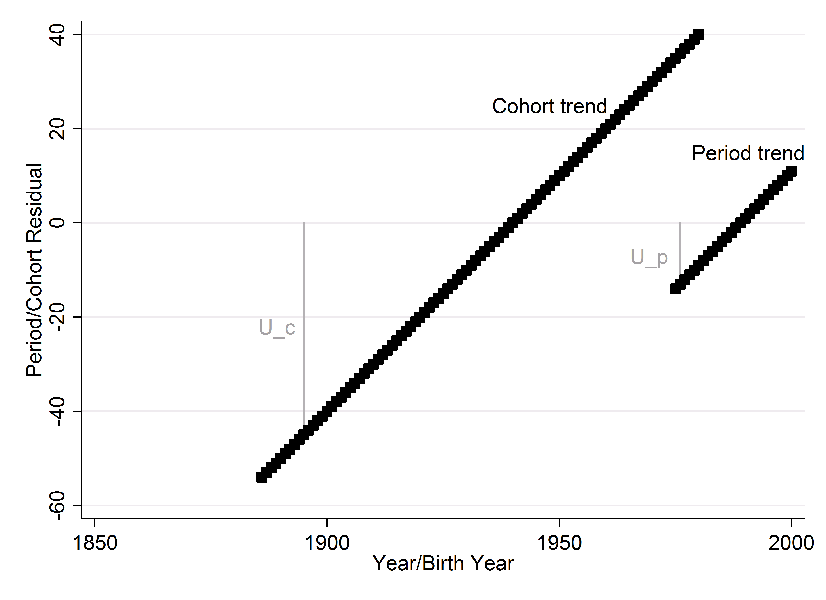
What we argue
Imagine a repeated cross sectional dataset of individuals sampled 1976-2002 (as Reither et al 2009)
What would a period or a cohort trend look like?

Slide 18
What we argue
Bigger residuals represent a bigger ‘penalty’ to the fit of the model
So the model will choose the less costly period trend

Slide 19
What we argue
Crucially
This has NOTHING to do with any substantive processes – it is to do with the data structure of repeated cross-sectional data that by necessity has a wider range of cohorts than periods.
We could collect data by birth cohorts instead of years, and we would get the opposite results

Slide 20
What we argue
Cohort
Age

Slide 21
What we argue
Cohort
Age

Slide 22
Simulations
Truth:
Y = 1 + (0.1*Age) + (-0.005*Age²) + (-0.01*Year) + (-0.002*Year²) + u_{C} + u_{p} + e_{i}
Sample 1: people born 1930 and 1965 (age 20-60)
Sample 2: years 1990 to 2010 (age 20-60)

Slide 23
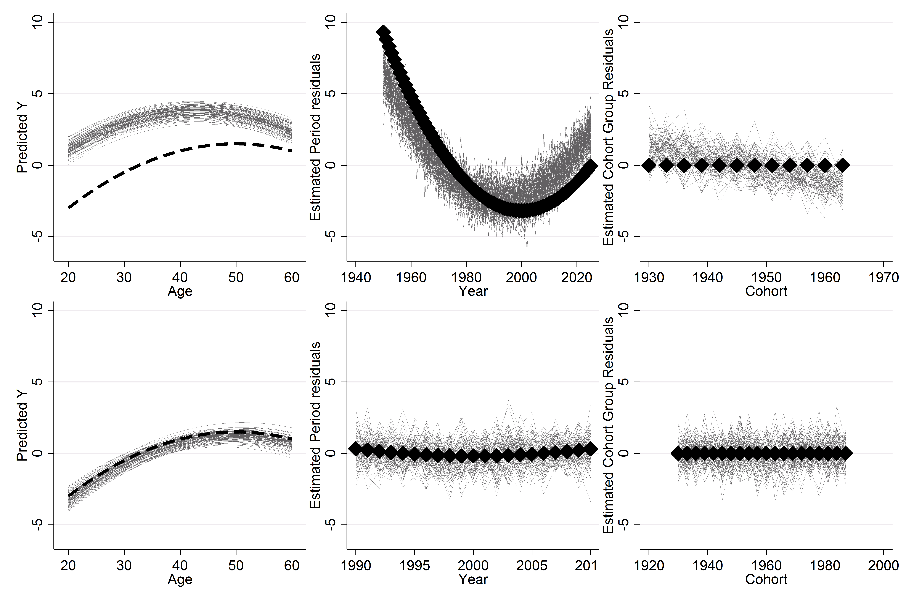
Simulations

Slide 24
Real data
This is more problematic to show with real data – collecting data by cohorts is expensive (a new cohort study every year)
But we can take samples from datasets to mimic those properties
Use NHIS data; response variable is obesity (same data as used by Reither et al 2009)

Slide 25
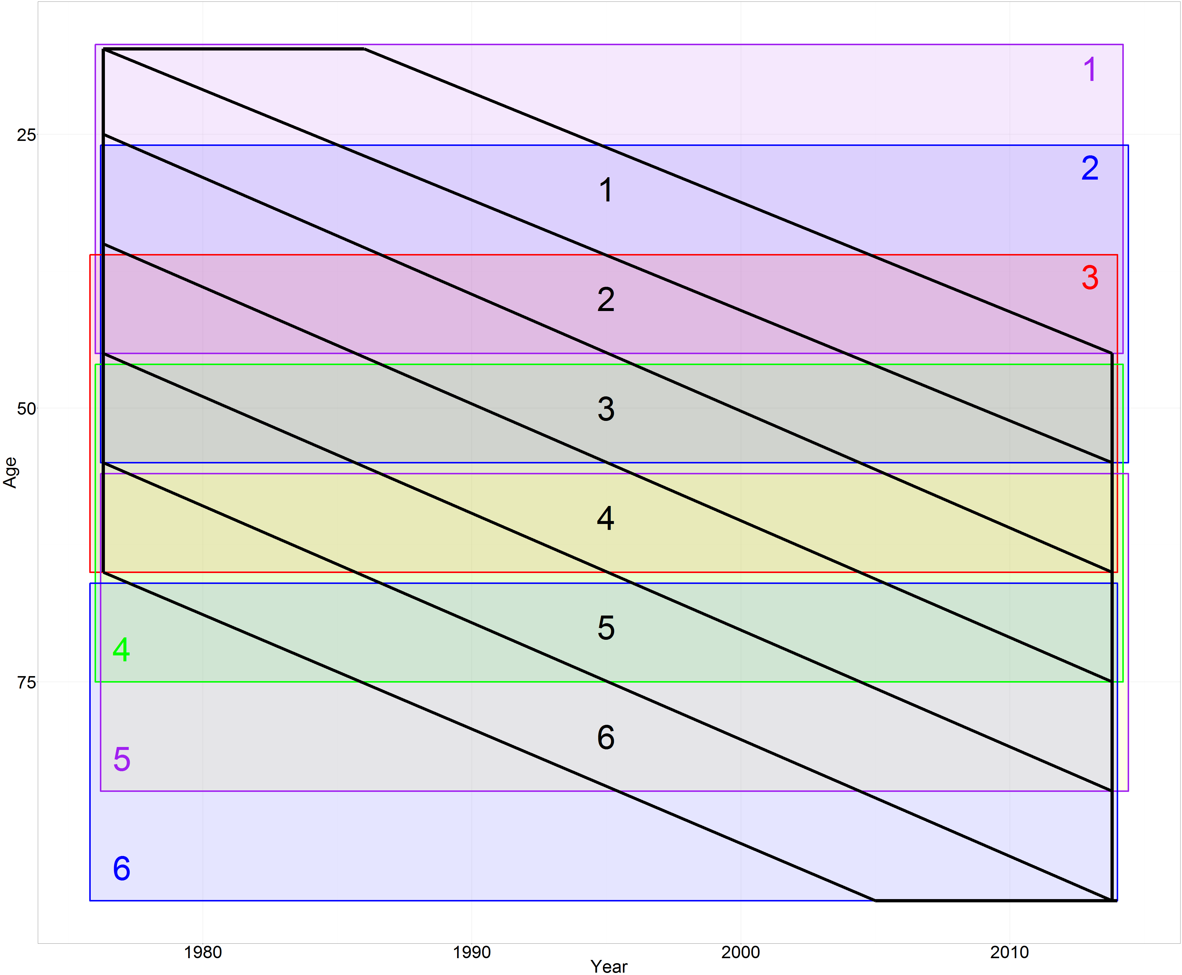
Real data
This is more problematic to show with real data – collecting data by cohorts is expensive
But we can take samples from datasets to mimic those properties

Slide 26
Cohort
Age

Slide 27
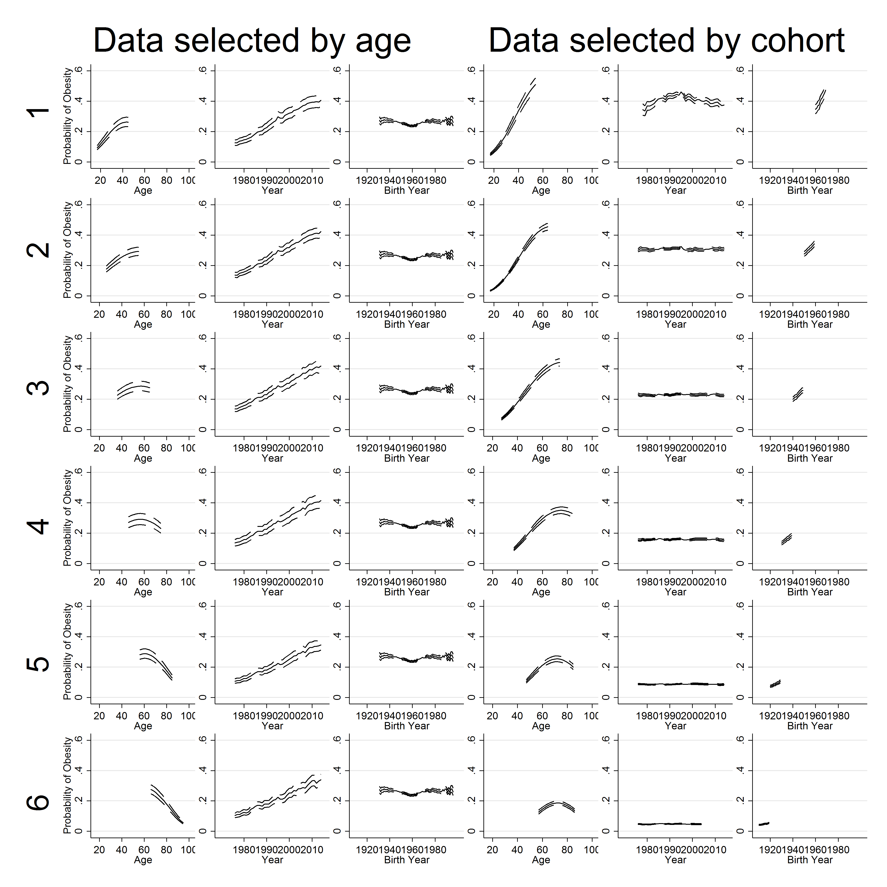
Real data

Slide 28
Real data
When there are more periods than cohorts, the trend goes to cohorts
When there are more cohorts than periods, the trend goes to periods
In neither case is there a substantive reason why this difference would occur, except for the data structure
In other words, the HAPC model MUST be misapportioning trends in one of the scenarios.

Slide 29
What should we do
What the HAPC model can do:
Works when there are no linear period and cohort effects
Works when you constrain one linear effect to a value (often zero)
NB need to think carefully about what counts as a linear effect

Slide 30
What should we do
So, need to use theory to make an assumption
Include cohort in fixed part; assume periods are trendless
Include period in fixed part; assume cohorts are trendless
Constrain the age coefficient to a value
Produce a ‘community of priors’ and argue which combination is most plausible

Slide 31
What should we do
Alternatively, only look at non-linear effects
Note, this is not a solution since the linear effects will often be the important part.
Restricts analysis to ‘bumps’

Slide 32
Conclusions
You can’t empirically separate linear APC effects mechanically
But you can if make assumptions, justified by theory
It is important to do this whenever you are interested in any of APC, and make those assumptions explicit so they can be challenged.

Slide 33
References – SS&M debate
Reither, E.N., Hauser, R.M. & Yang, Y., 2009. Do birth cohorts matter? Age-period-cohort analyses of the obesity epidemic in the United States. Social Science & Medicine, 69(10), pp.1439–1448.
Bell, A and Jones, K (2014) Don’t birth cohorts matter? A commentary and simulation exercise of Reither, Hauser and Yang’s age-period-cohort study of obesity. Social Science and Medicine, 101, 176-180.
Reither, E.N., Masters, R.K., et al., 2015. Should age-period-cohort studies return to the methodologies of the 1970s? Social Science & Medicine, 128, pp.356–365.
Bell, A. & Jones, K., 2015b. Should age-period-cohort analysts accept innovation without scrutiny? A response to Reither, Masters, Yang, Powers, Zheng, and Land. Social Science and Medicine, 128, pp.331–333.
Reither, E.N., Land, K.C., et al., 2015. Clarifying hierarchical age-period-cohort models: A rejoinder to Bell and Jones. Social science & medicine (1982), 145, pp.125–8.
Bell, A and Jone, K (2016) The Hierarchical Age-Period-Cohort model: why does it find the results that it finds? In preparation

Slide 34
References - others
Bell, A (2014) Life course and cohort trajectories of mental wellbeing in the UK, 1991- 2008 – a multilevel age-period-cohort analysis. Social Science and Medicine, 120, 21-30.
Bell, A and Jones, K (2014) Another futile quest? A simulation study of Yang and Land’s Hierarchical age-period-cohort model. Demographic Research, 30, 11, 333-360.
Bell, A and Jones, K (2013) The impossibility of separating age, period and cohort effects. Social Science and Medicine, 93, 163-165.
Bell, A and Jones, K (2015) Bayesian informative priors with Yang and Land’s Hierarchical age-period-cohort model. Quality and Quantity, 49: 255-266
For constraining parameters to something other than zero
Bell, A and Jones, K (2015) Age, period and cohort processes in longitudinal and life course analysis: a multilevel perspective. In A life course perspective on health trajectories and transitions, edited by Claudine Burton-Jeangros, Stéphane Cullati, Amanda Sacker and David Blane. Springer.
Luo, L. & Hodges, J.S., 2015. Block Constraints in Age-Period-Cohort Models with Unequal-width Intervals. Sociological Methods & Research.
Yang, Y. & Land, K.C., 2006. A mixed models approach to the age-period-cohort analysis of repeated cross-section surveys, with an application to data on trends in verbal test scores. Sociological Methodology, 36, pp.75–97.
Yang, Y. & Land, K.C., 2013. Age-Period-Cohort Analysis: New models, methods, and empirical applications, Boca Raton, FL: CRC Press.
Tweet @andrewjdbell
Email andrew.j.d.bell@sheffield.ac.uk

