Slide 1
Teaching quantitative methods: Expert practitioners talk about pedagogy
Prof Melanie Nind
Dr Sarah Lewthwaite

Slide 2
The Pedagogy of Methodological Learning Project
How are advanced social science research methods taught and learned?
Research Aims:
Develop the pedagogical culture & pedagogical content knowledge for social science research methods teaching
Create a typology of pedagogical approaches for social science research methods teaching
Generate a coherent theoretical framework for social science research methods teaching

Slide 3
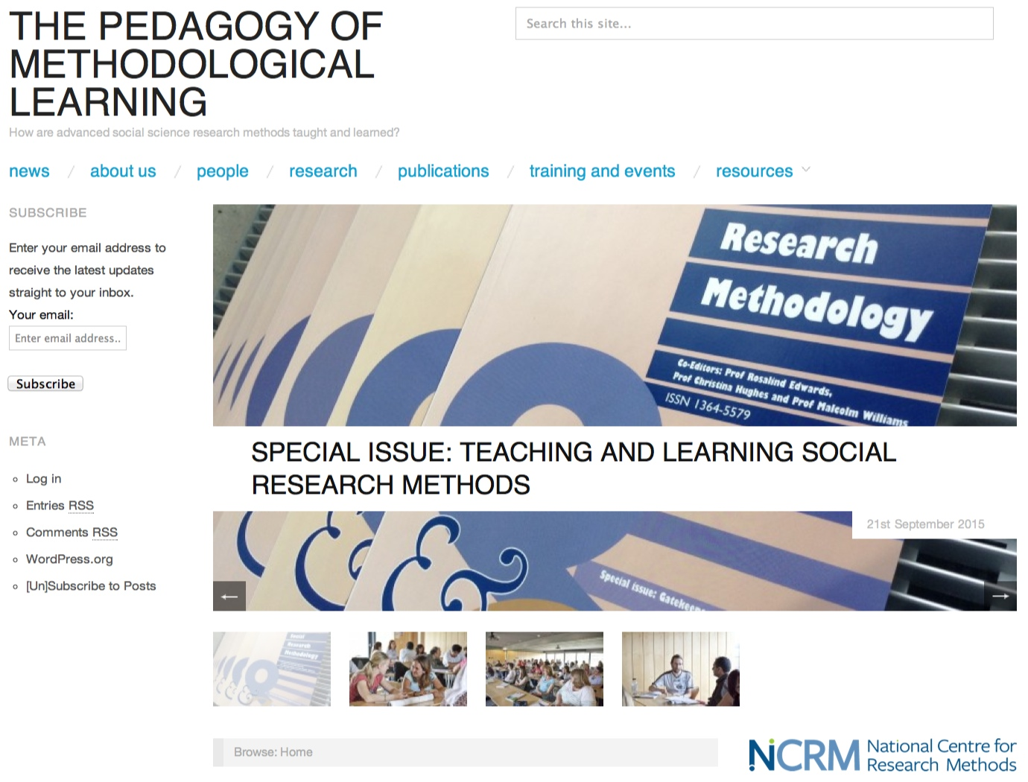
http://pedagogy.ncrm.ac.uk

Slide 4
Teachers’ knowledge (Shulman)
Knowledge of curricula, learners, educational needs and ends
Knowledge of content to be taught & learned
General pedagogical knowledge (‘those broad principles and strategies of classroom management and organization that appear to transcend subject matter’ (Shulman 1987: 8)
But key for us = Pedagogical Content Knowledge (PCK) - pedagogical knowledge specific to the subject matter

Slide 5
Pedagogic Content Knowledge (PCK)
e.g. how to powerfully represent ideas, which analogies and examples are effective, what makes grasp of specific topics easier etc.
‘craft knowledge’ - practical wisdom that interacts with (rather than opposes) theoretical knowledge
PCK is tacit, practical & situated
So, for researchers it is ‘hard to know’ (Nind et al. in press)
But we need to ‘attempt to surpass the idiosyncratic level of individual narratives’ (van Driel et al.1998: 674) to build pedagogic culture & share PCK

Slide 6
‘I want a space where I can talk more about my own pedagogical challenges, I want to reflect on them with a group of people that share this with me, and I want to share resources, I want to share new ideas, to continue to foster a kind of interdisciplinary pedagogical culture.’
Sharlene Hesse-Biber

Slide 7
So…
What PCK do social science research methods teacher ‘experts’ have that we can bring together and learn from?

Slide 8
Expert panel interviews
John Creswell
Sharlene Hesse-Biber
Richard Rogers
Max Bergman
Paul Vogt
Andrew Gelman
Yvonna Lincoln
Cesar Cisneros-Puebla
Johnny Saldana
Anne Porter
Bagele Chilisa
Pat Bazeley
Chris Wild

Slide 9
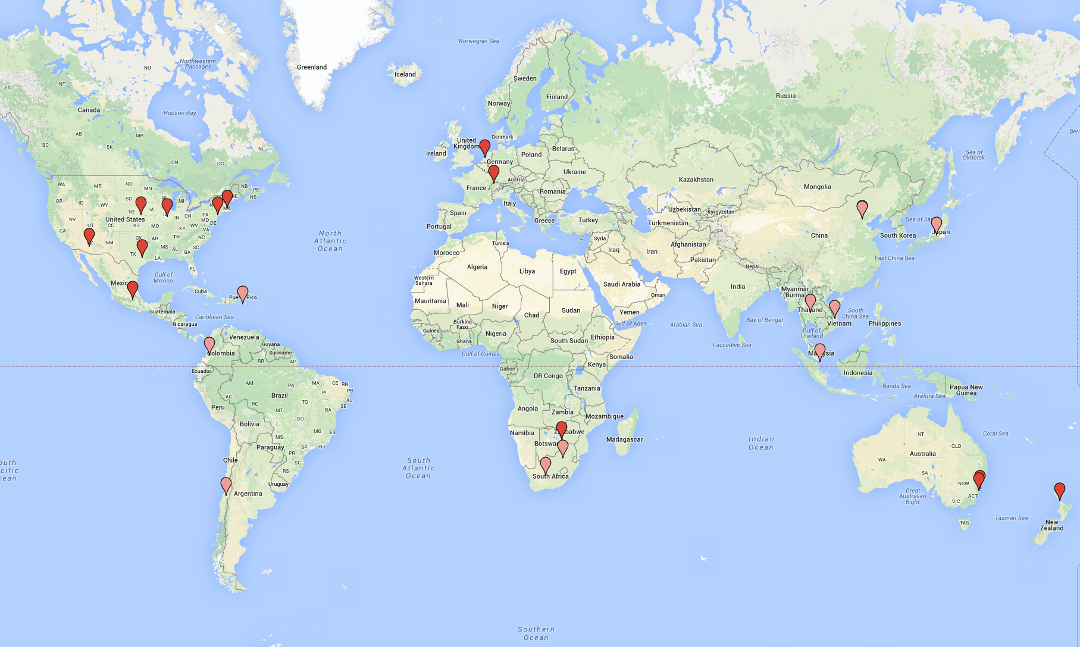
Locations of expert panelists

Slide 10
Themes for discussion
The roots of our pedagogic approaches
Our pedagogic starting points or hooks
Pedagogic resources and the associated PCK
Pedagogic challenges
The teacher as learner
Pedagogic culture

Slide 11
Pedagogic Approaches
Student centred pedagogy in quantitative methods teaching:
Fearful learners
Unprepared learners
Unprepared teachers
Difficulty of content

Slide 12
Verbal approaches
‘you need to report on these different things about the structure of the data and what you see. It has to be in statistical terms and it has to be in lay people language as well’
Anne Porter
‘students in a field like psychology are coming in because they need statistics … it’s like it’s a foreign language you need to speak, otherwise they can’t design their experiments’
Andrew Gelman

Slide 13
W. Paul Vogt:
‘we tried to find non-technical, verbal ways of teaching research methods, so teaching regression analysis in terms of the questions that people doing regression analysis would be trying to answer, and teaching that in a class or two, and then having people read real research output and teaching them how to read it.’
‘I taught them [students] how to read the research, what it meant. It was more like teaching a foreign language than it was like teaching statistics; then took them to the lab, gave on hands-on experience, how to do it, and that was possible - especially with user-friendly software like SPSS.’

Slide 14
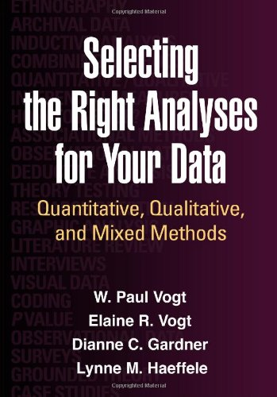
W. Paul Vogt

Slide 15
Visual Approaches
‘My main interest is in making it easier for people to see things and then being able to see data-related things quicker’
‘first try to get people to a realisation that data can tell you something interesting’ ‘when their spark has been ignited then go back and talk about things more holistically’.
‘try to approach everything through things you can see, or metaphors which are often largely visual, and then backfill that with more technical things later if you need to.’
Chris Wild

Slide 16
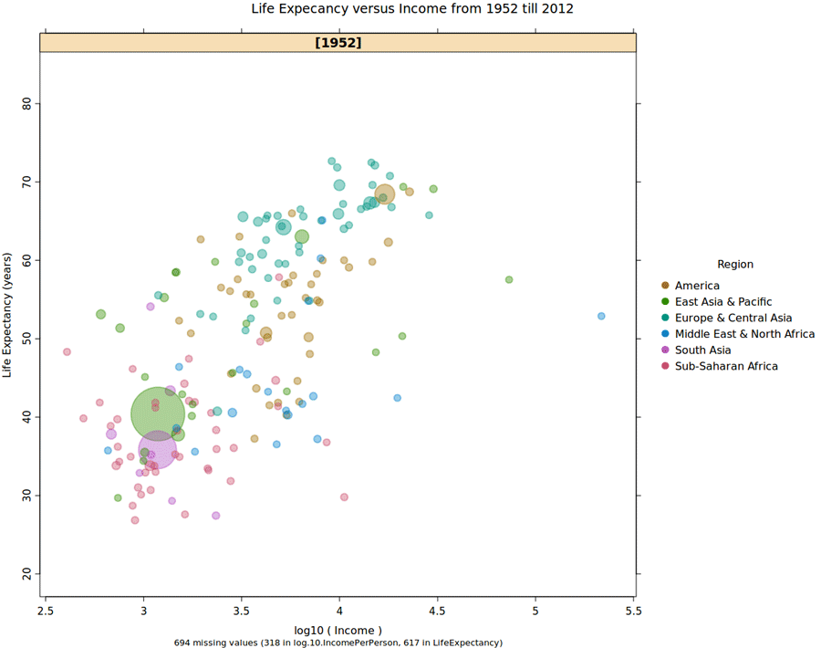
iNZight https://www.stat.auckland.ac.nz/~wild/iNZight/index.php
‘A data analysis system with a particularly short learning curve’
Chris Wild

Slide 17
Conceptual Pathways
Creating… ‘a minimal conceptual pathway, of trying to look at an idea, and trying to come up with a map for sets of, for the absolute minimum sets of concepts you need to get your head around something’
Chris Wild

Slide 18
Implications:
Reflexivity on standpoints
‘knowing not only your own standpoint as a researcher but where your students can understand their own standpoint, where are they coming form, and how does their thinking evolve over time’
Sharlene Hesse-Biber

Slide 19
Reflections:
Student centred: how implicit or explicit is the student centred-ness of these pedagogic approaches?
Is this about the student, or the student in a given context?
Innovative?? Are these approaches common to other aspects of teaching in statistics and quantitative methods?

Slide 20
References
Nind, M., Curtin, A. & Hall, K. (in press) Research Methods for Pedagogy. London: Bloomsbury.
Shulman, L. (1987). ‘Knowledge and teaching: Foundations of the new reform’. Harvard Educational Review, 57(1), 1–23.
van Driel, J. H., Verloop, N., & de Vos, W. (1998). ‘Developing science teachers’ pedagogical content knowledge’. Journal of Research in Science Teaching, 35, 673–695.

Slide 21
Resources
http://pedagogy.ncrm.ac.uk
Lewthwaite, S. & Nind, M. Let’s talk about pedagogy, MethodsNews Spring 2015, p.1 http://eprints.ncrm.ac.uk/3754/
Teaching advanced research methods - NCRM quick start guide http://eprints.ncrm.ac.uk/3746/
IJSRM special issue: http://www.tandfonline.com/toc/tsrm20/18/5

Slide 22
Contact:
Sarah Lewthwaite: s.e.lewthwaite@Southampton.ac.uk
Melanie Nind:
m.a.nind@Southampton.ac.uk

