Slide 1
Just ‘transferring online’? Valuing COVID-19 methodologies
Poppy Gerrard-Abbott
PhD Sociology
University of Edinburgh

Slide 2
Sailing the ship in stormy waters
A microscope to inequality
Whose knowledge, what path?
Isn’t all research for the sake of change?

Slide 3
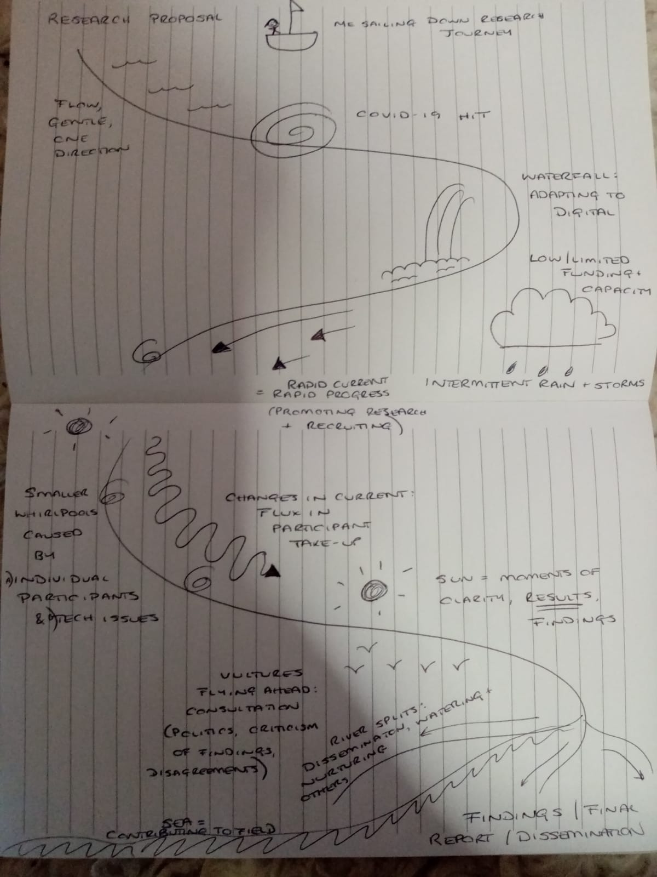

Slide 4
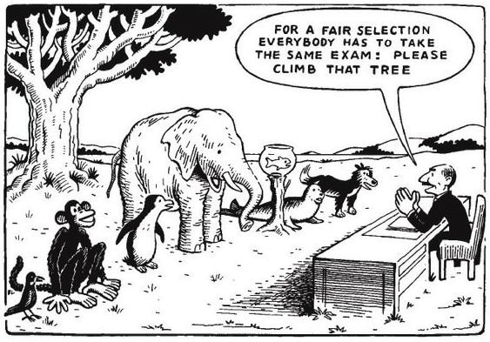
Below: cartoon by Micah Russell on the education system, 2012

Slide 5
Below: one of many Trafalgar Square anti-lockdown protests The Guardian, September 2020

Slide 6
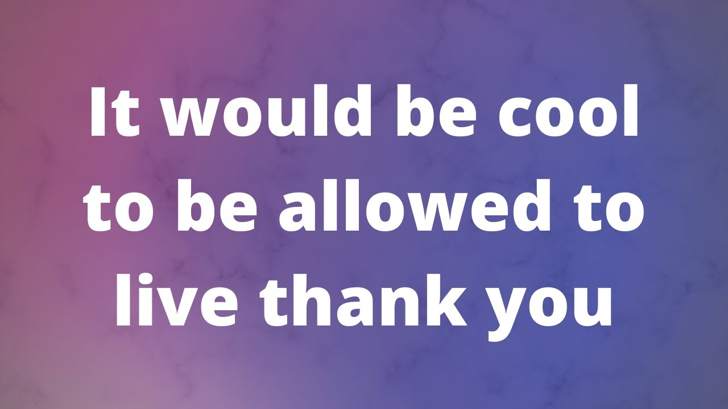
Below: thumbnail of Youtube video ‘Disability and Capitalism’ by vlogger Leslie Exp, April 2020

Slide 7
Below: screenshot of Powerpoint slide from ‘feminist approaches to research’ lecture, Jan 2021

