Slide 1
Show me the data: research reproducibility for qualitative methods
Louise Corti
Director, Collections Development and Data Publishing
NCRM Research Methods Festival
University of Bath
Thursday 5th July, 11:15 - 12:45

Slide 2
Session Tweeting
#RMF18
#reproducibility
#qualidata
#IDocumentMyData
@UKDSRDM

Slide 3
Today’s debate
In quantitative methods, reproducibility is held as the gold standard for demonstrating research integrity
Threats to scientific integrity, such as fabrication of data and results have led to some journals now requiring data, syntax and prior registration of hypotheses to be made available as part of the peer-review
The ‘reproducibility’ of qualitative research has been questioned but has also been protected from the recent transparency agenda. But for how long?
What if journals begin to mandate the sharing of data and analysis for qualitative research?

Slide 4
International transparency agenda
Increasing drive for openness and sharing – value and transparency
Funders, Professional Societies and Journals driving open research mandates
Data sharing: RCUK Common Principles on Data Policy
UK Parliamentary Science and Technology Committee Inquiry on Research Integrity - so-called 'crisis in reproducibility' of research

Slide 5
But, a slight terminology crisis
Open research
Open science
Open access
Open data
Open Research ≠ Open Data

Slide 6
Integrity
Transparency
Reproducibility
Verification
Replication
Restudy
Follow-up

Slide 7
Replication and process transparency
Much fieldwork is impossible to fully replicate
But, we can better expose methods/process transparency
What evidence /documents can help provide this?
What is the qualitative equivalent of code/syntax?
Surely depends on the level of ‘immersivity’
Can we respond to questions around ‘quality’ of qualitative research’ more positively by better showing methods and data? Or not?

Slide 8
Advocating methods /data sharing benefits
Fundamental in collaborative and multi-stakeholder projects
Extend voices of participants
Make best use of hard-to-obtain data, e.g. elites, socially excluded, over-researched
Not burden over-researched, vulnerable groups
Provide greater ‘research transparency’
In each, ethical duties to participants,
peers and public may be present

Slide 9
Documenting Methods and Data
Documentation of method
Described method in articles, often highly sanitized; unlikely to be fully transparent
Raw and derived data in qualitative research
What counts as ‘data’?
What is ‘replication data’ – a ‘subset’ of whole data?
Ethical issues in exposing data
Time and cost to prepare, often not planned well

Slide 10
Providing research context – through data?
Research Data Policy in place in UK since 1995
People share what they feel they ‘can’ share
Hard to see exactly what data were created, what methods were used and what fieldwork represented the research
Evidence base: 1000 qualitative data collections shared
Context debate about reusing data in sociology dating back to 1995 (UK Qualidata). Literature
Guidance on how to ‘do’ context
Lots to learn from historians on methods for assessing provenance and assessing value of a data collection

Slide 11
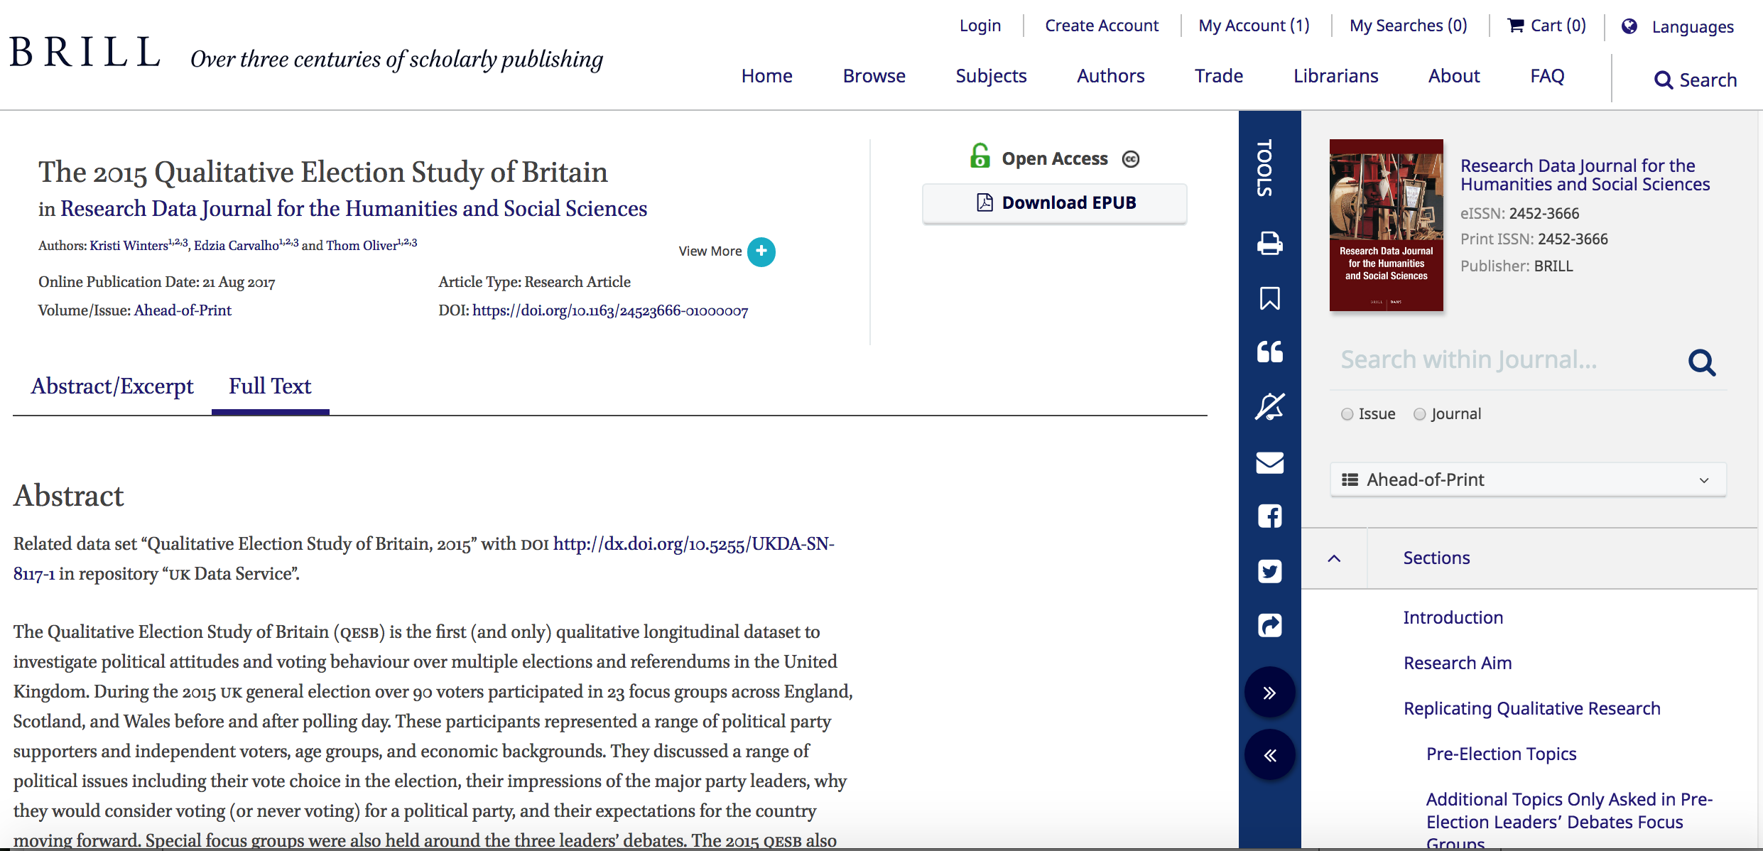
The Data Paper
Provides a good link between a published paper and underlying data sources and the methods narrative

Slide 12
‘Analytic’ transparency
Linking a claim to a data source(s)
Annotation for Transparency Initiative (ATI))
‘facilitates transparency in qualitative research by allowing scholars to ‘annotate’ specific passages in an article. Annotations amplify the text and include a link to one or more data sources underlying a claim; data sources are housed in a repository
A challenge for qualitative research
not simple running code
assumptions about the sources (e.g. historical memo)
But, a slippery slope?…

Slide 13
We are here to debate ‘reproducibility’ approaches, issues, and what standards for ‘process transparency’ might look like for qualitative research

Slide 14
Questions
How can we respond positively to transparency calls?
What is the ‘evidence’ and where should it sit?
What are some of the issues and challenges?
How do publishing outlets – journals and data archives work together to solve this?
What advocacy and training do we need and when should it start?

Slide 15
Our speakers today
Dr. Nicole Janz, Assistant Professor in International Relations, The University of Nottingham @polscireplicate
Learning how to do research reproducibility in political science
Prof. Sarah Nettleton, Department of Sociology, University of York
Crisis what Crisis? Can qualitative data archiving enhance transparency?
Maureen Haaker, Senior User Support Officer, UK Data Service @mahaake
Some practical protocols for transparency for qualitative research

