Slide 1
Data Journeys: Capturing the socio-material constitution of data objects and flows Jo Bates Information school University of Sheffield
Notes:
1

Slide 2
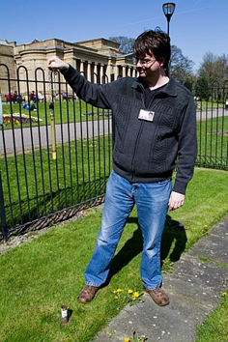
Data Journeys: motivations
2012/13 Data Hype: Big data, open data, data = oil….
A lot of the discourse - celebratory, not very critical – notable exceptions e.g. Gitelman, Bowker “Raw Data is an Oxymoron”
Data Journeys
How to make sense of…
…. the diverse and complex socio-material forces that shape how data objects are produced and how they move between different sites of practice, and
…. the ways in which data flows across space and time bring people & objects into new forms of relation with one another.

Slide 3
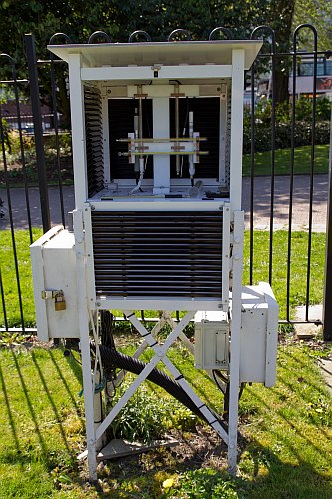
The Secret Life of a Weather Datum
AHRC funded project (Jan 2014 – March 2015) – Jo Bates and Paula Goodale (Sheffield) & Yuwei Lin (University for the Creative Arts)
Piloted “data journeys” methodology to explore socio-material life of data objects/flows
Research Questions:
The ‘journey’ of weather data from production to re-use as ‘big’ weather data in science & markets
Socio-cultural values and practices shaping, and being shaped by, production, distribution and (re)use of data over course of journey
Institutional and government policies and legislation shaping distribution of data
Communicating complexity of these socio-material dynamics to a wider audience.
Notes:
3

Slide 4
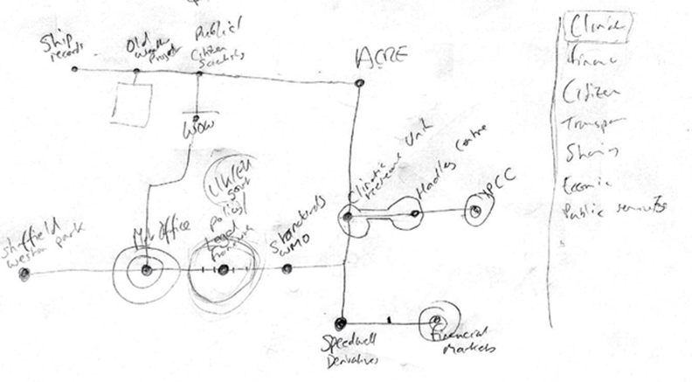
Following the data
Researcher journeys with the data – a traveller through the infrastructure.
RQ1: Mapping the journey of the data
Identifying what data to follow
Mapping data flows & sites of practice
Identifying sites for data collection
Iterative process
Initial design for interactive website
Notes:
4

Slide 5
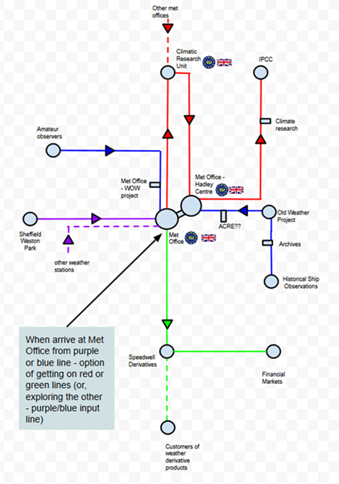
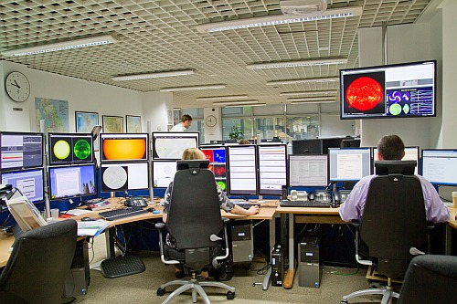
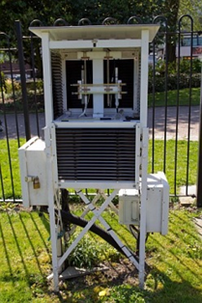
RQ2: Socio-cultural values & practices
RQ3: Policy & legislation
At each ‘station’ - interviews, observations, documents. Thematic analysis.
4 cases: local weather stations (purple), citizen science/amateur observation (blue), climate science (red), financial markets (green) UK Met Office as a central site of practice
Notes:
5

Slide 6
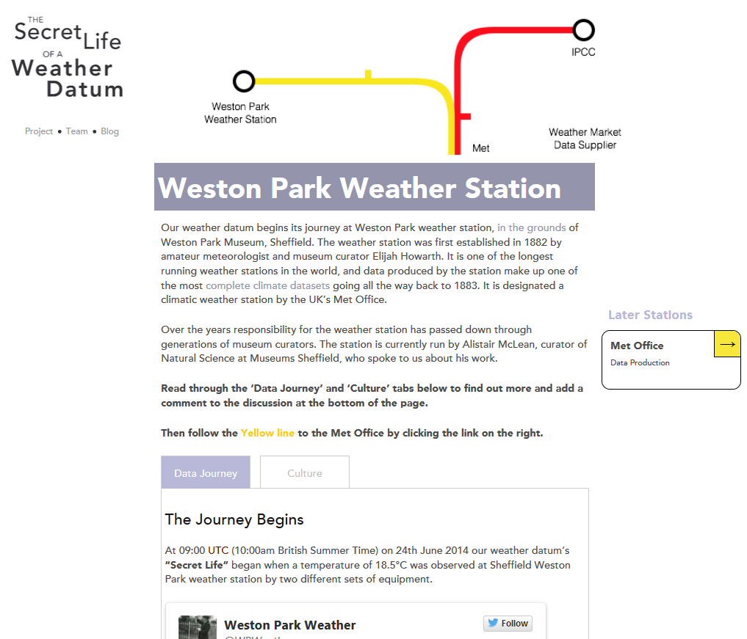
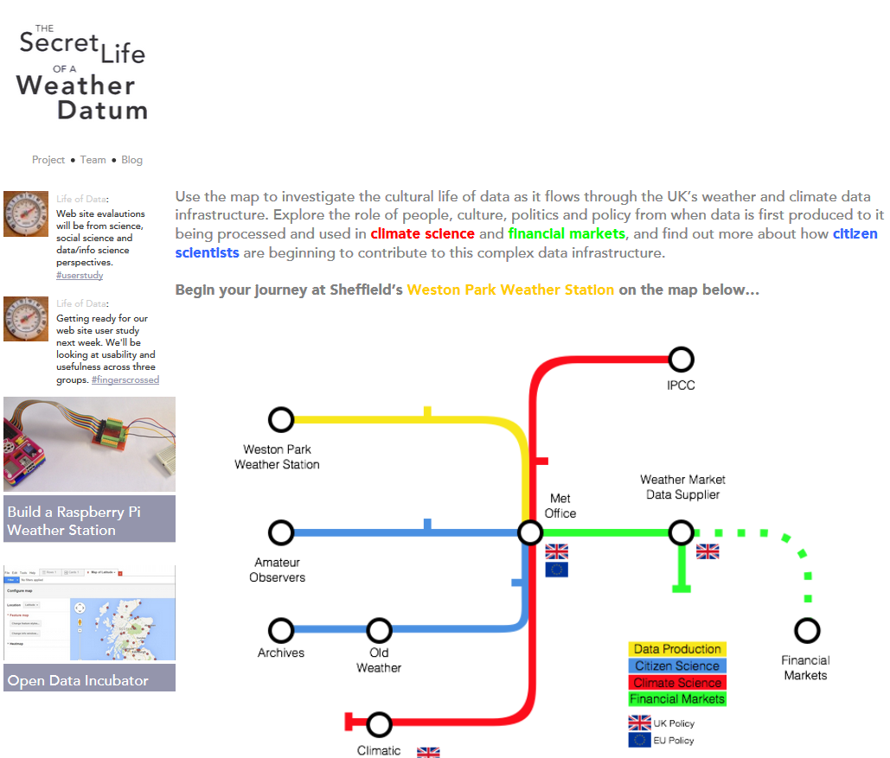
Visualisation of research design
Embedded research data – rich, transparent, bring the social alive
Emphasis on people, culture, stories, relations
Space open for public discussion

Slide 7
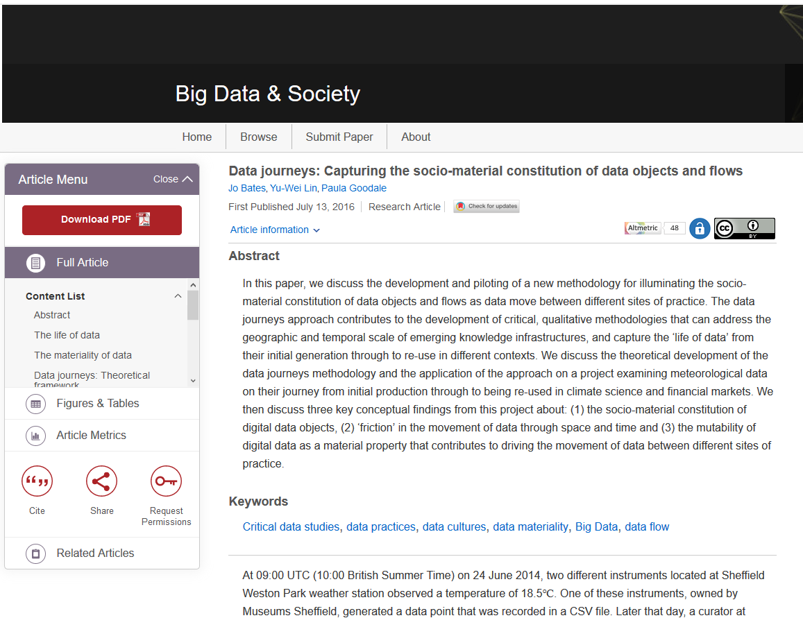
Data Journeys: key insights
Relations between people – space & time
Friction in data movement
Socio-material constitution of digital data objects
Data objects as mutable mobiles
Bates, J., Lin, Y, and Goodale, P. (2016). Data Journeys: Capturing the socio-material constitution of data objects and flows. Big Data and Society. 3(2).

Slide 8
Data Journeys: key insights
Relations between people – space & time
Friction in data movement
Socio-material constitution of digital data objects
Data objects as mutable mobiles
Data journeys bring people into new & different relations with one another
‘Local’ actors <-> big data-driven global markets & climate science
Affective dynamics holding the ‘assemblage’ of actors together
Social relations across time
Inter-generational connections – sailors, archivists, previous generations of curators

Slide 9
Data Journeys: key insights
Frictions in the circulation of data objects
E.g. Archived ship log books to global climate science database
Neoliberal funding and policy constraints, archival practices, socio-technical complexity
Flexibility & adaptation: voluntary labour (citizen science), informal/horizontal/ entrepreneurial culture (ACRE)
Bates, J. (2017) The Politics of Data Friction. Journal of Documentation.
Bates, J., Goodale, P. and Andrews, P. (forthcoming)
Assembling an infrastructure for meteorological data recovery.
Relations between people – space & time
Friction in data movement
Socio-material constitution of digital data objects
Data objects as mutable mobiles

Slide 10
Jo Bates @j0bates Information School, University of Sheffield
Notes:
10

