Slide 1
Digital
Identity
Dr. Duncan Hodges
d.hodges@cranfield.ac.uk
@dunc_h
Information Operations Group
June 2018

Slide 2

Disclaimer
CC BY: Paul Inkles - http://www.visioncreation.co.uk
Notes:
Not an expert at this
Personal experience
Personal development …

Slide 3
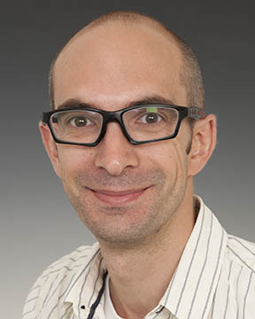
About me
Lecturer in the Information Operations Group, Cranfield Defence and Security

Slide 4
My Sponsors
Government Office for Science
… advise the Prime Minister and members of the Cabinet, to ensure that government policies and decisions are informed by the best scientific evidence and strategic long-term thinking.
Alan Turing Institute (Defence and Security Programme)
We are the national institute for data science and artificial intelligence.
Collaborating with the defence and security community to deliver an ambitious programme of data science research, to deliver impact in real world scenarios.

Slide 5
What does my sponsor want ?
Really, really want ?

Slide 6

How can my sponsor demonstrate / frame my work ?
CC BY-NC-ND: Anthony Theobold - https://www.flickr.com/photos/antphotos/4226218448

Slide 7

How can I make this work for me ?
CC BY-SA : Nick Youngson - http://www.nyphotographic.com/

