Slide 1
Calculating a multilevel index of dissimilarity in R
Richard Harris
(with thanks to Dewi Owen)
School of Geographical Sciences
University of Bristol

Slide 2
Introduction
Measuring segregation with the Index of Dissimilarity (ID)

Slide 3
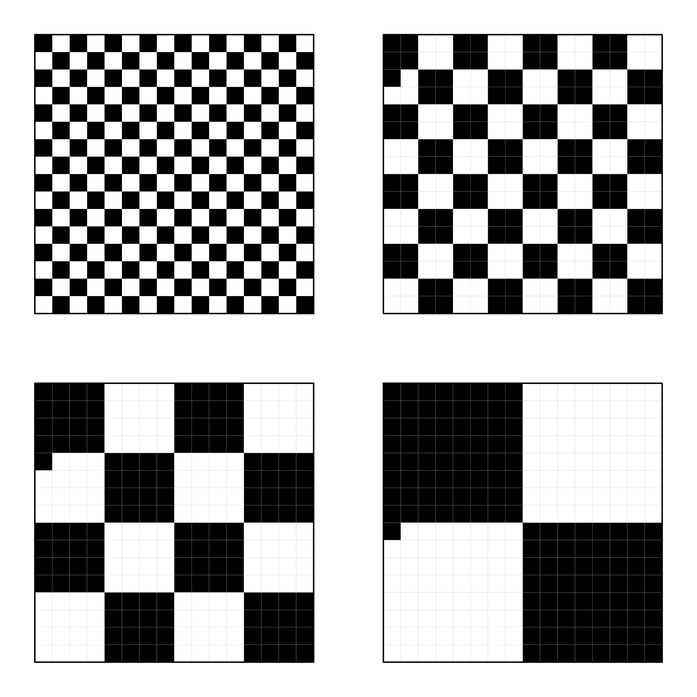
Index of Dissimilarity
“all of the segregation indexes have in common the assumption that segregation can be measured without regard to the spatial patterns of white and non-white residence in a city.”
Duncan and Duncan (1955, p.215)
ID =1 in all four cases (the segregation is equal in all cases)

Slide 4
Index of Dissimilarity
Measures spatial unevenness (spatial heterogeneity) and the numeric scale of segregation
But not spatial clustering and the geographical scale of segregation
ID =1 in all four cases (the segregation is equal in all cases)

Slide 5
Multiscale measures of segregation
Segregation as a multiscale outcome of processes that themselves operate across geographic scales

Slide 6
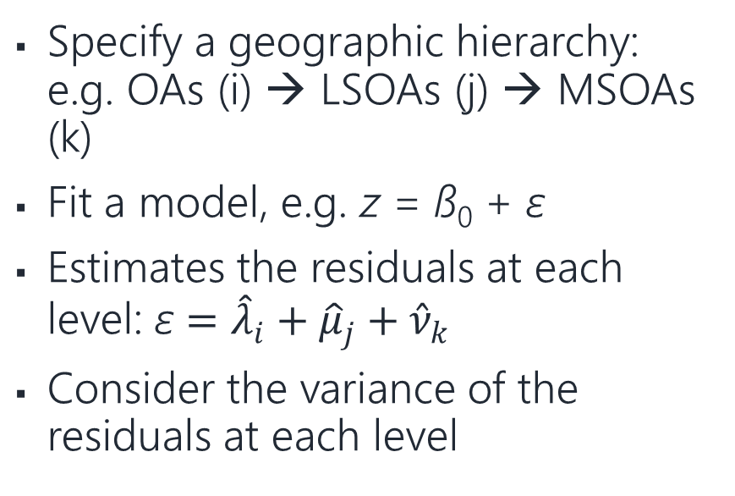
Multiscale measures of segregation
Egocentric approaches
Multilevel approaches
Group a neighbourhood with its k₁ nearest neighbours – make the calculation, z
Repeat with k₂ nearest neighbours (k₂ > k₁)
And with k₃ nearest neighbours (k₃ > k₂ > k₁)
Etc.
Look at z ƒ k
Specify a geographic hierarchy: e.g. OAs (i) → LSOAs (j) → MSOAs (k)
Fit a model, e.g. z = ß₀ + ε
Estimates the residuals at each level: ε $={{\hat{λ}}_{i}+\hat{μ}}_{j}+{\hat{ν}}_{k}$
Consider the variance of the residuals at each level

Slide 7
Multiscale measures of segregation
Egocentric approaches
Multilevel approaches
Rooted in a view of geographic space as continuous (a field-based view)
Flexible
But examining aggregation effects not scale effects per se
Rooted in a view of geographic space with discrete boundaries (an object-based view)
More rigid
Does measure the residuals at each level net of those at others (so disentangling what is due to each distinct level)
But is conflating levels with scales

Slide 8
Multilevel Index of Dissimilarity
Theory and Measurement

Slide 9
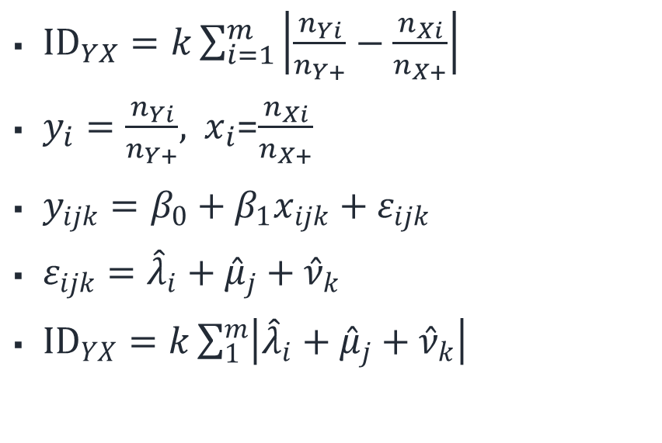
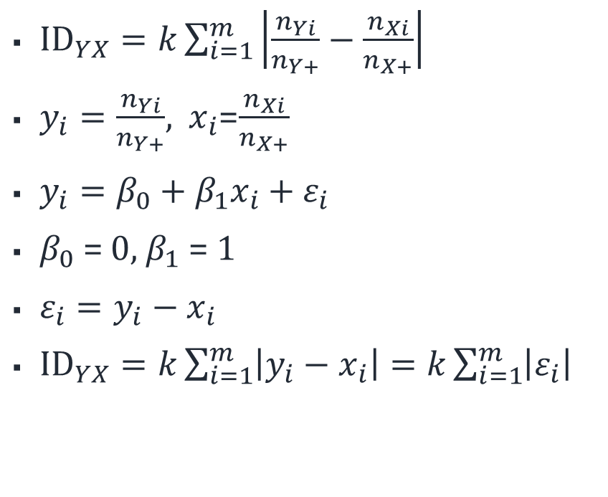
Multilevel Index of Dissimilarity (MLID)
Standard Index
Multilevel Index
${ID}_{YX}=k\sum_{i=1}^{m}{\left|\frac{n_{Yi}}{n_{Y+}}−\frac{n_{Xi}}{n_{X+}}\right|}$
$y_{i}=\frac{n_{Yi}}{n_{Y+}}$, $x_{i}$=$\frac{n_{Xi}}{n_{X+}}$
$y_{i}=β_{0}+β_{1}x_{i}+ε_{i}$
$β_{0}$ = 0, $β_{1}$ = 1
$ε_{i}=$ $y_{i}−x_{i}$
${ID}_{YX}=k\sum_{i=1}^{m}{\left|y_{i}−x_{i}\right|}=k\sum_{i=1}^{m}{\left|ε_{i}\right|}$
${ID}_{YX}=k\sum_{i=1}^{m}{\left|\frac{n_{Yi}}{n_{Y+}}−\frac{n_{Xi}}{n_{X+}}\right|}$
$y_{i}=\frac{n_{Yi}}{n_{Y+}}$, $x_{i}$=$\frac{n_{Xi}}{n_{X+}}$
$y_{ijk}=β_{0}+β_{1}x_{ijk}+ε_{ijk}$
$ε_{ijk}={{\hat{λ}}_{i}+\hat{μ}}_{j}+{\hat{ν}}_{k}$
${ID}_{YX}=k\sum_{1}^{m}{\left|{{\hat{λ}}_{i}+\hat{μ}}_{j}+{\hat{ν}}_{k}\right|}$

Slide 10
Two principal dimensions of segregation:
Unevenness and clustering
 | TL | TR | BL | BR
ID | 1.0 | 1.0 | 1.0 | 1.0
σ_{1×1} | 100% | 1.56% | 1.56% | 1.56%
σ_{2×2} | 0% | 98.4% | 0% | 0%
σ_{4×4} | 0% | 0% | 98.4% | 0%
σ_{8×8} | 0% | 0% | 0% | 98.4%

Slide 11
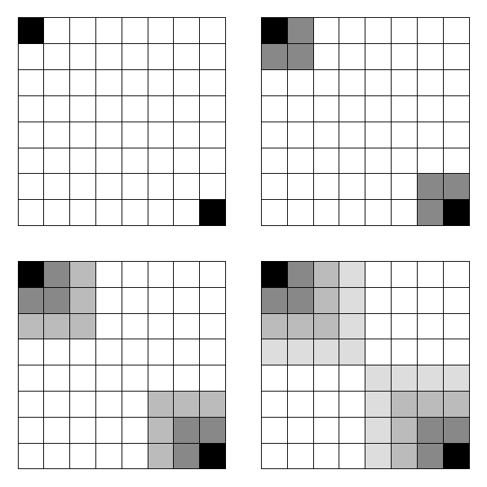
Process of spatial diffusion
 | TL | TR | BL | BR
ID | 1.00 | 0.875 | 0.719 | 0.561
σ_{1×1} | 100% | 16.1% | 29.5% | 22.0%
σ_{2×2} | 0% | 83.9% | 60.3% | 51.4%
σ_{4×4} | 0% | 0% | 10.2% | 26.7%

Slide 12
Implementation
The MLID package for the open source software, R

Slide 13
The MLID package for R
require(MLID)
data(ethnicities)
# Standard ID
id(ethnicities, c("WhiteBrit", "Bangladeshi"))
# Multilevel ID
id(ethnicities, c("WhiteBrit","Bangladeshi“),
levels = c("LSOA", "MSOA", "LAD", "RGN"))

Slide 14
The MLID package for R
WhiteBrit ~ Bangladeshi
ID: 0.852
Pvariance Holdback
Base 28.48 -12.16
LSOA 13.77 -3.14
MSOA 26.55 -4.66
LAD 26.82 -1.72
RGN 4.38 -12.32

Slide 15
The MLID package for R
model1 <- id(ethnicities, c("WhiteBrit","Bangladeshi"),
levels = c("LSOA", "MSOA", "LAD", "RGN"))
ci <- confint(model1)
catplot(ci)

Slide 16
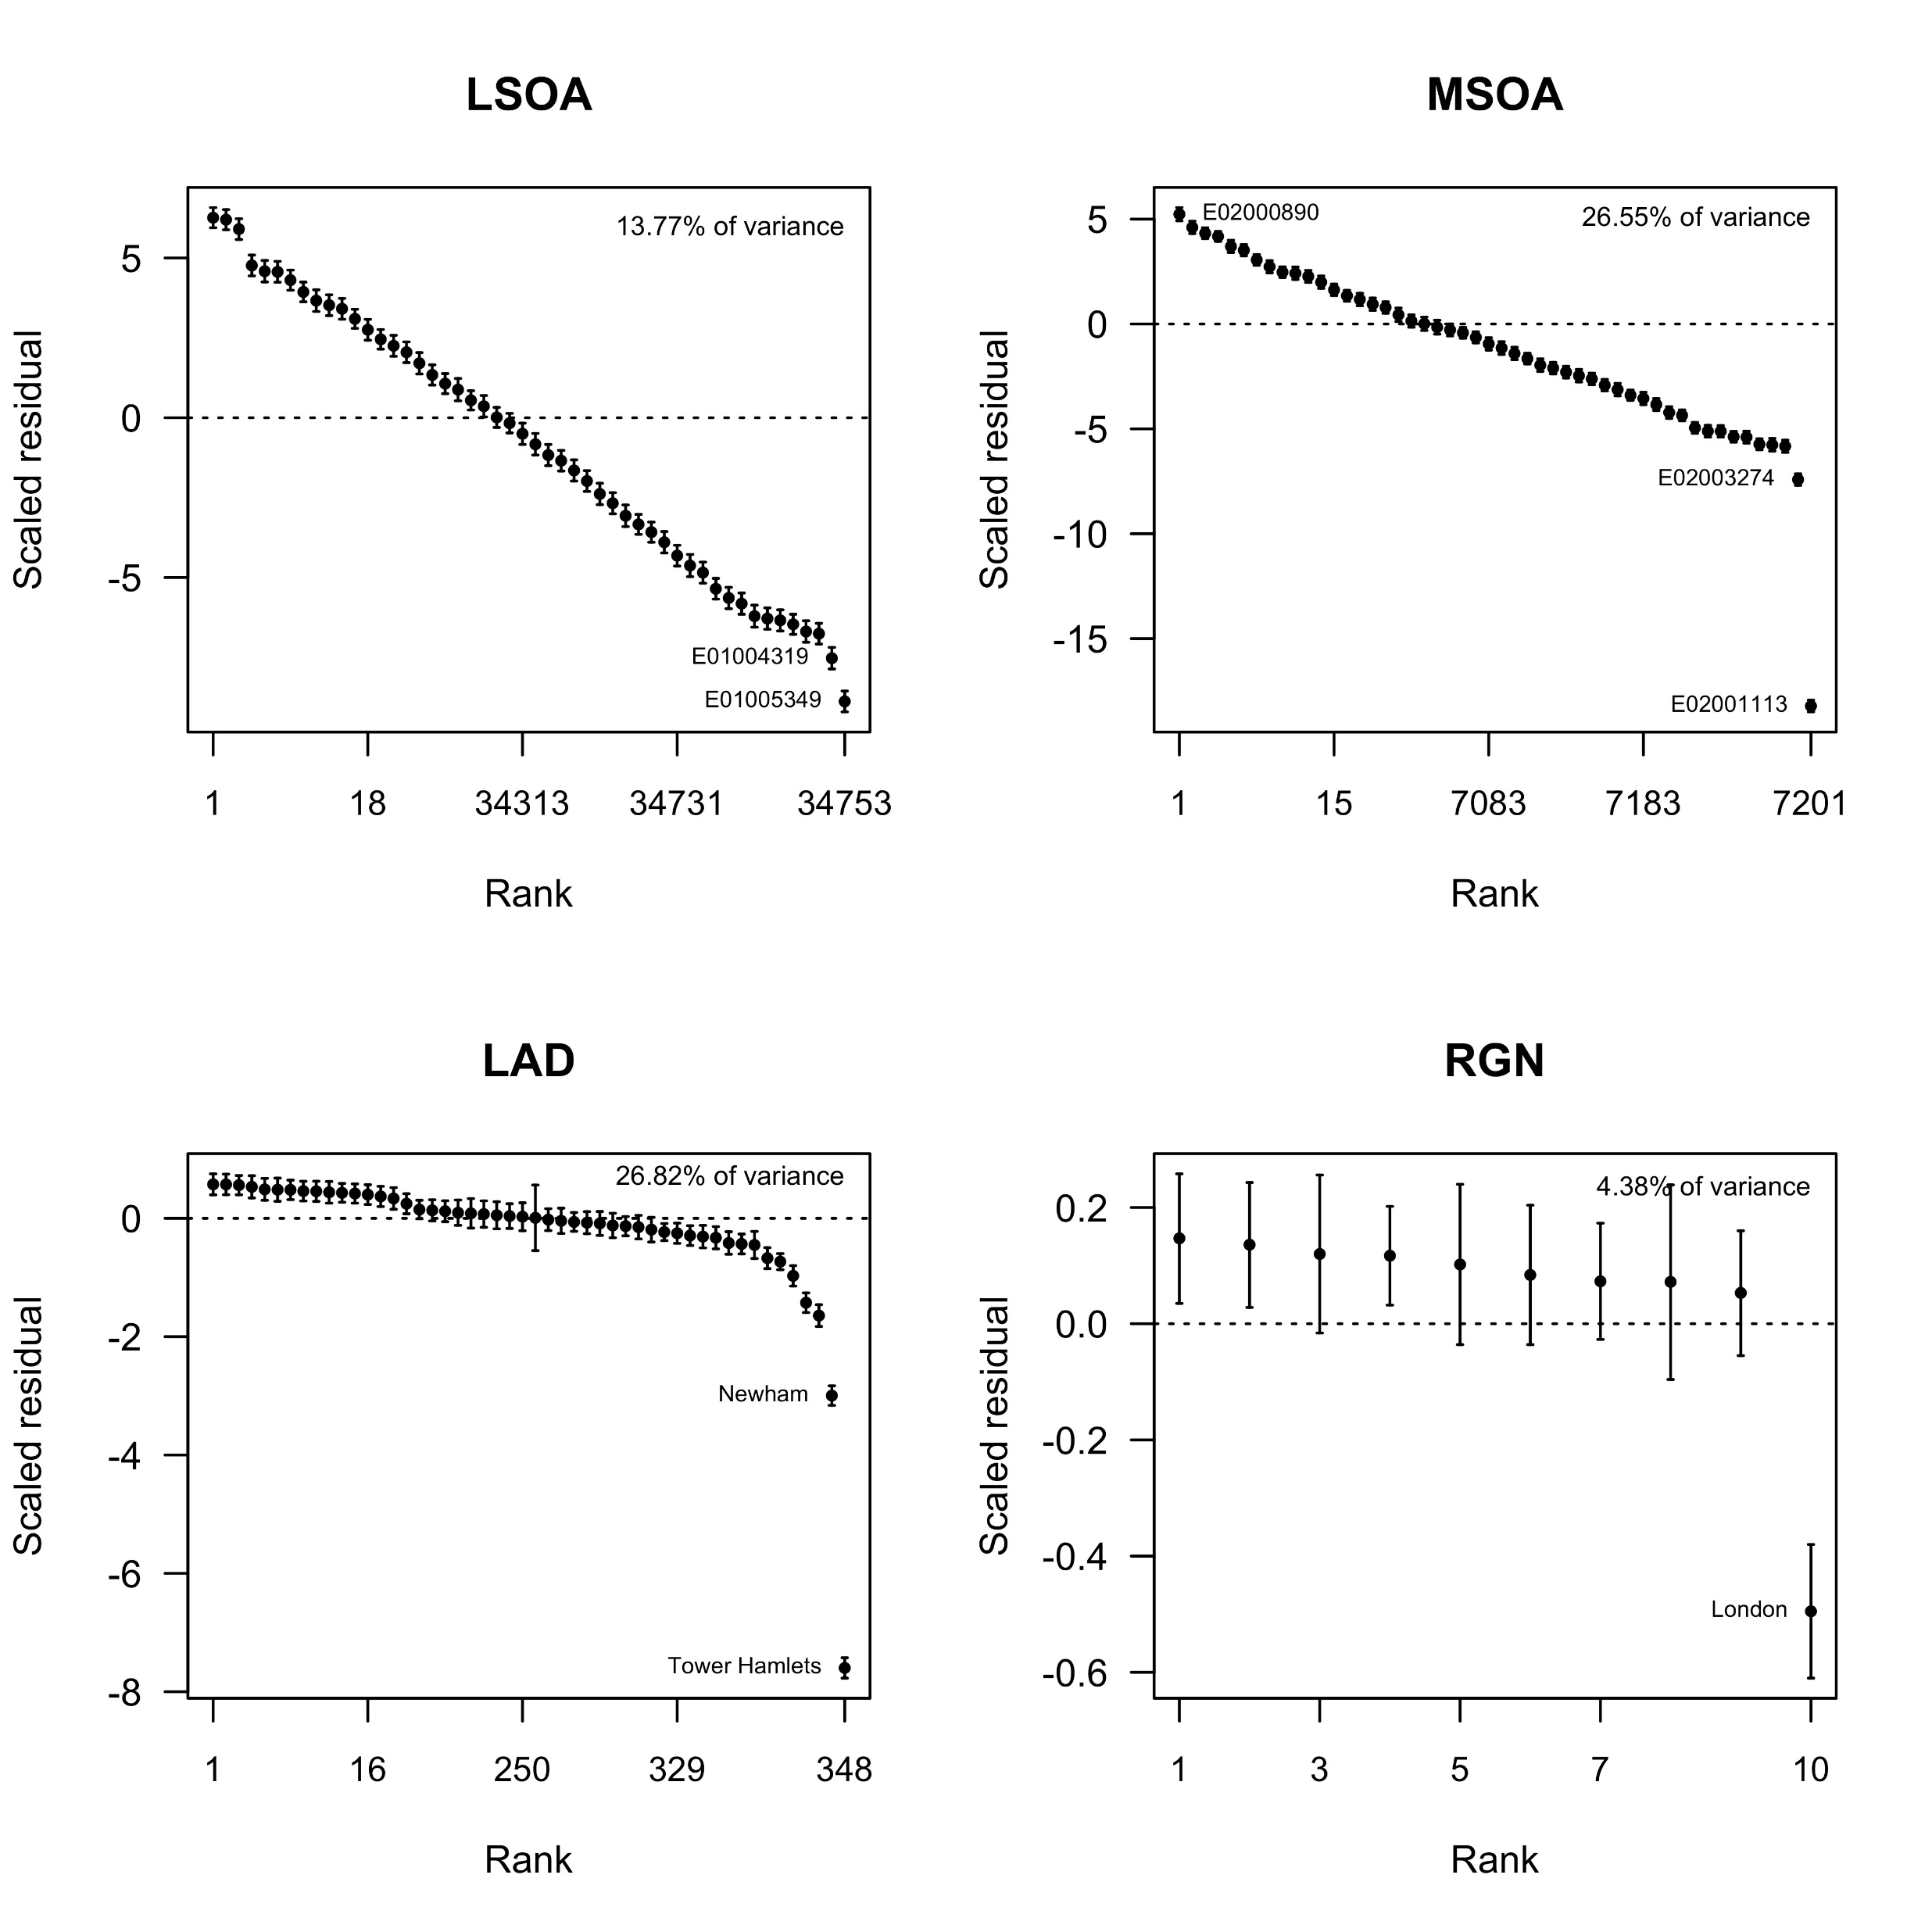

Slide 17
The MLID package for R
Offers a range of ways to explore effect sizes, to consider the impact of various places upon the overall ID, to see what happens if specific places are omitted, etc.
See the tutorial (vignette) at
https://cran.r-project.org/web/packages/MLID/vignettes/MLID.html

Slide 18
References
Harris R 2017 Measuring the scales of segregation: looking at the residential separation of White British and other schoolchildren in England using a multilevel index of dissimilarity Transactions of the Institute of British Geographers http://onlinelibrary.wiley.com/doi/10.1111/tran.12181/abstract
Harris R 2017 MLID: Tools and functions to fit a multilevel index of dissimilarity School of Geographical Sciences, University of Bristol https://cran.r-project.org/web/packages/MLID/
Harris R & Owen D 2018 Developing a multilevel index of dissimilarity in R with a case study looking at the changing scales of residential ethnic segregation in England and Wales between 2001 and 2011 Environment and Planning B http://journals.sagepub.com/doi/full/10.1177/2399808317748328

