Slide 1
Sampling
Health-Related Social Networks in Cross-Country Surveys
Nutcha Charoenboon
Mahidol-Oxford Tropical Medicine Research Unit
NCRM Research Methods Festival 2018
Bath, 3 July 2018

Slide 2

Health behaviour and treatment seeking do not take place in isolation
Policy relevance for health education and intervention targeting
Calls for more health-related network data and deeper analysis
Recurrent issues
Decision on network level (individual, household, community, village)
Boundary definition of catchment areas (physical, social)
Choice of name generator questions
Enumeration of network participants (e.g. manual, census data)
Tie identification
Recommended literature for this session: Perkins, J. M., Subramanian, S. V., & Christakis, N. A. (2015). Social networks and health: a systematic review of sociocentric network studies in low- and middle-income countries. Social Science & Medicine, 125, 60-78. doi: https://doi.org/10.1016/j.socscimed.2014.08.019
Health-related social networks in LMICs

Slide 3
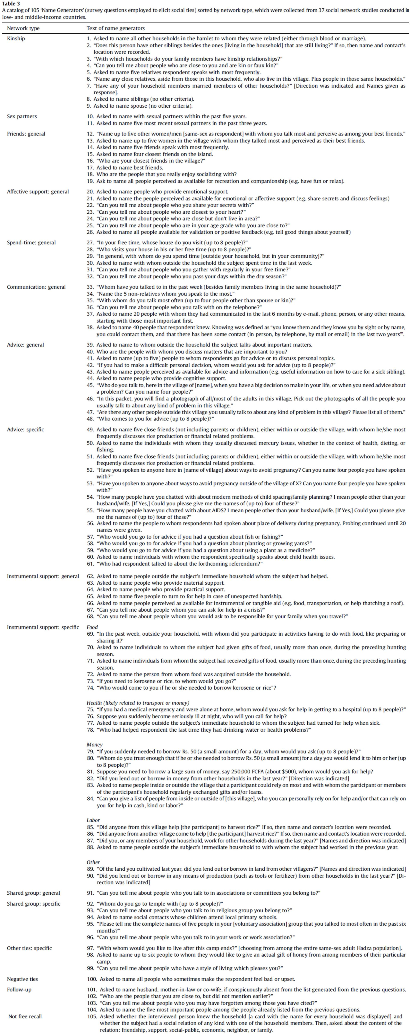





Network sampling: name generators
Perkins, J. M., Subramanian, S. V., & Christakis, N. A. (2015). Social networks and health: a systematic review of sociocentric network studies in low- and middle-income countries. Social Science & Medicine, 125, 60-78. doi: https://doi.org/10.1016/j.socscimed.2014.08.019

Slide 4
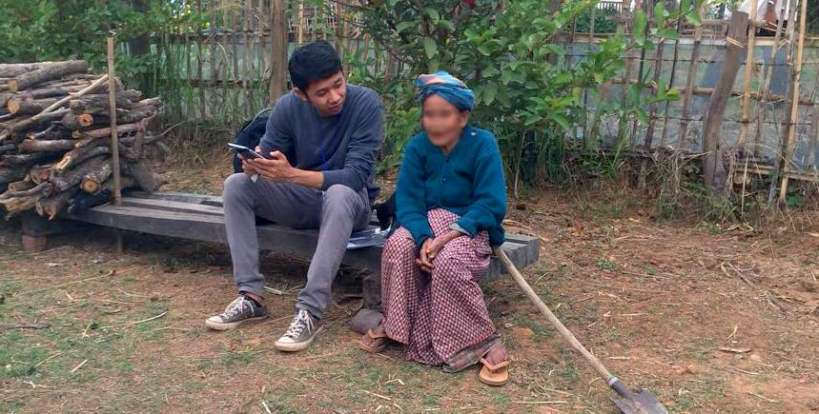
  Semi-structured qualitative technique to inform survey research
  Purpose | Questionnaire testing & development
  Interpretation of survey responses
  Contextualising & triangulating survey data
  Methods | Think aloud
  Probing
  Observation
  Paraphrasing
  Rating tasks
  Response latency
  Free-sort and dimensional-sort classification tasks
  Training | NCRM course “Cognitive interviewing for testing survey questions,” P. Campanelli
Cognitive interview
Source: Campanelli, P (2017). Cognitive interviewing for testing survey questions.
Photo: Lao team member interviewing a villager in Salavan
Photo credit: Amphayvone Thepkhamkong

Slide 5

  Cross-cultural applications of cognitive interviews
  (Farrall et al., 2012; Miller et al., 2011; Pan, 2004; Sopromadze & Moorosi, 2017;
  Sha & Pan, 2013; Taylor et al., 2016; Thrasher et al., 2011)
  Respondent characteristics influence cognitive interview responses
  (Miller et al., 2011; Park et al., 2016)
  Intrinsic assumptions and cultural adaptation of cognitive interview instruments
  (Martin et al., 2017)
Cognitive interview: literature and issues

Slide 6

  I think the questions to get to this kind of information [cognitive interview questions] might be too high, or [pause] in another level. If the respondents, say the villagers… villagers in the lower level would not be able to answer clearly. Sometimes they know [the answer], they do, but they cannot answer straightforwardly. […] Sometimes it’s,
  you know, too high of a question. It’s out our power to [laughed]
  explain, or seek for more things or better things to be an answer.
  - Villager, 66 y/o, retired teacher
Cognitive interview – a comment
Lao team members practicing interview using questionnaire
Photo credit: Nutcha Charoenboon

Slide 7

  Research Sites | Thailand (Chiang Rai) – Lao PDR (Salavan)
  Approach | Mixed-methods research to understand antibiotic use in context of broader treatment-seeking behaviour
  Cross-council initiative to Tackle Antimicrobial Resistance
  Representative district survey: 134 villages in 60 PSUs – 2,141 villagers
  Social network census: 5 villages – 3,744 interviews during 2 rounds
  Cognitive interviewing: 50 villagers
  Themes | Antibiotic use in context of marginalisation
Behaviour: What is problematic behaviour, and is it common?
Knowledge: Will “desirable” knowledge spread in villages?
Indicators: Can we detect problematic behaviour easily?
Project overview
Exhibition at Doi Tung, Thailand
Photo credit: Marco J Haenssgen

Slide 8

Where do you spend most of your time interacting
with other people from your village?
                a) Field: ___
                b) Temple: ___
                c) Local store: ___
                d) Market: ___
                e) Children’s schools: ___
                f) Home: ____
                g) Workplace: ___
                h) Village event/s: ______
                i) Other site: ___
Our question – Where?
Villagers drawing village map to illustrate landmarks and important locations
Photo credit: Marco J Haenssgen

Slide 9

Outside your household, with whom do you interact
on a regular basis?
a) What are the names of the person?
b) How is this person related to you?
c) What is the sex of this person?
d) Where does this person live?
e) What is the name of the household head of this person?
f) How often do you interact with this person?
g) How do you interact with this person?
h) Do your conversations relate to health and well-being?
Our question – Who I
Champa Lao – National flower of Lao PDR
Photo credit: Marco J Haenssgen

Slide 10
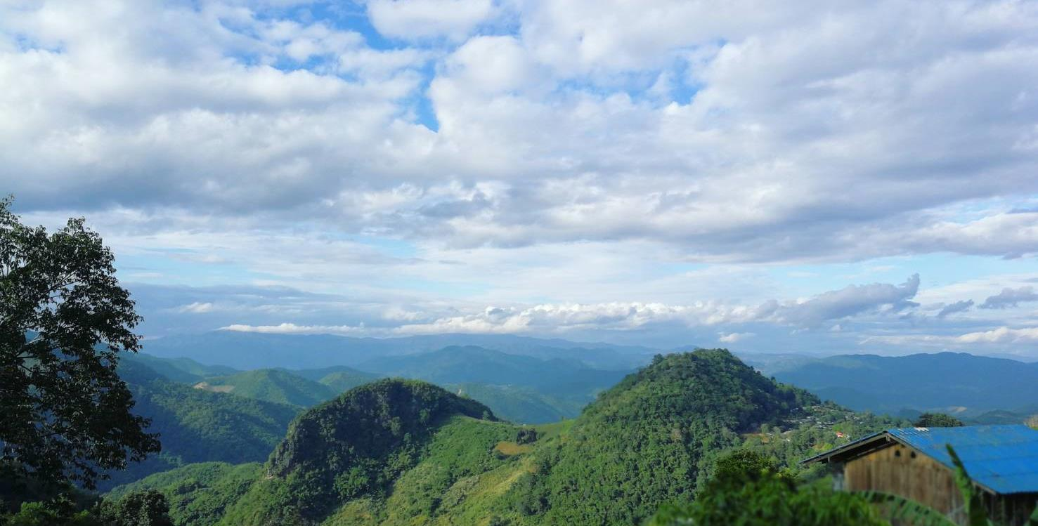
Now if you think again, is there anyone else
with whom you talk about health?
a) What are the names of the person?
b) How is this person related to you?
c) What is the sex of this person?
d) Where does this person live?
e) What is the name of the household head of this person?
f) How often do you interact with this person?
g) How do you interact with this person?
Our question – Who II
Mountain village
Photo credit: Patchapoom Uthong

Slide 11
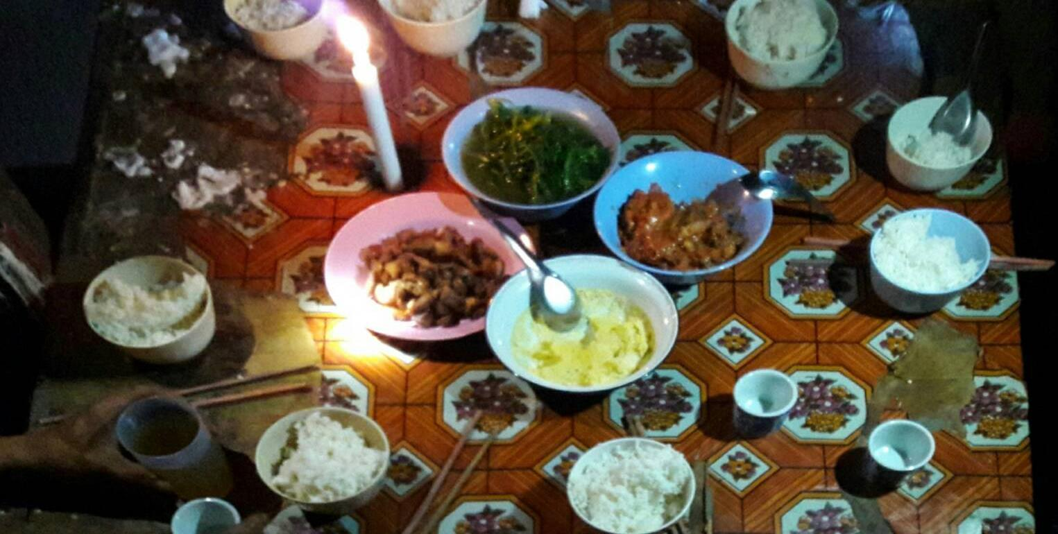
Is there anybody in your household with whom
you talk about health and well-being?
Our question – Who III
Dinner table where family members meet at the end of the day
Photo credit: Thai survey team

Slide 12

Was anybody of your personal relationships
involved in providing advice or help during the illness?
          a) What is the name of the person?
          b) How are these people related to you?
          b) What kind of support did they provide?
Providing healthcare/attending
          Transportation/
          Lending vehicle
Providing advice
Lending/
granting money
Providing food
Contacting
family/friends
Helping with children/housework
Our question – Who IV
Providing medicine
Helping with jobs/agriculture work (feeding animals/tending crops/covering shifts, etc.)
“Guasa,” a traditional treatment villagers perform on each other when sick
Photo: Tales of Treatment; Photo credit: Patthanan Thavethanutthanawin

Slide 13
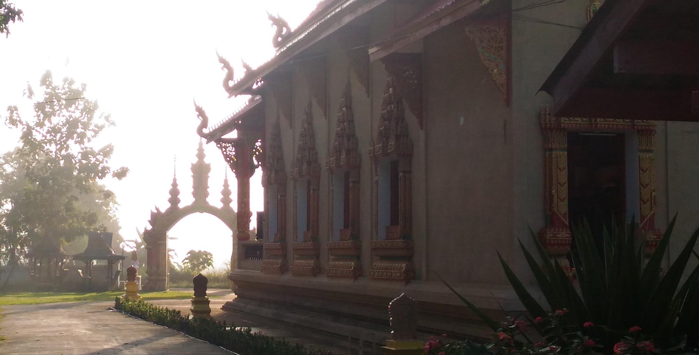
  Our gain | NOT people’s cognitive process
  Lessons about local context and appropriateness
  Understanding of local language and interpretations
  Answers for specific interests
  Application | Experiences and observations benefit data collection for field investigators
  and data analysis for analysis team
  Improvements | Changes in survey instrument
  Questions added: health network, family network
  Questions dropped: health conversation topic
  Sequence of questions: where comes before who, e.g.
  Adjustments of answer categories: frequency of health conversation
  Prioritization of answer categories: asking generic questions before details
Evolution of questions
Temple in a network village where team rested during the day
Photo credit: Nutcha Charoenboon

Slide 14
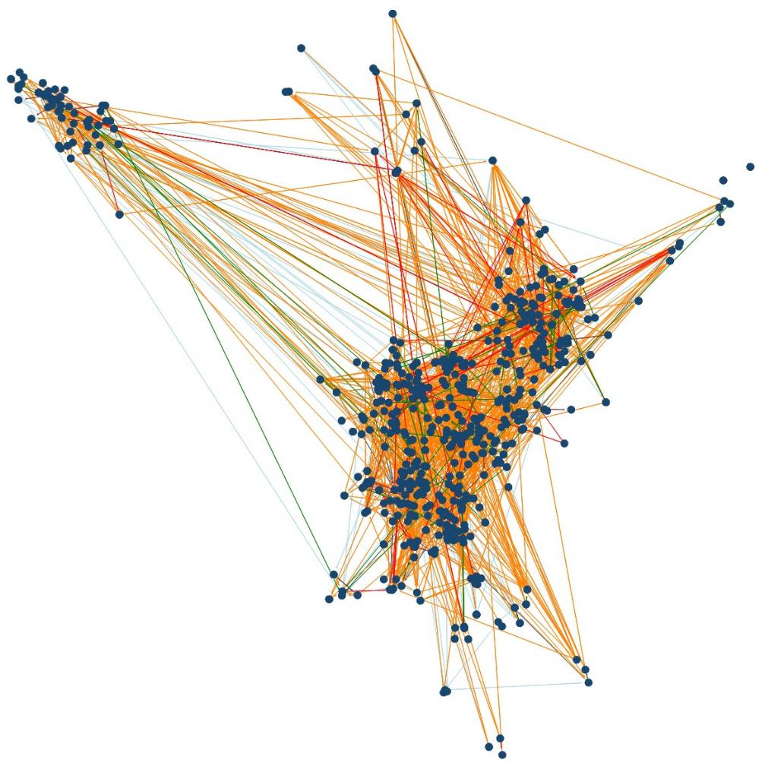
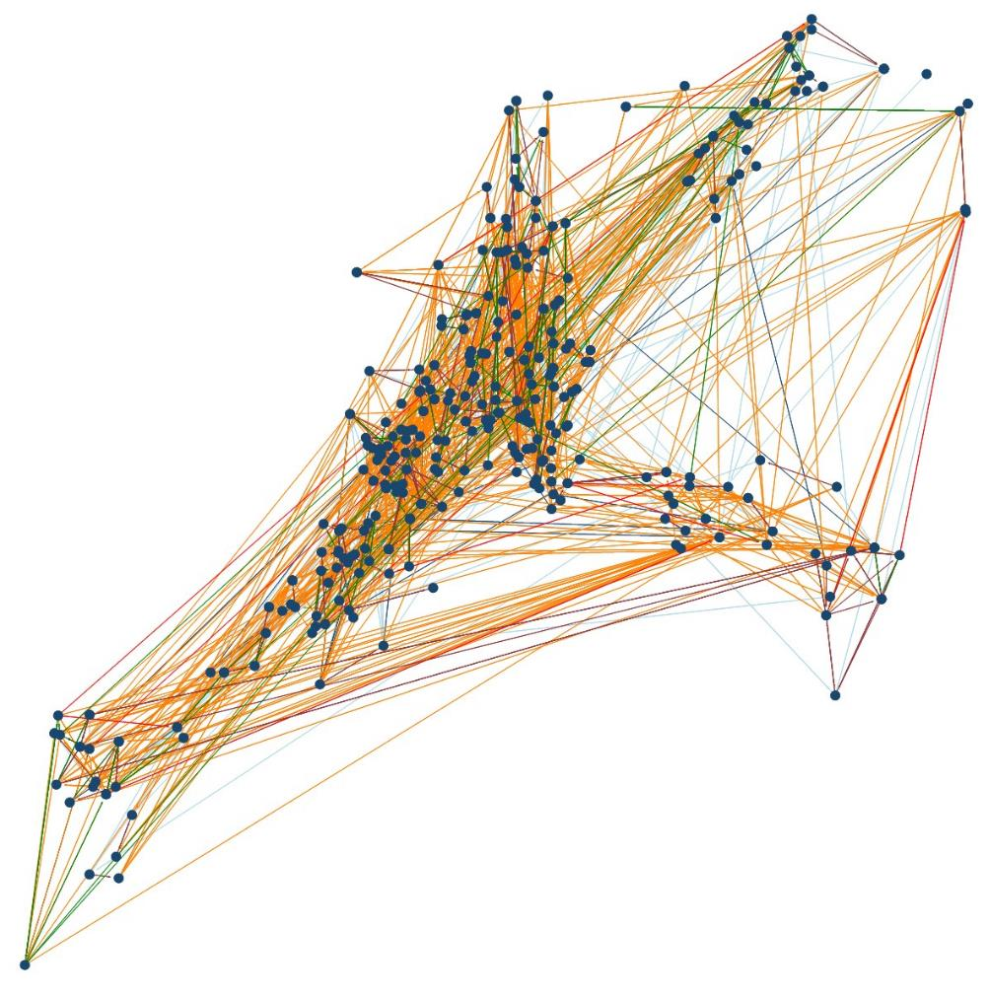
Non-health village communication
Activity communication
Village health communication
Additional village health communication
Household health communication
Help network
Results
Notes:
Up to 5.7 nominations

Slide 15
Results
Notes:
Up to 5.7 nominations

Slide 16
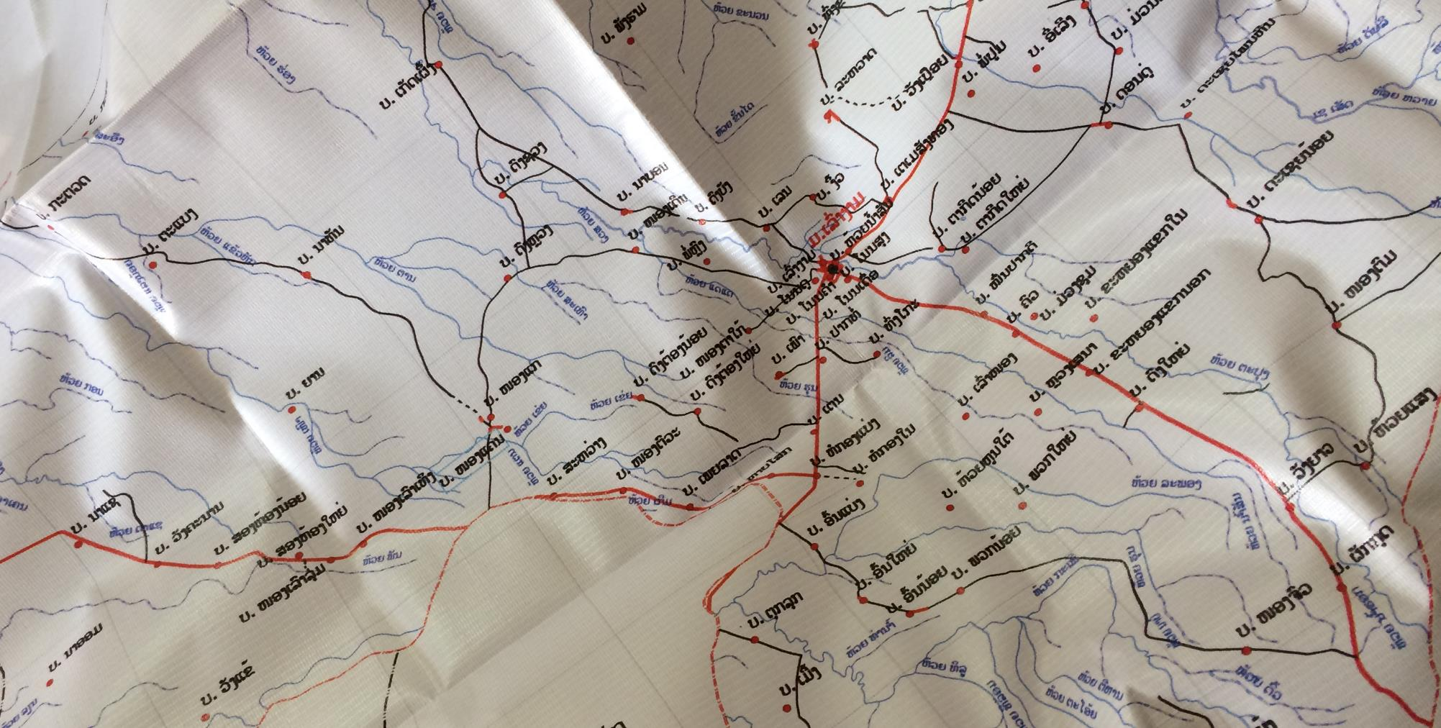
  Role of social network in behavior
      Social network helps gain deeper understanding of behaviour
      but further research is required
  Role of qualitative methods in social network
      Cognitive and/or in-depth interviews complement social network sampling
      and can help improve data collection and interpretation
  Role of context in social research
      Cognitive interviews as well as social network surveys have
      intrinsic assumptions that may be violated in rural non-Western contexts
Conclusion
Salavan district map in public health office
Photo credit: Nutcha Charoenboon

Slide 17

Thank you.
Questions?
nutcha7@hotmail.com
Tales of Treatment
Photo credit: Patthanan Thavethanutthanawin

Slide 18

  Farrall, S., Priede, C., Ruuskanen, E., Jokinen, A., Galev, T., Arcai, M., et al. (2012). Using cognitive interviews to refine translated survey questions: an example from a cross-national crime survey. International Journal of Social Research Methodology, 15(6), 467-483. doi: 10.1080/13645579.2011.640147
  Martin, S. L., Birhanu, Z., Omotayo, M. O., Kebede, Y., Pelto, G. H., Stoltzfus, R. J., et al. (2017). “I can’t answer what you’re asking me. Let me go, please.”: Cognitive interviewing to assess social support measures in Ethiopia and Kenya. Field Methods, 29(4), 317-332. doi: 10.1177/1525822x17703393
  Miller, K., Fitzgerald, R., Padilla, J.-L., Willson, S., Widdop, S., Caspar, R., et al. (2011). Design and analysis of cognitive interviews for comparative multinational testing. Field Methods, 23(4), 379-396. doi: 10.1177/1525822x11414802
  Pan, Y. (2004). Cognitive interviews in languages other than English: methodological and research issues. The 2004 American Statistical Association Proceedings of the Joint Statistical Meetings, 8-12 August 2004 (pp. 4859-4865). Toronto: American Statistical Association.
  Park, H., Sha, M. M., & Olmsted, M. (2016). Research participant selection in non-English language questionnaire pretesting: findings from Chinese and Korean cognitive interviews. Quality & Quantity, 50(3), 1385-1398. doi: 10.1007/s11135-015-0211-3
  Priede, C., & Farrall, S. (2011). Comparing results from different styles of cognitive interviewing: ‘verbal probing’ vs. ‘thinking aloud’. International Journal of Social Research Methodology, 14(4), 271-287. doi: 10.1080/13645579.2010.523187
  Sha, M., & Pan, Y. (2013). Adapting and improving methods to manage cognitive pretesting of multilingual survey instruments. Survey Practice, 6(4), 1-10. doi: 10.29115/SP-2013-0024
  Sopromadze, N., & Moorosi, P. (2017). Do we see through their eyes? Testing a bilingual questionnaire in education research using cognitive interviews. International Journal of Research & Method in Education, 40(5), 524-540. doi: 10.1080/1743727X.2016.1181163
  Taylor, T. M., Thurman, T. R., & Nogela, L. (2016). “Every time that month comes, I remember”: using cognitive interviews to adapt grief measures for use with bereaved adolescents in South Africa. Journal of Child & Adolescent Mental Health, 28(2), 163-174. doi: 10.2989/17280583.2016.1210154
  Thrasher, J. F., Quah, A. C. K., Dominick, G., Borland, R., Driezen, P., Awang, R., et al. (2011). Using cognitive interviewing and behavioral coding to determine measurement equivalence across linguistic and cultural groups: an example from the International Tobacco Control Policy Evaluation Project. Field Methods, 23(4), 439-460. doi: 10.1177/1525822x11418176
  Willis, G. B. (2015). The practice of cross-cultural cognitive interviewing. Public Opinion Quarterly, 79(S1), 359-395. doi: 10.1093/poq/nfu092
Cognitive interview references
Photo: Salavan temple fair
Photo credit: Nutcha Charoenboon

