Slide 1
Artificial data in social science
Richard Skeggs
rskeggs@essex.ac.uk
@rickskeggs

Slide 2
What is Artificial Data
First proposed in 1993.
Often referred to as Synthetic data.
In effect made up data.
Mimics real data.

Slide 3
Why Use Artificial Data
Reduces privacy concerns.
Bolsters small datasets for models.
Used for developing and training a model.
Can be cheaper to obtain.

Slide 4
Creating Artificial Data
Python synthetic data tools.
Synthetic Data Vault
Python & Numpy
R synthetic data tools.
Synthpop

Slide 5
Synthetic Data Vault
Patki, N., R. Wedge, and K. Veeramachaneni. “The Synthetic Data Vault.” In 2016 IEEE International Conference on Data Science and Advanced Analytics (DSAA), 399–410, 2016. https://doi.org/10.1109/DSAA.2016.49.

Slide 6
Synthetic Data Vault
34 data scientist given datasets.
No statistically different result between synthetic & control data.

Slide 7
Synthetic Data in Python
Trumania: Creates test data based on a scenario.
Synthetic-data-generator: generate random data follows uniform distribution.

Slide 8
Synthetic Data in R
SynthPop – R package.
Uses a logistic model predict variables based on real data.
Recursive model building up variables.

Slide 9
SynthPop
Variables synthesised using CART.
classification and regression trees.
The model is created by binary recursive partitioning.
Missing values are modelled.
A model is applied to each column.

Slide 10
SynthPop
Syn(data, Visit.sequence, k)
Usage:
Data – a dataframe or matrix containing original data.
Visit.sequence - column indices specifying the order of synthesis
K – size of synthetic data (optional)
Method – meyhod used for synthesising by default CART (optional)
Example:
syn.data<-syn(orig.data[c(7:28),], visit.sequence=c(7:28), k=39)

Slide 11
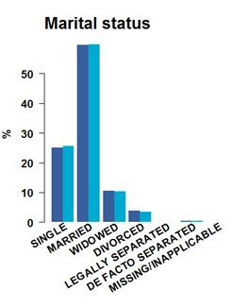
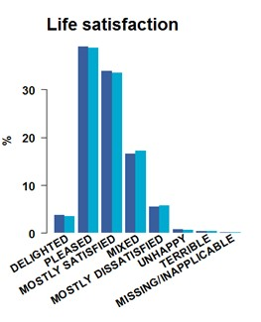
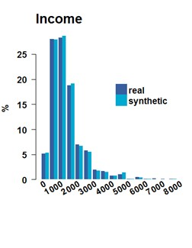
SynthPop
Administrative Data Research Centre – Scotland | Chris Dibben| 20 June 2014

Slide 12
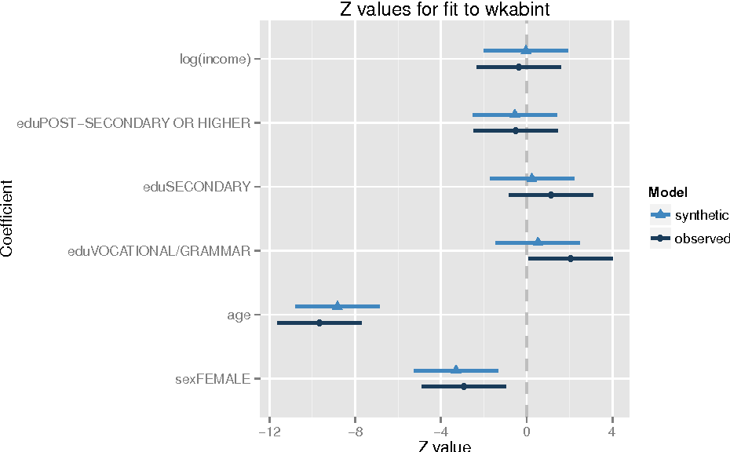
SynthPop
synthpop: Bespoke Creation of Synthetic Data in R Beata Nowok, Gillian M. Raab, Chris Dibben Published 2015
Notes:
The diagram shows the estimates and 95% confidence intervals for Z statistics from a logistic regression of intention to go abroad for work for observed and synthetic data. This diagram shows just how closely the synthetic data matches the observed results.

Slide 13
SynthPop
if(!require(synthpop))
{ install.packages("synthpop") }
library(synthpop)
syn.data<-syn(iris[c(1:150),], visit.sequence=c(1:150), k=150, proper=TRUE)
for(x in 1:nrow(iris))
{
if(x==1) { synth.data<-as.data.frame(syn.data$syn[x, ]) }
else { synth.data[x,]<-syn.data$syn[x,] }
}
View(synth.data)
plot(synth.data$Petal.Length, synth.data$Petal.Width)
Notes:
The diagram shows the estimates and 95% confidence intervals for Z statistics from a logistic regression of intention to go abroad for work for observed and synthetic data. This diagram shows just how closely the synthetic data matches the observed results.

Slide 14
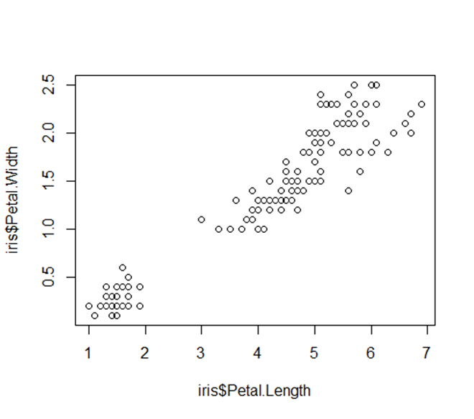
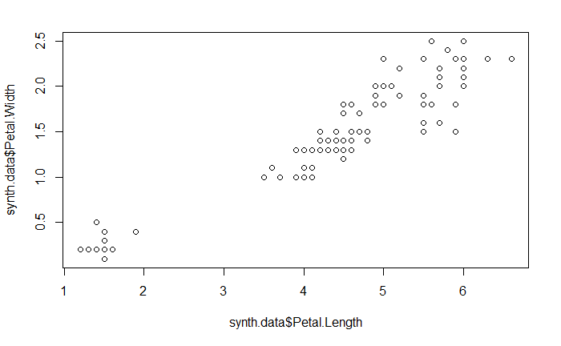
SynthPop
Original Data
Synthetic Data
Notes:
The diagram shows the estimates and 95% confidence intervals for Z statistics from a logistic regression of intention to go abroad for work for observed and synthetic data. This diagram shows just how closely the synthetic data matches the observed results.

Slide 15
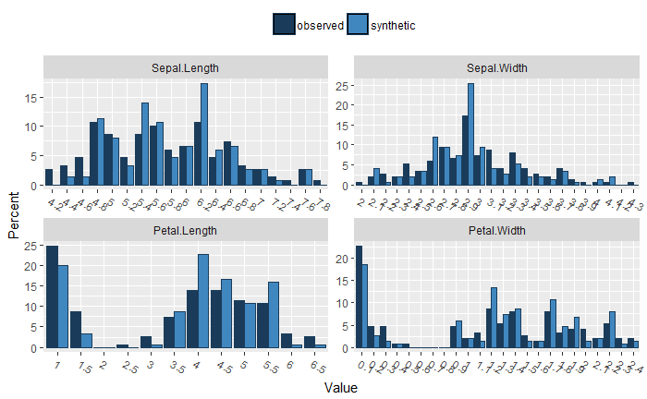
SynthPop
Notes:
The diagram shows the estimates and 95% confidence intervals for Z statistics from a logistic regression of intention to go abroad for work for observed and synthetic data. This diagram shows just how closely the synthetic data matches the observed results.

Slide 16
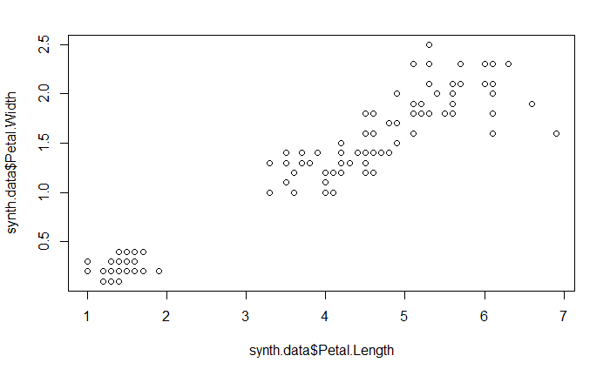
SynthPop
syn.data<-syn(iris, visit.sequence=c(1:150), k=150, proper=TRUE)
Notes:
The diagram shows the estimates and 95% confidence intervals for Z statistics from a logistic regression of intention to go abroad for work for observed and synthetic data. This diagram shows just how closely the synthetic data matches the observed results.

Slide 17
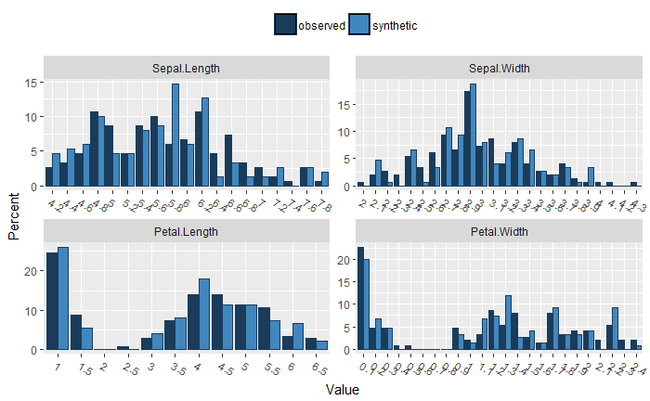
SynthPop
Notes:
The diagram shows the estimates and 95% confidence intervals for Z statistics from a logistic regression of intention to go abroad for work for observed and synthetic data. This diagram shows just how closely the synthetic data matches the observed results.

Slide 18
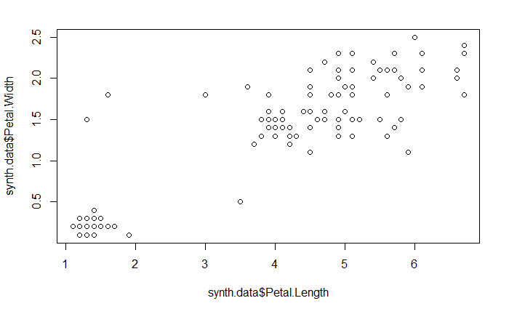
SynthPop
syn.data<-syn(iris, method="parametric", visit.sequence=c(1:150), k=150, proper=TRUE, default.method = c("normrank", "logreg", "polyreg", "polr"))
Notes:
The diagram shows the estimates and 95% confidence intervals for Z statistics from a logistic regression of intention to go abroad for work for observed and synthetic data. This diagram shows just how closely the synthetic data matches the observed results.

Slide 19
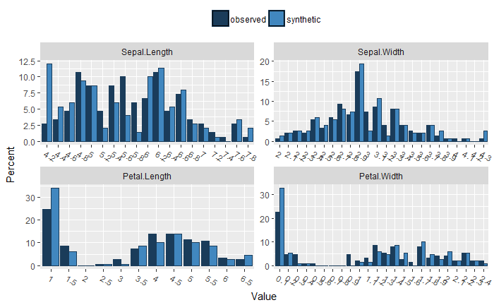
SynthPop
Notes:
The diagram shows the estimates and 95% confidence intervals for Z statistics from a logistic regression of intention to go abroad for work for observed and synthetic data. This diagram shows just how closely the synthetic data matches the observed results.

Slide 20
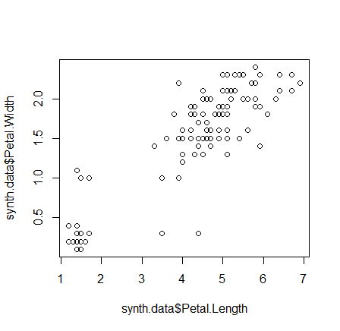
SynthPop
syn.data<-syn(iris, method="parametric", visit.sequence=c(1:150), k=150, proper=TRUE, default.method = c("normrank", "logreg", "polyreg", "polr"), seed=6000)
Notes:
The diagram shows the estimates and 95% confidence intervals for Z statistics from a logistic regression of intention to go abroad for work for observed and synthetic data. This diagram shows just how closely the synthetic data matches the observed results.

Slide 21
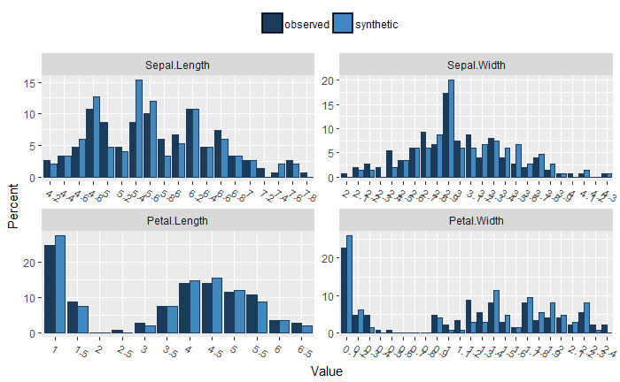
SynthPop
Notes:
The diagram shows the estimates and 95% confidence intervals for Z statistics from a logistic regression of intention to go abroad for work for observed and synthetic data. This diagram shows just how closely the synthetic data matches the observed results.

Slide 22
Any Questions?
Richard Skeggs
rskeggs@essex.ac.uk
5 April 2018

