Slide 1
Satellite-Aided
Household Survey Sampling in Low- and Middle-Income Settings
Marco J Haenssgen, University of Oxford
ESRC Research Methods Festival 2018
Recent Advances in Rural Health Survey Methodology
Bath, 3 July 2018

Slide 2

Approaches to Survey Sampling

Slide 3
Approaches to Survey Sampling
Traditional Approaches
  In absence of registers as sampling frames, rural household surveys in LMICs are often based on random walk procedures or household listing. For example, health surveys in LMICs:
  First-level cluster selection
    Based on census data, proportional to population size
  Second-level household selection
  Household listing and mapping
    Select segments and list every inhabited structure
    Choose starting point and interval
  Random walk
    Drop pin to select starting household
    Choose interval and follow road, “spin the bottle” at each intersection
Notes:
For health: tech at our fingertips

Slide 4
Approaches to Survey Sampling
Satellite-Aided Approaches
  Satellite-based approaches are gradually emerging in research.
  Cluster random sampling
    Wampler et al. (2013) in Haiti
    Google Earth → ArcMap → Excel → GPS units
  Simple random sampling
    Escamilla et al. (2014) in Malawi; Shannon et al. (2012) in Lebanon
    GPS → GIS → Google Earth → Digipoint 2 → GIS → Hawth’s Tools → GPS
  Selection of starting point for random walk
    Galway et al. (2012) in Iraq; Flynn et al. (2013) in Canada
    GIS → Google Earth / Maps → Printed maps (Galway et al., 2012)
  Other (Disease and programme surveillance)
    Chang et al. (2009), Gammino et al. (2014), Morland & Evenson (2009)
    GPS → Google Maps / GIS → GPS
Notes:
For health: tech at our fingertips

Slide 5
Approaches to Survey Sampling
Satellite-Aided Approaches
  Researchers have started to incorporate satellite-based approaches in survey research.
Wampler et al. (2013)
Escamilla et al. (2014)
Galway et al. (2012)
Gammino et al. (2014)
Notes:
For health: tech at our fingertips

Slide 6
Approaches to Survey Sampling
Issues
Traditional Approaches
Satellite-Aided Approaches
Time and money intensive
Segmentation to manage workload
Clustering, high street bias in random walk
Verification problems
Specialised (though open-source) software/s
Professional equipment
Spatial considerations focus mainly on catchment
Random walk issues remain
Notes:
For health: tech at our fingertips

Slide 7
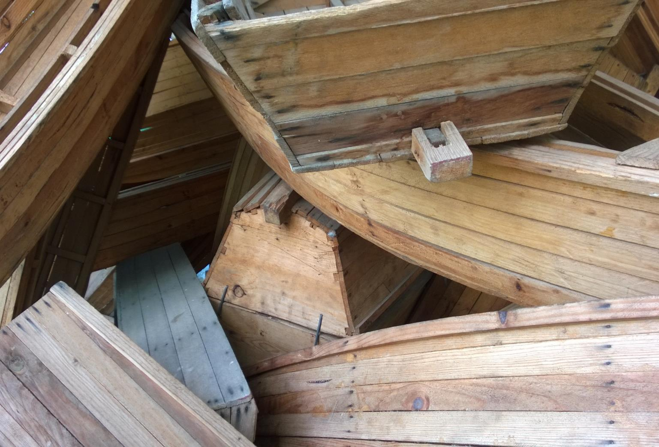
Setting and Challenges
Notes:
The context is a general adult population survey in rural Rajasthan and Gansu to better understand the link between healthcare access and phone use.

Slide 8
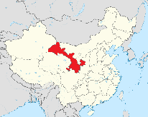
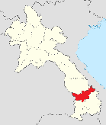
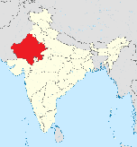

Setting and Challenges
Survey Data Collection
  Survey data collected from 6,685 respondents across 97 PSUs (171 villages) in Gansu (16), Lao PDR (32), Rajasthan (16), and Thailand (33).
  Eligibility: Ordinary village resident (>6m), 18 years and above
  4 steps in sample selection process
    Purposive selection of representative sub-districts in two districts
    Random selection of 16/30 villages in these districts
    Random selection of households in each village through interval sampling
    Random selection of respondents for each household
  60-minute questionnaires + PSU checklists
  Teams of 6 fieldworkers plus two supervisors
Notes:
The supervisors monitored the progress through random checks of the survey interviews, revisiting a sub-sample of the households, and checking all questionnaires before leaving the village. The supervisors further completed a village checklist that recorded the presence, characteristics, and location of selected village structures such as clinics and bus stops.

Slide 9
Setting and Challenges
Survey Data Collection
  The rural surveys faced common administrative and resource constraints.
  Administrative Challenges
    Absence of village population data (village name register from census)
    Mixed access to geographical information of villages
  Resource challenges
    Varying labour and transportation costs
    Limited team time per village
Notes:
I will show the counterfactual budget in a later slide. Suffice it to say that conventional strategy would have been unviable in most of these cases.

Slide 10

Process Description

Slide 11
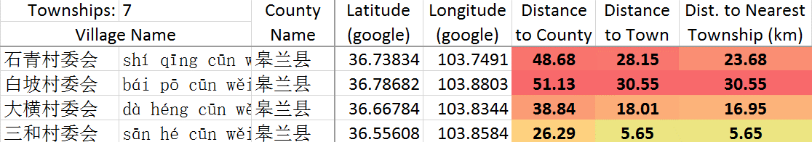
Process Description
Village Selection (China)
  Satellite maps were used to extract village locations for spatial stratification.
  1,736 sites in eight sub-districts in register
  Locate villages in Google Maps using Chinese names
  Manually extract coordinates into Microsoft Excel
  Calculate distance to assigned and nearest township
  Drop or reclassify outliers
  1,553 villages in sampling frame, 16 plus 32 replacements drawn

Slide 12
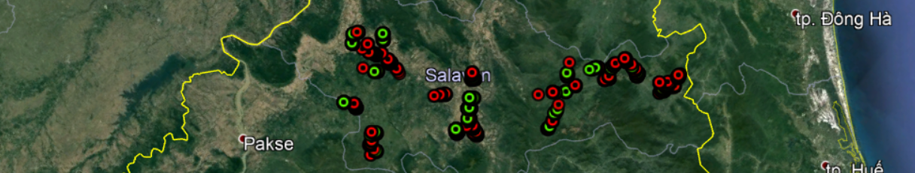
Process Description
Village Selection (Laos, Thailand)
  Satellite maps were used to extract village locations for spatial stratification.
  No local administrative register but Country Files from US National Geospatial-Intelligence Agency
  Calculate distance of 3,100 villages to nearest district town
  Stratify and select sample
  Locate sample on satellite maps and resample if non-existent or unclear
  60 PSUs drawn, 54 PSUs resampled (16/30 in Lao Ngam / Ta Oy, Salavan)

Slide 13
Process Description
Household Selection
  High-resolution aerial maps of selected villages were extracted to build village-level sampling frames.
  High-resolution village maps on Google Maps or Bing Maps
  Screen-cap highest-resolution maps (up to 1:670), 1km catchment
  Paste screenshots into Microsoft PowerPoint
  Assemble complete high-resolution area map (5-50 individual maps)
  Village maps contained total of 37,000 houses (up to 1,500 per village, 380 on average)

Slide 14
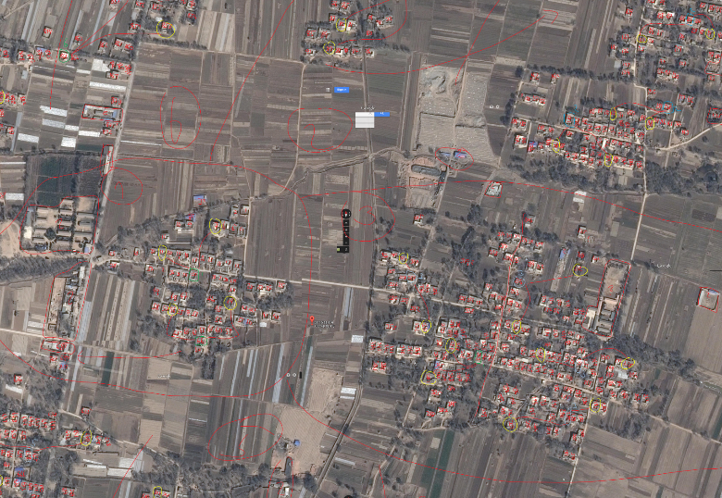
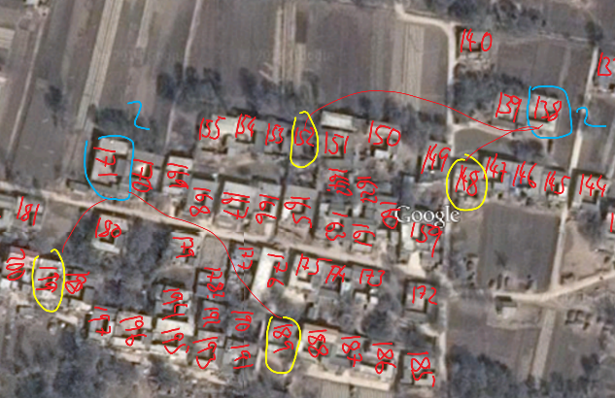
Process Description
Household Selection
Google Inc. (2014), 2014 map data from Google, DigitalGlobe

Slide 15
Process Description
Household Selection
  Village-level sampling frames were built through complete enumeration of identifiable housing structures.
  Homogeneous housing conditions, absence of apartment buildings
  Segment village maps to ensure spatial representativeness
  Number housing structures consecutively in PowerPoint
  Assign placeholders for unidentified structures
  Interval-sample (optionally plus replacement households) based on number of structures per segment

Slide 16
Process Description
Implementation and Monitoring
  Not only sample selection but also implementation logistics benefitted from digital aides.
  Satellite maps facilitated upfront planning
    Village approach via chartered unchartered roads using Bing/Here Maps
    Plan deployment/drop-off and pick-up
    Assign investigators according to fitness in difficult terrain
  Village maps to facilitate field investigator work
    Facilitate household location for fieldworkers
    Field investigators to record GPS coordinates using dongles or tablets
    Supervisors using geo-coordinates to verify correct households

Slide 17

Discussion

Slide 18
Discussion
Benefits: Financial
  Digital aides enabled low-cost sampling and streamlined logistics.
  PhD Research Scenario (16 villages, 400 households, mountainous areas)
  Savings (“realistic” scenario):
    Reduced travel, investigator work, insurance, researcher allowance
    Saved 25% of main survey time, 80 labour days
    Total savings: £4,300
  Expenses
    Actual: Smartphone, printing, network charges
    Optional: Touchscreen laptop, labour, GPS units, tablets for data collection
    Total expenditures: £170 to £2,000
  Bottom line: Savings of £2,300 to £4,100

Slide 19
Discussion
Benefits: Methodological
  ICT-aided sampling and implementation can also improve survey quality.
  Complete listing, even for spatially marginalised households
  Spatial representativeness (superimposed grids)
  Less clustering, thereby improving effective sample size
  Stronger adherence to pre-selected households

Slide 20
Discussion
Benefits: Methodological
  In the absence of spatial autocorrelation, spatial stratification / segmentation is at least as accurate as simple random sampling.
Delmelle (2009: 186-189)
Notes:
Better chance of maximising the information in the cluster, which can reduce the required number of clusters

Slide 21
Discussion
Requirements
  Researchers need to meet specific conditions to realise these benefits.
  Locational requirements
    Local knowledge of field sites
    Up-to-date, high resolution imagery
    Identifiable, consistent, stable living conditions
    Economic viability
  Technical requirements
    Off-the-shelf ICT
    2G connectivity (not needed for GPS signals)
    Optional: Lowest-cost GPS units, compasses, tablets
  Logistical requirements
    Training on map reading
    Detailed team instructions prior to village visit
    Information from local leaders

Slide 22
Discussion
Challenges
  Reliance on technical aides can have methodological implications.
  Village selection
    Use of official but incomplete village registers can curtail sampling frame
    Insensitivity of population size can produce bias towards smaller villages
    Sensitivity towards population size can explode survey costs
    Villages outside of selected district need separate permission for access
    Remedies: Visual inspection of maps, expand catchment areas, ex-post weighting, replacement village list (readily sampled)
  Household selection
    Hit rates between 50% and 94%, average of 79% are residential buildings
    Abandoned and shared housing units can influence sampling interval
    Manual household listing can create trust that is forgone in ICT-aided sampling
    (total of 61 refusals or up to 4 per village)
    Remedies: on-the-spot updates of village maps, revisits, drone reconnaissance

Slide 23

Conclusion

Slide 24
Approaches to Survey Sampling
Satellite-Aided Approaches
  Useful approach in contexts that have
    Lack of administrative data for sampling frame
    High survey costs
    Homogeneous and identifiable dwelling units
    Quality satellite maps (Google, Bing/Here, Apple, …?)
  Transparent, efficient, low-cost alternative to random walk and household listing
  Saved between £4,000 and £39,000, making surveys feasible
  No specialised equipment / skills required
  Suitable for student researchers and resource-constrained studies
  More detail here (open access): Haenssgen, M. J. (2015). Satellite-aided survey sampling and implementation in low- and middle-income contexts: a low-cost/low-tech alternative. Emerging Themes in Epidemiology, 12(20). doi: 10.1186/s12982-015-0041-8
Notes:
£4,000 (PhD, 16 villages) and £39,000 (research project, 65 villages)

Slide 25

Thank you.
Questions? marco.haenssgen@ndm.ox.ac.uk
Twitter: @HaenssgenJ

