Slide 1
Using real world media examples to teach statistical literacy
Andrew Bell, Sheffield Methods Institute, University of Sheffield
Email: Andrew.j.d.bell@Sheffield.ac.uk
Tweet: @andrewjdbell

Slide 2
This talk
An introduction to a new book (nearly finished writing) on Making Sense of Data in the Media, to be published by Sage
With Todd Hartman, Aneta Piekut, Alasdair Rae, Mark Taylor
The approach to teaching statistics that it encompasses
Why that approach is important
How you can fit it into your statistics teaching

Slide 3
The current situation
Quantitative methods taught separately from substantive subject
‘Standard’ textbooks help with these courses
How to do t-tests, Mann-Whitney tests, etc… through to regression and then sometimes some more complex things
The good ones will use non-technical language (but still some equations / technical language needed
Often based on specific software packages
Other USPs (eg An Adventure in Statistics)

Slide 4
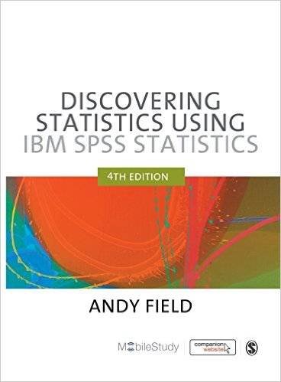
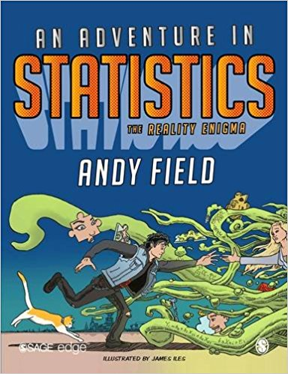
The current situation
Quantitative methods taught separately from substantive subject
‘Standard’ textbooks help with these courses
How to do t-tests, Mann-Whitney tests, etc… through to regression and then sometimes some more complex things
The good ones will use non-technical language (but still some equations / technical language needed
Often based on specific software packages
Other USPs (eg An Adventure in Statistics)

Slide 5
The current situation
Some books organised more by concepts rather than methods

Slide 6
The current situation
Attempts to make it easier for students – adapt to a fear of maths, student dissatisfaction (and subsequent module evaluations)

Slide 7
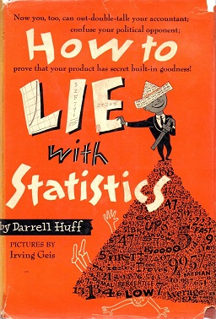
The current situation
Also some general audience books

Slide 8
The problem with this (1)
Students aren’t easily taught why they are doing what they are doing
fake datasets used (for good reason often)
Students learn formulaic ways of doing things, not the concepts behind it
My masters student “my intro module taught me how to do stuff but not what it meant”

Slide 9
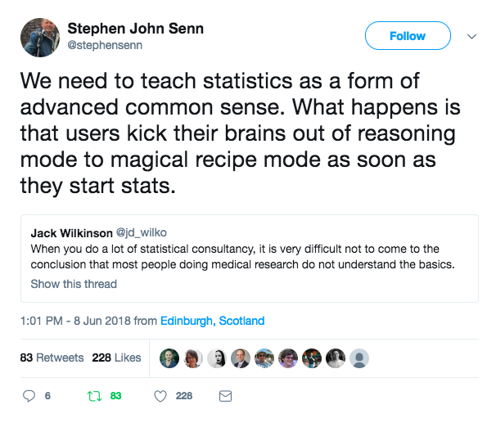
The problem with this (1)
Students aren’t easily taught why they are doing what they are doing
fake datasets used (for good reason often)
Students learn formulaic ways of doing things, not the concepts behind it
My masters student “my intro module taught me how to do stuff but not what it meant”

Slide 10
The problem with this (1)
Concept sometimes lost
Example based on whatever data available (often boring)
How to do a method
Why it matters usually lost

Slide 11
The problem with this (2)
Textbooks teach in a specific order – and that isn’t always the order you want to teach in
This means I rarely end up using them (I’m aware this isn’t everyone’s view)

Slide 12
Our view of teaching statistics
Need to turn statistics on it’s head
Start with why statistical concepts matter
Start with examples
Start with the principles of statistics without maths
Statistics as ‘Advanced Common Sense’
Attempting to make statistics easier is usually counterproductive
Students end up not knowing why they are doing what they are doing
Students don’t enjoy it / engage because they don’t understand why they are pressing the buttons that they are

Slide 13
Our book
No (or very few) equations
No (or very little) software
Chapters based around statistical concepts
Is a number big or small
Graphs
Maps
Good and bad data
Representativeness
Uncertainty
Causality
Rankings

Slide 14
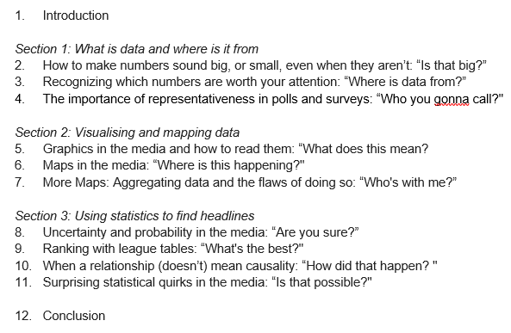
Our book
No (or very few) equations
No (or very little) software
Chapters based around statistical concepts
Is a number big or small
Graphs
Maps
Good and bad data
Representativeness
Uncertainty
Causality
Rankings

Slide 15
Our book
Each chapters start with (an) example(s) from the media (broadly defined) which are used to explain the theory
Why it matters
Example
Concept
How to do it happens next

Slide 16
Our book
Each chapters start with (an) example(s) from the media (broadly defined) which are used to explain the theory
Can get to quite advanced topics – but only if they can be taught with no equations, using media examples
All in ‘plain language’ – but that isn’t the same as dumbing down
Help students understand data in the media – become responsible data consumers in the world of Trump, Russian media interference, etc

Slide 17
Example chapter: league tables
Start with school league tables published in the UK
Explain why it matters (parents choice, schools closed down, etc)
Think about statistical concepts underlying it
Subjectivity of measurement
Uncertainty
Bayesian shrinkage in multilevel models
……

Slide 18
How does it fit in quants methods teaching
An enjoyable book to read
First year modules like those at Bristol / Cardiff / Sheffield – lies damned lies and statistics – this could be a course book!
Supplementary reading to keep students interested in the concepts / methods learned in a more standard quants course
Chapters as the basis of seminar/tutorial discussion

Slide 19
It won’t replace good stats teaching
Still need to teach the concepts and not just the buttons to press in SPSS
Dumbing down makes students like courses less
There isn’t a shortcut for this
But: the book provides a mechanism for discussion / understanding of statistics applying to real life.
Can augment the hard stuff so it’s actually learned properly

Slide 20
Thanks for listening!
Contact me:
Twitter: @andrewjdbell
Email: Andrew.j.d.bell@Sheffield.ac.uk

