Slide 1
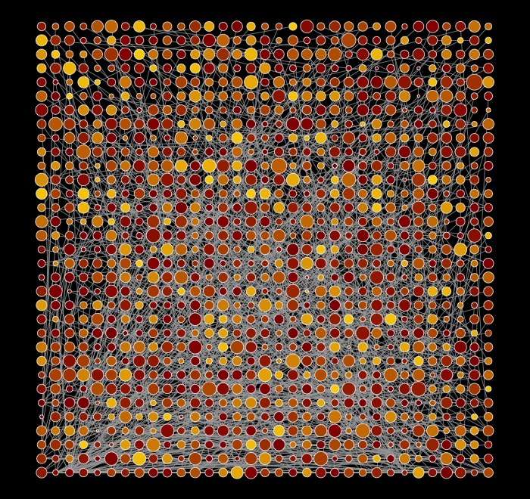
Computer Science and Social Science
Paradigms for deriving insights from data

Slide 2
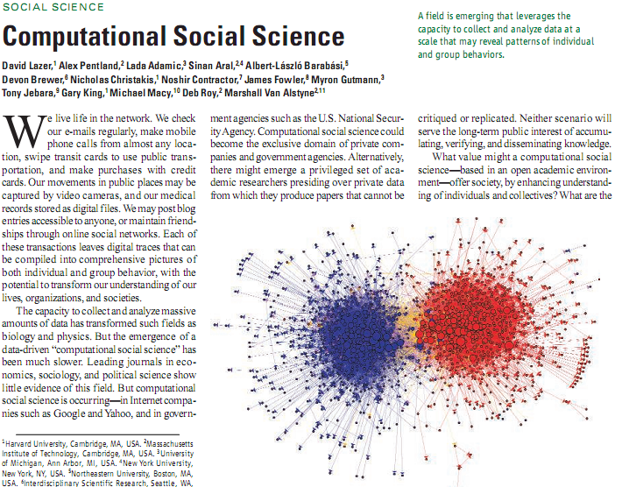
Big data and the social sciences

Slide 3
There has been a fundamental shift in the opportunities in data collection about humans.

Slide 4
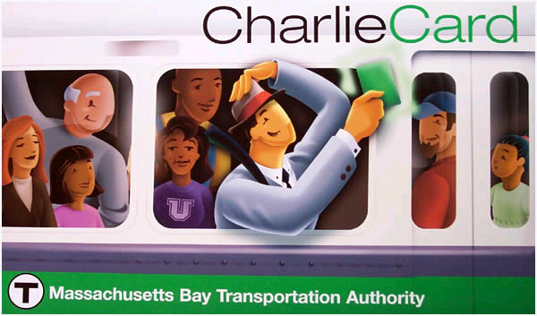
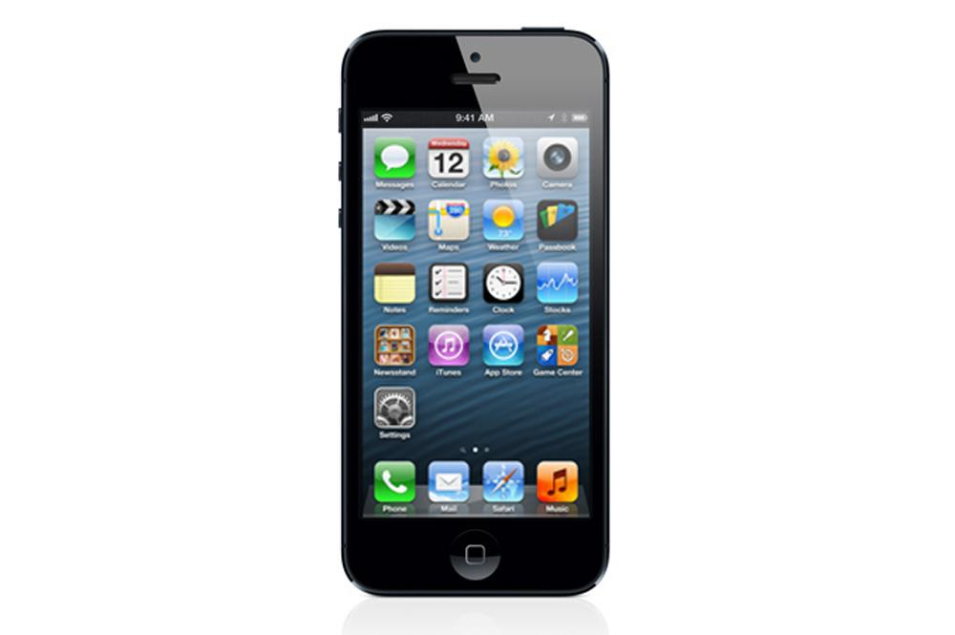
Our digital breadcrumbs…
E-mail
Twitter
Instant messaging
Text messaging
Call data records (from cell phones)
Link structure among websites (google algorithm)
Google searches
What can data like these tell us?
Notes:
Every day each of us leaves thousands of digital breadcrumbs. Our e-mail captures our work transactions, our texts our friendships, our phone calls our connections and locations, link structure the pattern of the conversation of the world, and Google searches our informational needs and, sometimes, our innermost desires. What can these breadcrumbs tell us? [clockwise, e-mail, e-plates from UK meant to track locations of cars, charlie cards, the usage of which is tracked by mbta, e-mail, and iphone]

Slide 5
Phones
Mapping societies (Onnela et al PNAS 2007)
Identifying relationships (Eagle et al PNAS 2009)
Identifying behavioral change associated with the flu (Madan et al Ubicomp 2010)
Emergency-related behaviors (Altshuler et al 2013 Jnl Stat Physics; Margolin et al ICWSM 2013)
Macro-economic change (Toole et al 2015)

Slide 6
Social Media
Real time tracking of opinions during debates (Lin et al WWW 2013)
Studying dynamics of competing hashtags on Twitter (Lin et al ICWSM 2013)
Studying unstructured text to detect “invisible” networks (JAIST 2015)
Detecting political spin (Tsur et al ACL 2015)

Slide 7
Internet as experimental platform
Online field experiments with Members of Congress (various papers with Neblo, Esterling and others in APSR, POQ, PNAS etc)
Experimenting with personalization with Google, Travelocity, etc
VolunteerScience.com

Slide 8
There has been a fundamental shift in the opportunities in data collection about humans.
But: the social sciences have been slow in getting on the boat

Slide 9
We need a new synthesis

Slide 10
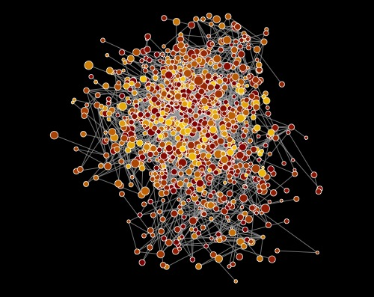
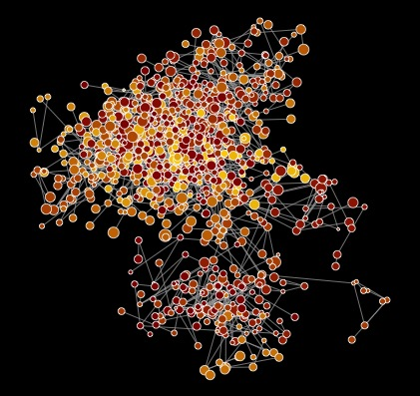
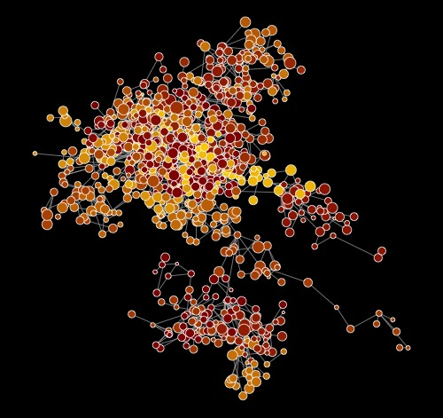
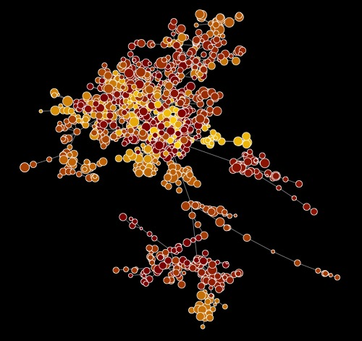
Computer Science
Create features from large, messy data
Apply algorithms, iterate to best parameters
Evaluate fit

Slide 11
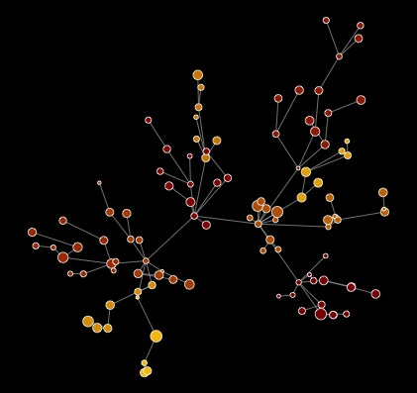
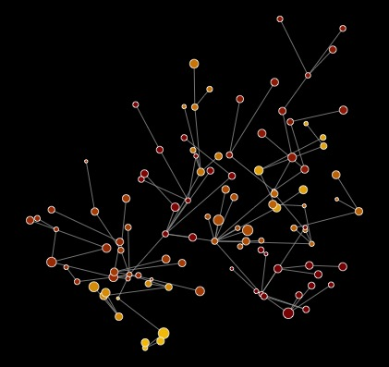
Social Science
Apply social theory and
inferential statistics
Collect ‘small’ datasets
Evaluate fit

Slide 12
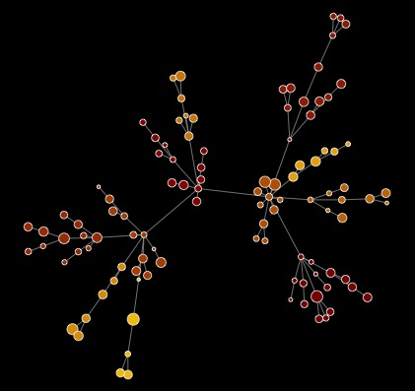
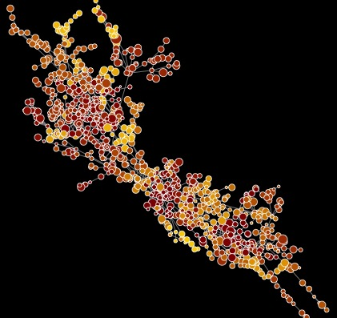
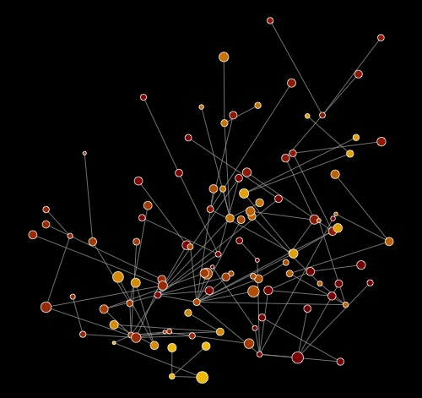
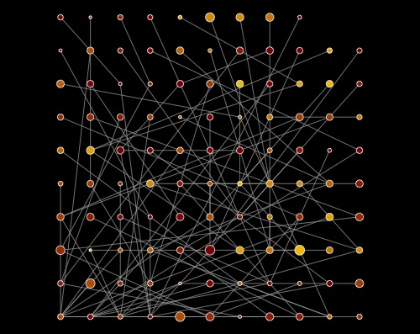
Computational Social Science
Make population-level inferences
Apply models, iterate to best
parameters
Create features using social theory
Search for representative data hidden in big data

Slide 13
Social science issues
Static
Small scale, not system level
Decontextualizes behavior re social networks/time/space
Little emphasis on prediction (and often does badly)
(Largely) ignores vast majority of existing data on humans

Slide 14
Computer science issues
Often ignores “validity” issues re data
Underemphasis on curation of data/producing powerful subsamples
Emphasis on prediction over interpretability
Ignores emergent social part of sociotechnical systems
Ignores algorithmic biases

Slide 16
Google flu trends

Slide 17
Google flu trends
Examine 50m search terms
Which ones are most heavily correlated with flu prevalence, as measured by CDC regional data?

Slide 19
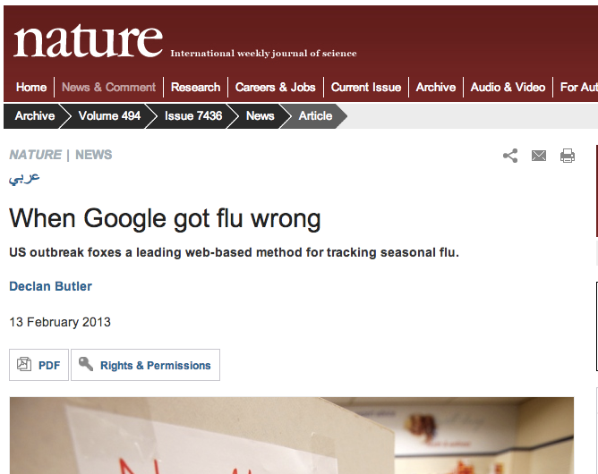

Slide 20
Why did google flu miss?
Big data hubris.
And it was the algorithm’s fault.

Slide 21
Big data hubris

Slide 23
The hubris
Google flu is promoted as more up to date than CDC data
The search terms were identified through brute force “what correlates with CDC data” (50m search terms against 1152 data points) initially leading to some spurious relationships, and then changed once (and then again in Oct 2013)

Slide 24
Overfitting (in 2008 paper)…

Slide 25
The hubris
Google flu is promoted as more up to date than CDC data
The search terms were identified through brute force “what correlates with CDC data” (50m search terms against 1152 data points) initially leading to some spurious relationships, and then changed once (and then again in Oct 2013)
But lagged model based on t-3 does better than Google flu

Slide 26
Modified model…
GFT + lagged CDC (t-2) + correction for previous miss by GFT

Slide 28
The algorithm

Slide 29
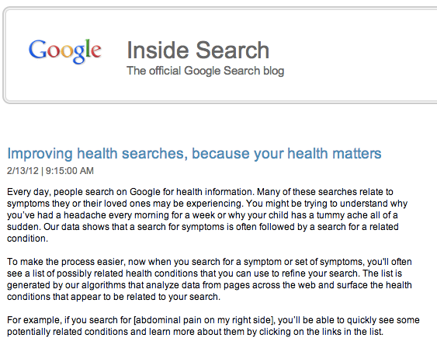

Slide 30
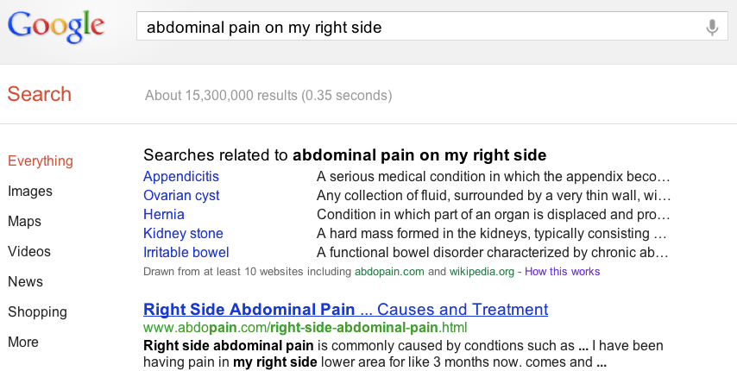
Notes:
Ask people to search for this phrase.

Slide 31
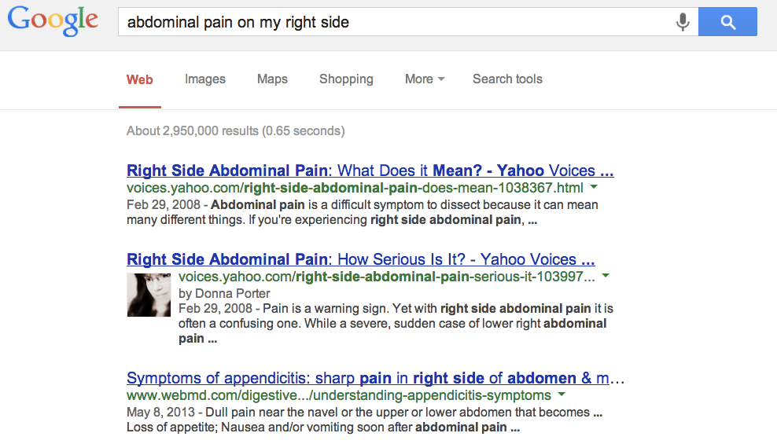

Slide 32
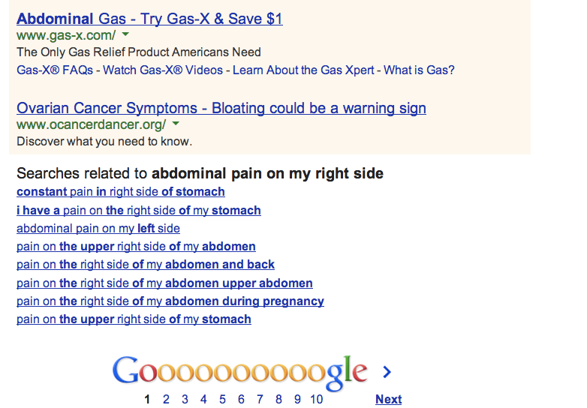

Slide 33
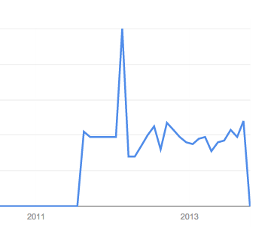
Trends: abdominal pain on my right side

Slide 34
Getting Google Flu’s Search Terms
Google Correlate has a link labeled “…match the pattern of actual flu activity (this is how we built Google Flu!)”
We conducted four Google Correlate searches based on the following time-series:
The CDC % ILI data from 2003 to present.
The CDC % ILI data from 2003 to 2009 (the training period for Google Flu).
The actual Google Flu national time-series.
The Google Flu national time-series post-2010 (when it went off the rails).

Slide 35
Search Prevalence (Top 50 From Google Correlate) For Google Flu and CDC Time Series
GFT is heavily tilted toward remedies

Slide 36
Catching the Google flu: lessons learned
Signals from sociotechnical systems are constantly in flux, to not build that into analyses is statistical hubris.
Big data can overwhelm “small” data
Focus big data on what we don’t know (spatial granularity)
We need to understand behaviors cultivated on sociotechnical systems
The technical part of sociotechnical is worthy of study

Slide 37
Catching the Google flu: lessons learned
There needs to be more transparency in the methods
Big data requires multidisciplinary teams
Train computational social scientists
Develop appropriate infrastructures for 21st century social science

Slide 39
Work in progress…
Using Twitter to predict polls

Slide 40
Twitter
The good:
Runs 24/7
Rich source of opinions, discussion, networks
The bad:
Unrepresentative of the voting public
Bots and organizations
Skews young, urban, Democrat

Slide 41
Overview
Goal: a barometer of public opinion that runs in real time, provides a polling signal at fractional cost.
Challenges: validity, representativeness of the signal.
Our approach: matching, smoothing, re-weighting.
Takeaways: Potential to complement traditional polls.

Slide 42
Matching Twitter to Voter data
Collaboration with vendor to gain access to voter records for Iowa and New Hampshire
Objective: link voter data to Twitter handles
Method: start with unique names in voter data, and link to data in Twitter accounts.

Slide 43
Creating Predictive Features using Tweets
Goal: create predictive features from Twitter data that are not biased vis-a-vis voters.
Challenge: registered voters are diverse, and Twitter skews young, urban, Democrat. Old, rural, and conservative voters may be sparse.
Our approach: multilevel regression with poststratification (Wang et al 2014)

Slide 44
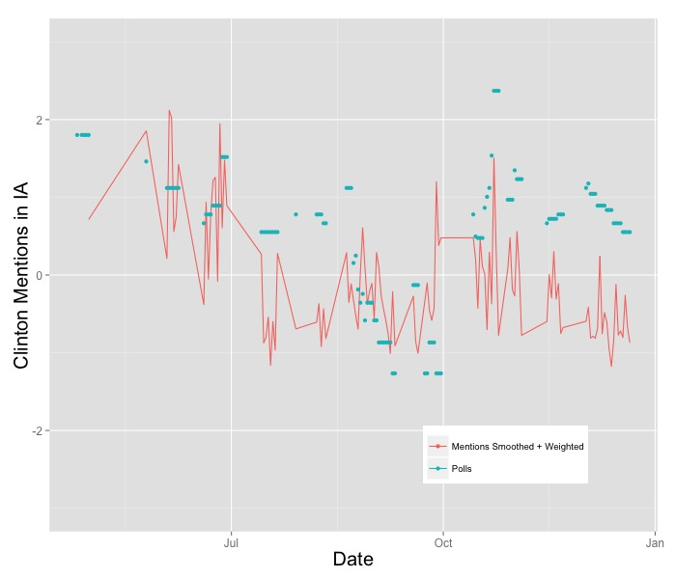
Example: Clinton in IA
Raw Twitter Mentions
Smoothed and Weighted Twitter Mentions
Note: variables are only scaled to mean zero and standard deviation 1.

Slide 45
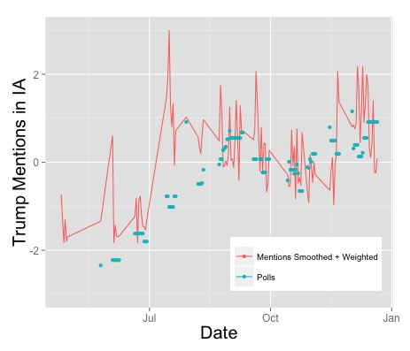
Example: Trump in IA
Raw Twitter Mentions
Smoothed and Weighted Twitter Mentions
Note: variables are only scaled to mean zero and standard deviation 1.

Slide 46
Predictors
Mentions in tweets
Partisanship of user * partisanship of candidate
Sentiment (using crowd-sourced dictionary)
Retweets
Prior polls (7 day lag)

Slide 47
Modeling
Strategy: use features created by multilevel regression with poststratification to predict polling margins.
Gradient stochastic boosting
Tried: least squares, boosted least squares, random forests, partial least squares.

Slide 48
Data
IA: 1,212 voters
NH: 382 voters
Democrats-580, Republicans-514, Ind-500
Men-871, Women-708
Race: Asian-12, Black-16, Hispanic-11, White-1545

Slide 49
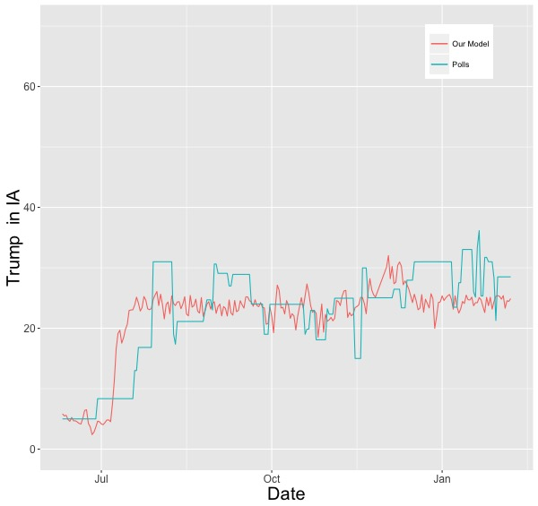
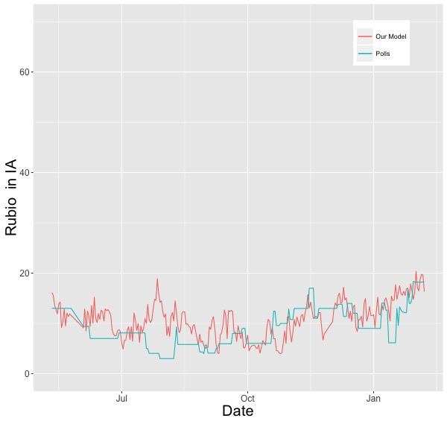
Model Performance w/o polls
Predicts ~80% of the variance out of sample
Improves error of null model by ~55%

Slide 50
Determining a Benchmark Model
What is the appropriate benchmark model?
Challenges:
poll aggregation produces very high day-to-day autocorrelation by design, ~98%
difficult to make improvement over short intervals
Our Approach:
Use naïve AR1 model (w/ week-long lags) as a benchmark

Slide 51
Benchmark Model
Linear extrapolation of earlier polls (7 days)
Autoregressive (AR1) model uses week-old polls to forecast current polls.
Average error and $R^{2}$ out of sample:
Autoregressive model: 4.14 pts., ~.93 $R^{2}$

Slide 52
Clinton in IA: Benchmark Model

Slide 53
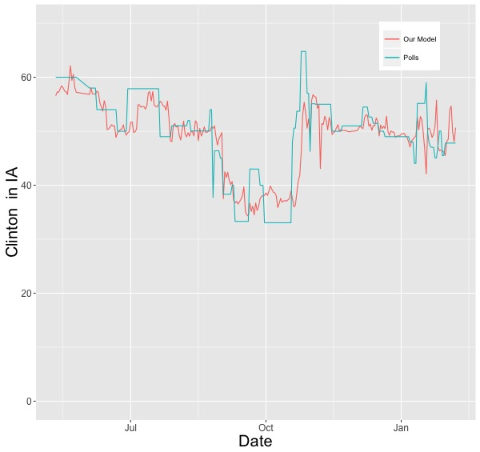
Clinton in IA: Our Model

Slide 54
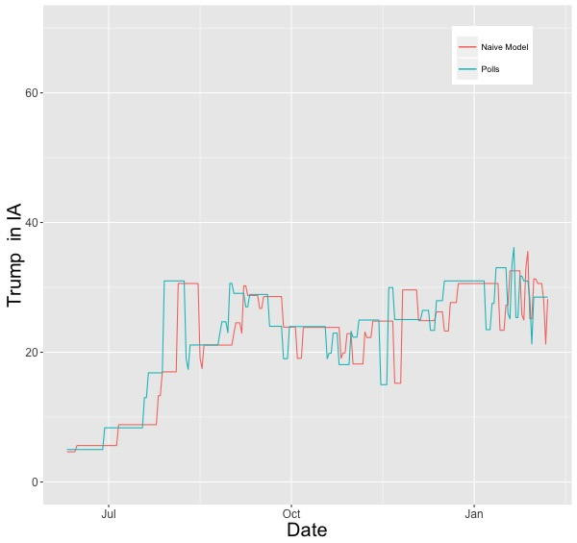
Trump in IA: Benchmark Model

Slide 55
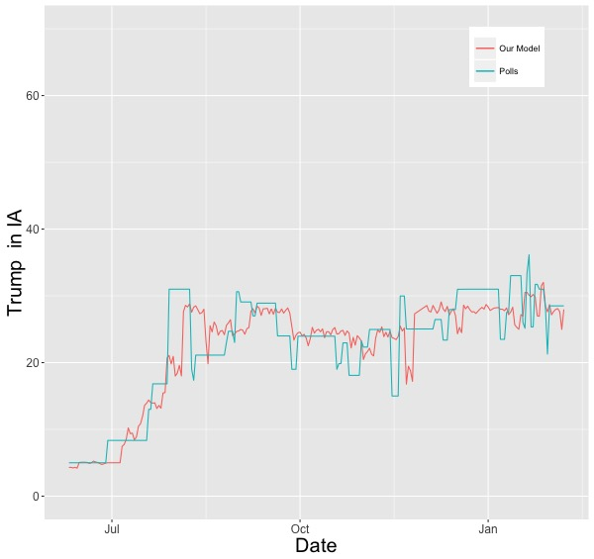
Trump in IA: Our Model

Slide 56
Sanders in IA: Benchmark Model

Slide 57
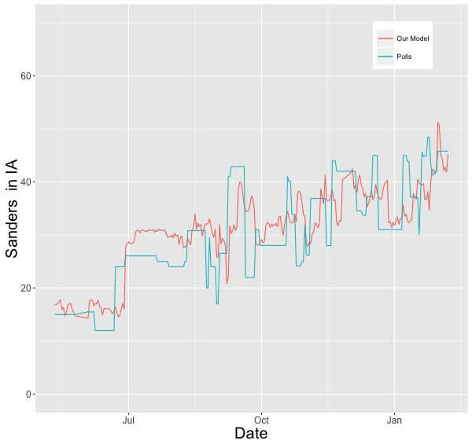
Sanders in IA: Our Model

Slide 58
Comparison: Our Model vs. Benchmark
Twitter Model with 7-day poll lag
MR.P Twitter features fitted with Stochastic Boosting
Average error and $R^{2}$ out of sample:
Benchmark model: 4.14 pts., ~.92 $R^{2}$
Our model: 3.81 pts., ~.94 $R^{2}$, ~8% reduction in error over benchmark

Slide 59
Model Performance
Reduces error of benchmark models by ~8%
Average error 3.81 points in out of sample contest compared to 4.14 in benchmark
Captures variance in polls without relying on prior polls.
Applications:
Fill in where polls less dense
Provide real-time complement to polls

Slide 60
Next Steps
Reducing sparsity: using free text mentions rather than @mentions only.
Increase sample size through more powerful matching
Better features: ensembles of sentiment
Expand to other states and national sample
Predict opinion across interesting subgroups (e.g. women, latinos).
Use same panel to predict other things

Slide 61
Key ingredients
Development of tiny subsample of Twitter data, but to homogeneous sample of individuals with known attributes
Develop a panel
Extract features using computational methods
Application of advanced applied stat methods from social sciences
Predictive models from machine learning methods

Slide 62
Mobilization ecosystem
Notes:
Nodes represent websites referenced by Twitter accounts for people in NH. The size of the node reflects how often it is referenced, and a link between two nodes mean that the same people reference both. In the middle are broadly viewed mainstream media (e.g., the Boston Globe). There are multiple special interest communities in this graph, which encompass the central nodes (e.g., around sports, music, religion).
The question is whether this method can identify the sources/institutions that mobilize different parts of the population. E.g. could we use this as a map to identify the coordinative mechanisms for social movements, etc.

Slide 64
Names
Query name-words
No match
One match
Multiple matches
Voter Profiles
Twitter Profiles
Locations
To US location
To foreign location
To unknown location
To same state
To other state
Example 1: 25K voters with unique names
-2300 with one match
-1300 to unknown location
-474 to foreign locations
-342 exact match to listed state

Slide 65
Multilevel Regression with Poststratification
Poststratification: multiply smoothed estimate by weights based on occurrence of each person-type in the population of interest.
Unrepresentative Twitter data
Population weights
Urban
Rural
Urban
Rural
Young
Young
Old
Old

Slide 66
Directed tweets
Democratic voters –> Democratic candidates:
1896
Democratic voters –> Republican candidates:
404
Republican voters –> Republican candidates:
2509
Republican voters –> Democratic candidates:
262

Slide 67
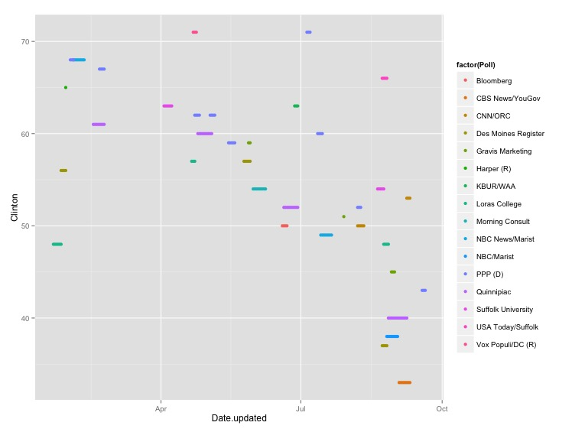
Polling Data – Raw

Slide 68
How to aggregate the Polls?
Challenge: Polls are noisy and intermittent, with high density closer to election.
Approach: Weighted daily averages as compromise between:
recency of poll
sample size

