Slide 1
Alternatives to GNP:
accounting unpaid work and enjoyment.
Jonathan Gershuny and Jooyeoun Suh
Centre for Time Use Research, University of Oxford
ESRC Research Methods Festival
5 July 2016

Slide 2
What’s in GNP?
All products exchanged for money
Some things that are not paid for (imputed rents)
Illicit activities - Drugs, prostitution, alcohol and tobacco smuggling, and tax evasion

Slide 3
What’s Not in GNP?
1. Output from Unpaid Work
  3rd person criterion
  Cooking, cleaning, caring, shopping
2. Enjoyment of work and consumption
  GNP assumes work is instrumental
  Alternative: Accounts of Intrinsic satisfaction from both work and leisure

Slide 4
British national time-use data
UK Heritage Studies
  1961 & 1974 BBC Audience Research
  1985 ESRC (SCELI)
  2001ESRC/ONS HETUS compliant
UK 2015
  Harmonised European Time Use Study (HETUS)
  ESRC funding, CTUR managed, NatCen collected.
  Nationally representative, 2 days, all >7 yrs
  Primary, secondary acts, location, co-presence
  New additions: enjoyment, device use.

Slide 5
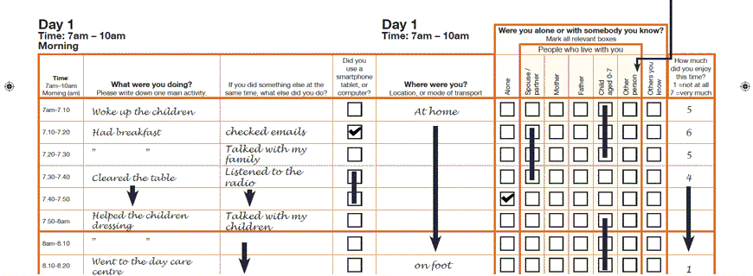
UK 2015 Time Diary Instrument

Slide 6
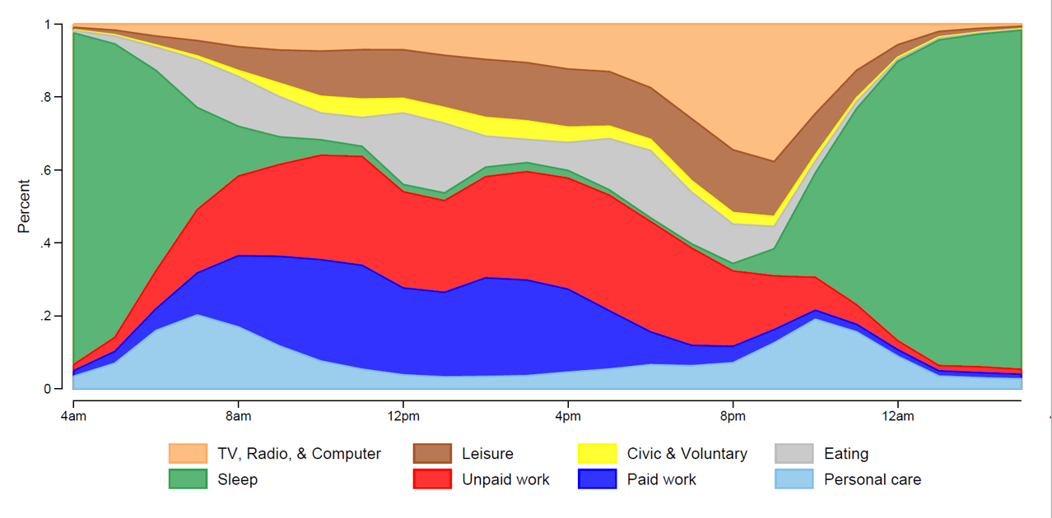
Paid and unpaid work through the day
2015 UK Time Use Data - Weekdays

Slide 7
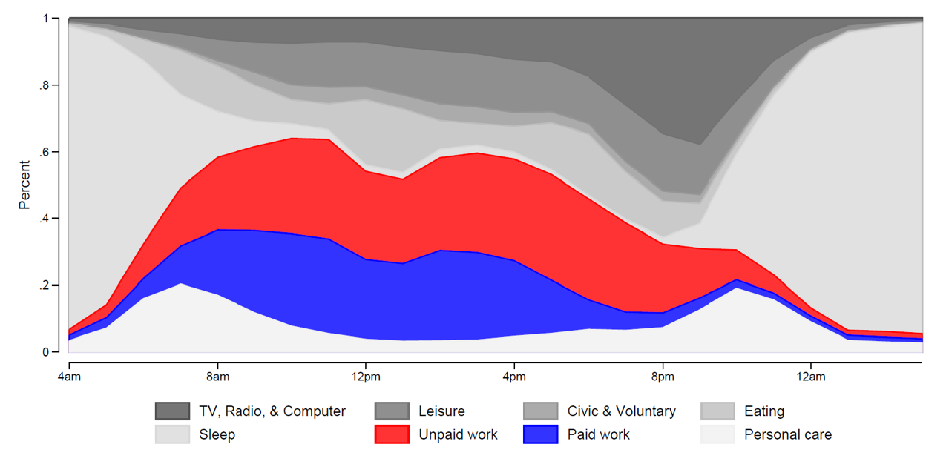
2015 UK Time Use Data - Weekdays

Slide 8
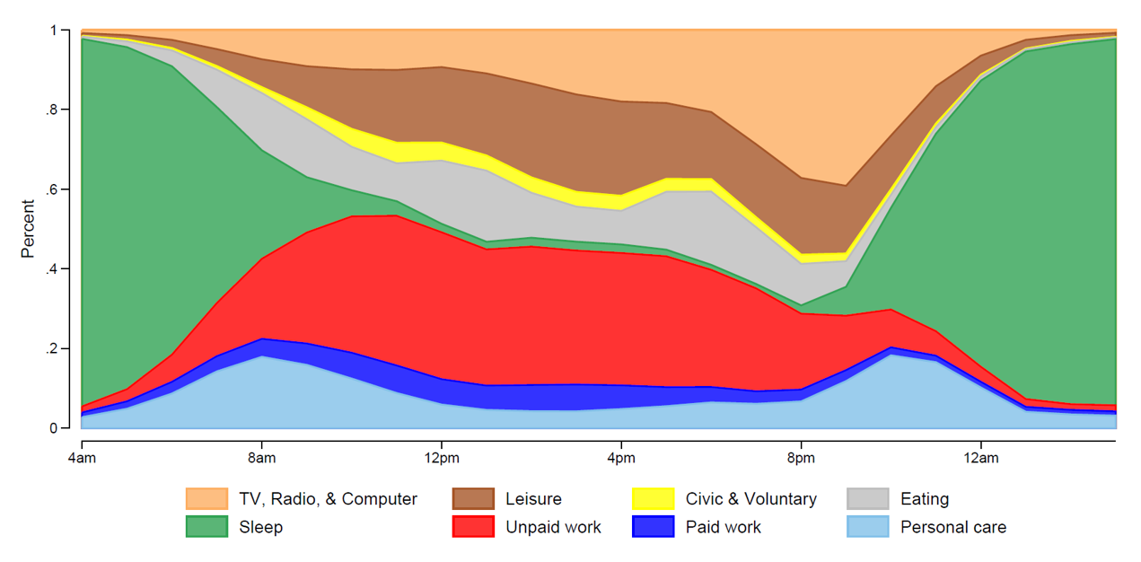
2015 UK Time Use Data - Weekends

Slide 9
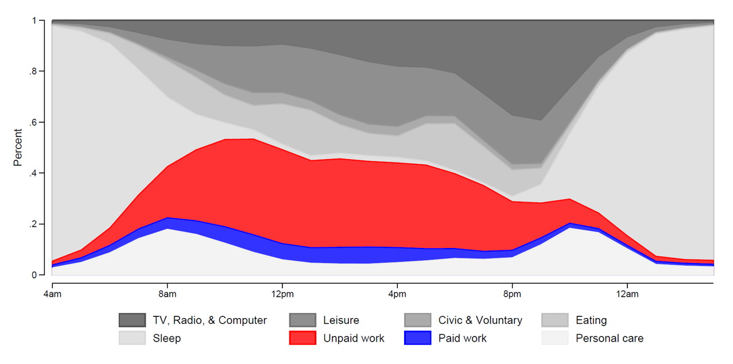
2015 UK Time Use Data - Weekends

Slide 10
Value of Household Production
Nonmarket household services (value of labour input)
+
Intermediate consumption (value of intermediate inputs)
+
Services of consumer durables
+
Services of owner-occupied housing (imputed rent)
+
Nonmarket household production of goods

Slide 11
Valuation Methods
Old debate now ended
  opportunity cost (loser!)
  replacement cost (winner!)
Issues still to be decided…
  Generalist wage (“housekeeper’s wage”)
  Specialist wage Adjustment for quality

Slide 12
Unpaid Household Activities |  | ASHE 2014 Wages
Child care | Physical | Nursery nurses and assistants
 | Developmental | Primary and nursery education teaching professionals
 | Other | Childminders and related occupations
 | Travel | Taxi and cab drivers and chauffeurs
Adult care |  | Care workers and home carers
Cooking |  | Food preparation and hospitality trades (bakers, chefs, cooks and so on)
Laundry |  | Launderers, dry cleaners and pressers
Home repairs |  | Skilled construction and building trades
Shopping |  | Caring personal service occupations
Gardening |  | Gardeners and landscape gardeners
Petcare |  | Animal care services occupations, not elsewhere classified
Travel related housework |  | Taxi and cab drivers and chauffeurs
Source: Annual Survey of Hours and Earnings, 2014, Office of National Statistics

Slide 13
Unpaid Household Activities |  | Minutes | ASHE 2014 Wages | Wages £/hour
Child care | Physical | 13.23 | Nursery nurses and assistants | 7.55
 | Developmental | 7.80 | Primary and nursery education teaching professionals | 20.00
 | Other | 1.17 | Childminders and related occupations | 8.26
 | Travel | 6.50 | Taxi and cab drivers and chauffeurs | 8.44
Adult care |  | 1.50 | Care workers and home carers | 7.96
Cooking |  | 52.39 | Food preparation and hospitality trades (buthers, bakers, chefs, cooks and so on) | 8.33
Laundary |  | 11.23 | Launderers, dry cleaners and pressers | 6.66
Home repairs |  | 14.22 | Skilled construction and building trades | 10.83
Shopping |  | 28.66 | Caring personal service occupations | 8.68
Gardening |  | 9.52 | Gardeners and landscape gardeners | 9.46
Petcare |  | 10.90 | Animal care services occupations n.e.c. | 8.27
Travel related housework |  | 16.61 | Taxi and cab drivers and chauffeurs | 8.44

Slide 14
UK 2015 Value of Unpaid Labour
GDP ≈ £1,900 Billion

Slide 15
UK 2015 Value of Unpaid Labour
GDP ≈ £1,900 Billion
Child care (Physical, Developmental, Other, Travel)
Adult care
Cooking
Laundry
Home repairs
Shopping
Gardening
Pet care
Travel related to Housework

Slide 16
UK 2015 Value of Unpaid Labour
GDP ≈ £1,900 Billion
Child care (Physical, Developmental, Other, Travel)
Adult care
Cooking
Laundry
Home repairs
Shopping
Gardening
Pet care
Travel related to Housework
Unpaid work time multiplied
by imputed wages (=XGDP)
≈ £615 Billion
……..or 33% of GDP

Slide 17
BUT, still missing….
…..the rest of the day!
Process benefits (Juster and Stafford 1984)
  Estimates from all daily activity…
  …”how much do you enjoy…..?”
  ∑(time in activity*q’nnaire enjoyment measure)
National Time Accounts (Krueger and Kahneman 2009)
  Affect fields in new HETUS diaries
  ∑(time in activity*diary-based enjoyment measure)

Slide 18
Time diary enjoyment studies
2010-2015 HETUS national representative studies in France, Italy and UK.

Slide 19
UK 2015 Time Diary Instrument

Slide 20
Time diary enjoyment studies
2010-2015 HETUS in France, Italy and UK.
Robinson 1985 US open-coded self-completion diary, start/end intervals, with enjoyment scale 0-10
Erlich UK 1986 pre-coded self-completion diary, fixed 30-minute slots, converted to start/end with terminal affect score, negative enjoyment scale 5-1, recoded as 2*(5.5 - enjoyment score)

Slide 21
US and UK men’s and women’s enjoyment

Slide 22
Utility estimation: analysis strategy
Start with a “case=event” file…
…attach to each event of a particular activity type, aggregate estimates of total time devoted by diarist to that activity during the diary day…
…weight each event by its duration and…
…regress total time, total time squared, and controls onto measured enjoyment of the event.

Slide 23
Marginal and total utility
Utility from one type of activity
        Eq 1) e_{ij} = a_{jk}X + b_{j}t_{j} +c_{j}t²_{j}
Marginal utility for an activity
Eq 2) δe_{ij}/δt_{j} =b_{j}+2c_{j}t_{j}
Total utility for the observation period
Eq 3) u = (∑₁^{i}∑₁^{j} d_{ij}.e_{ij} )/T
Where:
  e_{ij} is the enjoyment rating of each diary event
  d_{ij} is the duration of each event
  i events in a continuous diary sequence
  j exclusive categories of activity (eg “sleep”, “watching television”, “paid work”)
  X a vector of k control variables
  t_{j} total all time devoted by diarist to activity j over the entire period.
Estimates from j separate equations (one for each activity)

Slide 24
OLS regressions.
Dependent : enjoyment ratings
11 point ( 0-10) scale for US, 5 point (1-9) scale for UK, p<.05 in bold
Other controls not shown: age, age sq, employed fulltime, has cores. partner,
youngest child aged <5, youngest child aged 5-15,
complete sec'ry ed, some tertiary educ, log hourly wage
US (1985) | leis out | other home leis | pers. care | tv | paid work | dom work | shop | child care | travel
Multiple R | 0.24 | 0.12 | 0.06 | 0.15 | 0.16 | 0.09 | 0.22 | 0.26 | 0.14
Mins in activity/100 | 0.31 | 0.30 | 0.25 | -0.07 | 0.05 | 0.09 | 0.24 | -0.08 | -0.18
Mins acty sq/10000 | -0.02 | -0.03 | -0.02 | 0.02 | -0.01 | -0.01 | 0.65 | 0.08 | 0.03
UK (1986)
Multiple R | 0.17 | 0.20 | 0.19 | 0.21 | 0.24 | 0.28 | 0.29 | 0.23 | 0.26
Mins in activity/100 | 0.25 | 0.35 | 0.49 | 0.48 | -0.08 | 0.00 | 1.16 | 0.47 | 0.19
Mins acty sq/10000 | -0.02 | -0.04 | -0.04 | -0.06 | 0.02 | 0.02 | -0.16 | -0.10 | -0.01

Slide 25
Enjoyment of personal time

Slide 26
Enjoyment of time in home leisure

Slide 27
Enjoyment of time in out-home leisure

Slide 28
Correspondence of
UK/US “marginal utility=0” points
Marginal utility equals zero (mins/day) results where at least one temporal coefficient (t, t²) is significant bold where both temporal coefficients for the country are significant; red where the net marginal effect is positive.
 | leisure out | non-tv home leisure | sleep, personal | tv | paid work | domestic unpaid work | shopping | child care | travel
US | 855 | 448 | 702 | 192 | ns | ns | ns | ns | ns
UK | 561 | 445 | 617 | 430 | 207 | 6 | 370 | 235 | ns

Slide 29
Prospects from this work:
Properly grounded accounts of the enjoyability of daily life – “National Utility” accounts.
Essentially orthogonal to GNP and XGNP.
Could be used (following Stiglitz) to temper arguments for GNP-type growth:
  exchange frenetic US/UK productionist overwork…
  …for more balanced French-type work/leisure mix

