Slide 1
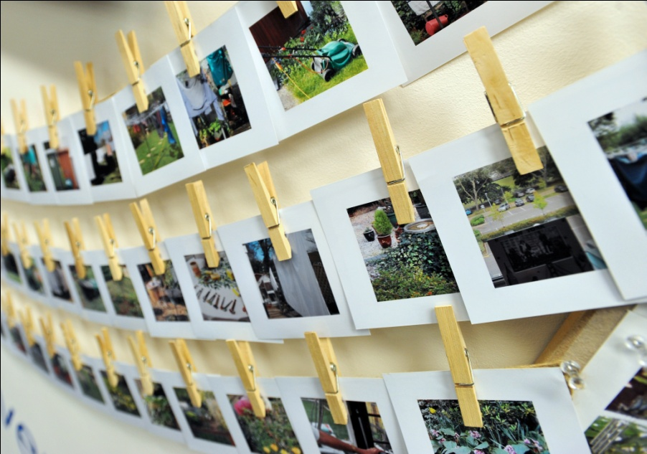
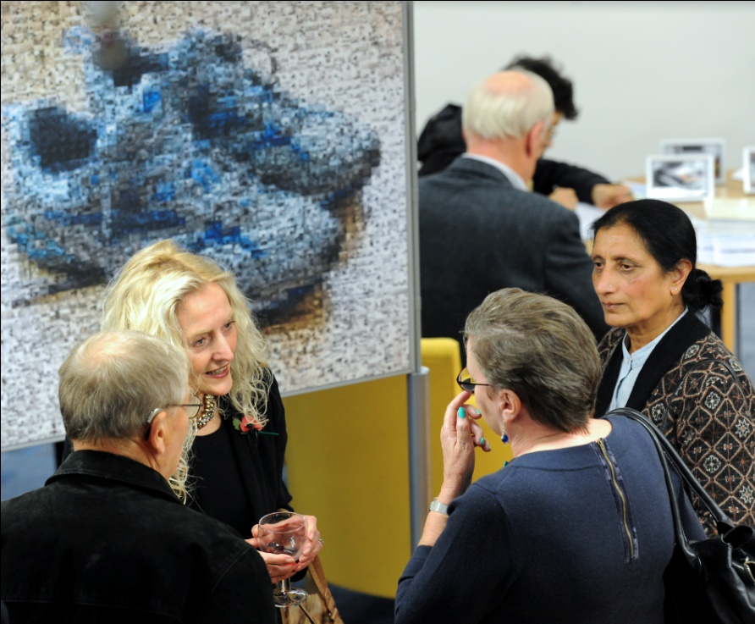
The Use of Visual Diaries to Elicit Insights into Everyday Life
Dr Wendy Martin
(Brunel University London)
Dr Katy Pilcher
(Aston University)

Slide 2
Focus of Presentation
To highlight the context of the ESRC research project: Photographing everyday life: ageing, lived experiences, time and space
To explore methodological issues around researching everyday life
To outline the research design – why visual diaries?
To consider opportunities / limitations of visual diaries
To highlight the focus and purpose of participatory photographic exhibition – disseminating social science data via arts and humanities

Slide 3
Open Access Paper
Issues of collaboration, representation, meaning and emotions: utilising participant-led visual diaries to capture the everyday lives of people in mid to later life
Katy Pilcher, Wendy Martin and Veronika Williams
2015
International Journal of Social Research Methodology

Slide 4
Focus on daily life
Situated within daily life: ordinary, mundane, day to day, habitual, routines
Make visible rhythms, patterns and tempo-spatial textures that underlie habitual / routinised everyday lives
Habitual practices as ‘natural’; the body taken for granted; defined by its absence

Slide 5
Researching daily life
Methodological / theoretical questions: how can we research daily life?
Use of photography to render daily routines visible
‘that our minds have failed to consciously register as we go about our lives’
(Chaplin, 2004)

Slide 6
Aims of research project
To explore the method of photography as a means to map, explore and document the daily and lived experiences and meanings of people in mid to later life
To reveal important insights and theoretical understandings about the everyday lives of men and women aged 50 years and over with different daily routines
To explore the possibilities and dilemmas of the use of photography as a means to explore the daily lives of people in mid to later life
To make visible and provide novel insights into the ordinary and day to day lives of people in mid to later life

Slide 7
Research Design
The research involved a diverse group of 42 women and 20 men aged 50 years and over who took photographs of their different daily routines to create a weekly visual diary
At the end of the week a researcher met the participants and talked through the visual diary during a ‘photo-elicitation interview’
Ethical approval was granted by Brunel University London
Photo-reproduction rights were negotiated and agreed with each participant

Slide 8
Methods and Methodology
Methods and Data Analysis
Visual diaries and photo-elicitation interviews: methods and data analysis
To explore opportunities and complexities with visual diaries:
Enjoyment and ‘collaboration’: the opportunities that visual research enables
Capturing the ‘everydayness’ of daily life?
Representation and the presentation of ‘self’ through images: what can images ‘mean’? Complexities around visual representations and what might get ‘left out’ from visual diaries

Slide 9
Visual Diaries and Photo-elicitation interviews
Research Design: Initial meeting to explain camera operation; participants create a visual diary for one week to show their daily lives/routines; followed by a photo-elicitation interview to discuss their images.
Ethics – consent forms, copyright - photographic reproduction rights form, pseudonyms, deleted photos.

Slide 10
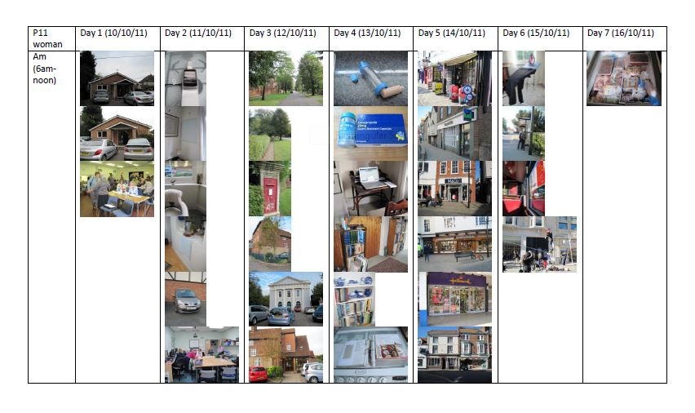
Data Analysis: Preparing Data

Slide 11
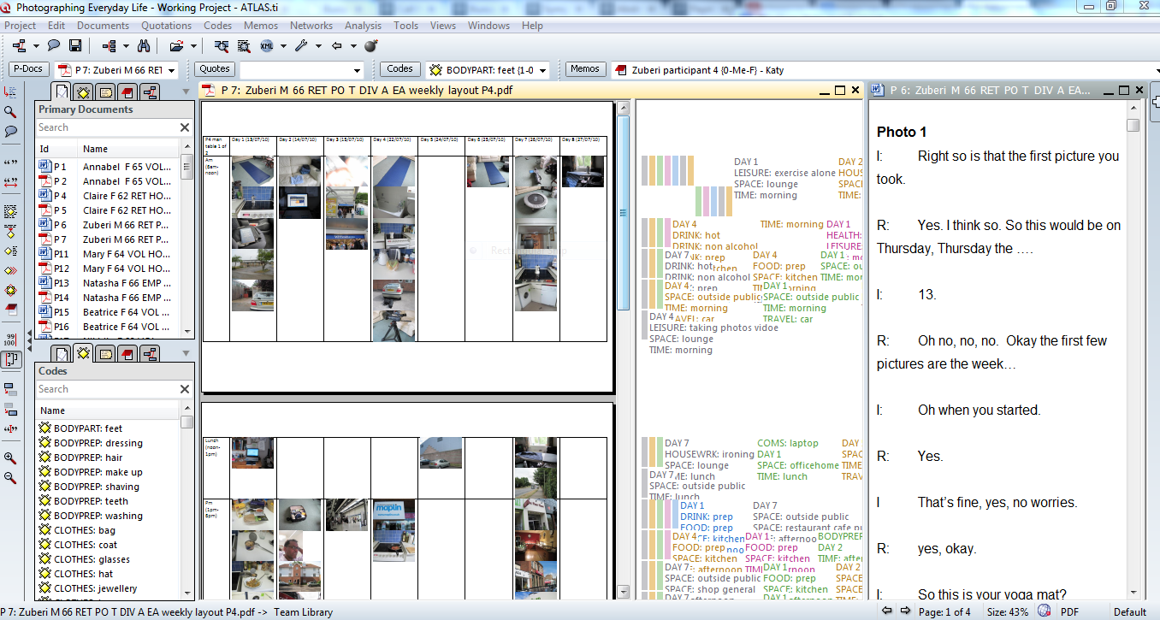
Data Analysis: Coding
Screen shot of Atlas Ti software with working project open

Slide 12
Data Analysis: Linking Text to Photos

Slide 13
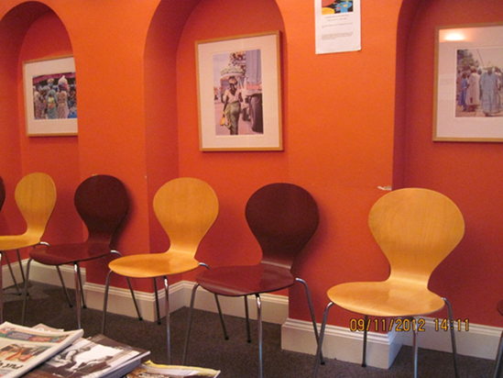
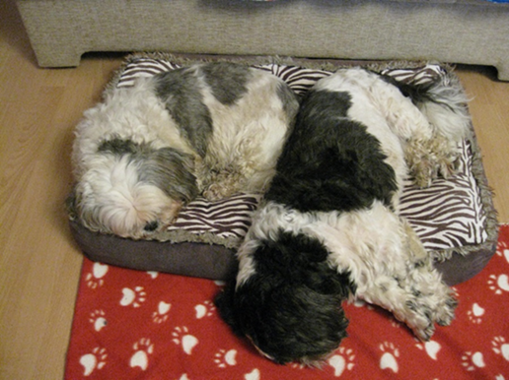
Enjoyment and novelty of the method
‘After, say, a couple of days I was quite enjoying myself’ (Annabel)
‘I thought it was a lovely camera to use. It was easy. After the first couple of days I didn’t think about it at all. I’d just suddenly be doing something and think, ah I need to take a photograph, you know, and I’d go and get it. But I didn’t feel it was an imposition or anything. And I quite enjoyed it actually.’ (Jolene)

Slide 14
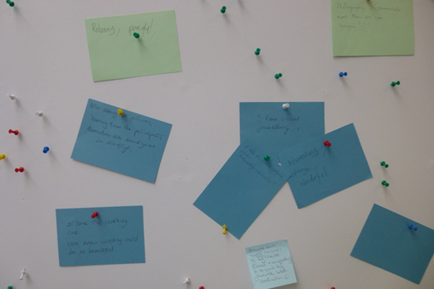
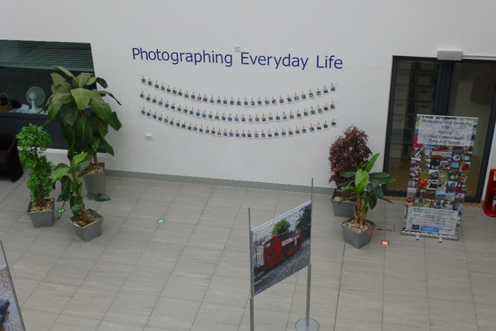
Collaboration
Participants are able to tell stories about their daily lives their own way/from their own point of view
Participants are in control of the camera and research process: can choose what to photograph and what not to photograph
Participants guide pace of interview
Potential collaborations ‘after’ the research process

Slide 15
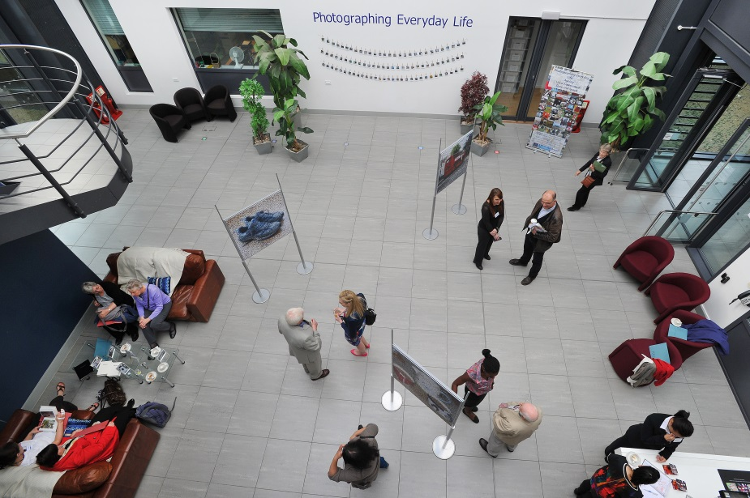
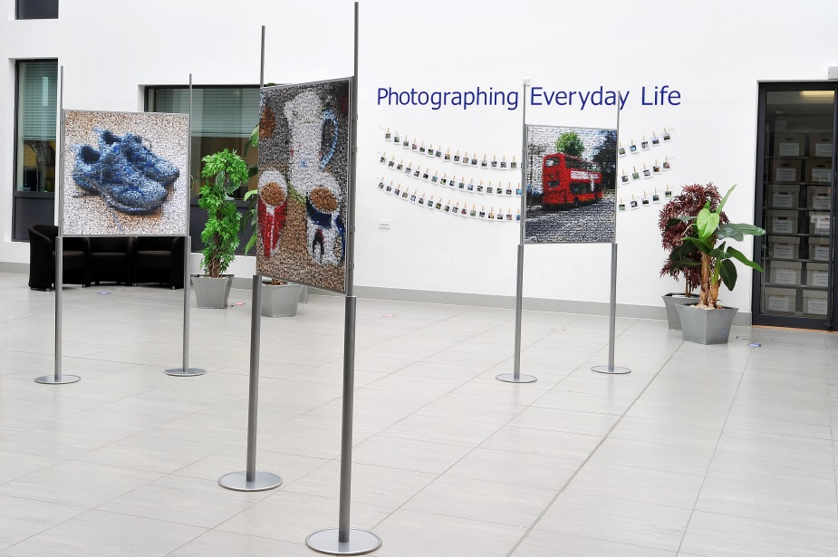
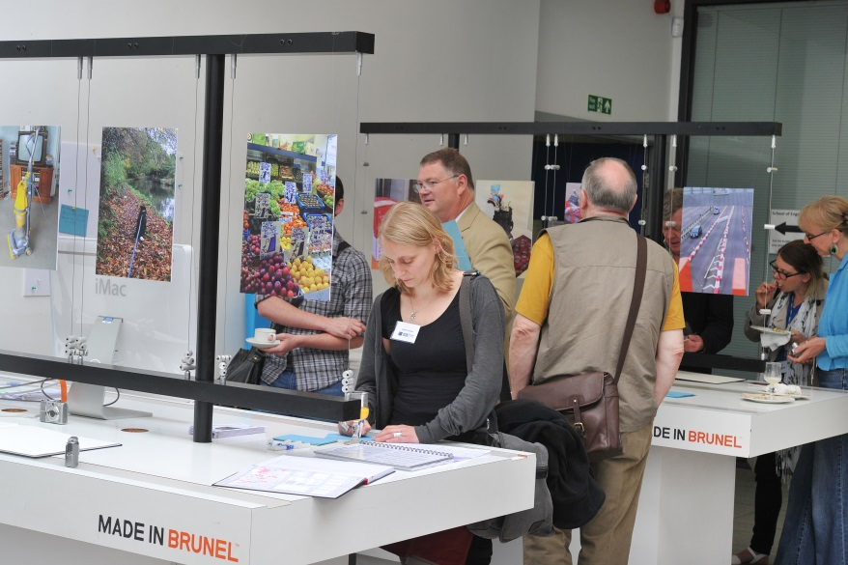
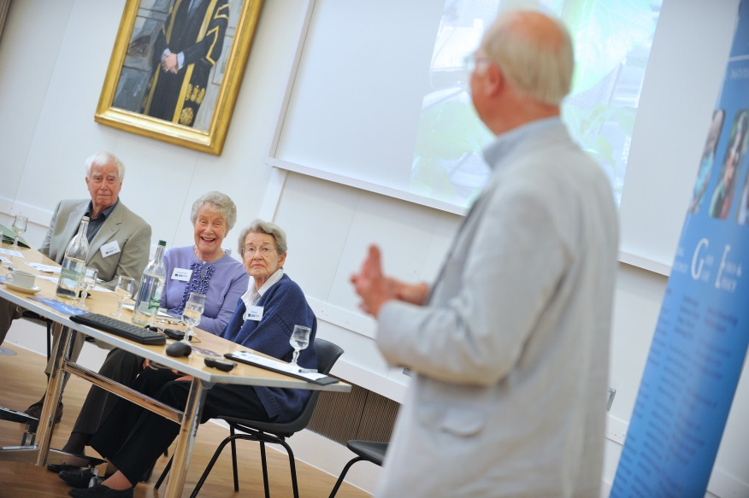
Interactive Photographic Exhibition

Slide 16
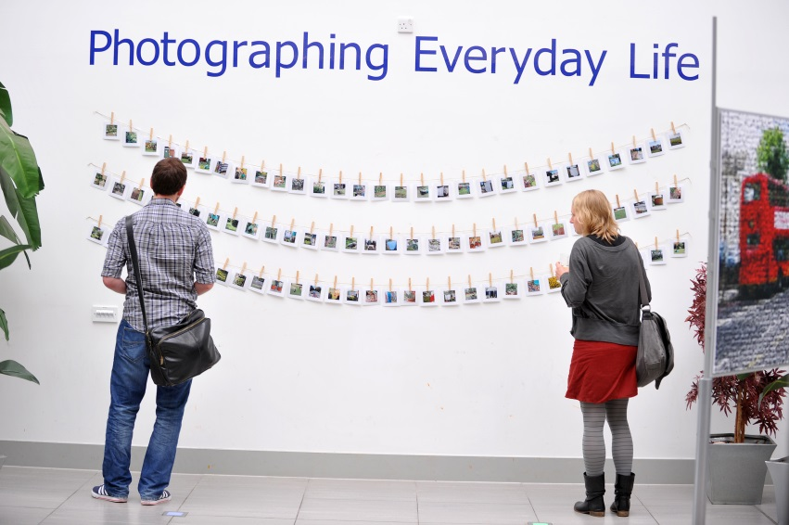
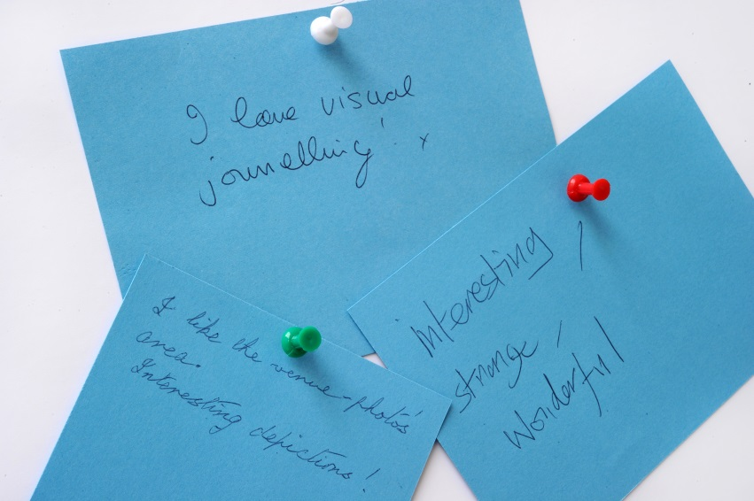
Interactive Photographic Exhibition
I love the washing line. Who knew washing was so beautiful
Interesting, Strange, Wonderful
The ordinary is indeed extraordinary!

Slide 17
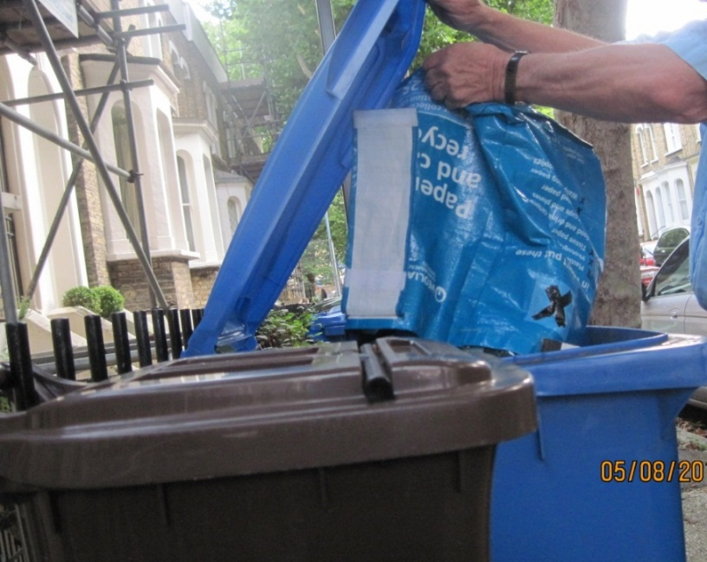
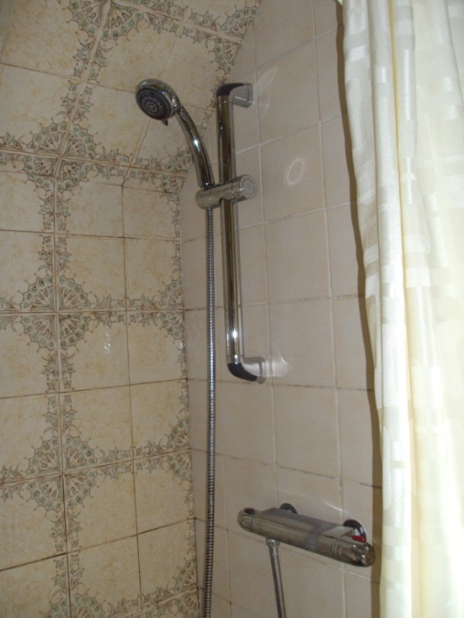
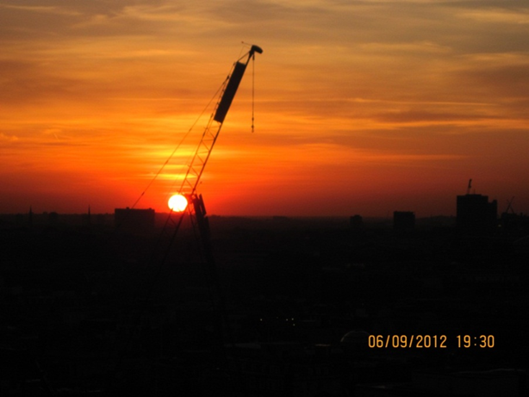
Capturing the ‘mundanity’ of daily life…?
‘…we do do a lot together. We share interests…..I was surprised that we did as much together as we did.’ (Jolene)

Slide 18
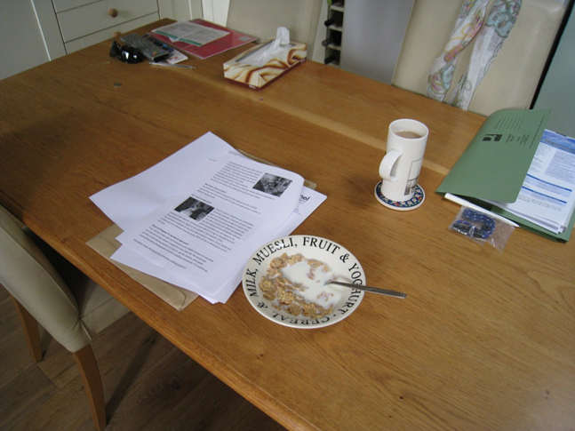
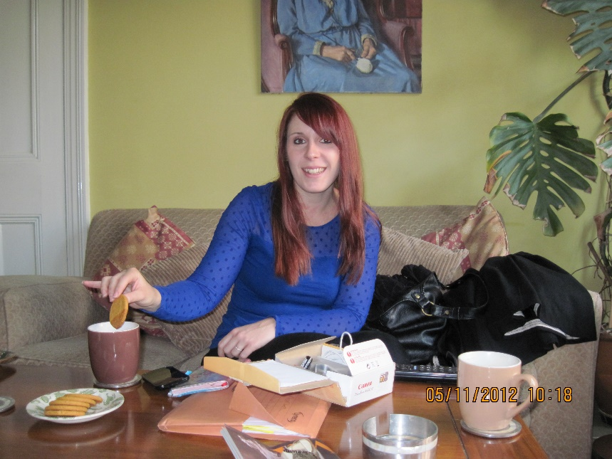
Representation and the presentation of ‘self’ through images: what can images ‘mean’?
Meaning of an image is not fixed. Photographs are partial views of the world – not a set ‘truth’ that can be ‘known’

Slide 19
Construction of images
Sally: And oh there’s the shopping again. Now why’s that there? Don’t know….
Interviewer: Right so the biscuits you bought?
Sally: Yes, yes, oh no, I did some more shopping, that’s right. That was, yes, they were the biscuits, but I put that in because I forgot to put in that I went shopping on Monday morning…And I thought oh gosh I haven’t photographed those and the biscuits were on the table, so I shoved them in the Tesco bag to show I’d been to Tesco’s.

Slide 20
Can we capture ‘dailyness’ through visual diaries?
Visual diaries are very particular ways of representing the self/identity/daily routines
‘I did find myself thinking about what to record and then whether that’s actually bad in this case because you tend to leave out the dross, as it were…….There’s no photographs of stacking the dishwasher or cooking the food or things like that which get done everyday.’ (Phillip)

Slide 21
Concluding remarks
Photographs produce unique interview encounters – difficult to replicate but also can uncover things that might not be elicited through other methods.
Opportunities for enjoyment, novelty, reflection and collaboration.
Issues with representation
Can we photograph the mundane/ordinary? E.g. mess and dirt? Or even things that are so normal/routinised that people do not think to take photographs of them?
Potential for challenging stereotypical images of mid to later life?
All photographs are copyright of Dr Wendy Martin, Brunel University London

