Slide 1



Multi-sectoral data linkage for intervention and policy evaluation
Professor Ronan Lyons, Swansea University

Slide 2
Outline of talk
Effective multi-sectoral collaboration and policy appraisal requires data sharing
Privacy protecting data linkage is essential
Exemplars using the Secure Anonymised Information Linkage (SAIL) system
Housing and household level interventions
Carmarthenshire Housing Regeneration and Health Study
Energy Efficiency – HEED
CHALICE (Alcohol outlets and related harm)
House Fire Risk
Moving house
Evaluation of multi-sectoral person-based interventions
Supporting People

Slide 3


Data Linkage: recent reports
Nuffield Council on Bioethics
Council of Canadian Academies

Slide 4
SAIL System – www.saildatabank.com
Suite of privacy-protecting technologies
  Multistage, multi-organisational encryption
      unique anonymised numbers replace individual, household, and organisational identities
- Can track anonymised individuals, never knowing who they are or where they live
- Members of public on an independent panel scrutinise proposals and are often involved in research
Many different health, educational, environment, housing and other public sector datasets and surveys
Funding: almost completely from competitive research grants
Setting up ‘Prudent Healthcare Intelligence Unit’ for service analyses with seconded/funded NHS/other staff
May extend to ‘Prudent Public Services’

Slide 5
Using SAIL
Making sense out of complex, sometimes poorly coded, data is a difficult task
  E.g. Asthma – 57 diagnosis codes and 600 + treatments
Quite a long learning curve
Real world evaluations are essential
  e.g. AirAware evaluation: real time pollution warning
    UK Government advice, logical model to reduce impact on NHS
    Result: Doubled ED attendances and quadrupled respiratory admissions (Lyons et al (2016), J Epidemiol Comm Health doi:10.1136/jech-2016-207222

Slide 6
Current Datasets in SAIL (incomplete coverage)
Administrative Health:
NHS population
Inpatients
Outpatients
Emergency Department
Child Health Database Wales
Administrative Non-Health:
Births
Deaths
Educational Attainment
Social Services
Housing
Crime
Clinically rich data bases:
Specialty specific
Cancer Incidence
Cancer Screening
Congenital Anomalies
Arthropathies
Myocardial Infarction
Diabetes
General
GP Data
Laboratory systems
Study specific
Embedded trials and cohorts
National surveys

Slide 7
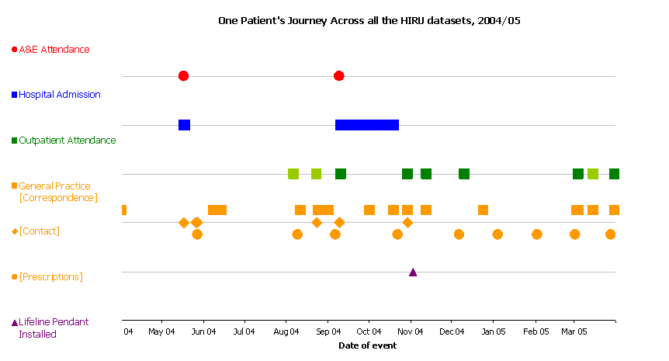
Patient journey analysis through health and social care

Slide 8
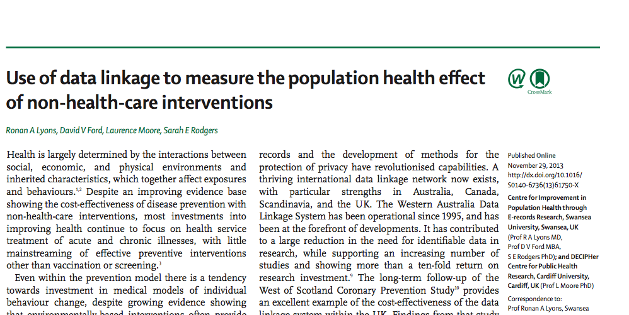
    Lyons, Ford, Moore, Rodgers. Using data linkage to measure the population health impact of non-healthcare interventions. The Lancet. http://www.ncbi.nlm.nih.gov/pubmed/24290768

Slide 9
Development of total population anonymised e-cohorts
Particular interest in Wales enabled by SAIL
A number have been created focussing on population groups or people with particular conditions:
  Wales Electronic Cohort for Children
  PsyCymru
  Arthritis
  Housing……

Slide 10
Wales Electronic Cohort for Children (WECC) – 1M :
Time to the first emergency respiratory hospital admission by duration of pregnancy
Risk decreased with each successive week in gestation up to 40 – 42 weeks.
Risk further increased for babies that were small for gestational age.
The increased risk is small for late preterm infants but the number affected is large and impacts on healthcare services.

Slide 11
WECC: moving house, health and education
Ability to track house moves via GP registrations
Study effect moving frequently has on outcomes
  Do children who move home and school frequently have poorer educational outcomes in their early years at school? An anonymised cohort study. PLoS One 2013, Aug 5. Yes
  Does frequent residential mobility in early years affect the uptake and timeliness of routine immunisations? An anonymised cohort study. Vaccine 2016, Feb 27. No
  Future:
          Influence of changing deprivation status
      Influence of changing environmental exposures: greenness

Slide 12
Association between serious head injury and satisfactory performance on KS1
Predictor |  | aOR (95% CI)
Head injury | None (reference) Skull fracture Concussion Intracranial injury | 1 0.79 (0.52, 1.18) 0.87 (0.31, 2.49) 0.46 (0.30, 0.72)
Gender | Male (reference) Female | 1 1.95 (1.87, 2.03)
Townsend deprivation index quintile | 1 (Least deprived) (reference) 2 3 4 5 (Most deprived) | 1 0.64 (0.59, 0.69) 0.49 (0.45, 0.52) 0.38 (0.35, 0.41) 0.26 (0.24, 0.28)
Age at KS1 assessment | (years) | 2.77 (2.60, 2.97)
Birth weight | (kg) | 1.41 (1.35, 1.47)
Gestational age | (weeks) | 1.01 (1.00, 1.03)

Slide 13
The Housing Regeneration and Health Study: Intervention
Investment of £204 million in Carmarthenshire social housing improvements; 9,256 homes (2008 – 2015)
internal works: kitchen units, bathroom suites, downstairs toilets, central heating, rewiring
windows and doors: double-glazed, locks
thermal insulation: walls and loft
gardens and estate package: fencing, security lights, paths in good condition.

Slide 14
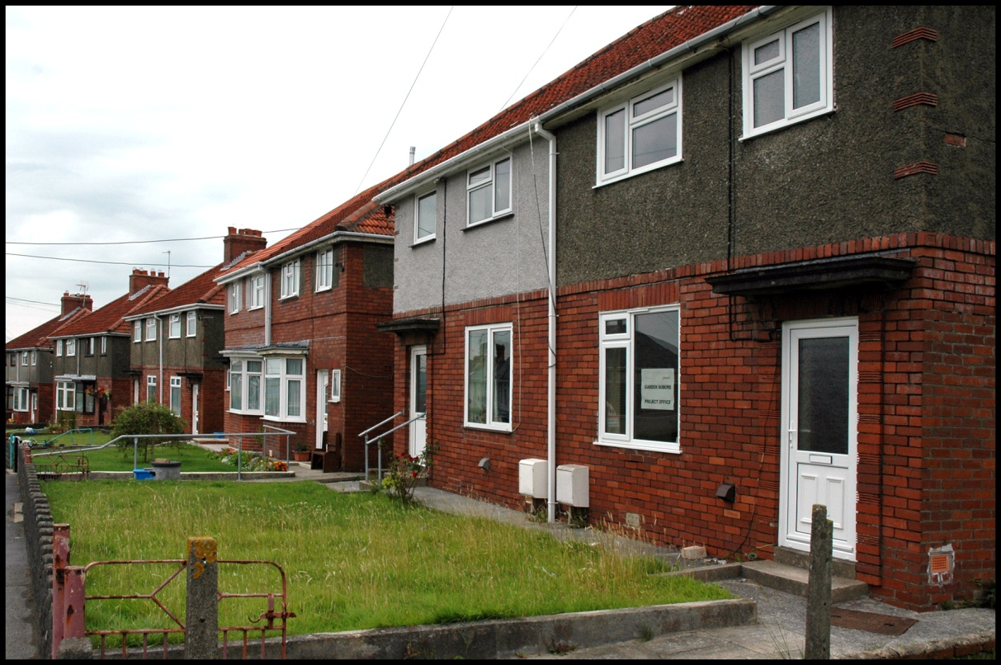
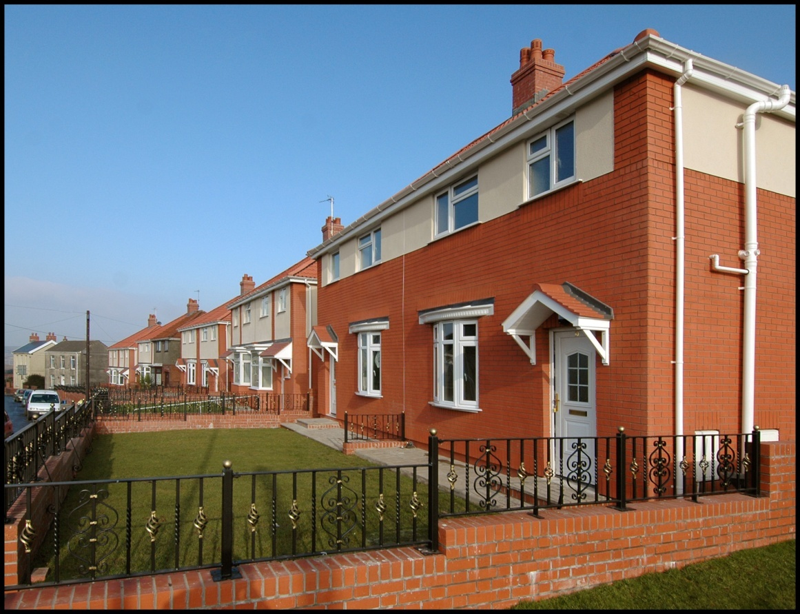

Slide 15
Question and methods
Does improving housing benefit the physical and mental health of residents?
Comparisons of health changes over time of
Intervention group: 9,256 social homes
Comparator groups
13,000 social households in a nearby LA
167,000 homes in Rest of Carmarthenshire

Slide 16
Outcomes
Primary outcome measure:
  change in the proportion of residents aged 60+ with emergency admissions to hospital for:
      Cardiovascular disorders
      Respiratory conditions
      Falls
      Burns
  Secondary outcome measures
    Incidence of GP treated anxiety and depression
    All-cause mortality
    Costs associated with using health service

Slide 17
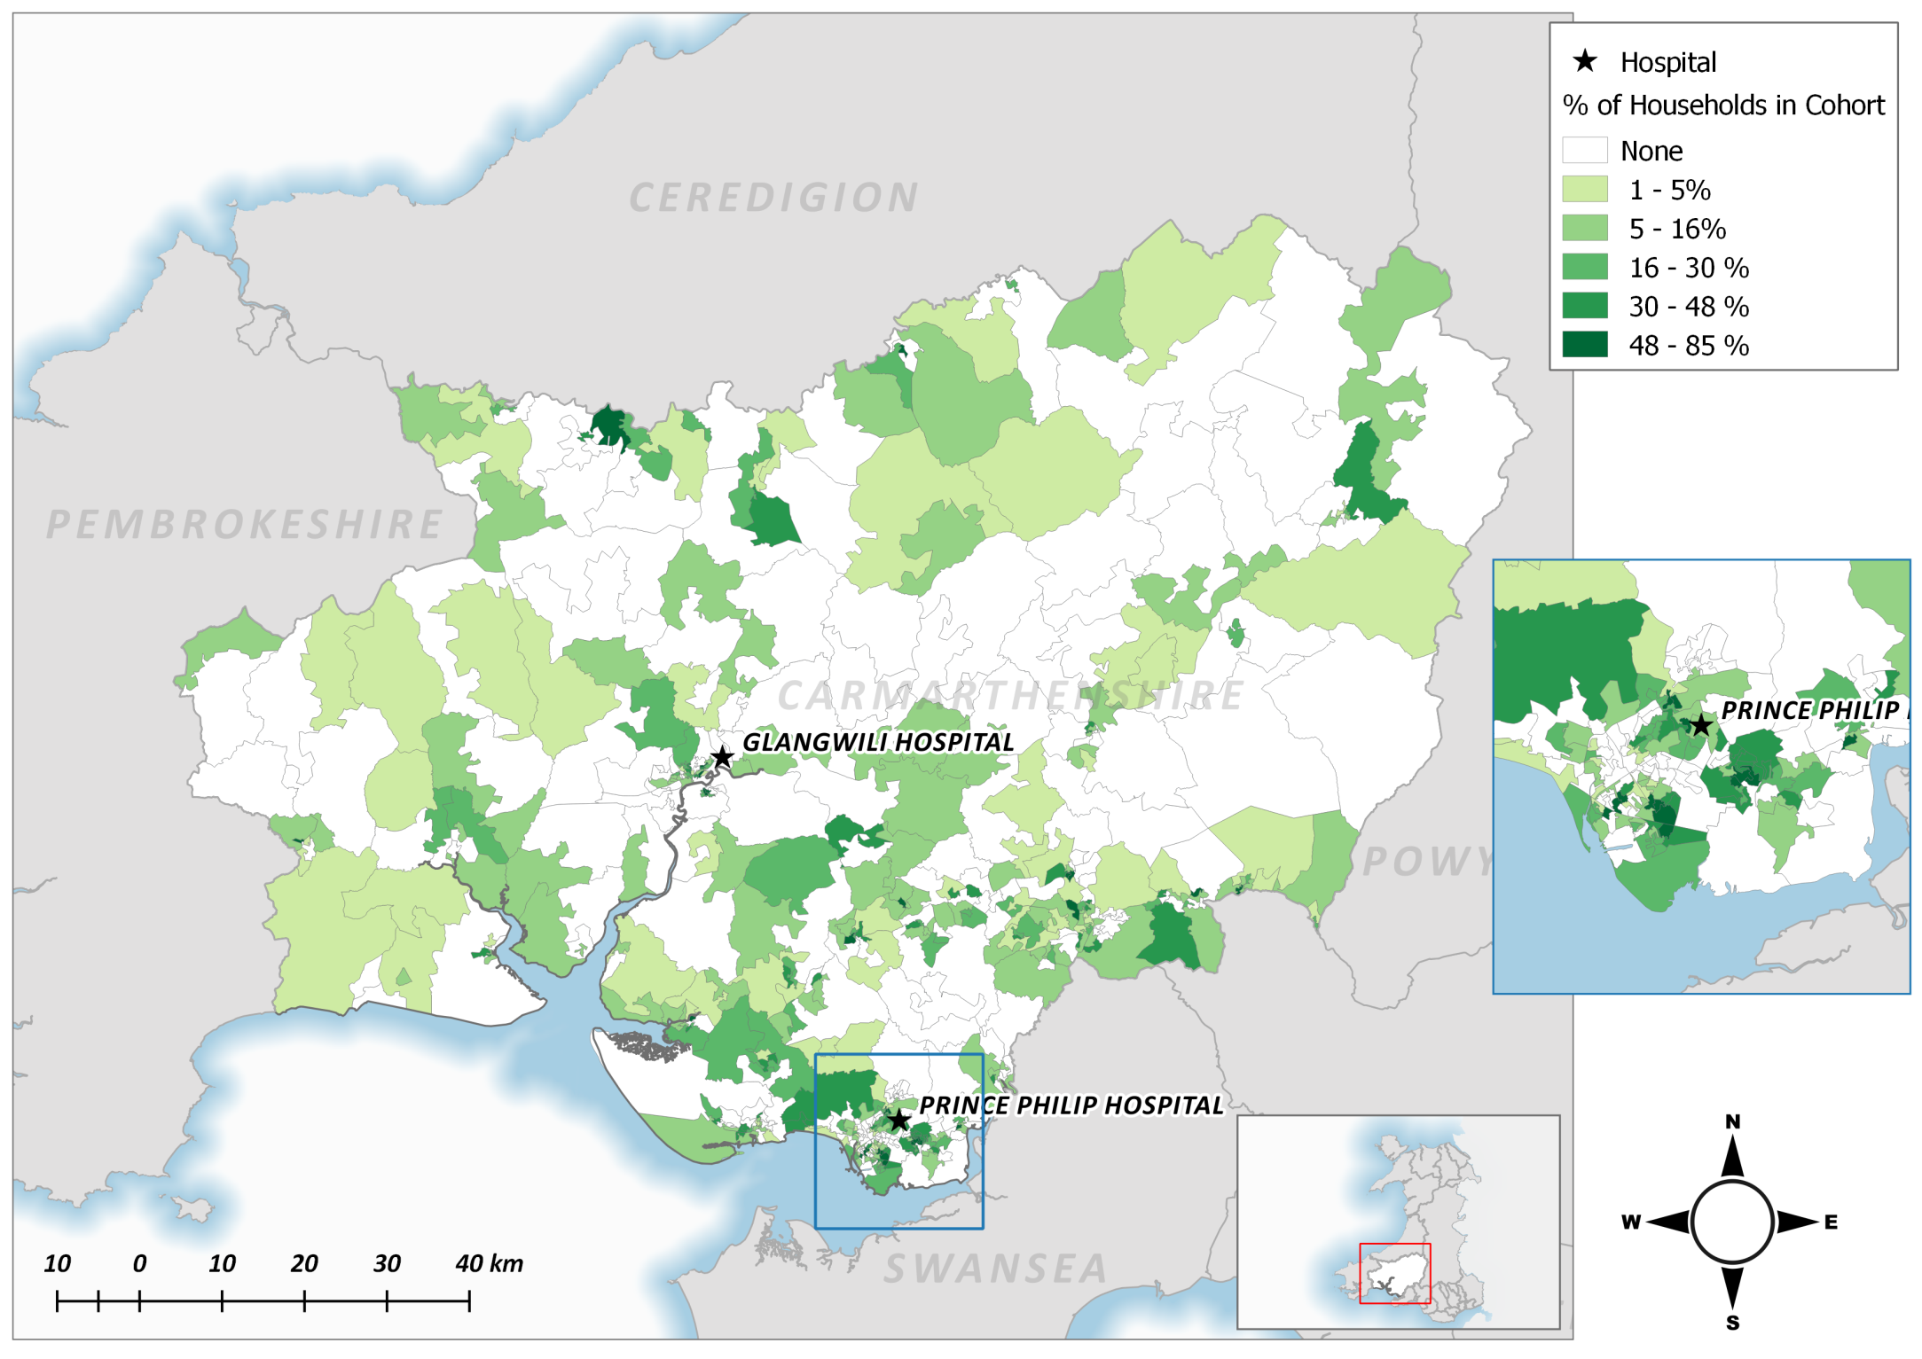
The Housing Regeneration and Health Study
Intervention
Comparator 1
Comparator 2
Individuals
32,000
Individuals
50,000
Individuals
231,000
Observations
2,218,000
Observations
3,347,000
Observations
25,241,000
Still at address
54%
Still at address
26%
Still at address
49%
Percentage of study properties per LSOA within Carmarthenshire County Council
Rodgers et al. Cohort Profile: The Housing Regeneration and Health Study. IJE 2012; 1–9, doi:10.1093/ije/dys200
Notes:
Note: data rounded to nearest 1000 and whole percentages. Emerging results – subject to change. Funded by NIHR PHR
Over the entire study period there were 32,000 individuals (of all ages) registered to an intervention address. Nearly 300,000 unique individuals in total for all intervention and comparator areas.
Over 45% of all participants had complete follow up, that is they contributed to all 123 monthly observation periods. This proportion was highest in the study area with 54% compared to the Social Housing comparator area (1) with 27%.
The regional comparator (2) had 49% of participants with complete follow up.

Slide 18





Anonymisation of Home Energy Efficiency Data to explore intervention outcomes
Taking HEED
Contact details: M.L.Heaven@swansea.ac.uk
Demonstration project reports:
http://gov.wales/statistics-and-research/data-linking-demonstration-projects/?lang=en
Notes:
Hello I’m martin Heaven, I’m a Senior research analyst at the Farr institute and support projects using the SAIL database. This presentation is about a demonstration project I carried out for WG to show the power of data linking.

Slide 19


HEED
SAIL
Home Energy Efficiency Database
Gov. funded home energy efficiency improvement programmes, including the Home Energy Efficiency Scheme
Address level data, with intervention and date of intervention detail
Anonymised into SAIL at address level
The anonymisation uses a trusted third party, the NHS Information Service in Wales.
NWIS utilise the patient registration database for Wales, a history of all GP registrations: who everyone is and where they have lived.
Both the person and their address history are anonymised into SAIL
An address is just a number, but we know which LSOA it is in.
It is possible to build cohorts for research from lists of anonymised addresses
Notes:
The idea of the project was to anonymise the Home Energy Efficiency database into SAIL. HEED is a database containing home improvement interventions from a number of government funded and supported schemes. The data from 2000 to 2013 are held by the Energy Saving Truss. The data they hold are at address level.
Brief explanation of SAIL anonymisation at address level and linked to person level.

Slide 20
Findings
The early group were more needy
Relative changes between the ‘early’ and ‘later’ intervention groups over time, if you allow for a lag period before a measureable difference is observed
The ‘later’ group catching up over time - as would be expected because interventions begin to take place

Slide 21

Further developments ...
3-year WG-ESRC Fuel poverty analyst post
WG-ESRC PhD Studentship (from ‘Oct 2015)
Linking data for more schemes (Arbed and NEST)
Feed findings into design of NEST successor scheme (consultation early ‘16, scheme commencing ‘17)
Linking to data on other outcomes e.g. education
Parallel project to make recommendations to Ministers on housing evidence – possible creation of ‘Dwelling Spine’ for Wales

Slide 22
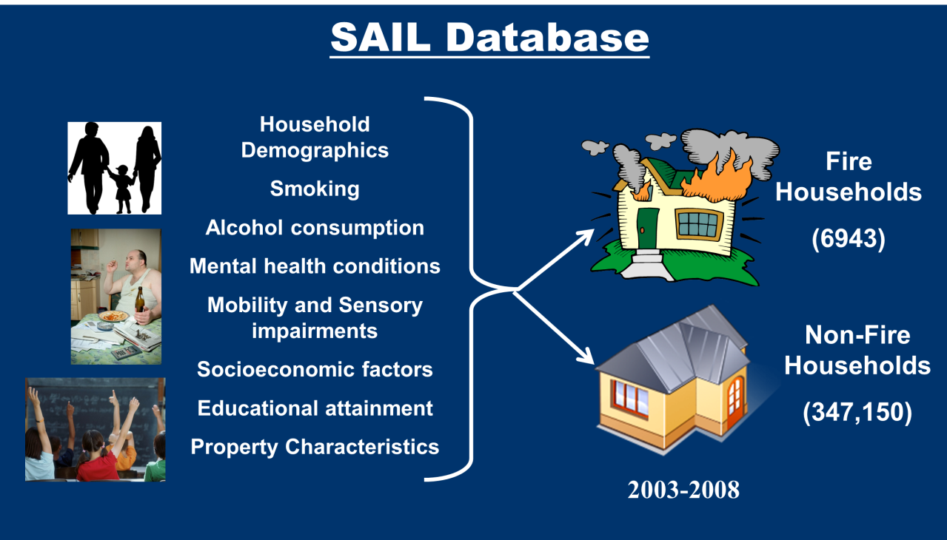
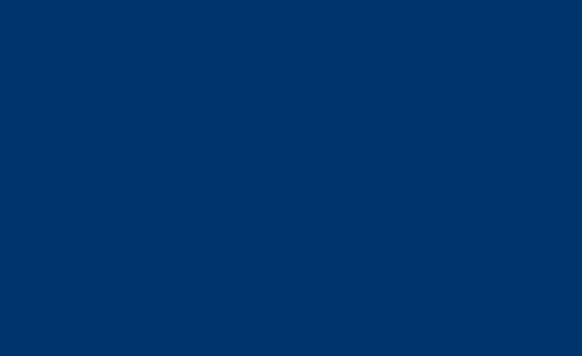

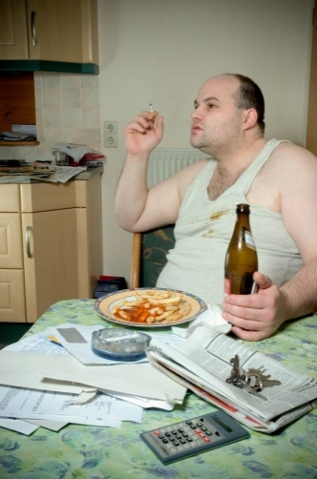


Identifying Risk Factors for Unintentional House Fires in Wales: Samantha Turner
  PhD Project linking Welsh Fire and Rescue Service data to health, educational and environmental data in SAIL
  Statistical analysis to create risk model
  Results will be shared with FRS and partner organisations to support targeting of preventative interventions
  Systematic Review of House Fire Risk Factors will be published shortly
SAIL Database
Household Demographics
Smoking
Alcohol consumption
Mental health conditions
Mobility and Sensory impairments
Socioeconomic factors
Educational attainment
Property Characteristics
Fire Households
(6943)
Non-Fire Households
(347,150)
2003-2008

Slide 23

CHALICE
Do changes in alcohol outlet density influence an individual’s health (alcohol related harm)?
Uses complex geographies of access & SAIL
Output:
Fone D, et al. Public Health Res 2016;4(3). http://dx.doi.org/10.3310/phr04030.

Slide 24
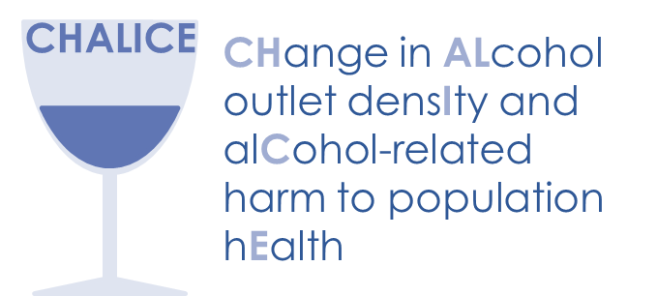
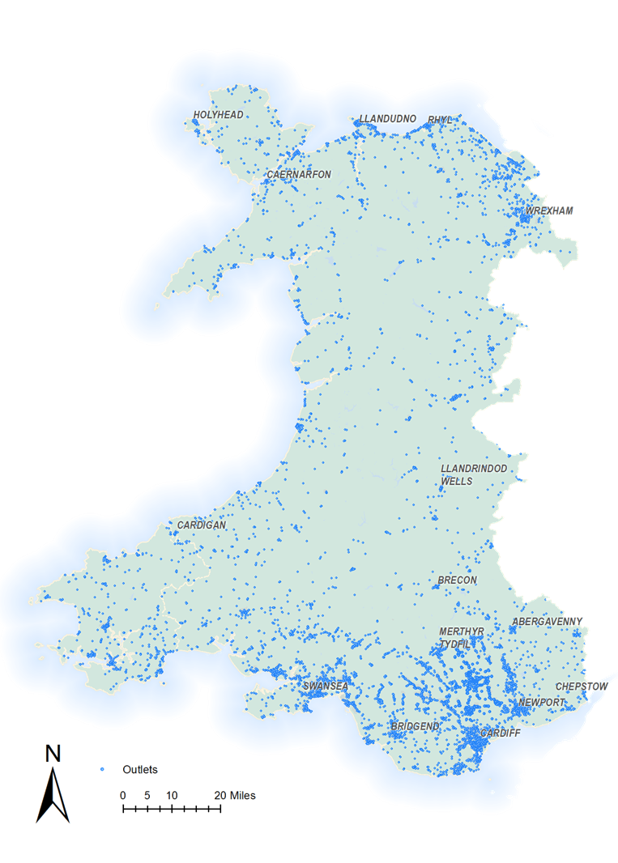
CHALICE
Change in alcohol outlet density and alcohol-related harm to population health
22 Local Authorities in Wales
Licence data addresses geocoded
Geographic Information System density calculations:
  Modelled each type of outlet (e.g. pub, supermarket etc.)
    Median distance to outlet -10 minute walk
    Median distance to outlet -10 minute drive
  Spatio-temporal interaction gravity model
    Quarterly outlet density score at household level
      7 year period
      ~2.5 billion calculations

Slide 25
CHALICE
Change in alcohol outlet density and alcohol-related harm to population health
22 Local Authorities in Wales
Licence data addresses geocoded
Geographic Information System density calculations:
  Modelled each type of outlet (e.g. pub, supermarket etc.)
    Median distance to outlet -10 minute walk
    Median distance to outlet -10 minute drive
  Spatio-temporal interaction gravity model
      7 year period
      2.5 billion calculations
  Walking distance is related to increased admissions from alcohol related conditions, injury and violent crime

Slide 26

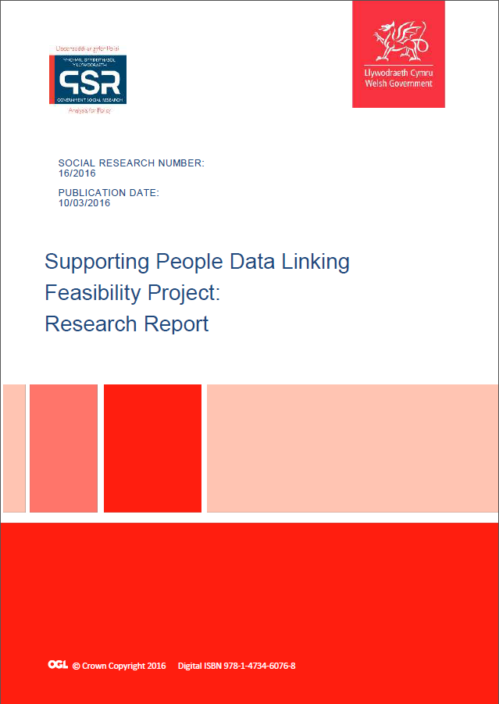
Sarah Lowe
Welsh Government Programme to Maximise the Use of Existing Data http://gov.wales/statistics-and-research/supporting-people-data-linking-feasibility-study/?lang=en

Slide 27
Supporting People Data Linking Feasibility Study
What is Supporting People?
Helps people find and keep a home that meets their needs and encourages independence in a healthy and safe environment
£124 million is invested by WG annually
60,000+ people are supported each year
Aims to prevent problems by providing help as early as possible
Works with some groups with chaotic or risky lifestyles e.g. people with substance misuse problems, people leaving situations of domestic violence
Expects to reduce demand on the NHS

Slide 28
Supporting People Data Linking Feasibility Study
What were we trying to find out?
What data Local Authorities hold
Can routine Supporting People data be linked to routine health data?
Can we identify a robust control/comparison group?
Can we show any change in health service use?
Can we identify cost-benefits of the impact of the programme in Wales

Slide 29

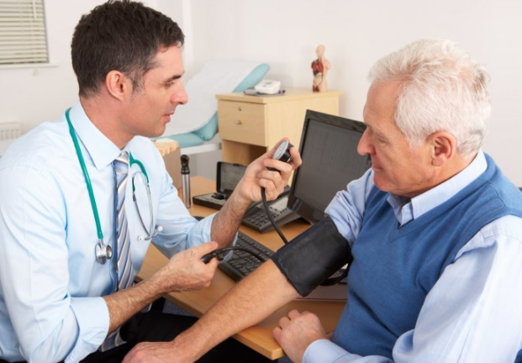
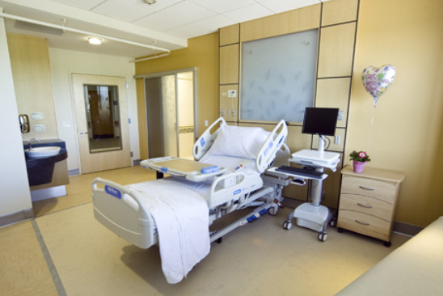
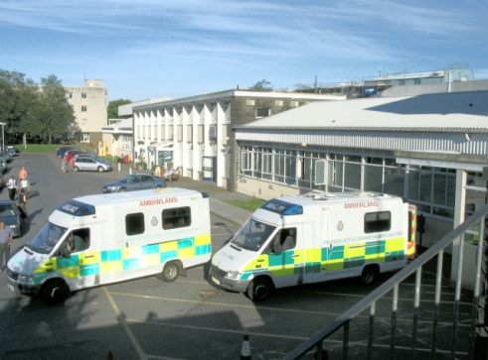
Supporting People: what did we link?
Lead Need (BG)
Service Group (Swansea)
Support Dates
Number of days on which GP Events occurred
Diagnosis codes
Prescribing codes
Number of Emergency Hospital Admissions
Reason for Emergency Hospital Admission
Number of A&E Visits
Reason for A&E Visit
Supporting People
GP
Hospitals
A&E

Slide 30
Supporting People Data Linking Feasibility Study
What we did / limitations of feasibility study
We learned a lot about quality of data and barriers to sharing
Two pathfinder LAs (Swansea and Blaenau Gwent) provided data
Findings are based on a relatively simple provisional analysis
Three key indicators of health service use were analysed:
  the number of days on which GP events occurred
  the number of A&E visits
  the number of emergency hospital admissions
We analysed by age group, gender, ‘lead need’ or ‘service group’

Slide 31
Supporting People Data Linking Feasibility Study
Is a full evaluation feasible? Based on 2 pathfinder LAs:
Linking rates were high (85% or higher)
Barriers can be overcome for LAs holding individual level data
Sufficient interactions with health services were found to make a study worthwhile
Indications are that a quantitative evaluation would be likely to produce statistically robust substantive findings
i.e. Yes!

Slide 32
Selected Findings – comparison group
    Blaenau Gwent LA SP floating support: no. of days on which GP events occurred per record in months before and after SP
    Key Issues:
    Comparators may be LESS engaged with health services or may have LESS severe problems
    Reduction in use is significantly greater for SP Group vs. Comparison Group
    More work is needed to allow us to attribute this effect to SP

Slide 33
Selected Findings
    Blaenau Gwent Local Authority Supporting People floating support: number of days on which GP events occurred per service user in the months before and after support start date by service user 'Lead Need'

Slide 34
Selected Findings
    GP diagnosis codes showing the greatest decrease and increase after the SP start date plus the top five GP diagnosis codes for general population comparison group
Order (top first) | Diagnosis code that decreased the most | Diagnosis code that increased the most | Top five diagnosis codes for general population
1 | Poisoning (can include poisoning by drug overdose) | Benign neoplasm of skin | Upper respiratory infection
2 | Anxiety with depression | Chronic rhinitis | Chest infection
3 | Alcohol dependence syndrome | Migraine | Pain in limb
4 | Suicide and self inflicted injury | Acute bronchitis or bronchiolitis | Tonsillitis
5 | Upper respiratory infection | Assault | Back pain

Slide 35
Next Steps for Supporting People Data Linking Study
    Minister agreed to fund Year 1 of full study (going back after election to request funding for Years 2 and 3)
    Acquire data from more Local Authorities and providers
    Make improvements to data quality and the SP Outcomes Spreadsheet
    Acquire data for social care and housing from LAs in Wales to investigate further impacts
    Through the ADS, acquire data on benefits (DWP/HMRC), criminal justice etc.

Slide 36





Proposed Data Linkage: victims of violence and abuse
Demographics
Education
Health
Police data
LSOA of residence
Attendance
Deprivation scores
A&E attendances
Unauthorised absences
Known victims & offenders
Address history
Hospital records
Missing Persons
GP data
Social Care
Deaths
Referrals
Substance Misuse
Notes:
SWP data – known victims and missing persons due to link with being reported missing
WDS – pop spine for wales. LSOA of res – deprivation score, urban/rural measure. Address history - any association between frequent house moves for example.
Social Services – all referrals – when, why and type/duration of support received.
Health service use in year prior to reporting. A&E – number of attendances, particularly injury related. Also look at patterns of attendance including where they visit – victims of DA have been known to visit multiple different A&E depts to avoid being detected. Also look at why they attended.
GP data – date of visit, symptoms/complaints, diagnoses, mediations, referrals. Multiple unspecific complaints.
5. Only really relevant to CSE

Slide 37
Summary
Quite a lot happening
Value of data expands exponentially as cross-linkages increase
Privacy-protecting data linkage achieves real academic/service/policy and multi-disciplinary collaboration
Produces rapid impact and case studies for next REF
Endless fun!

Slide 38
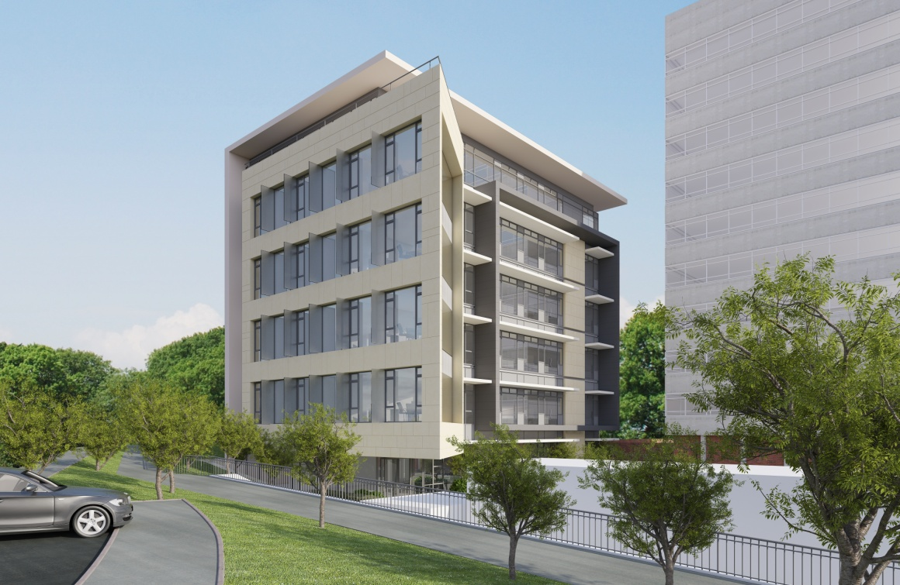
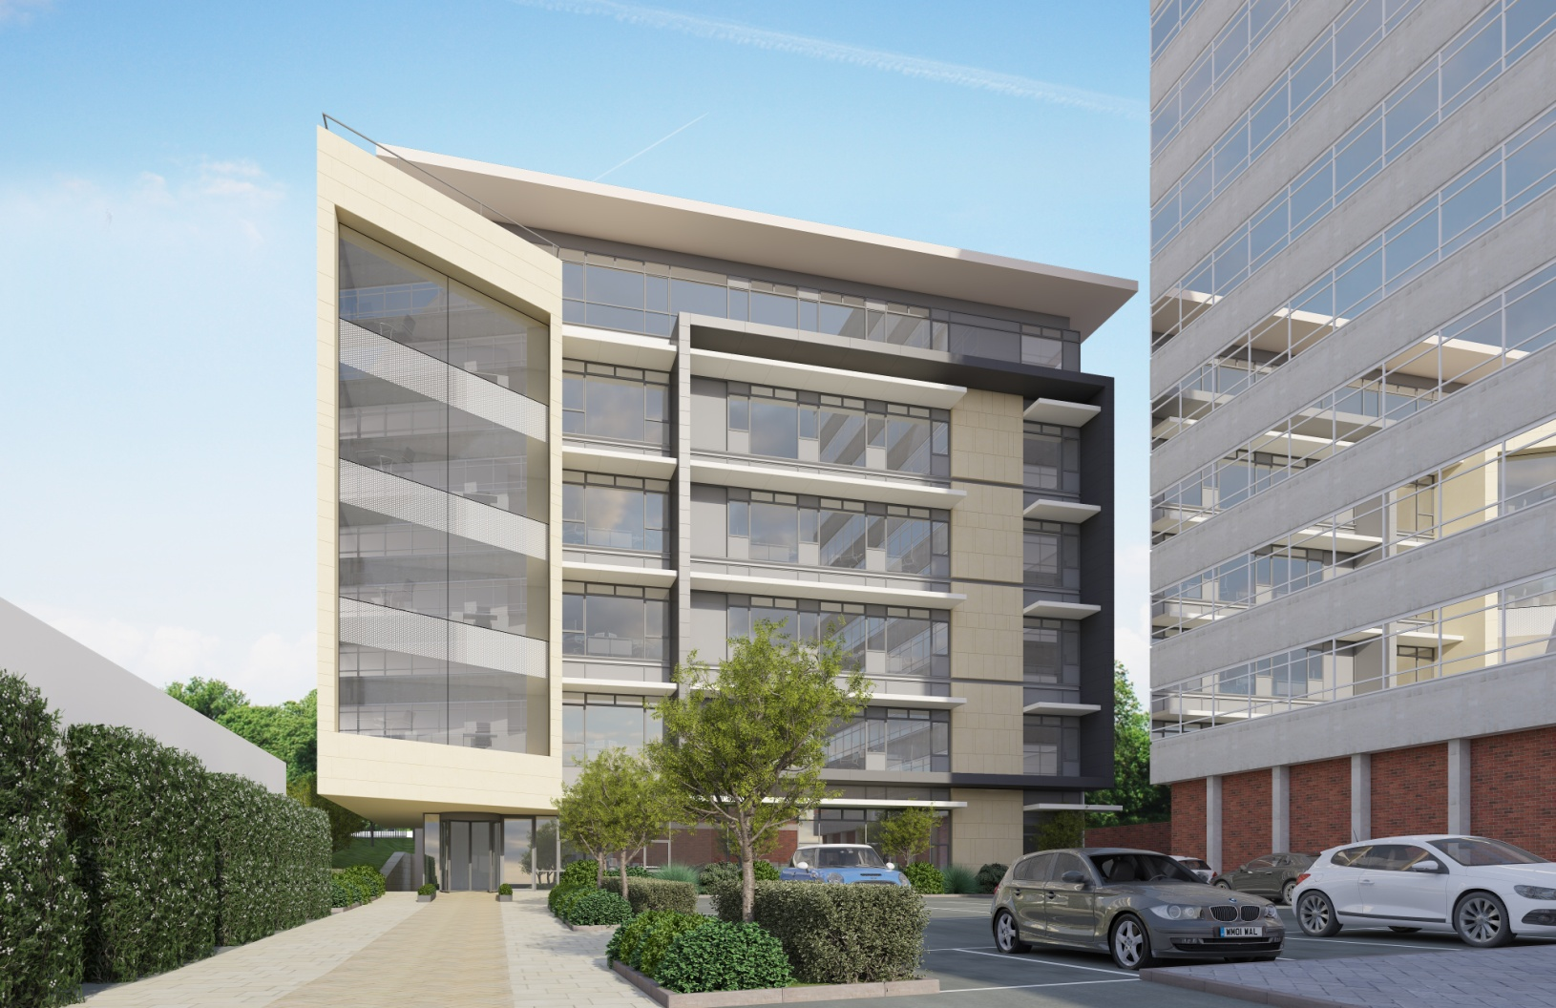



Data Science Building
Opened in summer 2015

