Slide 1
NCRM Conference
7th July 2016

Slide 2
Innovative methods to engage participants during transition to adulthood: ALSPAC
Lynn Molloy
Executive Director ALSPAC

Slide 3
Structure
Brief overview of ALSPAC
ALSPAC during transition years 12 - 18
Lessons learnt

Slide 4
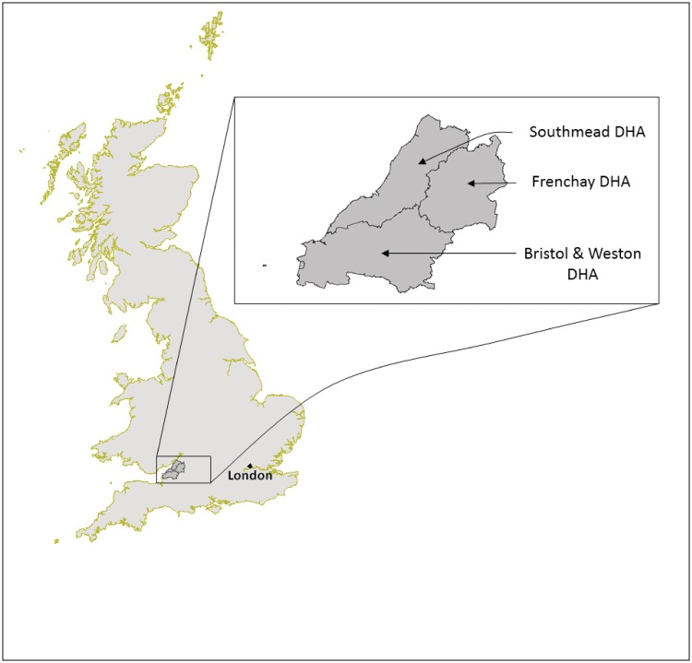
ALSPAC
Avon Longitudinal Study of Parents and Children
Bristol based (regionally) birth cohort study
1991 – 1992 14,500 pregnant women
Last 24 years 10,000 original children, mothers and fathers
Extended recruitment to children of children, grandparents and siblings
International Journal of Epidemiology 2012
Notes:
ALSPAC stands for the Avon Longitudinal Study of Parents and children.
It is a regionally based birth cohort study based in Bristol, which is in the south west of England.
In 1991 – 1992 14,500 pregnant women, who attended the three hospitals shown on the slide, were enrolled into the study. For the last 24 years ALSPAC has been following around 10,000 of the original children and their mothers and fathers. In last few years we have extended recruitment to include the children of the children (mow just under 400) and the siblings and grandparents of the original children. Now there are over 35,000 participants who are enrolled into the study. For those people who are interested in finding out more please look at the cohort profile published in IJE in 2012

Slide 5
ALSPAC
Biomedical model of research
Data and biological samples from 20 weeks pregnancy, birth and beyond
Genetic, biological, psychological, social and environmental data
Pearson H. Children of the 90s: Coming of age. Nature 2012: 484: 155-158.
Notes:
ALSPAC is firmly rooted into biomedical model of research. Data and biological samples were collected from 20 weeks of pregnancy, through birth and early life and beyond.
ALSPAC collects genetic, biological, psychological, social and environmental data and analyses this data in in relation to a diverse range of outcomes. This slide shows just the different types of questions and biological samples that we have collected over the years.

Slide 6
ALSPAC during adolescent years
Cohort aged ~ 25
Between 12 and 18 years intense period data collection:
lengthy clinical assessments on the whole cohort at age 12, 13, 15, 17
Sub studies on smaller number
12 questionnaires on whole cohort plus 3 on subsample
Notes:
Cohort aged ~25 so now through adolescence
During ages 12 to 18 intense period data collection

Slide 7
Notes:
These next few slides show the response rate during adolescence years:. The lowering of our response rate shows the same pattern as other similar studies.
This slide shows overall response rate to clinical assessments. As you can see there was a general lowering, stabilising at around 5000. We are currently undertaking a clinical assessment at age 24 and we are predicting that we will see around 4000 so this curve will dip lower.

Slide 8
Notes:
This is not the case with questionnaires, which shows a more complicated picture, much more variable.
Big dip around 16 (but this may be due to sheer number we sent out at this time). The last two annual questionnaires have stabilised around 4000

Slide 9
Notes:
When you break this down by gender you can see that more girls have responded to clinical assessment than boys and this is increasing over time ….

Slide 10
Notes:
For questionnaires many more girls have responded than boys during the whole of adolescence.
Interestingly they have followed a similar zigzag pattern.
Again bit dip around 16.
Stabilizing ….

Slide 11
Participant engagement and involvement in research
Notes:
ALSPAC like other studies used a variety of different methods to try and maintain response rate and deal with missing data e.g. interventions and RCT’s. However, I am going to focus on just one area – way we tried to engage and involve the participants into the study.

Slide 12
Participation engagement and involvement in research
Involvement
Members of public are actively involved in research projects and in research organisations
Participation
People take part in research
Engagement
Information and knowledge about research is provided and disseminated
Notes:
There are different ways in which studies engage and involve studies in research:
Least involvement – participants simply take part in the research
Engagement – study team provide information and knowledge about the research
Involvement -

Slide 13
Participation continuum
Engagement
ALSPAC
Participation
Involvement

Slide 14
Engagement during adolescent years
Engagement strategy changed
Focused on them rather than parents e.g. PIS, newsletters
Dedicated participation team experienced with teenagers
Easier data collection e.g. online questionnaires
Two-way communication through social media
Age appropriate engagement events e.g. parties
Data collection in schools, shopping centres
Allowed ‘holiday’ from the study
Incentive/payment for time
Developed policies to deal with disclosure of self-harm and suicidal thoughts, psychosis, child protection issues and criminal activity
Notes:
We recognised that the participants were changing and becoming adults so our engagement strategy changed as well …

Slide 15
Engagement in ALSPAC
Start of study ALSPAC engaged participants:
to ensure high response
ethical grounds i.e. participants given opportunity to contribute to research in which intimately involved
Engagement methods similar

Slide 16
Involvement in ALSPAC
21st anniversary science festival for participants
Participants fully involved in planning, organisation and
delivery through membership of the working group

Slide 17
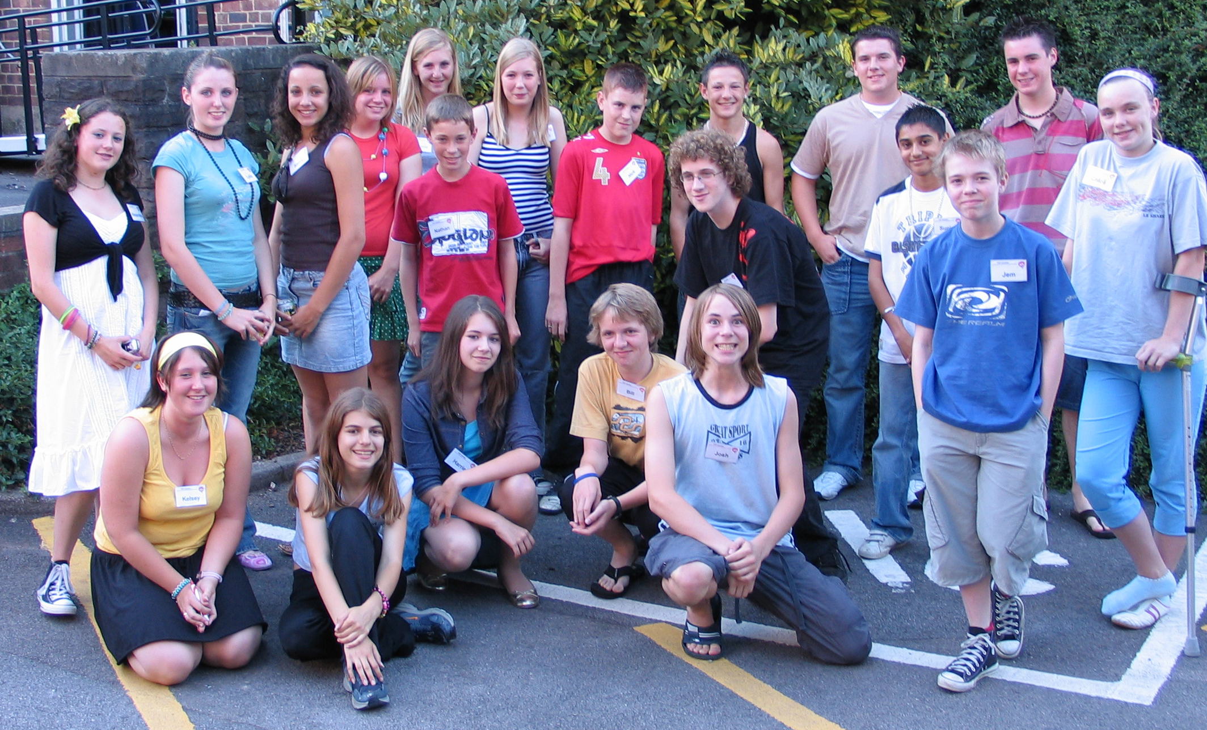
ALSPAC during adolescent years
Participant Advisory Panel in 2006, aged 15
Chaired and run by participants, representative
Typical agenda items:
data and sample collection
engagement and events
assisting policy developments and ethical discussions e.g. incidental findings, commercial research

Slide 18
Ethics process
ALSPAC Law and Ethics Committee from outset
Concerns consent, overburdening, disclosure
Membership clinicians, researchers, lawyers and lay people
In 2014 membership changed now 50% of membership is made up of study participants
Fundamental changes e.g. evening meetings, pre-meetings
Notes:
The ALSPAC Law & Ethics Committee (ALEC) set up right at the start of the study. At the time (early 90s) this was ground breaking. JG took the view that rather than shying away from some of the difficult ethical issues that beset a complex biomedical study like ALSPAC she wanted to tackle them head on. ALEC is firmly established as part of the governance structure in ALSPAC. ALEC concerns itself with issues such as consent, protecting participants from research that is too intrusive or burdensome and disclosure of research findings. We also are obliged to go to an NRES committee for applications studies involving the collection of biological samples, DXA and MRI scans or the collection of data from participants who lack the capacity to give informed consent. Membership has always been made up of clinicians, independent researchers, lawyers and lay members. But last year membership changed and now 50% of the members are made up of study participants. This was an active decision to include participants in decision-making. Fundamentally changed the way the committee operates from simple things like changing time of the meeting to process changes e.g. need to have a pre meeting with participants to ensure that they have an opportunity to ask questions so they are able to engage with debates from position of knowledge.

Slide 19
Lessons learnt
Transition phase difficult and needs careful planning
Keep parents/carers (mothers) involved e.g. 15 year clinic
Difficult to keep adolescent boys involved, specific strategies for boys e.g. male fieldworkers, images of males in communication, male researchers on media
Fieldworkers/PR experience/enjoy working with adolescents
Study break, but lines of communication open

Slide 20
Lessons learnt
Participant involvement in planning (feasibility and acceptability), organisation and delivery of research
Communication key; age appropriate, assume little knowledge and explain study aims
Re-consenting project at age 18 to continue to participate and link to medical/administrative records; risky and expensive but ultimately beneficial
Initiatives resource intensive and require funding …..

Slide 21
Summary
Transition years for longitudinal cohort studies very difficult
ALSPAC experienced declining response rate during these years
Participant engagement and involvement in research very important
Benefits overweigh challenges

