Slide 1
Research with the oldest old and those living and dying with dementia in care homes
Claire Goodman

Slide 2
Longitudinal research
Population based understanding of
Disease trajectory and cognitive decline
Changes in social status
Events that predate end of life
e.g. CFAS, ELSA, Whitehall Study

Slide 3
“Shortitudinal” (prospective) research over snapshot
Captures key events over time: interested in change
The individual
Details the opportunities and constraints experienced by older person and the services they receive
Freda Lebefer http://articles.philly.com/2015-03-12/entertainment/60013370_1_nurse-painting-rosemont-college

Slide 4
Goodman , Claire, Drennan,Vari, Manthorpe, Jill, Gage , Heather , Trivedi, Daksha, Shah, Drushita, Schiebel, Fiona, Poltawski, Leon, Handley, Melanie, Nash, Avril and Iliffe, Steve (2012)
A study of the effectiveness of interprofessional working for community dwelling older people. (Project Report) NIHR NETSCC.
Notes:
This patient also had COPD,hypertension, fewer services involved and more continuity but still had hospital admissions and whilst the CM liaised with other services her involvement restricted face to face contact with only one encounter with the GP and social worker

Slide 5
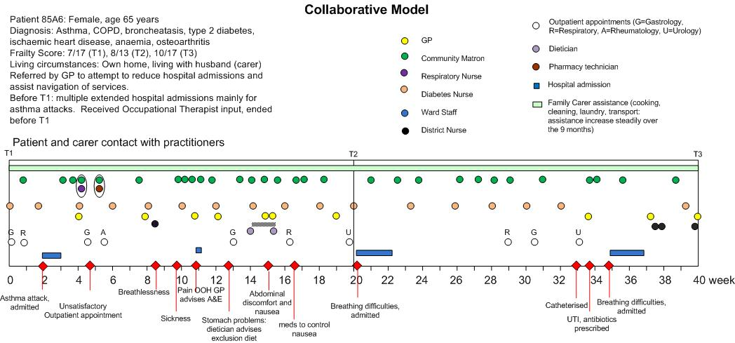
Goodman , Claire, Drennan,Vari, Manthorpe, Jill, Gage , Heather , Trivedi, Daksha, Shah, Drushita, Schiebel, Fiona, Poltawski, Leon, Handley, Melanie, Nash, Avril and Iliffe, Steve (2012)
A study of the effectiveness of interprofessional working for community dwelling older people. (Project Report) NIHR NETSCC.
Notes:
This woamn also had COPD and other morbidiites and as you can see a much messier pattern of involvement also with hospitalisations, but the pattern changes and becomes less frenetic, but still hospitalisations despite the regular involvement of a case manager working with other members of the teaam

Slide 6
Dying with or from dementia is invariably ‘protracted, unglamorous and ordinary’ (Small et al 2007).
Small,N., Froggatt,K. and Downs, M. 2007 Living and dying with dementia Dialogues about palliative care Oxford University Press

Slide 7
Research on end of life care for people living and dying with dementia
Care home are liminal places
Blurring of everyday and end of life care priorities
Research accounts are often retrospective and often focus on last weeks/days

Slide 8
Three source studies: mixed methods
Evidem End of Life : Tracked 133 residents living and dying with dementia in 6 care homes over 18m , used co-design approach (AI) to develop context sensitive interventions
EPOCH Tracked 121 residents over a year and interviewed 63 residents up to three times over 12m in 6 care homes
Train the Trainer: Process evaluation of a peer to peer EOL care education and training programme in 17 care homes. Collected data on sample of 274 residents’ service use plus review of 150 decedents’ notes
Notes:
This paper is based on a secondary data analysis of the transcripts and a review of the resource use data from the three standalone studies. These data were considered at a series of meetings during 2013-14 to debate the presence of uncertainty as an underlying and defining feature in the data.

Slide 9
Findings
For the majority of residents who died there was an identifiable period when they were recognised as dying and planned care put in place (NB often with period of prolonged uncertainty beforehand)
In all studies some deaths were unexpected
EPOCH 48% (n= 11)*
Evidem EoL 30% (n=8)
Train the Trainer 21% (n= 32)**
*+ 3 sudden deaths **Retrospective data
Notes:
Mitchells retrospective work on people that died with advanced dementia and pneumonia found 60% died within 6m which of course means that there were 40% who didn’t

Slide 10
GP visit: Continue ABX
Repeat chest X-ray in 6 weeks
Hospitalisation will be necessary
if not responding to ABX
:
prone to chest infections and UTIs”
ACP 4 yrs in CH:
Radiology Dpt. Hospital
Receives referral for X-ray
GP will send out letter
999
A&E: 3 week chest infection, not responding to ABX
Discharged same day w/o discharge letter
DN: Re-dress heel
DN: Dressing pressure sore
Orders pressure mattress
Place of death: Hospital
999
A&E: Breathing difficulties
T/c from Hospital-based Physiotherapist
re resident’s mobility
Admitted to hospital
Days before death
28
26
24
22
20
18
16
14
12
10
8
6
4
2
Final entry in care notes:
“Resident’s relatives
called to arrange
collection of possessions”
No further detail”
T/c to Hospital
“Resident still chesty,
Not mobilising, 3 people to get her out of bed
Waiting to see GP &
Physiotherapist”
(care notes)
Losing weight, food supplements prescribed
Poor mobility, unable to bear weight, increased risk of falling, Getting tired more easily
Emergency services
T/c to Hospital
“Suspected Pneumonia”
General Practitioner
T/c to Hospital
“Resident still chesty, on ABX
Not mobilising, eating
Will inform CHS of any change,
Call when better & ready for discharge”
District Nursing
Physiotherapist
Care Home
Visio from Evidem EOL (RP-PG-0606-1005)
Notes:
This person had been four years in the care home and was known to be prone to chest infections and UTIs it was only in hindsight that the staff realised that this time it was significantly different.

Slide 11
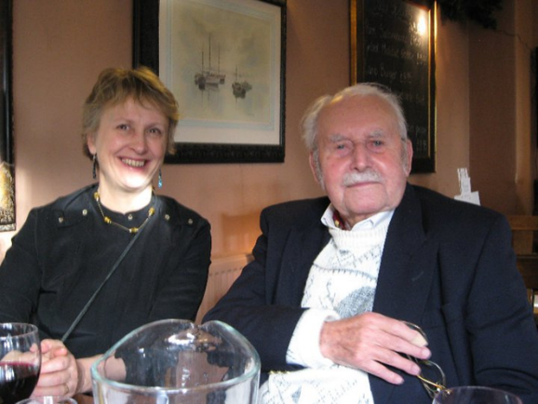
Treatment uncertainty
Intervention or palliation
Defining quality of life
Relational uncertainty
Role responsibility, accountability and liability
Involvement of GP, secondary care, family, care home staff and resident
Service uncertainty
Capacity and resources
Divide between public and private provision
Notes:
Results from phase one analyses

Slide 12
Treatment uncertainty
Care home manager talking about the difficulties of knowing if a resident is approaching the end of life:
“I don’t think you could say there is a usual pattern ( ...) Eating and drinking] can be the start of something...it can be, that’s what I mean. It doesn’t mean to say that that’s going to be Tender Loving Care it could just mean that they’re a bit unwell at that particular time” (EVIDEM EoL).
Treatment uncertainty where GP does not know at what point he should be taking lead in decision making:
“In an ideal world it would be a GP [deciding that an older person with dementia requires EOL care]. Everybody making that decision ….. because it’s undefined isn’t it? An undefined period of death... (EVIDEM EoL).
This resident questioned the value of advance care planning
“I really don’t see that there is an obligation to foresee all the circumstances that might happen to a person, that might make it very difficult when you come to die, that everything will be ready but it isn’t now and it never will be, whatever you supply” (EPOCH).
Comment by care home staff member referring to treatment uncertainty after completing EoL training:
“…when residents are getting better we always used to think ‘that’s it, they are getting better’… but it’s not. And it must be an emotional roller-coaster for a relative to hear that their parent has gotten worse, then better, then worse….”( TTT study).

Slide 13
Relational uncertainty
Example of how the relationship between paramedics and care home staff can be affected by different expectations:
“… you might get a conflict, but it depends on the way that the communication is going between the two. It’s quite often key to the decisions that are made as well, and sometimes it starts to get inflamed then it’s easy for us is just to take the patient out and take them to hospital rather than get in to any sort of rows, …. so it can be strained at times, .. it doesn’t happen very often but it does happen occasionally and that’s when it can become very difficult” [Evidem EoL].
GP providing an example of when good working relationships mean that she can be confident about a patient, but that this changes if she meets with different staff at every visit:
“I find that staff are very experienced, they know their patients (…). So I rely on them a lot to tell me about the changes in behaviour and how they perceive the patient. (…). But if you had a different carer every day, you can’t really make that picture [of the resident’s function]” [Evidem Eol].
Care home manager highlighting how family and residents’ wishes shape decision making, and her view that the power to decide is theirs:
“[I] do feel that it’s a bit of a fiasco when people decide ‘no, no, I want to still have an intervention’ and it’s chaos towards the end. .... It would be very nice to have a very clear treatment and to have everything crystal clear, but I don’t think that is ever going to happen [...] I mean, we can voice an opinion, but we don’t have the right to make those choices (...) we’re proving very much all the time that we’re giving the power to the residents, and that always involves the relatives as well” [EPOCH].
Care home staff member that has completed training in EoL care:
“In the type of job we do people’s lives are affected, it’s not just the person you are caring for. It’s all of their families….so we have lots of sensitive things to deal with….” [TTT study].
Notes:
NB include the reference to relational uncertainty in terms of regulator and NICE

Slide 14
Service Uncertainty
Example of service uncertainty linked to staff changes and the protracted period of dying that overrides good record keeping and shared documentation:
“… she had dementia and she had end stage kidney failure and heart failure … I’d been treating her for probably three or four years …she started to deteriorate … … it was written in her notes ‘this lady is for palliative care only and is not to be transferred to hospital unless she becomes acutely unwell’…… it was very visible in her summary, in red, unfortunately it was a day that I wasn’t around .She became acutely short of breath and a telephone call was made to the surgery …it was taken by one of our registrars who just didn’t see the entry on the notes and said ‘call an ambulance’ and she was taken by ambulance to hospital and died that day” [EVIDEM EoL].
Care home manager giving example of where a resident could not be supported in the care home for service reasons:
“…, because if I’ve got a ratio of 1 to 8 staff, it’s how much pressure do I put on staff? So, if I’ve got a resident who needs two to three carers, then it’s not actually our criteria...because I can’t up the staff level. It works both ways really, it’s obviously not putting pressure on staff as well as making sure that the person is going to get the best care. [EPOCH]
Notes:
Service uncertainty refers to how the organisation and delivery of services can influence decisions about place of care, resource allocation and continuity of care

Slide 15
Review of the Liverpool care pathway
Recommendation 14
Every patient diagnosed as dying should have a clearly identified senior responsible clinician accountable for their care during any ‘out of hours’ period. Unless it is unavoidable, urgent, and is clearly in the patient’s best interests, the decision to withdraw or not to start a life-prolonging treatment should be taken in the cool light of day by the senior responsible clinician in consultation with the healthcare team. The practice of making such decisions in the middle of the night, at weekends or on Bank Holidays, by staff that do not have the requisite training and competence, should cease forthwith.
Independent Review of the Liverpool Care Pathway (2013) More Care ,less pathway. A review of the Liverpool Care Pathway © Crown copyright 2013 2901073

Slide 16
Person with dementia living and dying in
a care home
Relational Uncertainty
Staff to staff working relationships
Care home staff and resident relationships
Visiting health care professionals
Family and friends involvement (and who is included)
Regulators’ validation of end of life decisions
Service Uncertainty
Workforce availability and skill level
Sustainability of open ended palliative care support
Funding to provide end of life care
Service responsiveness
Equipment
Treatment Uncertainty
Prognostication
Symptom management
Person with dementia’s wishes considered over time
How quality of life is defined by residents, staff and health professionals
Decision how long to persist with interventions and location of care

Slide 17
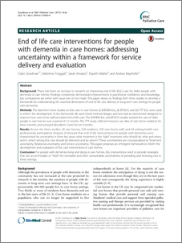
Summary
Tracking the care of older people can provide system and organisational awareness linked to their different and often protracted illness and dying trajectories
For people living and dying with dementia need to understand how these three aspects or key elements of end of life care differentially affect decision making over time in care homes
A model of care that aims for practical certainty and creates mechanisms that recognise and hold uncertainty within the intervention.

Slide 18
References
Amador S. Goodman, C King,D. Ng,Y.T Elmore,N. Machen,I. Knapp,M (2013) Exploring resource use and associated costs in end-of-life care for older people with dementia in residential care homes International Journal of Geriatric Psychiatry Article first published online: 6 DEC 2013 | DOI: 10.1002/gps.4061
Amador, S., Goodman,C.., King, D., Machen, I., Elmore, N., Mathie,E & Iliffe, S. 28 Aug 2014 Emergency ambulance service involvement in the support of older people with dementia: an observational study BMC Geriatrics 14, 6 p.95
Blom, J. W., Lemmens, S. P., Assendelft, W. J., Eekhof, J. A., & Gussekloo, J. (2012). Proximity to death is associated with frequency of GP contacts in the oldest old: the Leiden 85-plus study. Age and Ageing, 41(6), 814-817
Bristowe, K., Carey, I., Hopper, A., Shouls, S., Prentice, W., Caulkin, R., ... & Koffman, J. (2015). Patient and carer experiences of clinical uncertainty and deterioration, in the face of limited reversibility: A comparative observational study of the AMBER care bundle. Palliative medicine, 0269216315578990..
Broom, A., & Kirby, E. (2013). The end of life and the family: hospice patients’ views on dying as relational. Sociology of health & illness, 35(4), 499-513.
Froggatt K, Hockley J, Parker D, Brazil K (2011) A system lifeworld perspective on dying in long term care settings for older people: Contested states in contested places. Health and Place 17(1): 263–8
Goodman C, Amador S, Elmore N et al (2013) Preferences and priorities for ongoing and end-of-life care: A qualitative study of older people with dementia resident in care homes. Int J Nurs Stud 50(12): 1639–47
Goodman, C., Froggatt, K., Amador, S., Mathie, E. and Mayrhofer, A., 2015. End of life care interventions for people with dementia in care homes: addressing uncertainty within a framework for service delivery and evaluation. BMC palliative care, 14(1), .1.
Handley, M., Goodman, C., Froggatt, K., Mathie, E., Gage, H., Manthorpe, J., ... & Iliffe, S. (2014). Living and dying: responsibility for end‐of‐life care in care homes without on‐site nursing provision‐a prospective study. Health & social care in the community, 22(1), 22-29.
Lund, S., Richardson, A., & May, C. (2015). Barriers to advance care planning at the end of life: an explanatory systematic review of implementation studies.PloS one, 10(2), e0116629.
Mathie, E., Goodman, C., Crang, C., Froggatt, K., Iliffe, S., Manthorpe, J., & Barclay, S. (2012). An uncertain future: the unchanging views of care home residents about living and dying. Palliative Medicine, 26(5), 734-743.
Shah, S. M., Carey, I. M., Harris, T., DeWilde, S., & Cook, D. G. (2013). Mortality in older care home residents in England and Wales. Age and ageing,42(2), 209-215.
Wilson, F., Ingleton, C., Gott, M., & Gardiner, C. (2014). Autonomy and choice in palliative care: time for a new model? Journal of Advanced nursing, 70(5), 1020-1029.

Slide 19
Acknowledgements
EVIDEM End of Life: Sarah Amador UCL, Elspeth Mathie,Ina Machen UH Natasha Elmore University of Cambridge, Caroline Nicholson KCL , Yi Ting and Derek King LSE
EPOCH Elspeth Mathie, Mel Handley UHClare Crang, Stephen Barclay University of Cambridge, Steve Iliffe UCL, Jill Manthorpe KCL, Katherine Froggatt University of Lancaster
TRAIN the TRAINER Andrea Mayrhofer Sue Davies Sarah Amador UH
TOPIC: Vari Drennan St Georges Medical School and Kingston university Steve Iliffe UCL, Jill Manthorpe KCL, Heather Gage University of Surrey, Fiona Scheibl, Mel Handley ,Daksha Trivedi, Leon Poltawski, Avril Nash UH, Dhrushita Shah St Georges and Kingston University,

Slide 20
DISCLAIMER
Evidem EOL (RP-PG-0606-1005)
EPOCH : (PB-PG-0906-11387)
TOPIC: HS&DR 08/1819/216
The views expressed in this presentation are those of the author(s) and not necessarily those of the NHS, the NIHR or the Department of Health

