Slide 1
Bayes factors as a measure of strength of evidence in replication studies
Zoltán Dienes

Slide 2
Evidence for H0
No evidence to speak of
Evidence for H1

Slide 3
P-values make a two-way distinction:
Evidence for H0
No evidence to speak of
Evidence for H1

Slide 4
P-values make a two distinction:
Evidence for H0
No evidence to speak of
Evidence for H1
NO MATTER WHAT THE P-VALUE, NO DISTINCTION MADE WITHIN THIS BOX

Slide 5
No inferential conclusion follows from a non-significant result in itself
But it is now easy to use Bayes and distinguish:
Evidence for null hypothesis vs insensitive data

Slide 6
The Bayes Factor: Strength of evidence for one theory versus another (e.g. H1 versus H0): The data are B times more likely on H1 than H0

Slide 7
From the axioms of probability:
P(H1 | D) = P(D | H1) * P(H1)
P(H0 | D) P(D | H0) P(H0)
Posterior confidence = Bayes factor * prior confidence in H1 rather than H0
Defining strength of evidence by the amount one’s belief ought to change,
Bayes factor is a measure of strength of evidence

Slide 8
If B = about 1, experiment was not sensitive.
If B > 1 then the data supported your theory over the null
If B < 1, then the data supported the null over your theory
Jeffreys, 1939: Bayes factors more than 3 are worth taking note of
B > 3 noticeable support for theory
B < 1/3 noticeable support for null

Slide 9
Bayes factors make the three way distinction:
0 … 1/3
1/3 … 3
3 …
Evidence for H0
No evidence to speak of
Evidence for H1

Slide 10
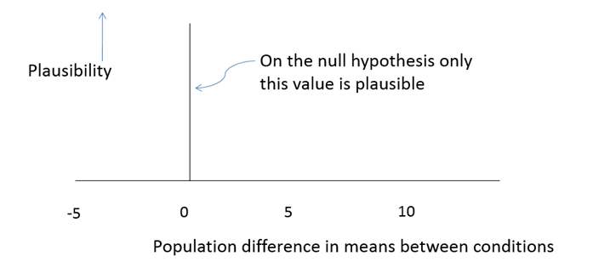
A model of H0

Slide 11
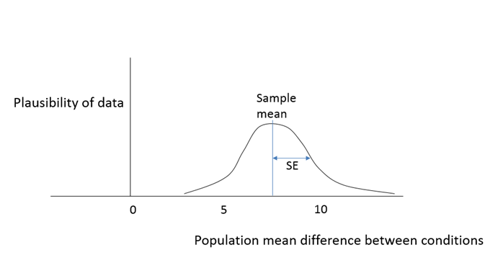
A model of H0
A model of the data

Slide 12
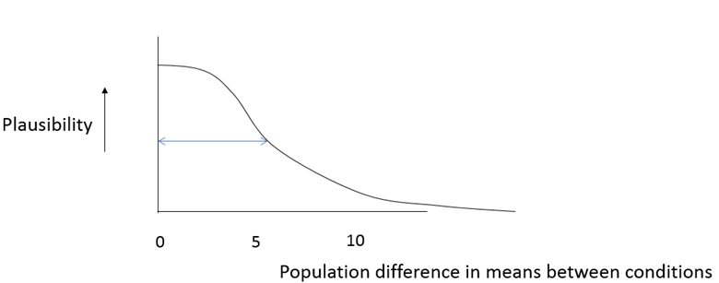
A model of H0
A model of the data
A model of H1

Slide 13
How do we model the predictions of H1?
How to derive predictions from a theory?
Theory
Predictions

Slide 14
How do we model the predictions of H1?
How to derive predictions from a theory?
Theory
assumptions
Predictions

Slide 15
How do we model the predictions of H1?
How to derive predictions from a theory?
Theory
assumptions
Predictions
Want assumptions that are a) informed; and b) simple

Slide 16
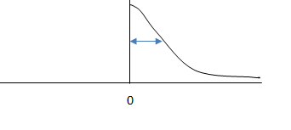
How do we model the predictions of H1?
How to derive predictions from a theory?
Theory
assumptions
Model of predictions
Plausibility
Magnitude of effect
Want assumptions that are a) informed; and b) simple

Slide 17
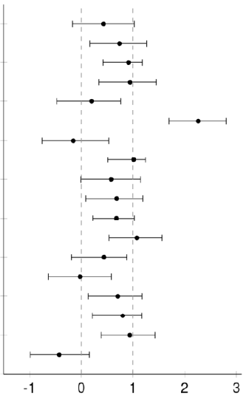
Some points to consider:
Reproducibility project (osf, 2015): Published studies tend to have larger effect sizes than unbiased direct replications;
Many studies publicise effect sizes of around a Cohen’s d of 0.5 (Kühberger et al 2014);
but getting effect sizes above a d of 1 very difficult (Simmons et al, 2013).
Original effect size
Replication effect size
Psychology
Behavioural economics
Notes:
Simmons et al: DV How many pairs of shoes do you own? IV Gender; d = 1.07; IV do you like spicy food? How much do you like Indian food? d = 0.80; IV gender DV height in inches d = 1.85
Average ES in social psych: r = .21, or d = 0.43 Richard, F. D., Bond, C. F., & Stokes-Zoota, J. J. (2003). One hundred years of social psychology quantitatively described. Review of General Psychology, 7, 331–363. doi:10.1037/1089-2680.7.4.331

Slide 18
Assume a measured effect size is roughly right scale of effect
Assume rough maximum is about twice that size
Assume smaller effects more likely than bigger ones
=>
Rule of thumb:
If initial raw effect is E, then assume half-normal with SD = E
Plausibility
Possible population mean differences

Slide 19
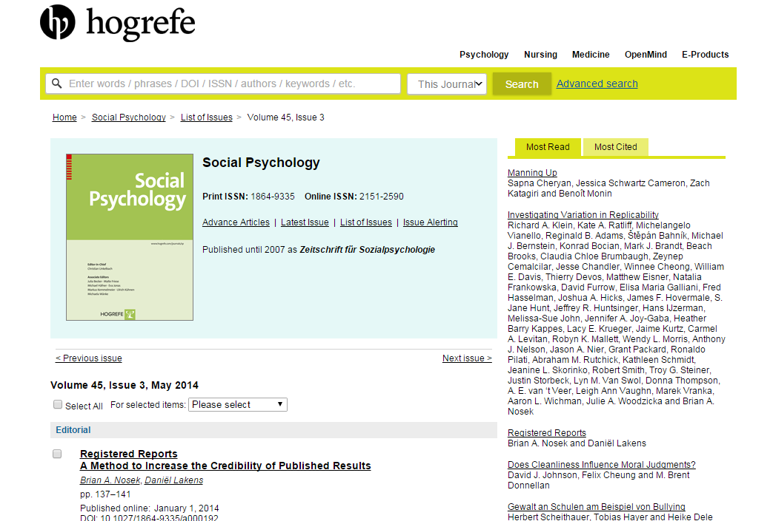

Slide 20
0. Often significance testing will provide adequate answers

Slide 21
Shih, Pittinsky, and Ambady (1999)
American Asian women primed with an Asian identity will perform better on a maths test than those primed with a female identity.
M = 11%, t(29) = 2.02, p = .053

Slide 22
Shih, Pittinsky, and Ambady (1999)
American Asian women primed with an Asian identity will perform better on a maths test than those primed with a female identity.
M = 11%, t(29) = 2.02, p = .053
Gibson, Losee, and Vitiello (2014)
M = 12%, t(81) = 2.40, p = .02.

Slide 23
Shih, Pittinsky, and Ambady (1999)
American Asian women primed with an Asian identity will perform better on a maths test than those primed with a female identity.
M = 11%, t(29) = 2.02, p = .053
Gibson, Losee, and Vitiello (2014)
M = 12%, t(81) = 2.40, p = .02.
B_{H(0, 11)} = 4.50.

Slide 24
Williams and Bargh (2008; study 2) asked 53 people to feel a hot or a cold therapeutic pack and then choose between a treat for themselves or for a friend.
selfish treat prosocial
Cold 75% 25%
Warmth 46% 54%
Ln OR = 1.26

Slide 25
Williams and Bargh (2008; study 2) asked 53 people to feel a hot or a cold therapeutic pack and then choose between a treat for themselves or for a friend.
selfish treat prosocial
Cold 75% 25%
Warmth 46% 54%
Ln OR = 1.26
Lynott, Corker, Wortman, Connell et al (2014)
N = 861 people
ln OR = -0.26, p = .062

Slide 26
Williams and Bargh (2008; study 2) asked 53 people to feel a hot or a cold therapeutic pack and then choose between a treat for themselves or for a friend.
selfish treat prosocial
Cold 75% 25%
Warmth 46% 54%
Ln OR = 1.26
Lynott, Corker, Wortman, Connell et al (2014)
N = 861 people
ln OR = -0.26, p = .062
B_{H(0, 1.26)} = 0.04

Slide 27
Often Bayes and orthodoxy agree

Slide 28
1. A high powered non-significant result is not necessarily evidence for H0

Slide 29
Banerjee, Chatterjee, & Sinha, 2012, Study 2
recall unethical deeds 74
ethical deeds 88
Mean difference = 13.30, t(72)=2.70, p = .01,
0
effect size for H0
13.30
Estimated effect size for H1
Brandt et al (2012, lab replication): N = 121, Power > 0.9
Notes:
Banerjee SE = 4.93

Slide 30
Banerjee, Chatterjee, & Sinha, 2012, Study 2
recall unethical deeds 74
ethical deeds 88
Mean difference = 13.30, t(72)=2.70, p = .01,
0
effect size for H0
13.30
Estimated effect size for H1
Brandt et al (2014, lab replication): N = 121, Power > 0.9
t(119)=0.17, p = 0.87
Notes:
Banerjee SE = 4.93

Slide 31
Banerjee, Chatterjee, & Sinha, 2012, Study 2
recall unethical deeds 74
ethical deeds 88
Mean difference = 13.30, t(72)=2.70, p = .01,
0
effect size for H0
5.47 Sample mean
13.30
Estimated effect size for H1
Brandt et al (2014, lab replication): N = 121, Power > 0.9
t(119)=0.17, p = 0.87
Notes:
Banerjee SE = 4.93

Slide 32
Banerjee, Chatterjee, & Sinha, 2012, Study 2
recall unethical deeds 74
ethical deeds 88
Mean difference = 13.30, t(72)=2.70, p = .01,
0
effect size for H0
5.47 Sample mean
13.30
Estimated effect size for H1
Brandt et al (2014, lab replication): N = 121, Power > 0.9
t(119)=0.17, p = 0.87, B_{H(0, 13.3)} = 0.97
Notes:
Banerjee SE = 4.93

Slide 33
A high powered non-significant result is not in itself evidence for the null hypothesis
To know how much evidence you have for a point null hypothesis you must use a Bayes factor

Slide 34
2. A low-powered non-significant result is not necessarily insensitive

Slide 35
Shih, Pittinsky, and Ambady (1999)
American Asian women primed with an Asian identity will perform better on a maths test than unprimed women
Mean diff = 5%

Slide 36
Shih, Pittinsky, and Ambady (1999)
American Asian women primed with an Asian identity will perform better on a maths test than unprimed women
Mean diff = 5%
Moon and Roeder (2014)
≈50 subjects in each group; power = 24%
M = - 4% t(99) = 1.15, p = 0.25.

Slide 37
Shih, Pittinsky, and Ambady (1999)
American Asian women primed with an Asian identity will perform better on a maths test than unprimed women
Mean diff = 5%
Moon and Roeder (2014)
≈50 subjects in each group; power = 24%
M = - 4% t(99) = 1.15, p = 0.25.
B_{H(0, 5)} = 0.31

Slide 38
Shih, Pittinsky, and Ambady (1999)
American Asian women primed with an Asian identity will perform better on a maths test than unprimed women
Mean diff = 5%
Moon and Roeder (2014)
≈50 subjects in each group; power = 24%
M = - 4% t(99) = 1.15, p = 0.25.
B_{H(0, 5)} = 0.31
NB: A mean difference in the wrong direction does not necessarily count against a theory
If SE twice as large then t(99) = 0.58, p = .57
B_{H(0, 5)} = 0.63

Slide 39
The strength of evidence should depend on whether the difference goes in the predicted direction or not
YET
A difference in the wrong direction cannot automatically count as strong evidence

Slide 40
3. A high-powered significant result is not necessarily evidence for a theory

Slide 41
Outcomes allowed by theory 1
Outcomes allowed by theory 2
All conceivable outcomes

Slide 42
Outcomes allowed by theory 1
Outcomes allowed by theory 2
All conceivable outcomes
It should be harder to obtain evidence for a vague theory than a precise theory, even when predictions are confirmed.
A theory should be punished for being vague

Slide 43
Outcomes allowed by theory 1
Outcomes allowed by theory 2
All conceivable outcomes
It should be harder to obtain evidence for a vague theory than a precise theory, even when predictions are confirmed.
A theory should be punished for being vague.
A just significant result cannot provide a constant amount of evidence for an H1 over H0; the relative strength of evidence must depend on the H1

Slide 44
Williams and Bargh (2008; study 2) asked 53 people to feel a hot or a cold therapeutic pack and then choose between a treat for themselves or for a friend.
selfish treat prosocial
Cold 75% 25%
Warmth 46% 54%
Ln OR = 1.26
Lynott, Corker, Wortman, Connell et al (2014)
N = 861 people
ln OR = -0.26, p = .062

Slide 45
Williams and Bargh (2008; study 2) asked 53 people to feel a hot or a cold therapeutic pack and then choose between a treat for themselves or for a friend.
selfish treat prosocial
Cold 75% 25%
Warmth 46% 54%
Ln OR = 1.26
Lynott, Corker, Wortman, Connell et al (2014)
N = 861 people
ln OR = -0.26, p = .062
Counterfactually, Ln OR = + 0.28, p < .05
selfish treat prosocial
Cold 53.5% 46.5%
Warmth 46.5% 53.5%

Slide 46
Williams and Bargh (2008; study 2)
N = 53
Ln OR = 1.26
Replication
N = 861
Ln OR = + 0.28, p < .05
0
effect size for H0
1.26
Estimated effect size for H1

Slide 47
Williams and Bargh (2008; study 2)
N = 53
Ln OR = 1.26
Replication
N = 861
Ln OR = + 0.28, p < .05
0
effect size for H0
1.26
Estimated effect size for H1

Slide 48
Williams and Bargh (2008; study 2)
N = 53
Ln OR = 1.26
Replication
N = 861
Ln OR = + 0.28, p < .05
B_{H(0, 1.26)} = 1.56
0
effect size for H0
1.26
Estimated effect size for H1

Slide 49
Vague theories should get less evidence from the same data than precise theories
Yet p-values cannot reflect this

Slide 50
Main criticism of Bayes:
Different models of H1 give different answers
Compare:
Different theories, or different assumptions connecting theory to predictions, make different predictions

Slide 51
Main criticism of Bayes:
Different models of H1 give different answers
Compare:
Different theories, or different assumptions connecting theory to predictions, make different predictions
“It is sometimes considered a paradox that the answer depends not only on the observations but also on the question;
it should be a platitude”
Jeffreys, 1939

Slide 52
There is no algorithm for making predictions from theory
Just so, there is no algorithm for modelling theories
Modelling H1 means getting to know your literature and your theory
Doing Bayes just is doing science

Slide 53
In sum,
P-values do not indicate evidence for H0
- not when power is high
- not when power is low
P-values do not provide evidence for H1 in ways sensitive to the properties of H1
By contrast
Bayes factors provide a continuous measure of evidence motivated from first principles

Slide 54
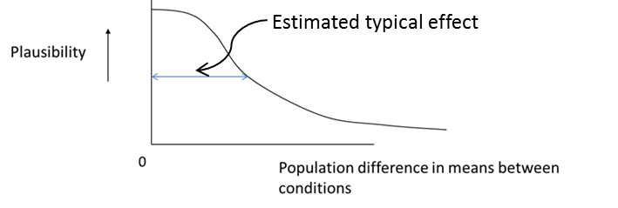
More general theory
(e.g. social and physical disgust are two variants of same thing)
Specifies conditions for obtaining conceptual replications
Specifies conditions under which direct replication should succeed
“Falsifying hypothesis” (e.g. Washing hands affects particular DV)
Probability model

